Slide 1

Fixed Operation 2
Service Homework

Slide 2
Strengths
Little Big Town Atmosphere, Everyone knows everyone.
Parts and Service Director, Service manager and Service writers along with key sales staff have a history with the community.
Off site satellite lots for additional cust-base
Area is growing with potential for new customers with big warehousing jobs i.e. Amazon etc

Slide 3
Weaknesses
Culture (not customer-orientated) just work get it done.
Store hours do not mirror sales
Techs have no urgency. Proficiency suffers due to Tech shop efficiency
Shop bays limited space
Service writers hourly paid
BDC hourly paid
Need to hire a full time designated Porter
No bonus structure or milestones
A lot of distractions (spending time on non-producing work or customers whom require more than they put in)
No SOP or system for monitoring Data i.e. RO counts A/P ect.
No org chart with defined roles or responsibility
No Marketing or advertising plan
No plan for satellite integration of cust-base
Tv in waiting room on regular tv
No service waiting room for just service (customers in sales area)
Updating customers (service writers our business don’t recognize cust is watching paint dry)
Service waiting area option with no stairs is in fleet sales and admin (no back ground music no Tv just gets to listen to private conversations not meant for customers to hear.

Slide 4
Opportunities
GM tools for Marketing and CSI Cust Data
Pay plan reboot to drive sales linked to CSI
SOPs Defining our directions and expectations
Plan for capturing customers from our sales and sales customers from our satellite lots
BDC sales ops for service contracts
Strategic Marketing and Management Plan
Extended hours/Mirror Sales
Culture change (cust is why we are here; not the time clock)
Our number one customer is our sales department
Inventory and SOP for Specialty tools tied to the RO by Parts

Slide 5
Threats
Independent marketing and advertising taking the customer away from our services due to their perception of service and aftermarket parts used.
Customer wait time (perception of time)
Customer expectation of their experience
Variable Sales down turns
Market Share

Slide 6
Objectives
Promote Team-work: Total Buy-in with team members and sales force.
Reduce discounted RO parts and Service
Track Policy Charges
Install new Standard Operating Procedures (SOPs): Define our expectations (Inspect what you expect) What’s a failure? What’s a win?
Org-chart with flow (who gets the hot cases (management) etc.
Working with sales as a team (data-mine cust-vehicles in service drive
Training for service; i.e Offer optional payment plans and service contracts

Slide 7
Strategies
Change Hours to mirror Sales Hours
Adding management for extended hours
Service BDC base-pay bonuses/kicker by appointments showed.
Service Writers Base/draw against gross & net commission pay plan &CSI.
Flat-rate Techs divided into teams.
Sep-Tech for All Internals
Implement A commercial/Fleet Service department separate
Call Guides and training for BDC and Service writers

Slide 8
Advertising & Marketing
We are developing a Measurable Strategic Marketing and Management Plan Targeted to our geographic service area.
Objectives: Develop a team building facility Culture with total buyin .
Theme (Who are we in the marketplace?)Family owned and operated-your hometown factory authorized team)
Tag line (“We can and we will”) do whatever it takes to earn your business
Name Recognition-Kelley Buick GMC (Brand Management) & Call to action (buying decision) Advertising campaigns/traffic drivers/price-driven ads
Advertising Campaign: Targeted categories: Our customers, Customers from same or cross brands not purchased from us. Customers non brand specific but in our target geographic area. Email, Outbound calls, Service and BDC scripts with rebuttals, Print with electronic media ad campigns targeted area with Traffic driver discounts (the hook)
Marketing-Brand Management: Grass Roots Programs for brand management: Educate our community about our name and factory certified services. Loaner, shuttle etc. What makes us different. Factory trained, Factory parts etc. Competitive priced comparison POPs at each sales, greeting, waiting area and included in advertising campaigns. Identify community opportunities and Sponsorships, area events, sports and cause marketing opportunities for brand management and educating the community.
Total Budget 3% of deparment gross.
Target launch date 4th quarter 2017

Slide 9
Tactics
Service Manager must approve the order for Warranty parts
Service Manager must run GM calc for Warranty
Service Manager must approve all discounts
Have weekly Schedule safety meetings and role in objectives for the week
Change Internal to Door Rate
Sales contests for service writers and BDC
Reward Wins and good culture (buy behavior)
Post daily/weekly sales forecast for each team
Include Parts manager in the meetings
Provide growth opportunity suggestion for all departments
Let the group help with fixing problems by providing suggestions

Slide 10
Action Plan for the 2017 4-Qrt
Hire new Parts and Service Manager for teams
Move current Pars and Service Manager to Fleet and Commercial for development of the new Fleet and Commercial Department
Change Service hours to match Sales
Change pay Plans to Commission
Change Techs to Teams
Change Service writers for Commission
Change BDC to Commission
Management Bonus base on millstones met
Install SOPs
Install weekly Safety and Sales Objective meetings
Create a Strategic Marketing and Management Plan
Create POS displays in Service drive. i.e. tire display Completive pricing with competition rates

Slide 11
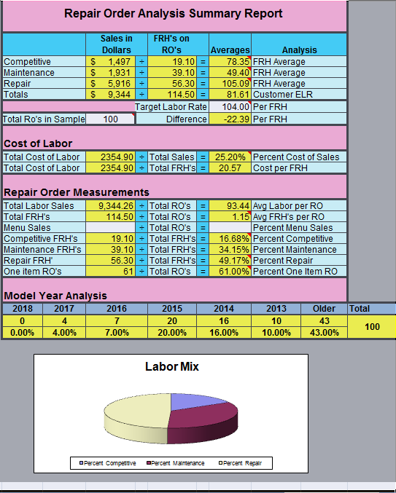
Repair Order Summary Report

Slide 12
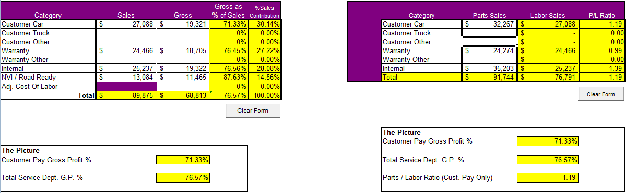
Tab A

Slide 13
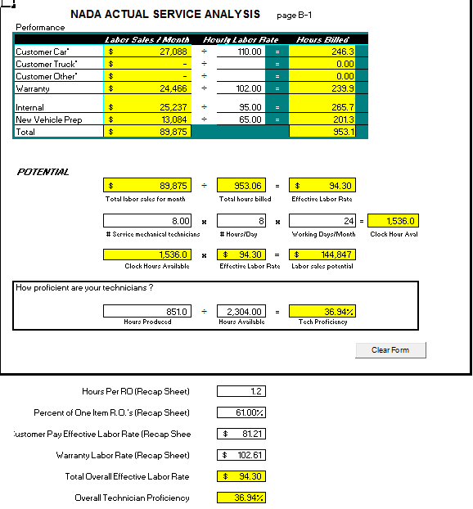
Tab B

Slide 14
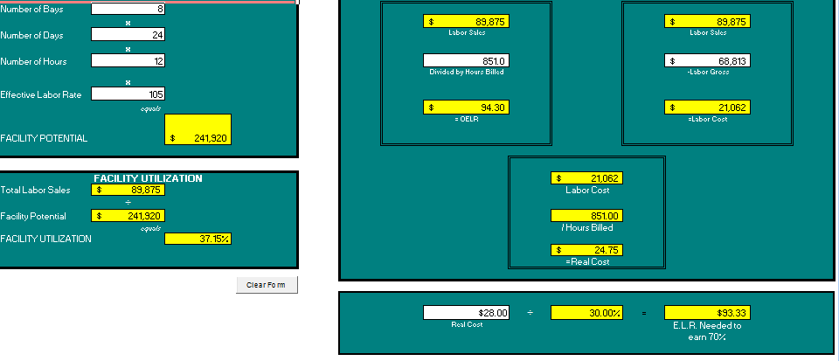
Tab B

Slide 15
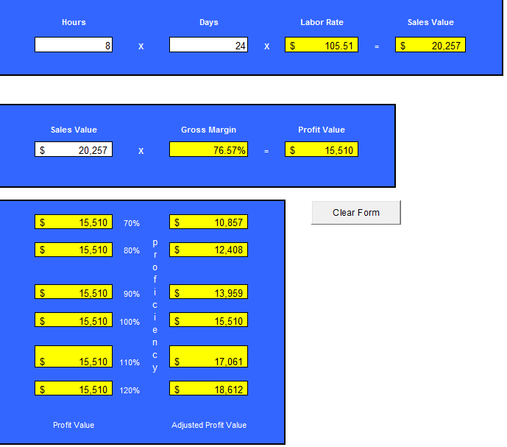
Tab C

Slide 16
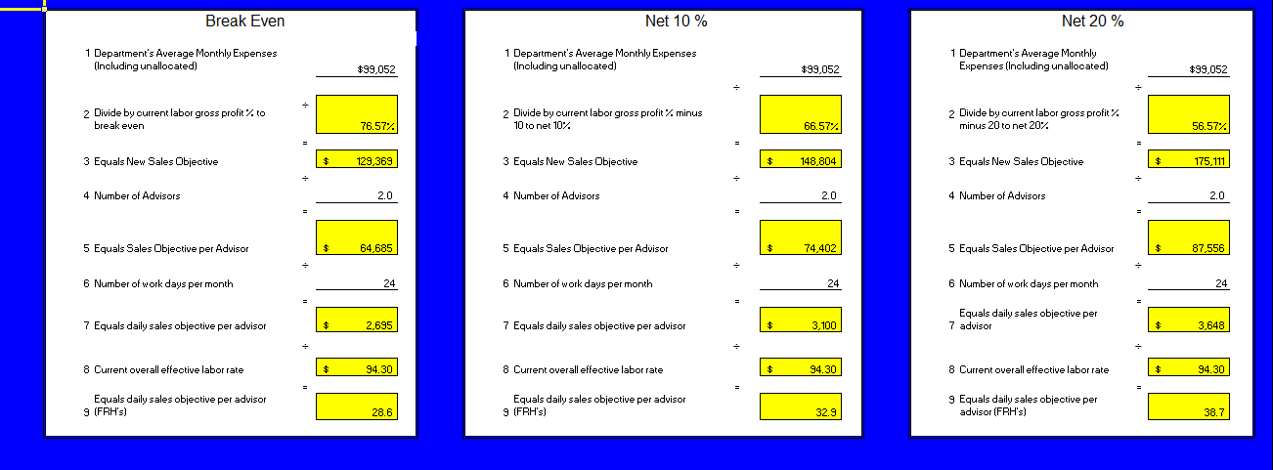
Tab C

Slide 17
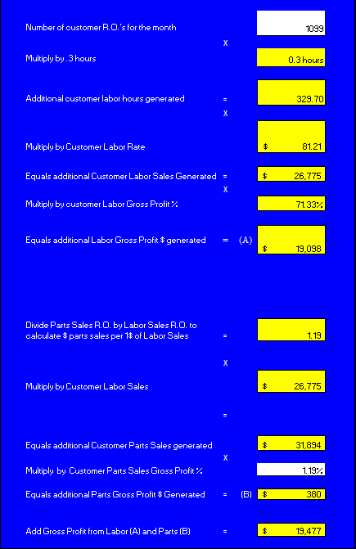
Tab C

Slide 18
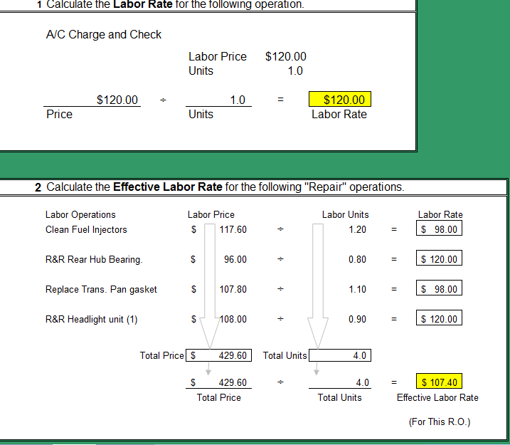
Tab D

Slide 19
Tab D

Slide 20
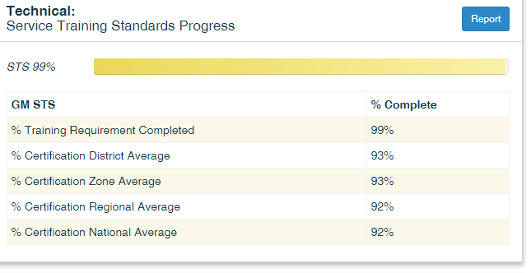
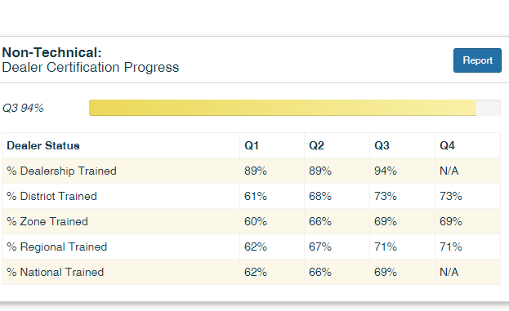

Slide 21
Synoposis
With addition of expanded hours and teams along with the new pay plans we should increase our gross sales by 45%
This should result in an additional 250K net annually

Slide 22
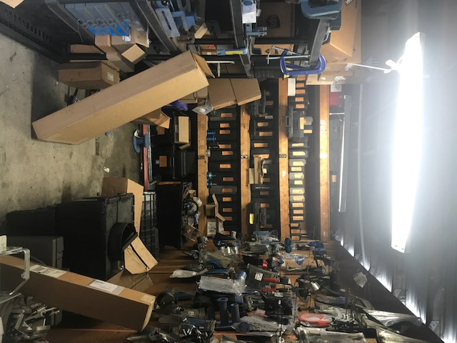
Specialty Tool Room

