Slide 1
SERVICE
HOMEWORK
CLASS N325
35-Reginal Wakim
Boch Honda

Slide 2
Advertising
We are keeping our dealership name in front of our customer in many ways for example;
Sending anniversary emails out to our customers letting them know we are thinking of them.
Email campaigns' for recalls and maintenance reminders to our customers.
Email twice a month to customers that have not been at the dealership in the past year.
Website specials page always updated with new coupons and packages.

Slide 3
Advertising Examples
MAINTENANCE MINDER B service
$86.90 Regular price $109.95
Replace engine synthetic oil and oil filter
Check & top off all fluids
Rotate Tires Inspect tires and set pressures
Test Battery
Comprehensive Multi-Point Inspection
Express Service 7 days/week
Valid at Boch Honda & Boch Honda West ONLY. Honda and Acura Vehicles only. Coupon must be presented at time of write-up. One coupon per customer, per visit. Not valid with any other offer, promotion or special. Cannot be combined with other coupons. No cash value. Not retroactive. See dealership for details. Void where prohibited by law. Expires 09/30/2017

Slide 4
We Match Any Competitors Price and Service
Why shop anywhere else. Let your fast and friendly Boch Honda technicians keep your vehicle reliable. We will fix it right and on time.
Valid at Boch Honda & Boch Honda West ONLY. Honda and Acura Vehicles only. Coupon must be presented at time of write-up. One coupon per customer, per visit. Not valid with any other offer, promotion or special. Cannot be combined with other coupons. No cash value. Not retroactive. See dealership for details. Void where prohibited by law. Expires 09/30/2017

Slide 5
FREE FAST LANE SERVICE
FREE FAST LANE SERVICE
NO appointment needed Top off washer fluid
Digital Battery Test
Set tire pressures
All in 5 Minutes!
Offer may not be combined with any other coupons, discounts, or promotions. Please present this coupon at time of purchase. Limit one coupon per person. Coupon does not apply to prior purchases. Other Restrictions may apply. Void where prohibited. Expires 09/30/2017

Slide 6
Marketing
DARE TO COMPARE posted online and in service drive
Non-dealer survey to make sure we are not to high or too low
Increasing our social media visibility
Continue to support local business (schools, hospitals etc..)
Continue supporting schools like UTI

Slide 8
Facility
We are currently at 52.93% of facility utilization. NADA guide is 75%. We have the potential to increase labor sales by $621,145.

Slide 9
Productivity
Our techs do a great job they are at 124.26% proficiency. NADA guide is 120%

Slide 10
Production method
Team
We have advisors split into 2 teams managed by the service managers
We have our techs split into 6 teams with lateral support
We have 2 teams of express techs

Slide 11
Analyze the Cost of Labor
Customer pay is at 75.68%. We are doing a nice job at 76.15% of total service gross profit.

Slide 12
Changes in expense structure
Area we are looking to improve in, is Parts/ Labor Ratio we are currently at .63. NADA guide is 1. Overall we do a great job net profit of 25.53% NADA guide is 20%.

Slide 13
Pay Plans
Technicians are flat rate and hourly
Advisors are paid 6% of total individual customer pay, warranty and internal parts and labor sales. * (NOT to include PDI’s, shop supplies, sublets, no charge rentals or sales tax.)
Service Manager are paid weekly salary and Bonus/Commission. 1.3% paid monthly on total service department gross profit, less the monthly service policy expense. .20% of the monthly gross profit (minus service policy) if the service department current month CSI score is at or above the zones 3 month average for the month.
Service Director is paid of gross and net of the department plus a CSI bonus.
Our pay plan works great for our store. Even though we are at 51.58% of personal expense and guide is at 45-50%.

Slide 14
Detail Performance Tracker
We have a daily service tracker that gets sent out to all GM’s, Service Directors and Corporate Managers.
The service tracker keeps track of the service departments performance. It also tracks where the service department actuals verses projected.
Below you will see pieces of our service tracker;
  PROJECTED RO’s vs ACTUAL RO’s

Slide 15
Detail Performance Tracker cont..
PROJECTED FRH’S vs ACTUAL FRH’S
PROJECTED ELS vs ACTUAL ELR
PROJECTED G.P. vs ACTUAL G.P.

Slide 16
Detail Performance Tracker cont..
The service tracker is used as a report card. The service director reviews daily with the service manger to make sure we are hitting our daily goals. They will also make adjustments depending on what kind of month we are tracking. The service manger will also review with the service advisors in their morning meeting.
The service advisors are also tracked and held accountable for their performance. They are tracked on their CP RO count, Total CP FRH’S, CP hours per RO, CP ELR, RETURNS, ASR PRESENTED, ASR SOLD, CSI and Total Sales.
This tracker gets sent out to the service advisors, service managers, and GM. See an example next page

Slide 17
Detail Performance Tracker cont..

Slide 18
Level of Current Training
Honda puts its techs and advisors through a thoroughly training program.
Technician
  The Technician curriculum is made up of sixteen course areas:
    Maintenance Repair Diagnostic Specialty Pre-Delivery Inspection Electrical, Fundamentals Electrical, Advanced Natural Gas Vehicle Express Service Fuel & Emissions, Basic Fuel & Emissions, Advanced General Electrical Systems Air Conditioning Brakes Engine Restraints Steering and Suspension Transmission, Automatic Transmission, Manual
Advisor
    The Advisors curriculum is made up of 3 course areas:
      Maintenance, Repair and Diagnostic.
Both advisors and Technicians are required to complete all modules and classroom course to maintain there certification status. One change that Honda is making with there Master Technician Certification is that it will only be good for 5 years. This is supposed to take place April 2018.
We also team up with technical schools like UTI and allow their students to come work at the dealership. We have an apprentice program we put them through after they graduate, and stay at the dealership for 2 years we cut them back a check for the required tools they need in the shop.

Slide 19
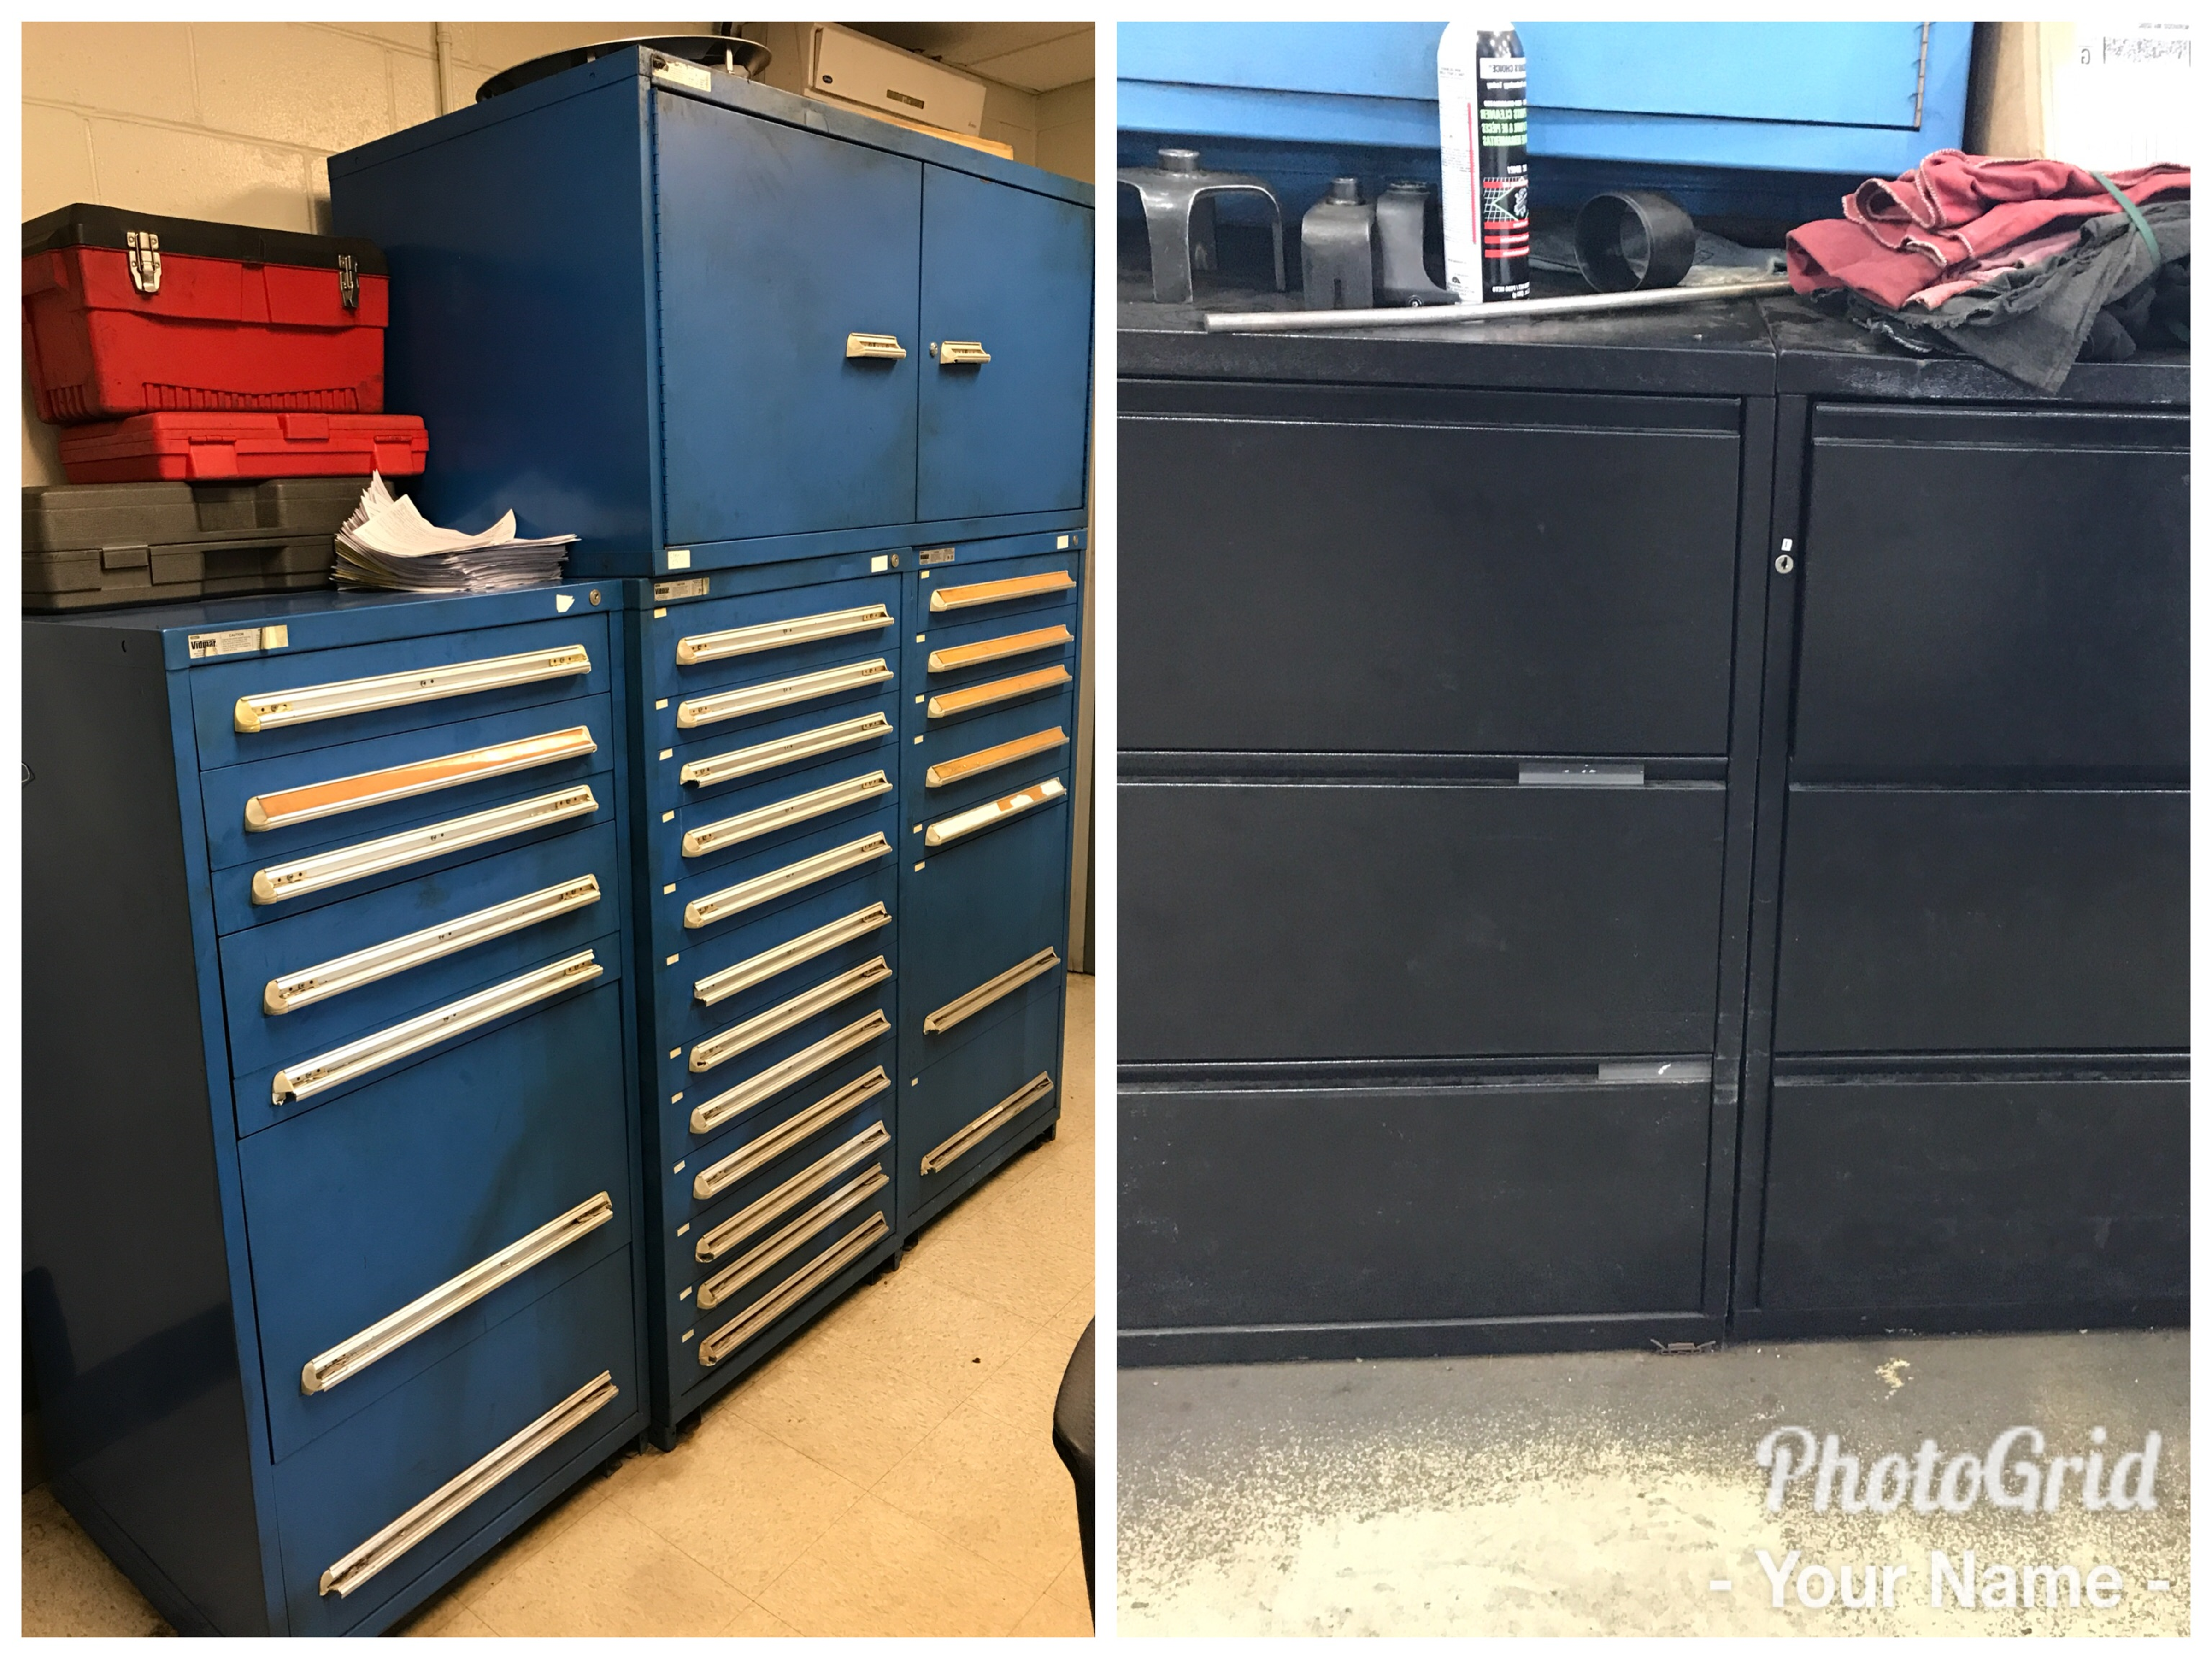
Special Tools
Our Special Tools are stored in 2 locations, one in the dispatchers office and one the first floor out in the shop. I am currently looking to change this process due to no accountability. There is no way of tracking who has what tool, with this current method.
I do not want to have the Specials Tools back in the Parts department but for the mean time I cannot leave them unaccounted for out in the shop.
We are looking into vending machines, that the techs can sign in and out special tools. It will also store shop supplies and provide reports to see who is using what.

Slide 20
100 RO Analysis

Slide 21
SWOT Analysis
Strengths
Family Atmosphere
Experience staff and managers
Our GM strong leader
Knowledgeable management team that cares about their people
People (diverse crew of techs and advisors)
Boch brand ( reputation)
Image Strong
Customer Service
Ability to problem solve
Dealership location right of a busy strip

Slide 22
SWOT Analysis
Weaknesses
Over scheduling from BDC
Lack of parking for customers
Lack of communication
Attitudes from senior techs
Selling used cars with high mileage and dealing with the issues
Grid Pricing going up
Micromanaging
Reviews-some employees don’t get annual reviews.

Slide 23
SWOT Analysis
Opportunities
Recognition
Customer Parking
Amenities-water & apples for customers
Off Brands vehicle being repaired here
Promote from with in
Have a bigger presence on social media and digital marketing
Dare to compare banner in service drive

Slide 24
SWOT Analysis
Threats
Customer experience if not positive can hurt us
Having a lot of independent shops and other dealers around us
Other shops trying to recruit techs and advisors
Need to stay competitive
Honda recalls hurting brand (AIRBAGS)
Customer wait time
Adding or changing processes when not needed

Slide 25
Objectives
Improve BDC appointment scheduling
Minimize One item RO’s
Increase parts/ labor ratio
Track lost sales
Improve customer wait time
Increase gross profit retention on customer pay labor
Increase technician proficiency

Slide 26
Strategies
Create a scheduling system that will allow us to maximize shop productivity.
Constant training with service advisors that have over 15% one item RO’s.
Develop a tracking report to see which service advisors discounting parts.
Service advisors need to help track lost sales to insure we have a great parts mix. More opportunity to sell and get work done same day.
Properly dispatch work to the right level tech, so work can be done correctly. Service advisor giving customer updates through out their wait.
Dispatch all maintenance and light repairs to express team and D techs.
Have part runners bring the techs their parts to keep them in their bay working.

Slide 27
Tactics
Service manager and director needs to review all next day appointments to make sure we are maximizing the shops productivity.
Service managers will need to check and make sure advisor is presenting ASR and also double TO, his/hers customer.
Service managers must authorize all parts and labor discounts.
Service advisor after every shift sends out a lost sales report to service and parts director.
Service advisor has to set the right time expectation with customer on repairs.
Service advisors have sell more work from ASR to increase their customer pay.
Getting parts runner to deliver parts to the technicians once ASR is approved.

Slide 28
Action Plan
Task By Whom Completion Date
Review scheduled appointments Svc Director & Svc BDC director Daily
Review daily ASM performance Svc Manger & Svc advisors Daily
Set up discount parameters in CDK Svc Director 10-2-17
Lost sales report Svc Advisors Daily
Customer updates on service Svc Advisors Daily
Review daily service tracker Svc Manager & Svc Director Daily
Parts runner Svc Director & Parts Director 10-2-17
Review CP parts and labor ratio Svc Director & Parts Director Weekly
Service Department Meeting GM Weekly
Dare to Compare Banner Svc Director & GM 10-2-17
New Hours Posted on Door Svc Director 9-30-17

Slide 29
Synopsis
As we look to maximize our productivity in the shop, we have to properly set appointments in BDC base on available hours. Over booking and having to shut down appointments for the rest of the day is not to our advantage. I know improving our BDC appointment process will keep a consistent flow of work through the shop. This will increase shop proficiency. Also the service advisor and techs moral will be positive knowing they will stay busy.
Its is glaring to me after reviewing the 100 RO analysis that we are not upselling and presenting an ASR to our customers at lease 95% of the time. We have 34% of one item RO’s when guide is at 15%. Having such a high percentage of 1 item RO’s effects our FRH’s per RO. We are at 1.67 when we should be 2.2 to 2.5. Having the service managers review the service advisors performance report on a daily bases, should help identify challenges that the service advisors are facing. We then can teach and coach to make sure they our maximizing their opportunities with the customer.
In the month of July our parts and labor ratio was .63. After review, we realize our service advisors were discounting parts sales on customer pay RO’s. We are currently looking into a program in CDK that will allow us to set parameters on discount that the service advisor can apply. Once we have this program in place, we will see an immediate increase in ELR and gross profit on customer pay. The service manger is going to be responsible, for reviewing and holding advisors accountable if they are discounting more then they should. This will be add to the ASM performance report, and reviewed daily with the service advisors.

Slide 30
Synopsis Cont.…
Tracking lost sales in parts and service is so important to having a right mix of parts. I notice their was a lack of communication with the service advisors and parts counter. The advisor will call parts and ask if we have a part, and if the parts counter said no. That was it, no more communication. We do not know if we could we have sold the job. This is why I am having my service advisors send a weekly report on what they could of sold if we had it in stock to service manager, director and parts director. This will give the parts director some valuable information as he is phasing in new parts.
Having an express tech available on every shift will help a tremendous amount, on cutting customer wait. Last month we started assigning light repairs to our express tech that took 45 minutes our less. We saw a quick improvement on getting customers in and out. It also helped out the higher level techs to continue to work on big jobs without many interruptions. They were able to get the big tickets items done quicker and take on additional work. The techs proficiency has also increase through this process. CSI has also increase due to reducing customer wait.
With changing some of our processes, this will allow us to continue to grow and run a profitable service department. Looking forward to successful future at Boch Honda Service.

