Slide 1

Service Department Analysis for Smart Motors
Hannah Smart –N331-24
Robert Jordan—N331-23

Slide 2
Merchandising
Competitive pricing efforts include:
Menus for factory scheduled maintenance and exception list
Quick reference parts and labor pricing guide
A variable labor rate system for competitive, maintenance and repair work
Add a “Dare to Compare” board with competitive pricing based on the non-dealer competitive survey
Add a tire board

Slide 3
Marketing/ Advertising
How we keep dealer name in front of customer:
Potential
Apprenticeship programs
High School Programs
Rental Program Advertisement
Based on our current advertising expenditures of 0.96% gross, we could invest additional advertising resources to reach the guide range of 1-3%.
Penetration
Partner with Toyota on Dealer National Campaign
Service Manager appears on NPR Radio
Dealer brochures
Business cards
RO Copy with logo
Competition
Non-Dealer Survey

Slide 4
Marketing/ Advertising
Competition

Slide 5
Facility
Our facility potential is currently at $1,994,668.
Given our Utilization guide of 70%, we have the capacity to add $734,364 in sales.
Either we are not getting the production out of our technicians or we do not have enough technicians to produce this level of sales.
If our technician proficiency is low, we would need to do a better job of technician production.
If our proficiency level is over 100%, we would likely need to add more technicians.

Slide 6
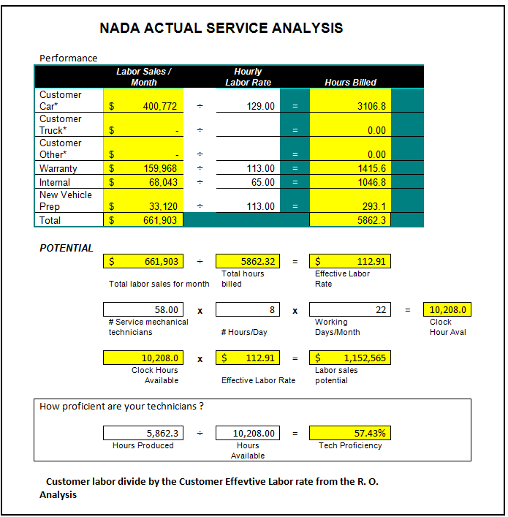
Productivity
Our overall technician proficiency gap is 62.57% compared to the NADA guide of 120%.
Based on our current technician proficiency of 57.43%, not only do we have facility capacity, but we also have technician capacity.

Slide 7
Production Methods
SERVICE MANAGER
ASMS (9)
TECHNICIAN
DISPATCHER
TECNHICIAN
TECHNICIAN
TECHNICIAN
TECHNICIAN
TECHNICIAN
TECHNICIAN
TECHNICIAN
ASM MANAGER
TECHNICIAN
SHOP MANAGER
TECHNICIAN
Smart Motors currently utilizes the Work Group (Lateral Support) Production Method.
We have one Service Manager who is responsible for the department
We have a separate Dispatcher responsible for distributing the work
Our ASM’s are responsible for sales for a group of Technicians
ASM’s are paid on their productivity and CSI Scores
2 bays per technician
Flat Rate pay plans are used for our technicians

Slide 8
Cost of Labor
Our cost of labor is well within guide at 73.71% gross profit as a percent of sales. One significant area that we could work on is our unapplied labor. In the month of March, we saw unapplied labor reach $15,047, which cost us about 2.5% off as a percent of sales. We will make one of our action plan items to make sure each manager is aware of the unapplied labor in their department and review pay plans to reduce unapplied labor as a structural expense.

Slide 9
Expense Structure
Our service department is just barely breaking even. Our ratios look good for both selling expense and semi-fixed expense. We are perhaps not paying enough to those who are generating the sales. We would have to earn an additional $90,000 in gross to reduce fixed expenses to the NADA guide of 30%.

Slide 10
Pay Plan Evaluation Technician
Current pay plan structure for Technicians with flat rate hours
Advantages
Price quotation is easy
Gross profit is easily controlled
Labor sales rates may be changed without regard to pay
A slow technician does not penalize the customer
Disadvantages
It’s easy to overprice competitive and maintenance items
May under-price some repair operations
If operations are completed in less than the flat rate time, customers often question work quality and price
My suggestions to improve performance
Minimum flat rate hours should be recorded per service advisor per day (reasonable daily sales objective)
Keeping track of unapplied time/ gross that we missed out on
Track technician value
Implement skill level rate program. This will allow more money to be charged for jobs that require highly skilled technicians so that we can pay them a higher rate and charge less for jobs needing only low-skilled, low paid technicians.
set- up a tiered system
Set up a variable labor rate system to monitor the ELR
Establish an instant gratification up-sell program for technicians

Slide 11
Pay Plan Evaluation ASM’s
Current pay plan structure for ASMs Salary/ Commission/ Bonus
Advantages
Independently allows each advisor to drive their own performance
Maintains a focus on CSI criteria and what dealer wants to improve
ASMs are able to work depending on their own abilities
Disadvantages
ASM are working towards a specific pay plan instead of working for the customer.
Their numbers could be manipulated for their own benefit
My suggestions to improve performance
Set ASM sales objectives by tracking department’s monthly expenses
Customize ASM bonus play to mirror their job description

Slide 12
Performance Enhancement Programs
Our performance enhancement program includes:
ASM- Paid on SPSI, Service Reception, Service Delivery, and Individual RO’s written per month when the ASM qualifies
Technician- Paid on RO count, Quality of work, SPSI, longevity bonus, productivity bonus for flagging above and beyond 80 hours per pay period, 72 hour guarantee when you clock in for 80 hours per pay period
These are set by:
Departmental Management
General Manager
These programs specifically measure:
ASM qualifiers:
A percentage of inspection requests on CP & warranty RO’s
A percentage of Dealer FX Menu on CP & warranty RO’s
Specific number of 15k Menu Sales
Objectives include:
CSI Bonus Plans
Monthly/ yearly incentives
Tracking methods
Medallia for CSI scores
Dealer FX for menus
ASM Self reporting
DMS reports for inspections
Communication tools
Performance reviews
Paper reports weekly/ monthly
Email notifications

Slide 13
Level of Current Training
The Current Level of Service Training:
The technical knowledge stems from
School
On the job training
Additional training programs and courses provided by dealer
Additional training needs
ASM sales training
ASM customer facing training
Additional DMS training for Technicians and ASMs
Quality control training for Technicians
Continuing ASE and Toyota Technician Training
Education for BDC on Service phone calls
Establish revised program to enhance training to meet future needs
Initiate customer facing meetings by our established dealer trainer
Implement ASM sales training within the dealership
Develop a training criteria pathway to grow from basic to advanced technician
Develop a phone system with direct number into service appointment coordinator (must be customer friendly)
Continue up-front education with sales people covering customer appointments, shop loading, special order parts, and rental car policies

Slide 14
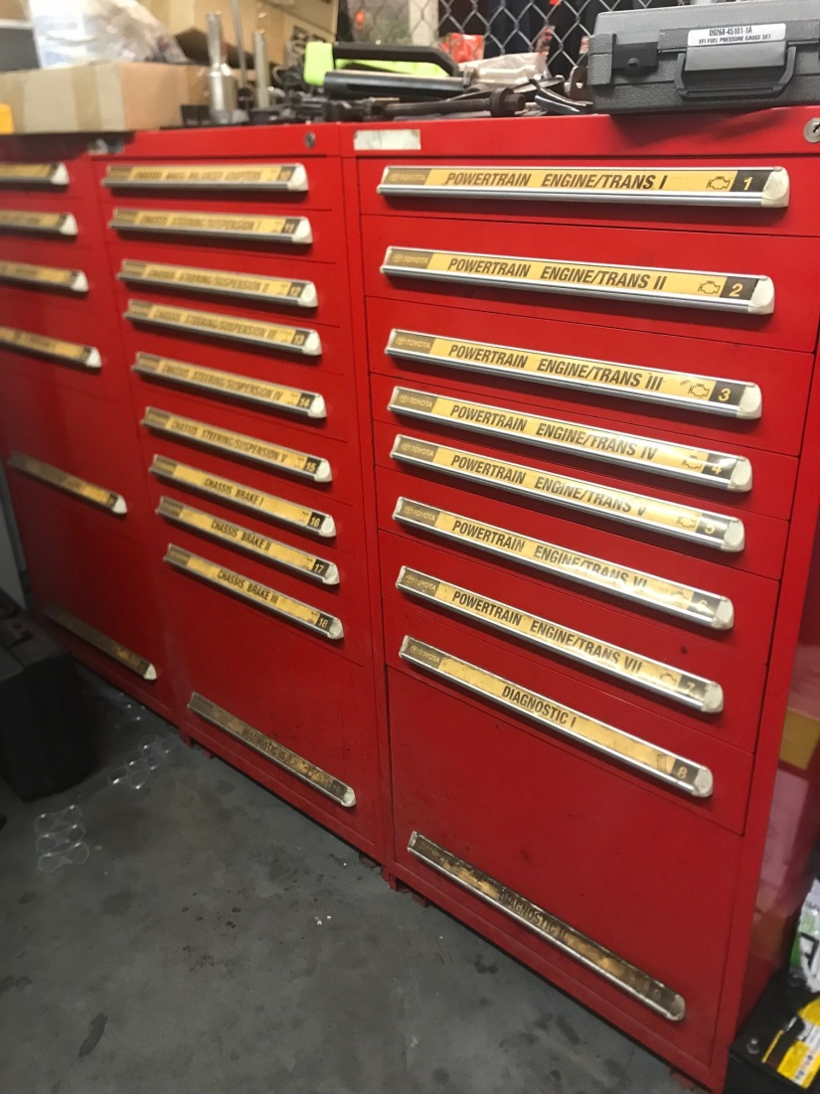
Special Tools/ Equipment
The condition of our special tools are in good working order.
They are all stored in a toolbox and used as needed when authorized.
We also have a check-out system maintained by dispatch for tools that are commonly misplaced

Slide 15
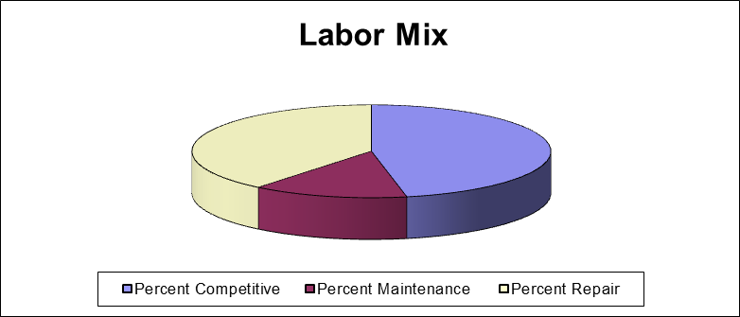
Repair Order Analysis

Slide 16
Repair Order Analysis
RESULTS OF NEW 100 RO ANALYSIS INDICATE:
Our current average flat rate hours per RO is 2.06 and would increase into the desired range of 2.2- 2.5 if we address the one item RO percentage, reducing that from 28% to the desired range of 10-15%.
Our cost of labor is at 21.13%. It is very low. It would indicate that our service department should be very profitable, but we aren’t. that indicates that we are not producing the level of service required to justify the number of support staff.
Our labor mix is at recommended levels, which indicates that we are reaching the accurate markets for maintenance, competitive and repair.
Our target effective labor rate is $115 per hour. We are currently at $102.41, meaning that we are perhaps too low in our competitive market since our maintenance dollars are currently in the preferred range.

Slide 17
SWOT Analysis- Strengths
The number of Master techs
Level of experience
Large dealer
Award winning
Business longevity
Beautiful facility
Family business
Size of dealership
Level of professionalism
Community involvement
Reputation of dealership
Quality of work
Good employees
Good equipment
Large customer base
Convenient Location
Brand understanding
Facility capacity
Teamwork

Slide 18
SWOT Analysis- Weaknesses
Outdated tools
Not enough tools provided
Unqualified techs with multiple bays
Car wash before service
Pay structure
Work is not evenly distributed
Management that lacks experience
Speed of turnaround for employees
More training opportunities
Lack of teamwork in the shop and between departments
Lack of communication
Techs and management
Techs and ASMs
Low morale/ attitude
Divisions between departments and individuals
Not capitalizing on all opportunities
Silos “it’s not my job”
“Pay me now for great work later”
Complacency
Not willing to change
Poor attitude
Unjustified repairs causing us to have a bad name

Slide 19
SWOT Analysis- Opportunities
Shop appreciation
Growth
Advancements in the company
Training
Smart Motors App for smart phones
More product/ service promotions
Old car discounts
More online services
Pay structure
Youth apprentice programs
Improve reputation with local schools
Recruiting
Mentoring
Career paths
Fleet customers
Hiring techs from independent shops
Growth to equal shop capacity/ utilization
Transparency
Ownership—service life path→ sales to service

Slide 20
SWOT Analysis- Threats
Other shops paying more per hour
Jobs with better benefits
Non-certified technicians make more hours elsewhere
More qualified= less hours/pay
Other local dealerships taking customers and employees
Over charging customers on labor for work not performed
Poor quality repairs or diagnosis
Outside shop competition
Market share/ loss of customers due to:
Poor quality of work
Customer service
Price
Independent shops
Non-dealer shops

Slide 21
SWOT Analysis Objectives
Increase employee retention and satisfaction
Increase customer satisfaction
Improve technician proficiency

Slide 22
SWOT Analysis Strategies
Address technician feedback on the SWOT analysis in two ways:
Select several easy items and get them resolved quickly to show that the dealership is taking initiative.
Take longer term items and give monthly progress updates
Increase number of hours produced by each technician
Ensure vehicles are fixed right the first time
Increase technician morale

Slide 23
SWOT Analysis Tactics
Analyze current pay plans to ensure they mirror the job description
Review current tools and create a list of tools that need replacing, adding or updating
Look at cost associated with hiring a quality control employee and analyze way to justify the additional expense
Research other companies who have good employee engagement (e.g. Disney) and look for ways we can implement similar strategies

Slide 24
SWOT Analysis Action Plan
TASK | BY WHOM | COMPLETION DATE
Review unapplied labor and pay plans in to reduce unapplied labor as a structural expense | Fixed Ops Management | August 1, 2018
Update and purchase additional tools | Service Manager | June 1, 2018
Create a plan on how technicians earn multiple bays | Fixed Ops Management | May 1, 2018
Create an employee engagement program | Human Resources | June 1, 2018
Initiate quality control program to reduce comebacks and increase customer satisfaction | Fixed Ops Management | August 1, 2018
Install competitive pricing board in the service drive | Marketing and Fixed Ops Management | June 1, 2018

Slide 25
SWOT Analysis Synopsis
It is clear from our SWOT analysis that we do a lot of things well, but we also have a lot of opportunities to take advantage of. We have done a good job of providing a good physical space for both our customers and our employees and now we need to do a better job of focusing on the intrinsic needs of our employees and customers.
By implementing an employee engagement plan, our team members will feel more valued and will lead to increased productivity and therefore increasing our CSI scores.
With the introduction of a quality control system, it will increase our customer satisfaction being that their vehicles will be fixed right the first time.
By adding a competitive pricing board, customers will no longer be under the impression that dealerships are far more expensive than independent shops.

