Slide 1
Sample Pay Plans

Slide 2
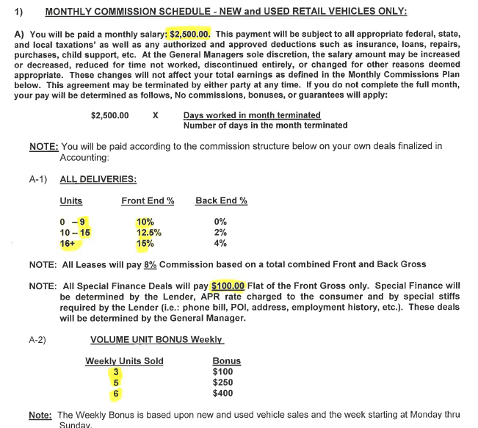
Example 1

Slide 3
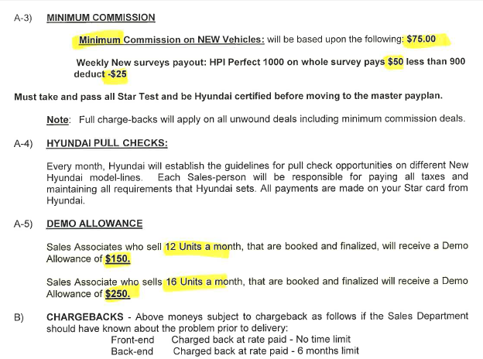
Example 1

Slide 4

Medium-Sized Town

Slide 5
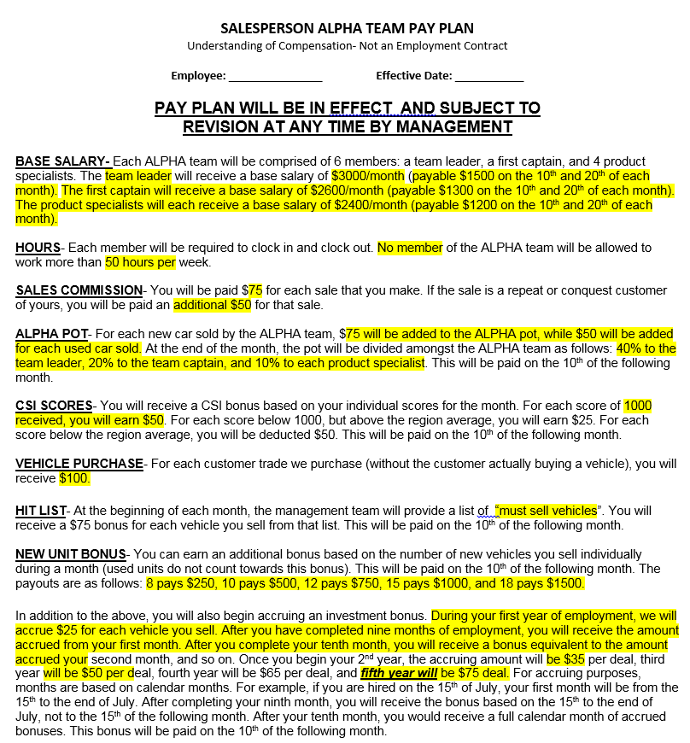
Example 2

Slide 6
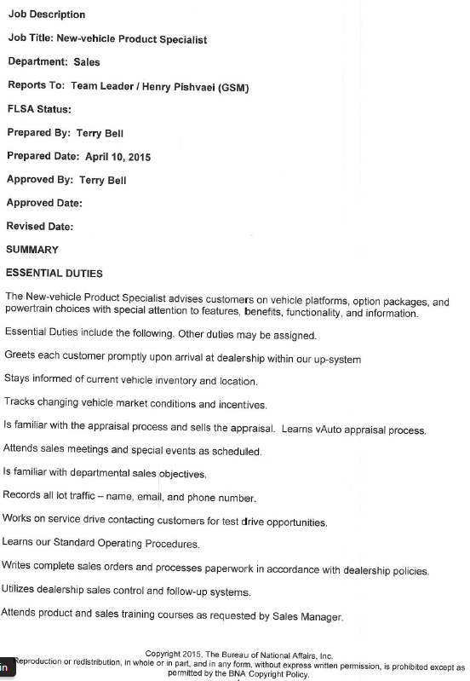
Example 2

Slide 7
Pay Plan Recap (aka, the ‘Millennial Pay Plan’)
Example 2
Payplan in place since April 2015
3 teams of 6 currently @ 60-75 sales per month per team. Adding additional team in February.
Recent Modification: Minimum of 24 units sold in 90 days if not their salary goes to $1500 month for the next 90 days.
Average sales consultant earns $5500 / month ($66k / year)
Team leaders making between $90k and $110k
9 month turnover is 2
What has this pay plan accomplished?

Slide 8
Salary & Monthly Bonus Pay Plan
Example 3
Salary + Monthly Bonus Pay Plan
Monthly Bonus Matrix
Salary: $600/week [$31,200/year]
+ Monthly Bonus Matrix
Sales Schedule:
42 Hour Work Week
Example: (Wednesday shown as Day Off in this example) Monday 9:00am – 8:00pm (1 hour lunch) 10 hours Tuesday 9:00am. – 5:00pm (1 hour lunch) 7 hours Wednesday OFF Thursday 9:00am – 8:00pm (1 hour lunch) 10 hours Friday 9:00am – 6:00pm (1 hour lunch) 8 hours Saturday 9:00am – 5:00pm (1 hour lunch) 7 hours
3 set teams with 1 Saturday off per month
A Team: off Tuesday with 1st Saturday off
B Team: off Wednesday with 2nd Saturday off
C Team: off Thursday with 3rd Saturday off
**The Saturday off replaces weekday off.**
Company vehicle and/or demo allowance are not included in this pay plan offering.
Note: All paperwork, titles and monies due (i.e. deposits, COD, registrations) must be completed and turned into the sales mgmt. office for bonuses to be paid.
Sold Units | Volume Bonus | Gross Profit Bonus | CSI Bonus | Total Bonus
10 | $400 | $150 | $250 | $800
12 | $500 | $250 | $250 | $1,000
14 | $750 | $500 | $250 | $1,500
16 | $1,000 | $750 | $250 | $2,000
18 | $1,250 | $1,000 | $500 | $2,750
20 | $1,500 | $1,500 | $500 | $3,500
22 | $1,750 | $1,750 | $500 | $4,000
24 | $2,000 | $2,000 | $500 | $4,500
26 | $2,250 | $2,250 | $500 | $5,000
28 | $2,500 | $2,500 | $500 | $5,500
30 | $3,000 | $3,000 | $500 | $6,500
Volume Bonus:
10 Unit level requires 3 used vehicles
12+ unit levels require 5 minimum used vehicles
Gross Profit Bonus:
Requires a minimum $2,200 Used Vehicle Front-End GPU
CSI Bonus
See Carbone CSI President’s Club Bonus criteria

Slide 9
Draw / Weekly Commission / Monthly Bonus Pay Plan (Old Dogs)
Example 3
Draw:
$405.00 per pay period.
Commissions:
New Vehicles: Used Vehicles:
20% with a $350.00 pack, 20% with a $750.00 pack,
at minimum $100.00 flat at minimum $100.00 flat
Upgrade Program commissions:
New Vehicles: $100.00 flat Used Vehicles: $225.00 flat
Monthly Demo Program:
Employees will receive an allowance of $400.00 per month or company demonstrator vehicle.
Employees will qualify for monthly Demo program eligibility when employee has sold a total of 12 units. Employee must maintain a minimum of 8 units sold per month.
Employee is not eligible for the Demo Program in any month in which he/she does not sell at least eight (8) units.
If Employee does not sell at least eight (8) units for two (2) consecutive months, he/she will become ineligible for the Demo Program (losing the monthly demo bonus or demo vehicle privilege). If the Employee loses eligibility in the Demo Program, he/she must sell 12 units to qualify for eligibility.

Slide 10
Draw / Weekly Commission / Monthly Bonus Pay Plan
Example 3
End of Month Bonus:
Unit Bonus:
8 units = $500
10 units = $1000
12 units = $1200
14 units = $1400
16 units = $1600
18 units = $1800
20 units = $2000
21+units = +$100.00 per unit
Note: All paperwork, titles and monies due (i.e., deposits, COD, registrations) must be completed and turned into the sales mgmt. office for commissions to be paid.

Slide 11
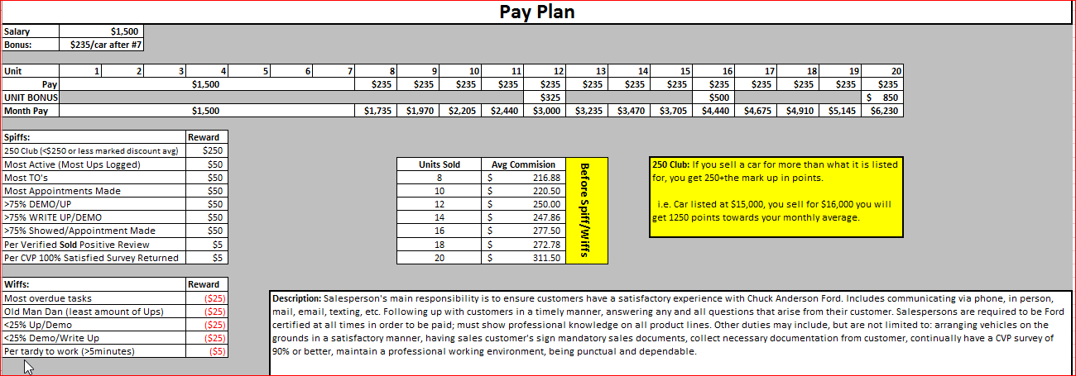
Example 4

