Slide 1
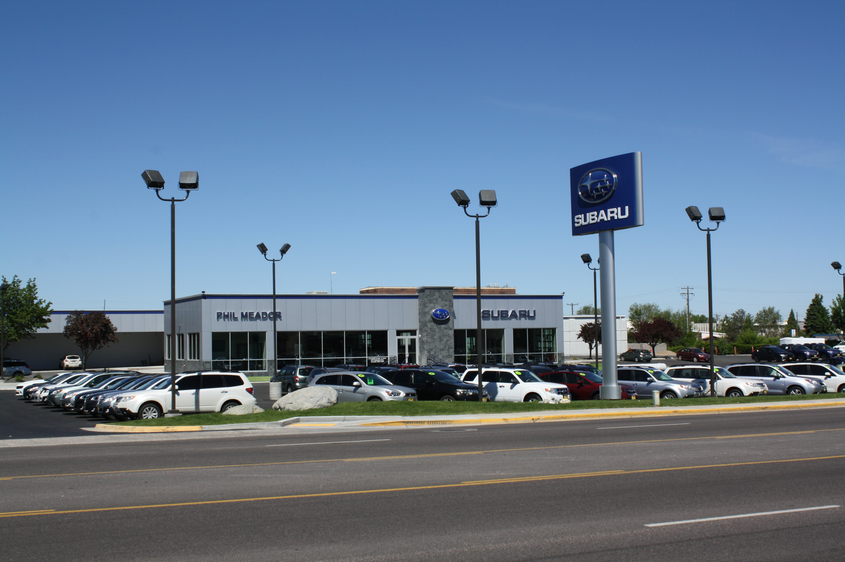

SERVICE DEPARTMENT ANALYSIS FOR PHIL MEADOR SUBARU

Slide 2
ADVERTISING/MARKETING
FROM A SERVICE SPECIFIC ADVERTISING AND MARKETING PERSPECTIVE, WE DEFINITELY HAVE ROOM TO GROW. WE ARE NOW ALMOST A YEAR AND A HALF INTO OUR BRAND-NEW FACILITY AND BEGINNING TO UNDERSTAND OUR LEVELS AND LIMITS. IN COMPLETING OUR NON-DEALER SURVEY PRIOR TO CLASS WE FOUND OUT THAT MUCH OF OUR COMPETETIVE AND MAINTENANCE SERVICES WERE AMONG THE CHEAPEST IN TOWN. UPON OUR RETURN WE IMMEDIATELY RAISED THE PRICES SEVERAL OF OUR SERVICES TO BE COMMENSURATE WITH WHAT WAS GOING ON AROUND US. FOR EXAMPLE, OUR LABOR CHARGE ON OIL CHANGES WENT FROM $12.50 TO $14.00, OUR TIRE ROTATION LABOR CHARGE WENT FROM $14.00 TO 16.00, AND OUR BRAKE FLUSH WENT FROM $95.00 TO $115.00. SMALL INCREMENTAL CHANGES THAT NEED TO BE EXAMINED REGULARLY BY VIRTUE OF COMPETIVE SURVEYS OF OUR COMPETITION.
PARTS
Parts and Service Fund Current Balance
Accrual Period | Effective Date | Expiration Date | Accruals | Approved/Paid | Balance
September 2017 | 08/01/2017 | 11/30/2017 | $975.00 | $0.00 | $975.00
October 2017 | 09/01/2017 | 12/31/2017 | $1,250.00 | $0.00 | $1,250.00
November 2017 | 10/01/2017 | 01/31/2018 | $725.00 | $0.00 | $725.00
Total Current Balance |  |  | $2,950.00 | $0.00 | $2,950.00

Slide 3
ADVERTISING AND MARKETING CONTINUED….
Flex Fund Current Balance
Accrual Period | Effective Date | Expiration Date | Accruals | Approved/Paid | Balance
September 2017 | 08/01/2017 | 11/30/2017 | $2,925.00 | $0.00 | $2,925.00
October 2017 | 09/01/2017 | 12/31/2017 | $3,750.00 | $0.00 | $3,750.00
November 2017 | 10/01/2017 | 01/31/2018 | $2,175.00 | $0.00 | $2,175.00
Total Current Balance |  |  | $8,850.00 | $0.00 | $8,850.00
The two above charts show that we have available funds from Subaru to assist us in promoting our Service Department. A small amount of our current advertising budget goes towards SEM and SEO pertaining to parts and service. With that, we are able to maintain an ‘Exact Match Impression Share’ of 90+% in most months. However, there is no need to let this money (that we earn) go back to the manufacturer. Moving forward, we will utilize all of these monies to promote Top-of-Mind awareness for our Award winning service department.

Slide 4
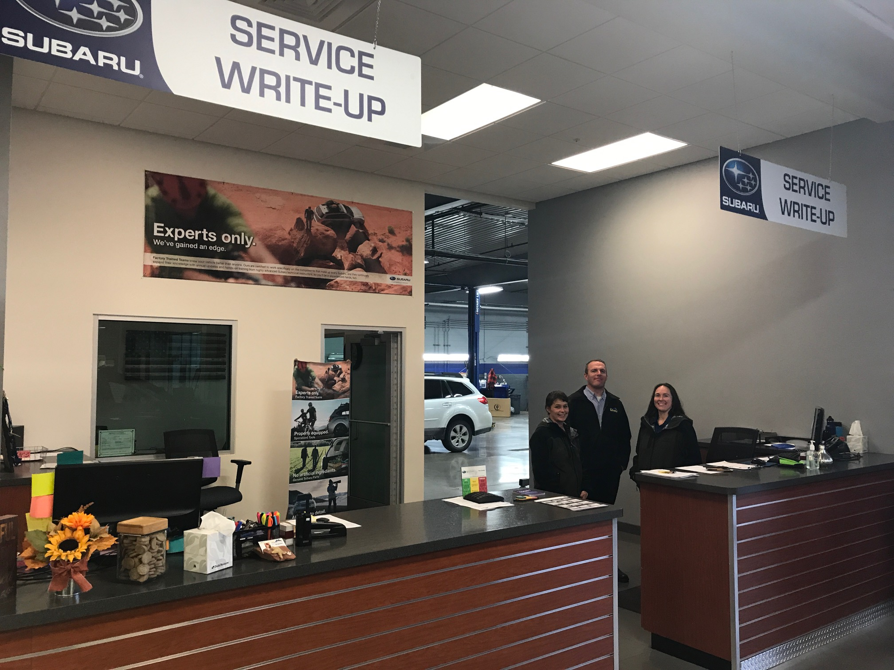
ADVERTISING AND MARKETING CONTINUED….
2017 YEAR TO DATE CUSTOMER SATISFACTION RATINGS - SERVICE
District Ranking WST-DEN-02 1 / 9
Zone Ranking WST-DEN 2 / 40
Region Ranking WST 3 / 154
National Ranking Subaru 32 / 648
As is evident in the above illustration, we have earned the right to advertise our Customer Service Satisfaction ratings. We are in the top 5% in the country year-to-date! That, along with the Subaru Stellar Care awards we have received, will be the USP’s that we will rely on for our main advertising messages for our dealership.
The main reason our CSI is so high is pictured at right >>>>>>>
Great people make happy customers

Slide 5
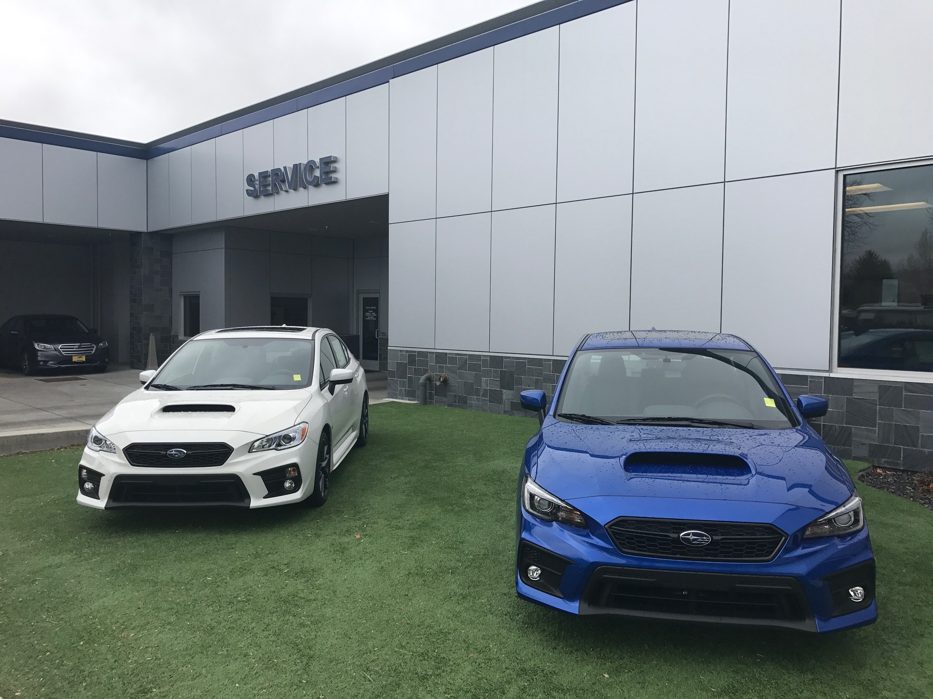
facility
FOR OVER SEVEN YEARS OUR DEALERSHIP OPERATED WITH A SEPARATED SALES AND SERVICE DEPARTMENT. OUR SALES DEPARTMENT WAS AT ONE LOCATION AND OUR SERVICE DEPARTMENT WAS COMBINED WITH OUR TOYOTA STORE SERVICE DEPARTMENT. ON JUNE 1st, 2016 WE FINALLY MOVED INTO OUR ALL-NEW SIGNATURE SUBARU FACILITY. BOTH OF OUR SALES AND SERVICE TEAMS, ALONG WITH OUR CUSTOMERS, ARE STILL EXCITED ABOUT OUR NEW HOME AND BEING ABLE TO TAKE CARE OF OUR CUSTOMERS THE RIGHT WAY! ALTHOUGH WE HAVE SEEN GOOD GROWTH, WE ARE STILL TRYING TO FIGURE OUT THE IDEAL BALANCE OF STAFFING, SUPPORT, PRODUCTION, ETC IN ORDER MAXIMIZE UTILIZATION AND PROFITABILITY.

Slide 6
FACILITY CONTINUED….
NADA ACTUAL SERVICE ANALYSIS
Performance
 | Labor Sales / Month |  | Hourly Labor Rate |  | Hours Billed
Customer Car* | $ 381,750 | ÷ | 95.00 | = | 4681.0
Customer Truck* | $ - | ÷ |  | = | 0.00
Customer Other* | $ - | ÷ |  | = | 0.00
Warranty | $ 121,237 | ÷ | 90.00 | = | 1221.0
Internal | $ 134,522 | ÷ | 95.00 | = | 1266.0
New Vehicle Prep | $ 16,485 | ÷ | 90.00 | = | 200.0
Total | $ 653,994 |  |  |  | 7368.0
POTENTIAL
 | $ 653,994 | ÷ | 7368.00 | = | $ 88.76
 | Total labor sales for year |  | Total hours billed |  | Effective Labor Rate
 | 6.00 | x | 8 | x | 21 | = | 1,008.0
 | # Service mechanical technicians |  | # Hours/Day |  | Working Days/Month |  | Clock Hour Aval
 | 1,008.0 | x | $ 88.76 | = | $ 89,471
 | Clock Hours Available |  | Effective Labor Rate |  | Labor sales potential
How proficient are your technicians ?
 | 7,368.0 | ÷ | 10,080.00 | = | 73.10%
 | Hours Produced |  | Hours Available |  | Tech Proficiency
As is evident by the year-to-date figures in the accompanying slides, our facility gives us the ability to grow with our UIO as that number increases over time. In the meantime, we have plenty of capacity to be aggressive in marketing and loading of our very experienced flat-rate technicians and our quick lube operation.

Slide 7
productivity
 |  | BRAD C. |  | ANGIE |  | DUSTY M. |  | DOMINIC |  | STORE
JANUARY
A |  | 108 |  | 99 |  | 43 |  | 59 |  | 77
B |  | 115 |  | 99 |  | 80 |  | 57 |  | 88
FEBRUARY
A |  | 118 |  | 90 |  | 69 |  | 52 |  | 82
B |  | 78 |  | 63 |  | 53 |  | 71 |  | 66
MARCH
A |  | 144 |  | 109 |  | 101 |  | 55 |  | 102
B |  | 118 |  | 150 |  | 107 |  | 91 |  | 116
APRIL
A |  | 99 |  | 98 |  | 78 |  | 58 |  | 83
B |  | 95 |  | 86 |  | 68 |  | 82 |  | 82
MAY
A |  | 113 |  | 113 |  | 72 |  | 56 |  | 89
B |  | 115 |  | 119 |  | 90 |  | 63 |  | 97
JUNE
A |  | 132 |  | 123 |  | 101 |  | 59 |  | 103
B |  | 106 |  | 102 |  | 59 |  | 95 |  | 96
JULY
A |  | 97 |  | 95 |  | 74 |  | 75 |  | 86
B |  | 123 |  | 90 |  | 76 |  | 73 |  | 91
AUGUST
A |  | 84 |  | 144 |  | 74 |  | 89 |  | 98
B |  | 117 |  | 113 |  | 80 |  | 69 |  | 95
SEPTEMBER
A |  | 112 |  | 120 |  | 96 |  | 62 |  | 97
B |  | 104 |  | 113 |  | 70 |  | 49 |  | 84
OCTOBER
A |  | 119 |  | 116 |  | 83 |  | 67 |  | 96
B |  | 145 |  | 108 |  | 70 |  | 119 |  | 110
NOVEMBER
A |  | 142 |  | 128 |  | 83 |  | 76 |  | 107
B
DECEMBER
A
B
YTD AVERAGE |  | 113.5238095 |  | 108.4761905 |  | 77.47619048 |  | 70.33333333 |  | 92.61904762

Slide 8
Productivity continued….
UPON RETURNING FROM THE NADA ACADEMY FINANCIAL MANAGEMENT CLASS, I IMMEDIATELY KNEW THAT WE NEEDED TO FOCUS ON OUR TECHNICIAN PROFICIENCY. SPECIFICALLY FOR OUR 4 FLAT-RATE TECHS, I BUILT THE GOOGLE DOC ON THE PREVIOUS SLIDE THAT TRACKS THEIR PROFICIENCY BY PAY PERIOD ALONG WITH THEIR CUMULATIVE PROFICIENCY, MINUS THE HOURLY QUICK LUBE TECHS. BOTH THE SERVICE MANAGER AND MYSELF HAVE ACCESS TO THE DOC SO WE CAN TRACK EACH EMPLOYEE. OUR SUSPICION WAS CONFIRMED THAT WE HAD TWO TECHNICIANS THAT WE NEEDED TO FOCUS OUR EFFORTS ON. ONE IS A CERTIFIED SUBARU MASTER TECHNICIAN AND THE OTHER IS A RELATIVELY NEW UCR TECHNICIAN WITH GOOD POTENTIAL, BUT IS STILL LEARNING HIS CRAFT. WE RECENTLY HAD A ‘WE CAN’T GO ON LIKE THIS’ HAMMER-STYLE MEETING WITH THE MASTER TECH AND IT WENT AS GOOD AS CAN BE EXPECTED. WE ADDRESSED WHAT COULD BE SOME SHOP LOADING DEFICIENCIES THAT ARE AFFECTING HIM AND HOW HE CAN POSTIVELY AFFECT HOW WORK IS DISTRIBUTED TO HIM. TIME WILL TELL IF THE CHANGES TRANSLATE TO LONG-TERM INCREASES IN HIS PROFICIENCY. IF NOT, IT COULD MEAN THAT HE WILL HAVE TO LOOK FOR A NEW LONG-TERM ADDRESS.

Slide 9
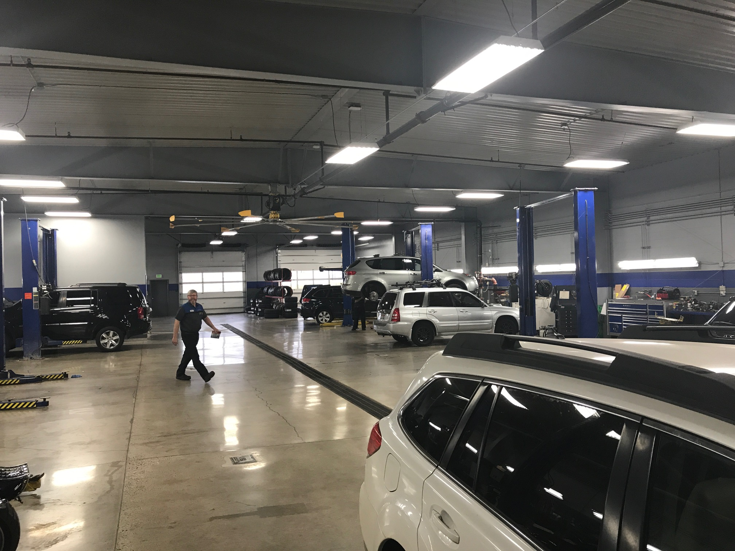
PRODUCTION METHOD
COST OF LABOR
WE CURRENTLY UTILIZE A CONVENTIONAL SHOP SETUP AS OUR PRODUCTION METHOD. BASED ON OUR CURRENT SIZE AND STRUCTURE, IT IS THE MOST VIABLE AND EFFECTIVE WAY FOR US.
ONE OF THE MOST VITAL THINGS COMING FROM ATTENDING THE ACADEMY IS FINDING ALL OF THE ERRORS IN HOW WE REPORT OUR FIGURES AND ACCOUNT FOR THEM ON THE STATEMENT. WE ARE IN THE PROCESS OF RE-ROUTING MANY OF OUR ACCOUNTS AND CLEANING UP THESE ERRORS. MOST OF THE #’S ABOVE ARE A CLOSE SNAPSHOT OF EACH LABOR TYPE EXTRAPOLATED FROM BLENDING THE OVERALL #’S ON THE STATEMENT WITH THE ACTUAL OP CODES AND REPORTS FROM CDK. THE BIGGEST THING THAT JUMPS OUT IN THESE YEAR-TO-DATE #’S IS THE AMOUNT OF ADJUSTED COST OF LABOR AT 8.5%! THE MAJORITY OF THAT COMES FROM UNBILLED TIME FROM OUR 2 QUICK LUBE TECHS AND OUR TIRE AND ALIGNMENT TECH. WE WILL DISCUSS OUR IDEAS ON DECREASING THAT # LATER IN THE SWOT ANALYSIS.

Slide 10
CHANGES IN EXPENSE STRUCTURE
$50694 AVERAGE EXPENSES
DIVIDED BY
69.02 CURRENT GROSS PROFIT %
= $73448 SALES NEEDED TO BREAKEVEN
$50694 AVG EXPENSES
DIVIDED BY
49.02 CURRENT GROSS PROFIT % MINUS 20
= $103414 SALES NEEDED TO NET 20%
THE FORMULAS ABOVE SHOW THE DIFFERENT SALES LEVELS NEEDED AT OUR CURRENT GROSS PERCENTAGE IN ORDER TO REACH A BREAKEVEN POINT AND A 20% NET PROFIT BASED ON OUR CURRENT AMOUNT OF EXPENSES. FURTHER EXPENSE REDUCTIONS COULD FURTHER DECREASE THESE DIFFERENCES FROM OUR CURRENT PRODUCTION LEVEL.
THE BATTLE WITH EXPENSES IS ONE THAT NEVER GOES AWAY. WE ARE IN A CONSTANT BALANCING ACT CONSISTING OF MAKING SURE WE HAVE PROPER STAFFING TO SATISFY DEMAND, BUT MAKING SURE NOT TO OVER-STAFF. WE HAVE REACHED THE PROPER PERSONNEL MIX BASED ON GUIDE, AS IT SHOWS IN THE ABOVE CHART, BUT OUR FIXED AND SEMI-FIXED EXPENSES ARE TWICE WHAT THEY SHOULD BE. OBVIOUSLY WE HAVE WORK TO CONTINUE IN THOSE AREAS, AS WE HAVE BEEN FOR THIS ENTIRE CALENDAR YEAR. HOWEVER, WE CAN ALSO FOCUS ON THE INCREASES IN PRODUCTION MENTIONED ON THE PREVIOUS SLIDES IN ORDER COMPENSATE FOR THESE DEFICIENCIES.

Slide 11
PAY PLANS
PERFORMANCE PROGRAMS
CURRENT TRAINING LEVELS
OUR ORGANIZATION CURRENTLY CONSISTS OF 3 NEW CAR FRANCHISE DEALERSHIPS. OUR PAY PLANS ARE STRUCTURED SIMILARLY THROUGHOUT ALL THREE STORES. THAT MAKES CHANGES DIFFICULT TO PROCESS AND WITH OUR REASONABLE COST OF LABOR, IT MAY NOT BE NECESSARY AT THIS POINT IN TIME.
SIMILARLY TO THE GOOGLE DOC ON SLIDE #7, I HAVE A SALES OBJECTIVES TEMPLATE THAT ALL THREE DEPARTMENTS UPDATE EACH DAY SHOWING SALES, GROSS, TRACKING ETC. THIS HELPS ALL DEPARTMENT MANAGERS TO STAY CONNECTED TO ONE ANOTHER AND UNDERSTAND WHERE EACH OTHER IS IN RELATION TO OUR MONTHLY GOALS SET OUT AT THE BEGINNING OF OUR YEAR.
IN REFERENCE TO PRODUCTIVITY & PERFORMANCE WE HAVE RECENTLY ADDED A SPIFF PROGRAM FOR OUR FLAT RATE TECHS TO ENHANCE THEIR FOCUS ON PROFICIENCY. THE GIFT CARDS THEY COMPETE FOR ARE FROM BUSINESSES AND VENDORS THEY UTILIZE, HOPEFULLY CREATING A FUN AND COMPETITIVE ENVIRONMENT BASED ON THEIR ABILITY TO PRODUCE BETTER PROFICIENCY #’S THAN THEIR TEAMMATES.
Month | Number of fully trained technicians | Number of credits needed | Number of credits taken | Percent attainment
Jan | 2 | 188 | 229 | 122.07%
Feb | 2 | 188 | 229 | 122.07%
Mar | 2 | 188 | 229 | 122.07%
Apr | 2 | 196 | 235 | 119.78%
May | 2 | 196 | 235 | 119.78%
Jun | 2 | 196 | 235 | 119.78%
Jul | 2 | 196 | 235 | 119.78%
Aug | 2 | 196 | 235 | 119.78%
Sep | 2 | 196 | 235 | 119.78%
Oct | 3 | 181 | 235 | 129.58%
Nov | 3 | 181 | 235 | 129.58%
TOOL ROOM
OUR TOOL ROOM IS CURRENTLY NOT A PROBLEM, BUT CAN CERTAINLY BE IMPROVED. I SURVEYED THE TECHNICIANS AND THEY DON’T BELIEVE IT HINDERS THEIR PRODUCTION AT THIS TIME. HOWEVER, SUBARU IS GOING TO MANDATE ALL DEALERS TO PURCHASE THEIR ORGANIZATIONAL SHELVING SYSTEM IN THE NEAR FUTURE WHICH WILL FURTHER OUR TOOL ROOM’S EASE OF USE.

Slide 12
100 REPAIR ORDER ANALYSIS: SUMMARY

Slide 13
SWOT ANALYSIS
STRENGTHS
WEAKNESSES
TEAMWORK
‘FAMILY’ ATMOSPHERE
HIGHLY TRAINED TECHNICIANS
EAGER, POSITIVE ATTITUDES
GREAT C.S.I.
AWESOME FACILITY
OWNERSHIP SUPPORT
GOOD RELATIONSHIP WITH SALES DEPT
LACK OF COMMUNICATION
DISPATCHING
TENSION BETWEEN ADVISORS
FTFR & PARTS ORDERING ACCURACY
SERVICE MARKETING
SALES TO SERVICE INTRODUCTION

Slide 14
SWOT ANALYSIS CONTINUED…
OPPORTUNITIES
THREATS
GROWTH IN PROFICIENCY
ROOM FOR OVERALL GROWTH
BRAND GROWTH & POPULARITY
LOCAL ECONOMY & GROWTH
MANUFACTURER RECALL OPPORTUNITIES FOR UPSELL
INDEPENDENT SHOPS CLOSING LOCALLY
LOTS OF COMPETITION, 6 NEW FACILITIES COMPLETED IN LAST 2 YEARS, FRANCHISED DEALERS
COMEBACKS
OTHER MANUFACTURERS PUSH FOR LESS CUSTOMER PAY MAINTENANCE
FICKLE ECONOMY
COMPLACENCY

Slide 15
SWOT ANALYSIS CONTINUED….
OBJECTIVES
STRATEGIES
IMPROVE OVERALL PROFICIENCY
IMPROVE OVERALL EXPENSE CONTROL
INCREASE SERVICE GROSS PROFIT POTENTIAL
IMPROVE SERVICE ADVERTISING TO CAPITALIZE ON MAINTENANCE SERVICES AND TOP OF MIND AWARENESS
INCREASE WRITER OPPORTUNITES FOR UPSELL THROUGH MULTI POINT INSPECTIONS
IMPROVE SHOP LOADING
CREATE FRIENDLY/COMPTETIVE ATMOSPHERE REVOLVING AROUND FRT PROFICIENCY
ANALYZE OVERTIME & OFFSETTING UNAPPLIED LABOR AMOUNTS
INCREASE LABOR RATES WHERE APPLICABLE
UTILIZE FACTORY $$ FULLY FOR SERVICE ADVERTISING
GET MORE CUSTOMERS THROUGH THE DOOR
REFINE PROCESS FOR DISPATCH/WORK FLOW

Slide 16
SWOT ANALYSIS CONTINUED….
TACTICS
ACTION PLAN
CHART YTD PROFECIENCY BY TECHNICIAN & INCENTIVIZE IMPROVEMENT BY GIFT CARD
ANALYZE UNAPPLIED LABOR FROM STATEMENT WITH OFFICE MANAGER.
ANALYZE OVERTIME & NON-PRODUCING EMPLOYEE EXPENSE. SEND EMPLOYEES HOME WHEN IDLE.
CHANGE QUICK LUBE POLICY TO NO APPT NECESSARY. LOOK AT ADVERTISING NEW POLICY. THIS SHOULD GIVE WRITERS MORE OPPORTINITIES FOR UPSELL ALONG WITH INCREASING PRODUCTIVITY OF NON FRT, THUS REDUCING UNAPPLIED LABOR
MOVE CUSTOMER PAY LABOR FROM $95/ HOUR TO $98/HOUR
INCREASE LOF LABOR FROM $12.50 TO $14.00
INCREASE ROTATION LABOR FROM $14.00 TO $16.00
INCREASE BRAKE FLUID FLUSH FROM $95.00 TO $115.00
ALL TO BE COMMENSURATE WITH THE MARKET BASED ON NON-DEALER SURVEY
REVERSE PROCESS OF LOF WITH 2ND LINE ITEM CONCERN TO SCHEDULE WITH FRT FIRST TO ADDRESS CONCERN THEN FINISH WITH LOF
THIS SHOULD MINIMIZE QUICK LUBE INCORRECTLY DISPATCHING ITEMS TO SHOP WITHOUT SA INPUT AND WITLL IMPROVE SHOP LOADING
TASK BY DATE
ANALYZE UNAPPLIED LABOR EXP W/ OFFC MGR GSM/SVC MGR 9/15/17
INCREASE CUST PAY LABOR RATE SVC MGR 10/1/17
INCREASE COMPETETIVE/MAINTENANCE SVCS SVC MGR 10/1/17
CREATE PROFICIENCY CHART FOR SHOP GSM 10/1/17
INSTITUTE PROFICIENCY COMPETITION FOR FRT SVC MGR 11/1/17
SHIFT TO NO APPT NECESSARY LOF & START ADVERTISING SVC MGR 12/1/17
CREATE MARKETING PLAN FOR 2018 FOR SERVICE GSM/SVC MGR 12/15/17
COMPLETE NON DEALER SURVEY SVC MGR EVERY 6 MONTHS
CONTINUE TO HONE STATEMENT REPORTING GSM/SVC MGR/OFFICE MGR ONGOING

Slide 17
SWOT ANALYSIS CONTINUED….
SYNOPSIS
Reading through the 4-squares turned in from all of the service department employees for the SWOT analysis, it was fun to see that everyone agreed that we have a great team and a positive environment. That is the culture we have tried to create from day one. However, as with any business, it is only fun for the long-term if we are productive and profitable.
As mentioned throughout this analysis, our main objective was to evaluate and improve our shop proficiency. By evaluating our areas of weakness in that area and improving those who are not pulling their weight we can bring up the overall profitability, functionality, and absorption of the service department.
The encouraging part is that we have great people that want to improve and are not afraid to make changes and challenge those who might be complacent at times. Understanding that a business can never stay the same, it is either improving or worsening- we must be proactive in finding ways to get better and increase our bottom line. We have been together long enough now, and accustomed to the new facility, that we can take the handcuffs off and fill up the schedule. Getting more people in front of our great advisors and in the hands of our awesome technicians will pay off right away, I have no doubt.
We have been given a great opportunity by our ownership. They have provided us with every advantage we could ask for and it is time for us to repay them for that faith and investment. I believe that these changes are the beginning of that return, and we will all see the fruits of these efforts very soon.

