Slide 1
Palm Springs Subaru
Larry Knowlton
Class 328 Student 36

Slide 3
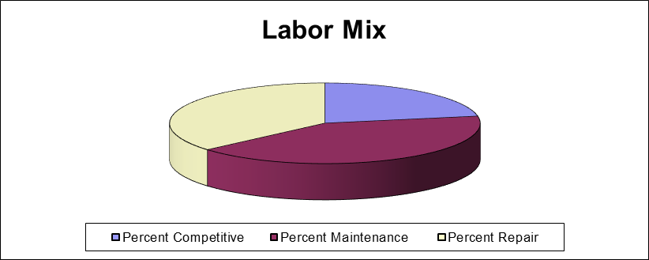

Slide 4
Strengths
Experienced Service Advisor Team
Continued High Customer service Scores
Very Experienced Heavy Line Techs
Great team work showed by all employees
Large Fleet of Loaner vehicles
Core Employees have been with the team for many years
Expanding service department(adding 10 bays)
Growing dealership (adding more units in operation)

Slide 5
Weaknesses
Parts department filling orders in a timely manner
Not answering phones well
Communication between departments
Lack of parking (due to construction)
Porters
Special tools unorganized

Slide 6
Opportunities
Growing dealership
Continued training of service techs
Sales trainings for service Advisors
Tire Sales and displays for new service drive
Parts accessories sales
Service contracts and Maintenance Contracts sells in drive.
Ability to increase warranty and customer pay labor rates

Slide 7
THREATS
Don’t answer phones quickly and return voicemails in a timely manner
Store is growing very rapidly, training new service staff to handle the volume is time consuming
Selling a franchise (will lose an average for 40k gross profit a month)
Young express service staff

Slide 8
Objectives
Improve customer pay hours per R.O. sales
Improve gross dollars on repair orders
Grow techs from express service to keep up with the demand and growth of the service department
Change service advisors pay plan to hourly plus commissions
Complete training of current techs to meet factory standards
Continued development of younger employees, through training and experience.

Slide 9
Strategies
Weekly training in drive with service advisors, covering walk arounds, in drive recommendations(specifically tires and alignments) and over coming objectives on upsells.
Move back up express advisor to a service receptionist who will answer phone calls and set appointments.
Send Service Manager to tech training seminar to set up 2018 tech training calendar.
Move Labor rate from $125.00 to $130.00
Increase shop productivity and hours produced
Hold a shop meeting to with all employees to inform the staff the direction of the dealership and the expectations
Work on special order process to better fill the shop and take care of customer

Slide 10
Tactics
Setup tire display in the service drive
Have service manager call competitive tire companies and provide a comparative analysis to customers to show we are competitive.
Have Bi-monthly meetings with the service manager and parts manager to track progress on the special order process and in drive recommendations
Provide a bonus program for advisors for in drive recommendations.
Multi-point inspections required on every vehicle started 1/1/18
Move up parts mark up to be in line with NADA guide.
Put together a bonus program for techs for upsells.

Slide 11
Action Plan
Service Advisor in drive Service Feb. 1, 2018
recommendation program Manager
Tech training calendar Service Feb. 20, 2018 Manager
Create in driver Tire Service Feb. 1,2018
Display Manager
Change Advisor General Feb. 1 , 2018
Pay Plan Manager
Bi-Weekly Fixed ops GM/SM/PM Weekly
Meeting

Slide 12
Action Plan
Create Tech bonus Service Manager March 1,2018
plan on upsells
Adjust parts mark Parts Manager Feb. 1, 2018
Up factor
In drive training Service Manager Weekly
for advisors
In Bay training for Shop Foreman/SM Bi-Weekly
techs on recommendations

Slide 13
Synopsis
With the growth of the service department a big objective for the store will be continued growth. As we sell our Volvo franchise, we will have to continue to look to pick up incremental business in service department to cover that lose of gross profit With appointments only out 2 days, we are going to have to focus on doing a better job of creating as much gross on each vehicle brought in. By implementing a through walk around when the vehicle comes in and an incentive based program for in drive recommendations, we should be able to increase gross with out having to work on more vehicles. Our service manager was brought on board in June for his ability proven success in the service drive.

Slide 14
SYNOPSIS
  To help increase on each repair order we will also lean on our Techs to provide a good multi-point inspection with good recommendations. We will have our shop foreman who is a 35 year Subaru vet provide training and start to spot check each multi-point inspection for quality and thoroughness. Beyond just hours received we will start a bonus program that can reward the techs for through inspections.
  We will really start to implement our new parts special order process
  Starting march 1st when the Volvo franchise leaves. This will help prevent having parts on the shelves.
  Palm Springs Subaru is a growing dealership with many veteran employees. The key to this dealerships continued success will be the veteran employees coming along side the new employees and help to train them. Palm Springs Subaru will continue to grow and succeed thanks to the people who work there and put there best efforts forward every day.

