Slide 1
PADDOCK CHEVROLET CRM REHAUL
November 2017
Lauren Paddock

Slide 2
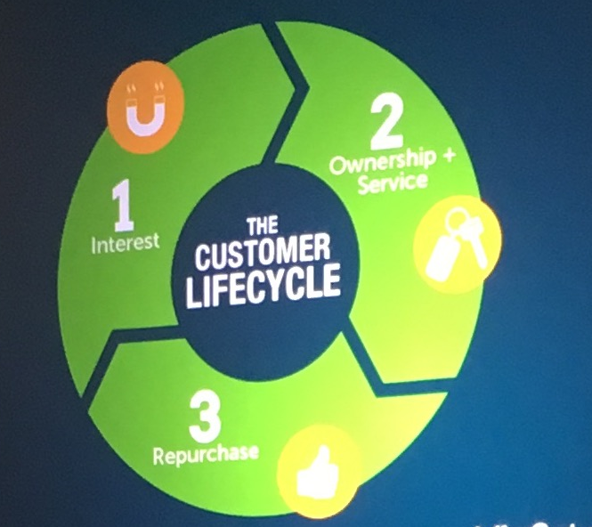
5 Common Biggest Mistakes
Not knowing which processes are set up today
Letting your team off the hook
Setting up unrealistic and complex processes
Not entering every opportunity into CRM
Not using CRM beyond the point of sale

Slide 3
New Internet Sales Leads

Slide 4
Standard Process
Task: Automatic Email – States we have received the customers credit app
Timing: Immediately
Assigned User : BDC Sales Rep
Task: Phone Call - Notifying the customer we have received their credit app
Timing: Immediately
Assigned User : BDC Sales Rep
Task: Generic - If no contact or has no co-signer, please call ASAP
Timing: 3 days
Assigned User : BDC Sales Rep
Task: Generic – Why is this lead still active?
Timing: 10 days
Assigned User : BDC Sales Rep
Automatic change status to Lost
Timing: 14 days
Assigned User : N/A

Slide 5
Credit App Rule
Task: Automatic Email – States we have received the customers credit app
Timing: Immediately
Assigned User : BDC Sales Rep
Task: Phone Call - Notifying the customer we have received their credit app
Timing: Immediately
Assigned User : BDC Sales Rep
Task: Generic - If no contact or has no co-signer, please call ASAP
Timing: 3 days
Assigned User : BDC Sales Rep
Task: Generic – Why is this lead still active?
Timing: 10 days
Assigned User : BDC Sales Rep
Automatic change status to Lost
Timing: 14 days
Assigned User : N/A

Slide 6
Used – Internet Sales Lead Process
Task: Phone Call – Used lead first touch, make the appointment
Timing: Immediately
Assigned User: BDC Sales Rep
Task: Email – Send out either Thank you for your time or Check Your Voicemail
Timing: 1 Hour
Assigned User : BDC Sales Rep
If BDC does not make the appointment, 12 hours post: Change to Sales Rep
Task: Phone Call – Check notes and call to make the appointment
Timing: 12 hours post
Assigned User : Used Sales Rep
Task: Generic – Notifying used manager that a lead has been reassigned to a salesperson
Timing: 12 hours post
Assigned User : Tom Fogarty
Task: Email – Sales Introduction
Timing: 1 day post
User: Used Sales Rep
Task: Phone Call – Still no appointment? Get an appointment
Timing: 3 days post
User: Used Sales Rep

Slide 7
Used – Internet Sales Lead Process
Task: Automated Email – You Have So Many Options
Timing: 5 days
Assigned User: Used Sales Rep
Task: Phone Call – Call to follow-up on day 5 email
Timing: 8 days
Assigned User : Used Sales Rep
Task: Phone Call – Get the appointment!
Timing: 14 days
Assigned User : Used Sales Rep
Task: Automated Email – Make Your Appointment Today!
Timing: 20 days
Assigned User : Used Sales Rep
Task: Phone Call – Last Chance to get the appointment
Timing: 25 days
Assigned User: Used Sales Rep
Automatic Change Status to Lost
Timing: 30 days
Assigned User: N/A

Slide 8
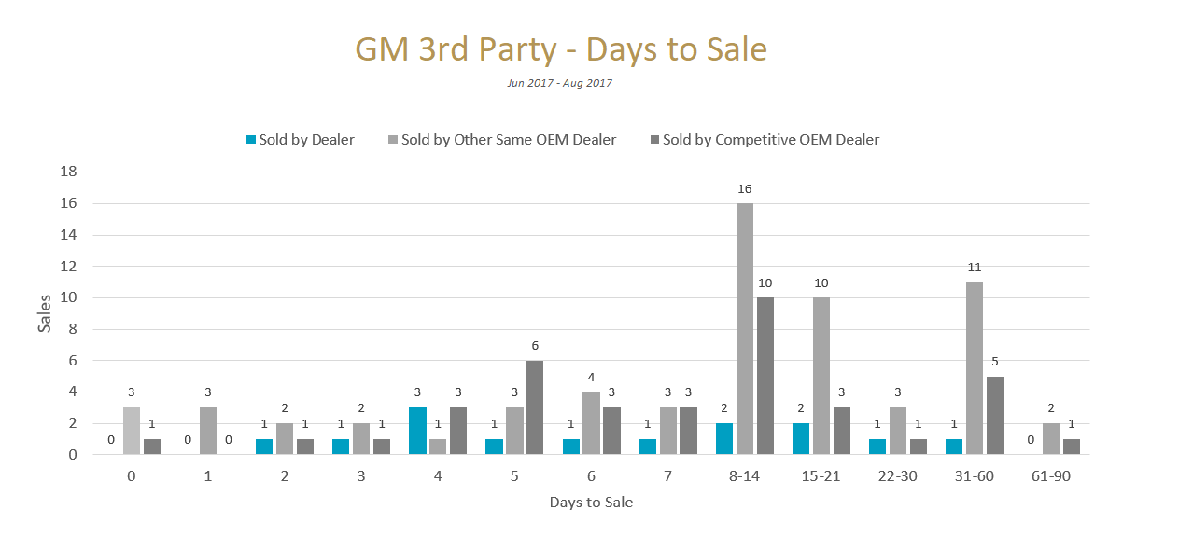
GM Third Party

Slide 9
GM Third Party
Task: Phone Call – First touch to this customer
Timing: Immediately
Assigned User: BDC Sales Rep
Task: Automated Email – Why Buy From Paddock Chevrolet?
Timing: 1 hour post
Assigned User: BDC Sales Rep
Task: Phone Call – Following up on the email we sent
Timing: 12 hours post
Assigned User : BDC Sales Rep
Task: Automated Email – Inconvenient Time
Timing: 5 days
Assigned User : BDC Sales Rep
Task: Phone Call – Get the appointment, have they received our emails?
Timing: 10 days
Assigned User: BDC Sales Rep
Task: Automated Email – Did Your Buying Requirements Change?
Timing: 20 days
Assigned User: BDC Sales Rep

Slide 10
GM Third Party
Task: Automated Email – Should I Cross You Off My List?
Timing: 30 days
Assigned User: BDC Sales Rep
Task: Automated Email – New Month, New Incentives
Timing: 45 days
Assigned User: BDC Sales Rep
Task: Automated Email – I Hate Sales Emails
Timing: 60 days
Assigned User : BDC Sales Rep
Task: Automated Email – Haven’t Found What You’re Looking For?
Timing: 70 days
Assigned User : BDC Sales Rep
Task: Phone Call – End of process – last chance to see if they are still in the market
Timing: 90 Days
Assigned User: BDC Sales Rep

Slide 11
Phone Lead Follow Up

Slide 12
Standard Process
Task: Phone Call – Follow-up to initial call, where did you leave off?
Timing: 1 day post
Assigned User: BDC Sales Rep
Task: Automated Email – Why Buy From Paddock Chevrolet?
Timing: 3 days
Assigned User: BDC Sales Rep
Task: Phone Call – Read past notes/history. Why aren’t they coming in?
Timing: 7 days
Assigned User : BDC Sales Rep
Task: Automated Email – Should I Cross You Off My List?
Timing: 15 days
Assigned User : BDC Sales Rep
Task: Automated Email – New Month, New Incentives
Timing: 30 Days
Assigned User: BDC Sales Rep
Change Status to Lost in 31 Days

Slide 13
Showroom Visit Follow-Up

Slide 14
Standard Process (New)
Task: Automated Email – Thank You for visiting us!
Timing: 8 minutes post
Assigned User: Sales Rep
Task: Phone Call – Following up on the customer’s showroom visit
Timing: 2 hours post
Assigned User: Manager
Task: Phone Call – Customer follow-up, why didn’t they purchase?
Timing: 1 day post
Assigned User : Sales Rep
Task: Automated Email – General Sales Manager Visit Follow-Up
Timing: 2 days
Assigned User : General Sales Manager
Task: Phone Call – Read the notes/rehash the deal, make the call
Timing: 3 Days
Assigned User: Manager

Slide 15
Standard Process (New)
Task: Automated Email – Help me, Help you
Timing: 5 days
Assigned User: Sales Rep
Task: Phone Call – It’s been a week and following up on them emails
Timing: 7 days
Assigned User: Sales Rep
Task: Automated Email – Why buy from Paddock Chevrolet?
Timing: 10 days
Assigned User: Sales Rep
Task: Phone Call – It’s been over 2 weeks, what is preventing them from buying?
Timing: 15 days
Assigned User: Sales Rep
Task: Phone Call – Did programs change? Rehash the deal and call
Timing: 18 Days
Assigned User: Sales Rep

Slide 16
Standard Process (New)
Task: Automated Email – Should I Cross you off my list?
Timing: 21 days
Assigned User: Sales Rep
Task: Phone Call – Over a month, definitely new programs, how can we get the deal
Timing: 32 days
Assigned User: Sales Rep
Task: Generic Task – Is this customer engaged? (Custom status) If not, it will go to lost.
Timing: 33 days
Assigned User: Manager
Task: Alert Notification – Can we salvage the deal?
Timing: 34 days
Assigned User: Manager
Automated Change Status to Lost – 36 Days

Slide 17
Beback Process
Task: Automated Email – Beback (Thanks for Coming Back!)
Timing: 30 minutes post
Assigned User: Sales Rep
Task: Phone Call – This isn’t a thank you call – left showroom twice without purchasing. What is going on?
Timing: 1 day
Assigned User: Manager
Task: Phone Call – Did the manager speak with the customer? What is going on?
Timing: 2 days
Assigned User: Sales Rep
Task: Automated Email – What are we missing?
Timing: 4 days
Assigned User: Manager
Task: Phone Call – Ask customer if they got our emails. What are we missing?
Timing: 7 days
Assigned User: Manager
Task: Phone Call – Last ditch effort before moving into the lost process.
Timing: 10 days
Assigned User: Sales Rep
Task: Alert Notification – Beback customer is about to go to lost. Is there anything else we can do?
Timing: 14 days
Assigned User: Manager
Automated Change Status to Lost – 15 days

Slide 18
Used Showroom Follow-Up Process
Task: Automated Email – Used, Thank you for coming in
Timing: Immediately
Assigned User: Used General Manager
Task: Phone Call – Call customer and thank them for their visit
Timing: 2 hours
Assigned User: Used Manager
Task: Phone Call – Customer was in the showroom yesterday, check notes and call. Get them back in.
Timing: 1 day
Assigned User: Used Sales Rep
Task: Phone Call – Check notes of previous conversation, call and get them back!
Timing: 3 days
Assigned User: Used Manager
Task: Automated Email – Help me, Help you
Timing: 5 days
Assigned User: Used Sales Rep
Task: Automated Email – Did your buying requirements change?
Timing: 10 days
Assigned User: Used Sales Rep
Task: Phone Call – It’s been 2 weeks, what’s preventing them from buying?
Timing: 15 days
Assigned User: Used Sales Rep

Slide 19
Used Showroom Follow-Up Process
Task: Automated Email – Fresh Inventory
Timing: 21 days
Assigned User: Used Sales Rep
Task: Phone Call – Last ditch effort before it goes into our lost process
Timing: 30 days
Assigned User: Used Sales Rep
Task: Alert Notification – This lead is about to go into lost. Is there anything we can do?
Timing: 31 days
Assigned User: Used General Manager
Automated Change Status to Lost – 33 Days

Slide 20
Custom Follow Up Processes

Slide 21
Sales Apt For ABN
Task: Alert Notification – Customer made an apt, make sure it’s on the apt board
Timing: Immediately
Assigned User: Receptionist
Task: Generic Task – Customer has an upcoming apt, is the apt on the board?
Timing: Immediately
Assigned User: Receptionist

Slide 22
Cancelled Appointment
Task: Automated Email – When will we see you?
Timing: 30 minutes post
Assigned User: Manager
Task: Phone Call – Person recently, why? When can we reschedule?
Timing: 12 hours
Assigned User: Manager
You will have to manually implement!
Task: Automated Email – Why buy from Paddock Chevrolet?
Timing: 3 days
Assigned User: Sales Rep
Task: Phone Call – Has this person rescheduled? Have they responded to emails? Call them!
Timing: 5 days
Assigned User: Manager
Task: Automated Email – Did your buying requirements change?
Timing: 10 days
Assigned User: Manager
Task: Phone Call – Last chance to make an appt before this going into lost process
Timing: 20 days
Assigned User: Manager
Task: Automated Email – New Month, New Incentives
Timing: 30 days
Assigned User: Sales Rep
Task: Generic Task – Is this person still engaged? 30+ Still engaged custom process
Timing: 31 days
Assigned User: Manager
Automated Change Status to Lost – 33 Days

Slide 23
Unsold Follow-Up Post 30 Days (New)
Task: Automated Email – Unsold Follow-Up 45 Days
Timing: 45 Days
Assigned User: General Sales Manager
Task: Generic Task – See if they responded to email, call as a check-in
Timing: 60 Days
Assigned User: Sales Rep
Task: Automated Email – Gone, but Not Forgotten
Timing: 90 Days
Assigned User: Sales Rep

Slide 24
Monthly Pull-Ahead Process
Task: Phone Call – Call ASAP, lowest hanging fruit
Timing: 3 Days
Assigned User: Sales Rep
Task: Automated Email – You’ve Been Selected For GM’s Pull-Ahead Program!
Timing: 3 Days
Assigned User: Sales Rep
Task: Phone Call – Following up on the email and calling the person again to get them in.
Timing: 7 days
Assigned User: Sales Rep
Task: Phone Call – Customer is still pull-ahead, why aren’t they coming in?
Timing: 14 days
Assigned User: Sales Rep
Task: Phone Call – Time is running out! Get them in here!
Timing: 21 days
Assigned User: Sales Rep
Task: Generic – This lead is about to expire in 2 days! That’s still enough time to sell them a car!
Timing: 28 days
Assigned User: Sales Rep
Automated Change Status to Bad – 30 Days

Slide 25
Monthly Lease Loyalty
Task: Automated Email – GM Qualified You for Another Incentive!
Timing: Immediately
Assigned User: Sales Rep
Task: Generic Task – Customer is lease loyalty, call them and set an appointment
Timing: 12 hours
Assigned User: Sales Rep
Automated Change Status to Lost – 30 Days

Slide 26
Monthly Lease Loyalty
Task: Automated Email – GM Qualified You for Another Incentive!
Timing: Immediately
Assigned User: Sales Rep
Task: Generic Task – Customer is lease loyalty, call them and set an appointment
Timing: 12 hours
Assigned User: Sales Rep
Automated Change Status to Lost – 30 Days

Slide 27
Sales Appointment Follow-Up

Slide 28
Sales Appointment Scheduled
Task: Automated Email – Your Sales Appointment is Confirmed! (New only)
Timing: Immediately
Assigned User: Manager
Task: Automated Email – Your Sales Appointment is Confirmed! (Used Only)
Timing: Immediately
Assigned User: Manager

Slide 29
Sales Appointment Reminder
Task: Phone Call – Is this appointment confirmed?
Timing: 1 day prior
Assigned User: Manager
Task: Automated Email – See you tomorrow at Paddock Chevrolet! (NEW)
Timing: 12 hours prior
Assigned User: Manager
Task: Automated Email – See you tomorrow at Paddock Chevrolet! (Used)
Timing: 12 hours prior
Assigned User: Used Manager
Task: Alert Notification – You have a sales appointment in an hour. Are you ready?
Timing: 60 minutes prior
Assigned User: Sales Rep

Slide 30
Sales Appointment Rescheduled
Task: Automated Email – Your Sales Appointment has been updated! (New)
Timing: Immediately
Assigned User: Manager
Task: Automated Email – Your Sales Appointment has been updated! (Used)
Timing: Immediately
Assigned User: Used Manager

Slide 31
Sales Appointment Missed
Task: Automated Email – When will we see you?
Timing: 30 minutes prior
Assigned User: Manager
Task: Phone Call – This person missed their appointment. Have they rescheduled?
Timing: 12 hours
Assigned User: Manager
Task: Automated Email – Why buy from Paddock Chevrolet?
Timing: 3 days
Assigned User: Sales Rep
Task: Phone Call – Has this person rescheduled?
Timing: 5 days
Assigned User: Manager
Task: Automated Email – Did your buying requirements change?
Timing: 10 days
Assigned User: Manager

Slide 32
Sales Appointment Missed
Task: Phone Call – Last Chance to reschedule this person!
Timing: 20 days
Assigned User: Manager
Task: Automated Email – New Month, New Incentives
Timing: 30 days
Assigned User: Sales Rep
Task: Generic Task – Does this customer still seem engaged? Put it in a custom process
Timing: 31 days
Assigned User: Manager

Slide 33
Sales Lead Marked Lost

Slide 34
Lost Reason: Requested No Further Contact
No Future Follow-Up
Clear All Tasks Will Run Immediately

Slide 35
Lost Reason: Import Lead
No Future Follow-Up
Clear All Tasks Will Run Immediately

Slide 36
Lost Reason: Working with other salesperson
No Future Follow-Up
Clear All Tasks Will Run Immediately

Slide 37
Lost Reason: Bad Credit/No Agreement Reached
Task: Automated Email: We’re Still Here
Timing: 1 week
Assigned User: General Sales Manager
Task: Automated Email – A reminder…
Timing: 3 months
Assigned User: Sales Rep
Task: Automated Email – The Deals that make us proud
Timing: 9 months
Assigned User: BDC Sales Rep
Task: Automated Email – Why buy from Paddock Chevrolet?
Timing: 12 months
Assigned User: Sales Rep

Slide 38
Lost Reason: Process Complete/OOM/No Response
Task: Automated Email: Are we breaking up?
Timing: 1 month
Assigned User: Sales Rep
Task: Automated Email – Hello Stranger
Timing: 5 months
Assigned User: Sales Rep
Task: Automated Email – A to Z
Timing: 8 months
Assigned User: Sales Rep
Task: Automated Email – Good things come to those who click
Timing: 11 months
Assigned User: Sales Rep
Task: Automated Email – Hello from the other side
Timing: 14 months
Assigned User: Sales Rep
Task: Automated Email – Deals that make us proud
Timing: 17 months
Assigned User: Sales Rep
Task: Automated Email – Why buy from Paddock Chevrolet?
Timing: 20 months
Assigned User: Sales Rep
Task: Automated Email – Did your buying requirements change?
Timing: 24 months
Assigned User: Sales Rep

Slide 39
Sales Lead Marked Bad
No Future Follow-Up
Clear All Tasks Will Run Immediately

Slide 40
Sales Lead Marked Sold Pending
Task: Alert Notification – Making Money
Timing: Immediately
Assigned User: General Sales Manager
Task: Generic – IMPORTANT, did you take a picture and post to ABN?
Timing: Immediately
Assigned User: Sales Rep
Task: Generic – What’s going on with this customer?
Timing: 3 days
Assigned User: Finance Managers
Task: Phone Call – Why isn’t this delivered?
Timing: 7 days
Assigned User: Finance Managers
Task: Generic – Have we forgotten to make this dead or delivered?
Timing: 30 days
Assigned User: Manager

Slide 41
Sold Delivered Follow-Up

Slide 42
Standard Process (Lease)
Task: Phone Call – Purchase Thank You
Timing: 1 day
Assigned User: Sales Rep
Task: Automated Email – After Sales Survey Email
Timing: 3 days
Assigned User: Sales Rep
Task: Phone Call – Follow-up on survey email
Timing: 4 days
Assigned User: Sales Rep
Task: Automated Email – Nothing is complete…(Accessories Email)
Timing: 7 days
Assigned User: Sales Rep
Task: Phone Call – Purchase Thank you (General Manager)
Timing: 8 days
Assigned User: General Sales Manager
Task: Automated Email – Any Questions
Timing: 15 days
Assigned User: Sales Rep

Slide 43
Standard Process (Lease)
Automated Email – Welcome to Paddock Service
Timing: 30 Days
Assigned User: Service Director
Task: Automated Email – Your Paddock Chevrolet Service Guide
Timing: 90 Days
Assigned User: BDC Service Manager
Task: Phone Call – Make service appointment for oil change
Timing: 180 Days
Assigned User: BDC Service Rep
Task: Phone Call – Anniversary Call
Timing: 1 year
Assigned User: Sales Rep
Task: Automated Email – Like Us on Facebook!
Timing: 15 months
Assigned User: Sales Rep

Slide 44
Standard Process (Lease)
Automated Email – That’s What We’re Working With (Inventory)
Timing: 19 months
Assigned User: Sales Rep
Task: Automated Email – Your 2 Yr Maintenance is about to expire
Timing: 20 months
Assigned User: BDC Service Rep
Task: Phone Call – Warranty Expiration
Timing: 35 months
Assigned User: F&I Managers

Slide 45
Purchase (New) Process
Task: Phone Call – Purchase Thank You
Timing: 1 day
Assigned User: Sales Rep
Task: Automated Email – After Sales Survey Email
Timing: 3 days
Assigned User: Sales Rep
Task: Phone Call – Follow-up on survey email
Timing: 4 days
Assigned User: Sales Rep
Task: Automated Email – Nothing is complete…(Accessories Email)
Timing: 7 days
Assigned User: Sales Rep
Task: Phone Call – Purchase Thank you (General Manager)
Timing: 8 days
Assigned User: General Sales Manager
Task: Automated Email – Any Questions
Timing: 15 days
Assigned User: Sales Rep

Slide 46
Purchase (New) Process
Automated Email – Welcome to Paddock Service
Timing: 30 Days
Assigned User: Service Director
Task: Automated Email – Your Paddock Chevrolet Service Guide
Timing: 90 Days
Assigned User: BDC Service Manager
Task: Phone Call – Make service appointment for oil change
Timing: 180 Days
Assigned User: BDC Service Rep
Task: Phone Call – Anniversary Call
Timing: 1 year
Assigned User: Sales Rep
Task: Automated Email – Like Us on Facebook!
Timing: 15 months
Assigned User: Sales Rep

Slide 47
Purchase (New) Process
Automated Email – That’s What We’re Working With (Inventory)
Timing: 19 months
Assigned User: Sales Rep
Task: Automated Email – Your 2 Yr Maintenance is about to expire
Timing: 20 months
Assigned User: BDC Service Rep
Task: Phone Call – 2 year Anniversary Call
Timing: 2 years
Assigned User: Sales Rep
Task: Phone Call – Warranty is about to Expire
Timing: 35 months
Assigned User: FI Manager
Task: Phone Call – 3 year Anniversary Call
Timing: 3 years
Assigned User: Sales Rep
Task: Phone Call – 4 year Anniversary Call
Timing: 4 years
Assigned User: Sales Rep
Task: Phone Call – 5 year Anniversary Call
Timing: 5 years
Assigned User: Sales Rep

Slide 48
Purchase (Used) Process
Task: Phone Call – Purchase Thank You
Timing: 1 day
Assigned User: Sales Rep
Task: Automated Email – After Sales Survey Email
Timing: 3 days
Assigned User: Sales Rep
Task: Phone Call – Follow-up on survey email
Timing: 4 days
Assigned User: Sales Rep
Task: Automated Email – Nothing is complete…(Accessories Email)
Timing: 7 days
Assigned User: Sales Rep
Task: Phone Call – Purchase Thank you (General Manager)
Timing: 8 days
Assigned User: General Sales Manager
Task: Automated Email – Any Questions
Timing: 15 days
Assigned User: Sales Rep

Slide 49
Purchase (Used) Process
Automated Email – Welcome to Paddock Service
Timing: 30 Days
Assigned User: Service Director
Task: Automated Email – Your Paddock Chevrolet Service Guide
Timing: 90 Days
Assigned User: BDC Service Manager
Task: Phone Call – Make service appointment for oil change
Timing: 180 Days
Assigned User: BDC Service Rep
Task: Phone Call – Anniversary Call
Timing: 1 year
Assigned User: Sales Rep
Task: Automated Email – Like Us on Facebook!
Timing: 15 months
Assigned User: Sales Rep

Slide 50
Purchase (Used) Process
Automated Email – That’s What We’re Working With (Inventory)
Timing: 19 months
Assigned User: Sales Rep
Task: Automated Email – Your 2 Yr Maintenance is about to expire
Timing: 20 months
Assigned User: BDC Service Rep
Task: Phone Call – 2 year Anniversary Call
Timing: 2 years
Assigned User: Sales Rep
Task: Phone Call – Warranty is about to Expire
Timing: 35 months
Assigned User: FI Manager
Task: Phone Call – 3 year Anniversary Call
Timing: 3 years
Assigned User: Sales Rep
Task: Phone Call – 4 year Anniversary Call
Timing: 4 years
Assigned User: Sales Rep
Task: Phone Call – 5 year Anniversary Call
Timing: 5 years
Assigned User: Sales Rep

Slide 51
End of Term Lease

Slide 52
End of Term Lease
Automated Email – The last ONE
Timing: 1 Year before end of lease
Assigned User: Sales Rep
Task: Automated Email – We’re in the home stretch
Timing: 6 months before end of lease
Assigned User: Sales Rep
Task: Automated Email – A Check-In
Timing: 4 months before end of lease
Assigned User: General Sales Manager
Task: Phone Call – This customer’s lease expires in 4 months
Timing: 4 months before end of lease
Assigned User: Manager
Task: Phone Call – The lease expires in 3 months, call and make an appointment
Timing: 3 months before end of lease
Assigned User: Sales Rep
Task: Phone Call – The lease expires in 2 months, call and make an appointment
Timing: 2 months before end of lease
Assigned User: Sales Rep

Slide 53
End of Term Lease
Automated Email – We need your lease
Timing: 2 months before end of lease
Assigned User: Sales Rep
Task: Phone Call – This customer’s lease expires in 1 month. Need to get these people in!
Timing: 1 month before end of lease
Assigned User: Sales Rep
Task: Automated Email – One door closes as another one opens…
Timing: 1 month before end of lease
Assigned User: Sales Rep

Slide 54
Customer Sales Rep Changed

Slide 55
Customer Sales Rep Changed
Automated Email – Update to your account
Timing: Immediately
Assigned User: Sales Rep
Task: Generic – You have a newly assigned customer
Timing: Immediately
Assigned User: Sales Rep

Slide 56
What’s coming down the pipeline?
Expiring Warranty Process for F&I
Monday, November 6th: Clear all tasks and set lock-out
Accessories Process
Manager Meeting
Salesperson Meeting

