Slide 1
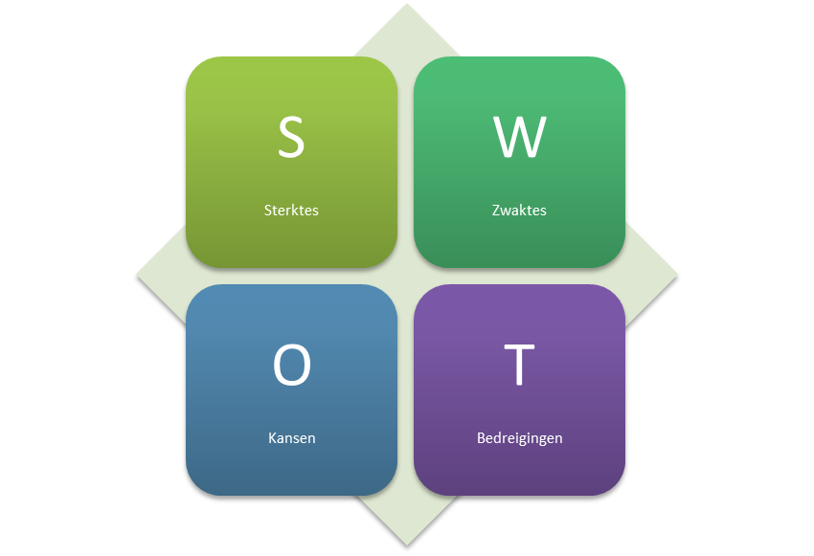
Lafontaine buick gmc
NADA QUALITATIVE ANALYTICS TIME FRAME ANALYZED JULY 2017

Slide 2



Strengths
Strong Technicians
Teamwork
Our People
Excellent Product Support
Excellent Support Staff
Management that steps in and helps
Large store
Technician team leads that help

Slide 3

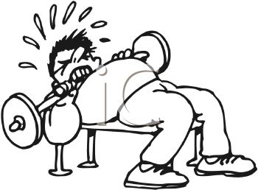

Weaknesses
Low employee morale
Current parking lot situation and finding cars for pick ups.
Obtaining parts
Communication
Not enough support staff
Poor workflow in the shop
Not able to find good new hires
Pay
Follow up
Lack of concern for employees due to focus on Dealer’s well-being.

Slide 4




Opportunities
Show appreciation for employees
More used car business
Improve service lane phone pick up
Higher pay
To gain back customers
Better shop flow
Expand service department
Find more good new hires
Give staff a path to move up

Slide 5



Threats
Hours
Employee burn out
Managers that are fired or moved to other stores
BDC not picking up calls
Wait times for customers
The loss of good staff
Parking lot and lot damage
Lack of work

Slide 6


OBJECTIVES
Employee Morale
Open repair orders over 10 days old
Effective Labor Rate
Single line repair orders
Getting technician staff fully trained
Build a team of customer-centric Service Advisors
Promote from within

Slide 7

Strategies & Tactics
Create fun and competitive work environment through all-inclusive contests that promote production and team work.
Review open repair orders twice a week. Managers split team members to spend more time with individual service advisors to clean up orders.
Divide and Conquer, Split time between technicians and advisors to increase sales through better MPVIS and better explanations to customers.
Weekly review of Advisor and Technician training path and completion to reach overall goal and promote fully trained status.
Revamp our job boards and focus on customer service, servant mentality representatives that can properly take care of our customer base.
Identify career paths for individuals, set clear concise goals, create obtainable metrics for both dollar increases as well as promotions.

Slide 8

Action plan
TASK | BY WHOM | COMPLETION DATE
Employee Morale | Management | 09/30/2017
Open Repair Orders> 10 days | Management/Service Consultants | Ongoing
Increase in ELR/Decrease in 1 line repair orders | Management/Service Consultants/Technicians | Ongoing
Fully Trained Staff | Management/Service Consultants/Technicians | Ongoing
Hire two Service Consultants | Management | 09/30/2017
Create clear promotion paths | Management | 09/30/17

Slide 9

Overview
Our people are what make us great, from our technician leads to our Management team, no one is afraid to step in and assist. We work as a team and have strong technicians and support staff here at our largest store to help make things run smoothly.
One cannot improve without knowing where it’s greatest weaknesses lie. In our case it comes to communication. Communication between departments, through answering phones, shop flow and follow up. This will continue to be a focus for us in the months to come.
Throughout this process we’ve identified our areas of opportunity and it relates heavily to the people we put in the right places. Adding passionate staff members who can properly take care of our customer’s needs, identifying clear paths for our current staff to move up, and creating ways for staff as well as the dealer to make more money.
Through careful consideration, the areas that threaten our success focus on our people and their abilities to perform their job functions at the highest level. Employee burnout due to hours and lack of support are our biggest road blocks. This leads to reduced employee and customer retention.
In summation, we are not sales people, service consultants, or even technicians. We are presentation specialists, we are educators, and our goal is to build relationships that promote healthy business between the consumer and the dealership. We aim to treat employees like they make a difference and in return, they will.

