Slide 1
Starr motors suffolk, virginia
N329-39
Clay White

Slide 2
Advertising and marketing
The advertising for our dealership, especially our parts and service department has not developed into the world that we live in today. We are located in a super rural town and only have the one CJDR store in our group.
I have implemented a menu that the cashier attaches to every RO that is finalized in the accounting office when the customer pays. This shows how we are competitive in our area and helps people actually see the numbers that we are offering for our services. It was just implemented this calendar year 2018 and I hope to get more tracking on how this will help show that we are competitive with all different independent shops locally.
It has actually really helped to give the people a visual on our potential and market our products. In the flyer there it directs people to our website to get coupons and shows our weekly specials.

Slide 3
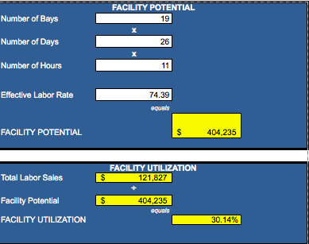
facility
As you can see our labor sales shows we are
very inefficient in how we use our shop effectively
and how we cannot keep our techs happy with the
amount of work for the entire day.

Slide 4
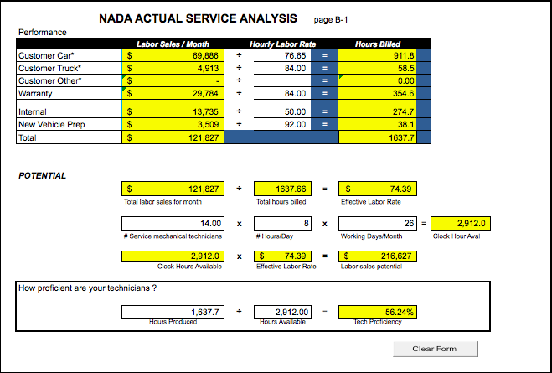
Tech Proficiency
The number is obviously skewed by the way we are set up with the internal rate at 50%, which I have been
Pushing the DP to change but without the internal at 50% we would still be only hovering around 74% for
Tech Proficiency. As of right now we are working through a conventional work load, but trying to change up
the rotations with the helpers and how involved they are with each seasoned tech.

Slide 5
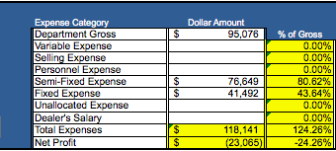
Service department profit(loss) Center
Obviously our expense is outweighing our gross. We need to make incremental changes to our
Processes from the top, down. It is actually embarrassing to see how we can lose money on something
Like labor which we should be grossing 75% on. We are not efficient or productive and
the feuds between our departments need to change.

Slide 6
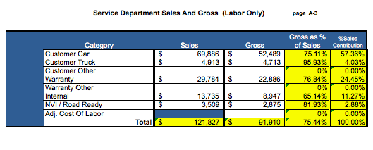
Service department sales and gross
I see a lot of grossing and sales opportunities in the little calculation because you can see how warranty
is grossing very highly and we need to take advantage of the warranties that are out there and call those
customers. Also we can see that we need to make a lot more sales to be where we want to be for
the expenses in the slide prior. We could double customer sales if we had the right plans and
processes in place to exceed customers expectations.

Slide 7
Communication skills
Between our fixed ops departments, we seem to be lacking major communication skills.
We need to come together as a team and it starts from the top. Not everyone can be the head chef in the kitchen especially when a car touches so many different departments when it comes in for service. Our managers need to be on the same page at all times and have open lines of communication and not undermine one another in a spiteful manner.
Communication needs to be the main goal for our dealership this year, because we are struggling without the proper guidelines for communication being set.

Slide 8
Special tools
Literally our specialty tools are right out in the middle of our service lane entrance and close to our customer lounge. I don’t get it!
I have done a lot of organizing and came up with a system so people are help accountable when grabbing the tools that are meant for the entire shop and not just for that one bay.
We have a system where a sticky note has to be placed in the spot where the special tool goes with the name of the tech and the RO that is opened for the use of that tool. It holds each tech accountable for taking the tools so others aren’t wasting time looking/asking for the tool they need to finish the job.

Slide 9
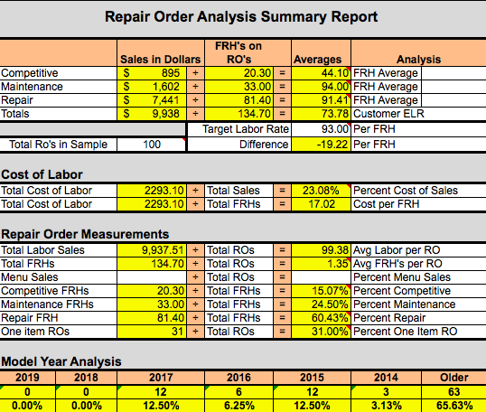
RO Analysis
I really wish we could get our ELR to somewhat match our Target Labor rate which would be above the warranty rate so we could ask for labor rate increases every 6 months to a year. But because of how we have our internal rate right now it will never be close. We have way too many one time repair orders with little to no money being made. We need to change how we market and make sure we do the inspection with the customer right when they walk in the door.

Slide 10
Strengths
We have some loyal customers and customer satisfaction seems to be imperative to our service writers.
We have a very experienced staff of writers and techs that know how to diagnose problems, but are also willing to help the younger and less experienced staff get better and train them
We have a solid space for the work to be done with a off road course for jeep branding.
Our service manager has amazing knowledge of the business

Slide 11
Weaknesses
Lack of professionalism in certain employees, not making the service department a destination in the dealership
Lack of communication between departments
Service hours do not mirror sales hours
Service writers do not schedule work properly to maximize workflow
Huge service/parts/bodyshop disconnect
Employees talking bad about their own business
Lack of productivity in the shop/ lack of pride in the work being done

Slide 12
opportunities
New marketing campaigns
New young employees willing to learn and grow the business
Installing tire display and a covered service drive
Marketing to people in our own back yard aggressively for service
Reaching out to businesses and showing we can work on any make and have a shuttle to and from their work.

Slide 13
Threats
Our entire staff/building/processes are dated. And stuck in their ways. Not willing to change with the times
We lose customers for life in our service department.
Hard to find techs that want to work in our environment with our labor rate being so low
Service doesn't’t try to actually sell, they are just the message man to the customer between the tech.

Slide 14
objectives
Increase ELR
Motivate and clean up the service department as a whole
Increase RO’s written with more than one line
Improve gross on labor sales

Slide 15
Strategies
Make an environment that is pleasant for the customer.
Meet the customers needs in any way possible
Clean up the shop
Every customer gets a complimentary 16 point check with an advisor right when they walk in the door
Track lost sales for parts mix
Shop meeting to boost morale in the shop completely.
Get everyone on the same page in every department

Slide 16
tactics
Parts pricing guides need to be updated
Discounting by writers and countermen needs to be monitored
Advertise service heavily
Change workflow hours
be at the weekly meeting to help boost morale
Eliminate wasted time spent by techs

Slide 17
Synopsis
It is apparent that our parts, processes, and proficiency are what seems to be hindering us from making a profit. We need to start from the top and change our processes in how we deal with our customer base to help boost profitability. We need to change the internal rates and make sure we monitor the lost sales and discounting. Customer service and newly upgraded building could help us to draw more people in the service at convenient hours. Handing out the menu sheet will help to show people some of the things we do with our certified techs. All of these things will help us to reach a better fixed absorption rate and to help cut expenses by grossing our way to new heights. We need to monitor our sales and see how it can change our proficiency when we can schedule techs to keep busy throughout the entire day.

