Slide 1
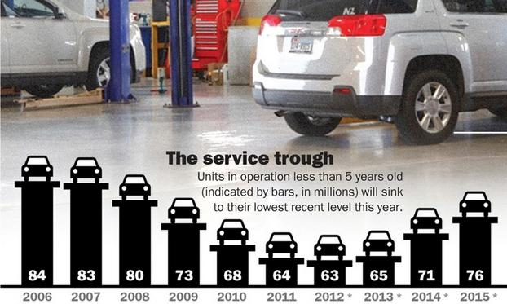
Surviving The Service Trough
Fewer car sales during the slump mean less repair revenue now
“The auto sales collapse that started in 2008 is hitting home in the service department in 2012.
The number of vehicles in operation that are 5 years old and newer will dip to 63 million this year, forecast to be the low point of the industry's downturn and recovery,”
J.D. Power and Associates.
(Source: Automotive News)

Slide 2
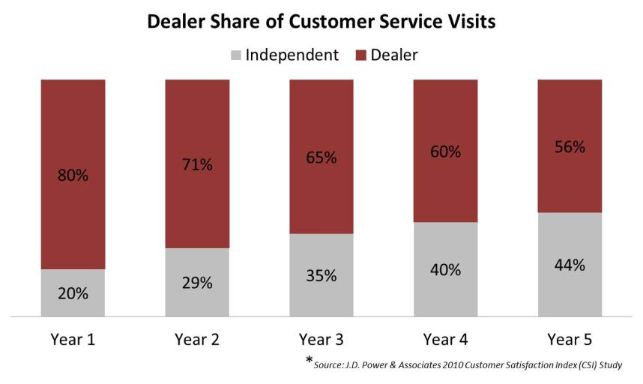
Market Trends – Maintenance & Repair
Notes:
What does this data tell us?
As your customer’s vehicle ages and the dealership opportunity to sell more maintenance and repair is ripe for the picking, but customer’s are defecting to independent repair shops.
With these trends in mind, let me introduce you to ADP ServiceEdge.

Slide 3
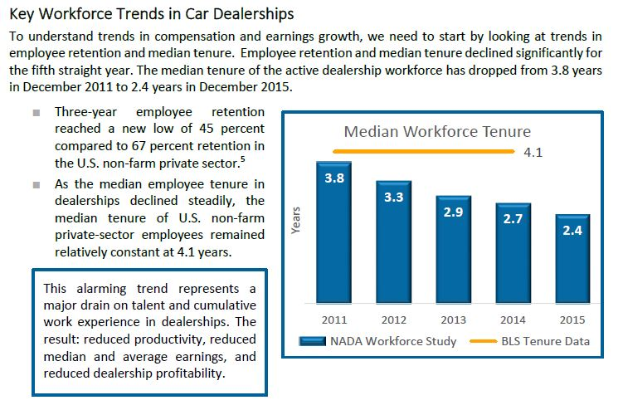
2016 NADA Workforce Study

Slide 4
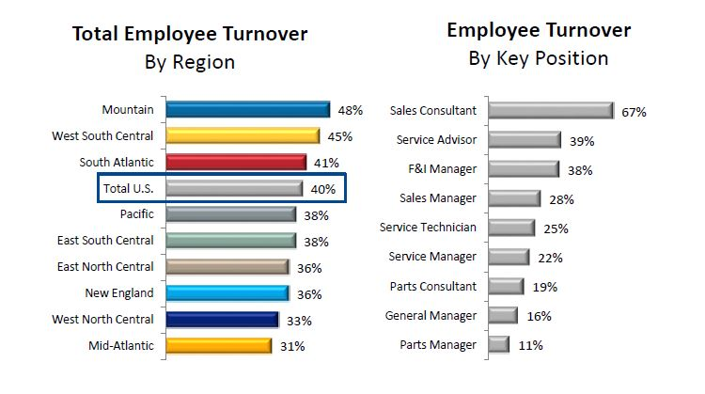
2016 NADA Workforce Study

Slide 5
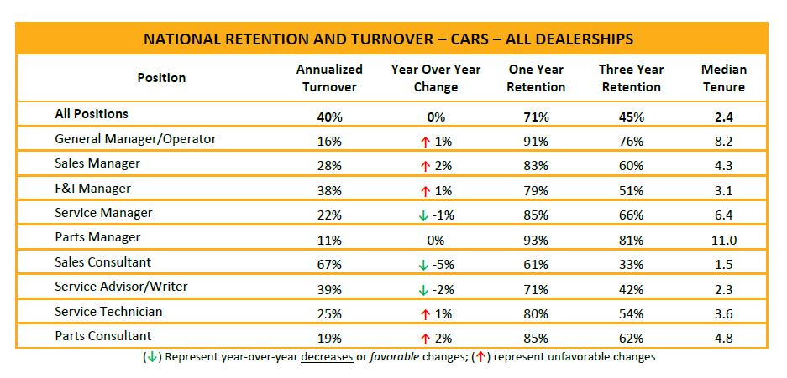
2016 NADA Workforce Study

Slide 6
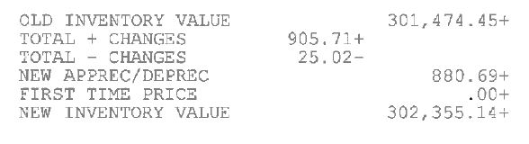
Price Changes from the Manufacturer

Slide 7
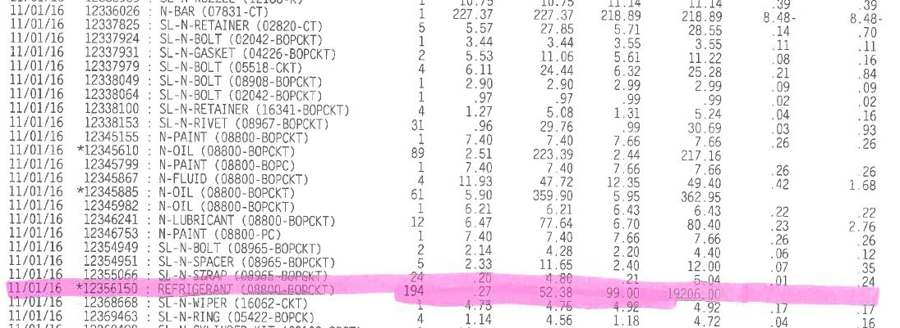
Price Change – Showing Detail

Slide 8
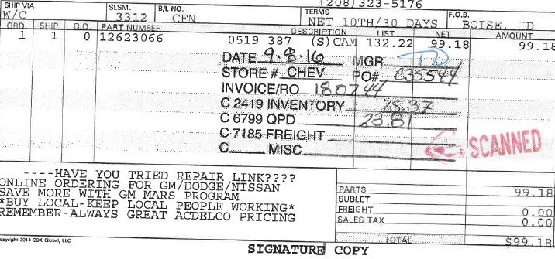
Inventory Stamp
Page 44

Slide 9
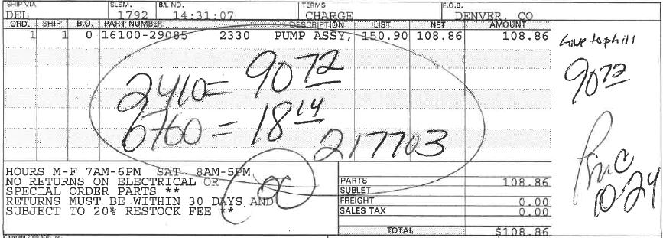
Inventory Stamps - Manual
Page 44

Slide 10
What do Technicians say have the biggest impact on ensuring quality, efficient repairs?

Slide 11
Mix – Benefits to All
Lower parts cost of sale = higher gross profit
Higher Customer & Employee CSI
Faster parts turn rate
Fewer special orders
Pre-owned cars fixed faster
Good technician recruiting tool
Less OBSO
Reduce lot damage
Fewer loaner cars
Fewer emergency purchases
Higher technician “Proficiency”
Page 54

Slide 12
Number one Reason Is . . .
NADA Guide is 120%
(Obtainable but Difficult to Sustain)
Higher Technician Proficiency
  Do you know how much in $ it costs a dealer per minute to have a technician waiting for a part?
___________ ÷ ___________ = ___________
Flat Rate Clock Hours Proficiency
Hours Sold Available per Day
9
8
112%
Page 54

Slide 13

How Much?
$3.33 per minute…
Page 54

Slide 15
Traditional Phase-In

Slide 16
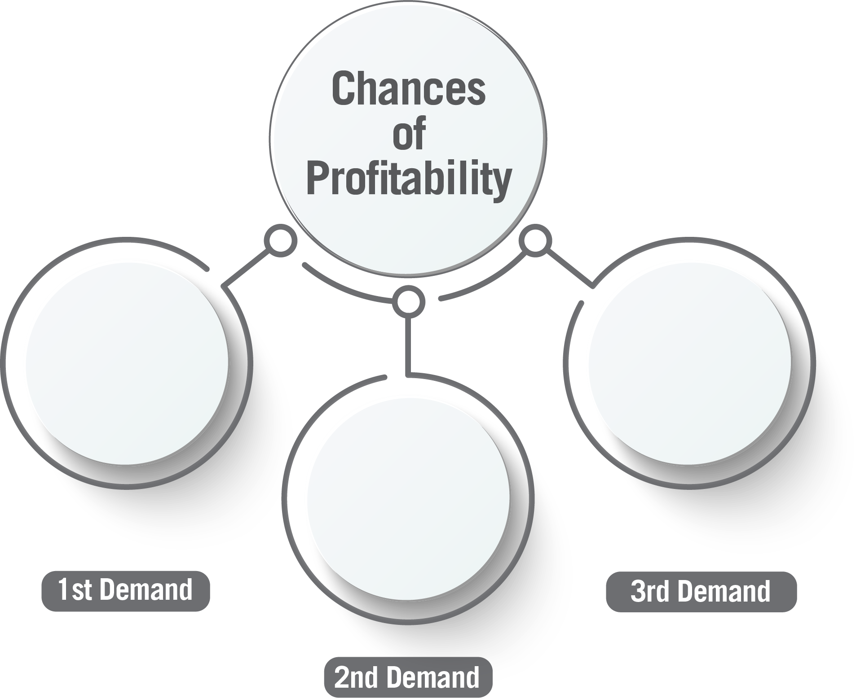
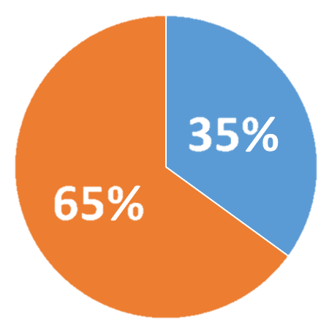
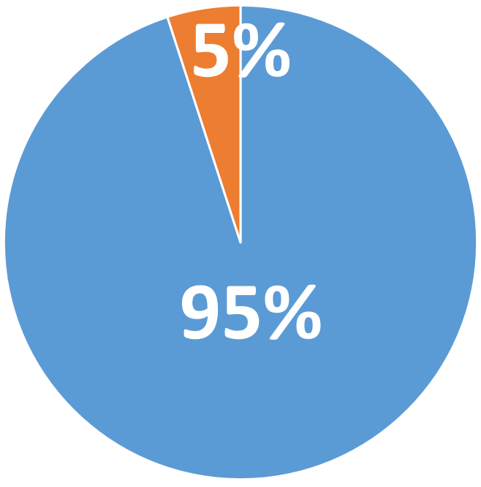
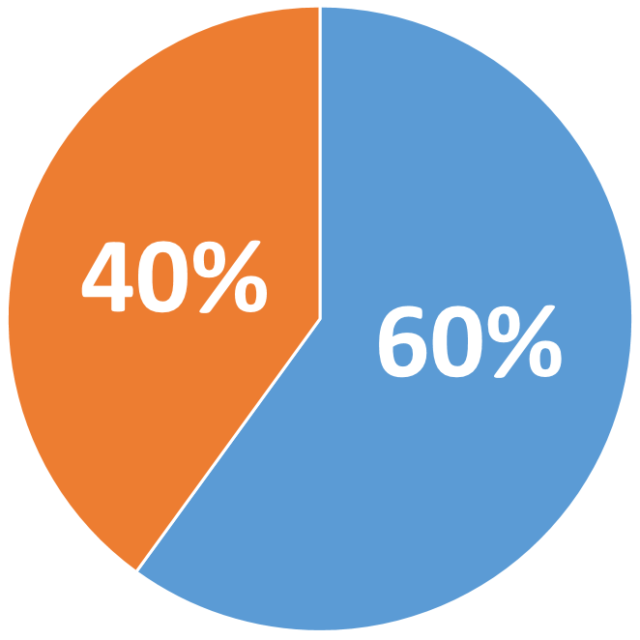
(FC)
(P)
(FC)
(P)
(FC)
(P)
Becomes Profitable (P)
Becomes Frozen Capital (FC)

Slide 17
When Stocked at the 1st Demand
17
Notes:
___________________________
___________________________
___________________________
___________________________
___________________________
___________________________

Slide 18
When Stocked at the 2nd Demand
Notes:
___________________________
___________________________
___________________________
___________________________
___________________________
___________________________

Slide 19
When Stocked at the 3rd Demand
Notes:
___________________________
___________________________
___________________________
___________________________
___________________________
___________________________

Slide 20
Inventory Profile
0 – 3 Months
45-65%
85%
4 – 6
15 - 30%
Probability of selling a part > 9 months old is only 15%
7 - 12
>12
< 5%

Slide 21
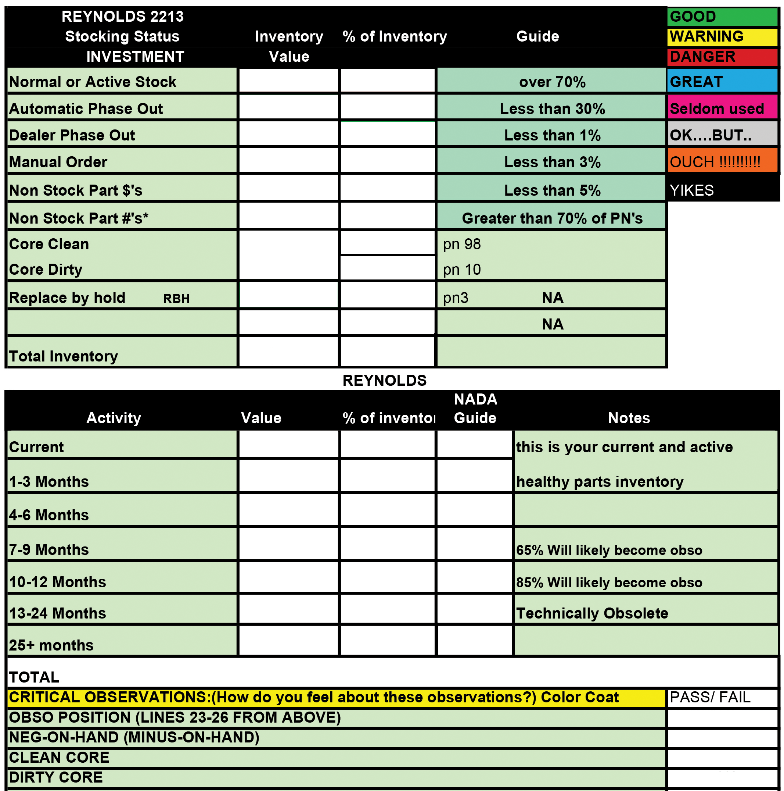
Reynolds & Reynolds DMS Scorecard
Page 84

Slide 22
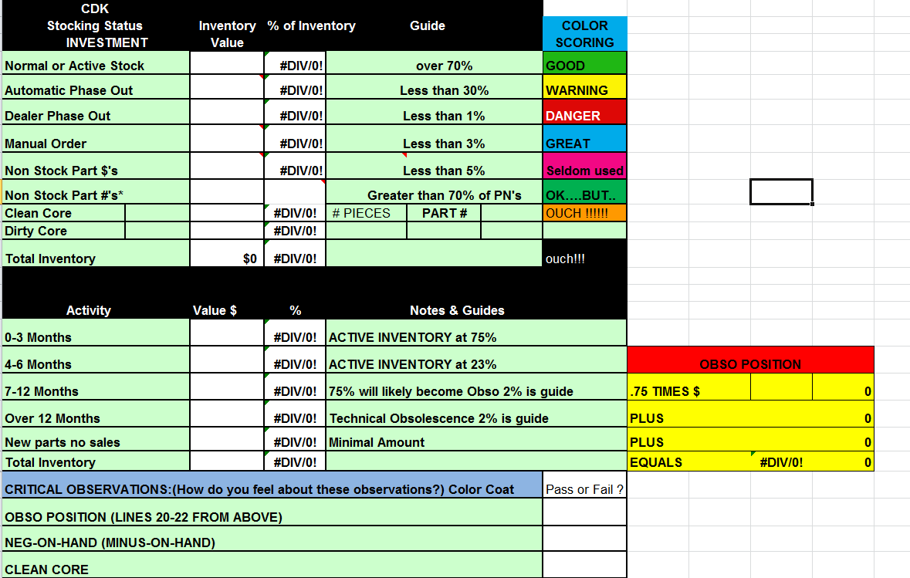
CDK DMS Scorecard

Slide 23
Parts Best Idea #1
Save an RO Meeting
  Parts & Service Manager
  Everday!
  Call Unsold Quote Customer and ask why?
  Learn from it
  Change something

Slide 24
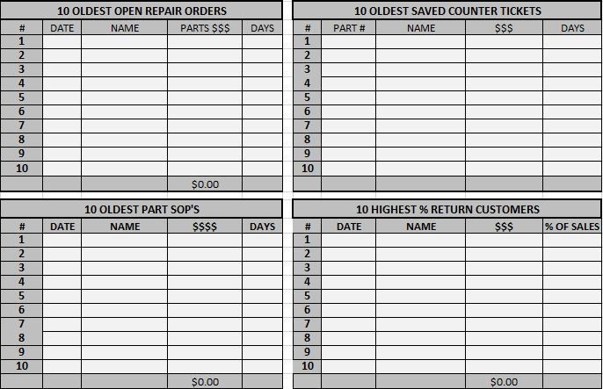
Parts Best Idea #2
Parts Oldest 10 – Hot Sheet

Slide 25
Parts Best Idea #4
Create a Google Doc for Special Order Parts (SOP’s) that is accessible to the General Manager, Parts - Service Managers, Counterpeople, and Advisors (add more if needed) and that can be updated with notes
  SOP Parts that arrive in the current week are highlighted in Green.
  If they’ve aged a week highlight them in Yellow.
  If they’ve aged two weeks highlight them in Red.
  General Manager/Dealer Principal gets a Hot Sheet copy of any red SOP parts

Slide 26
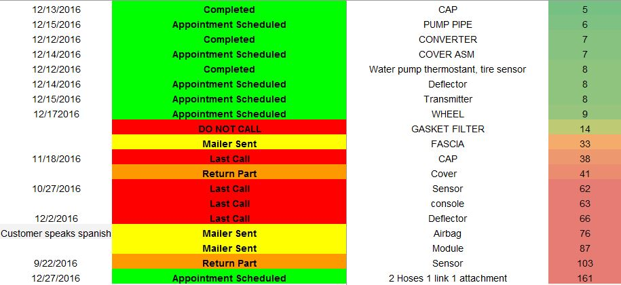
Parts Best Idea #4

Slide 27
Parts Best Idea #5
The 500 Rule
In order to reduce errors in diagnosing and being stuck with wrongly ordered parts. Before ordering any part over $500.00 (cost) from the shop, the Parts manager confirms the part to see that it is correct and the Service Manager will review the diagnostic process with the technician to certify that that part is needed for the repair.

Slide 28
Other Parts Best Ideas
Buy 3-5 Pizzas for your top three Wholesale accounts each month.
Charge an annual fee upfront (especially for your yellow and red light customers) for free shipping (Amazon Prime).
Bonus bogey for parts counter people when the shop attains a 100% productivity level
Contact your wholesale dist. to take back slow moving parts in exchange for fast moving parts.

Slide 29
Other Parts Best Ideas
Buy 3-5 Pizzas for your top three Wholesale accounts each month.
Charge an annual fee upfront (especially for your yellow and red light customers) for free shipping (Amazon Prime).
Bonus bogey for parts counter people when the shop attains a 100% productivity level
Contact your wholesale dist. to take back slow moving parts in exchange for fast moving parts.

Slide 30
Thank You!
Mark Michalski
Management Instructor
NADA Academy - Fixed Operations
443-801-6678 cell
mmichalski@ nada.org

