Slide 1
How to Use

Slide 2
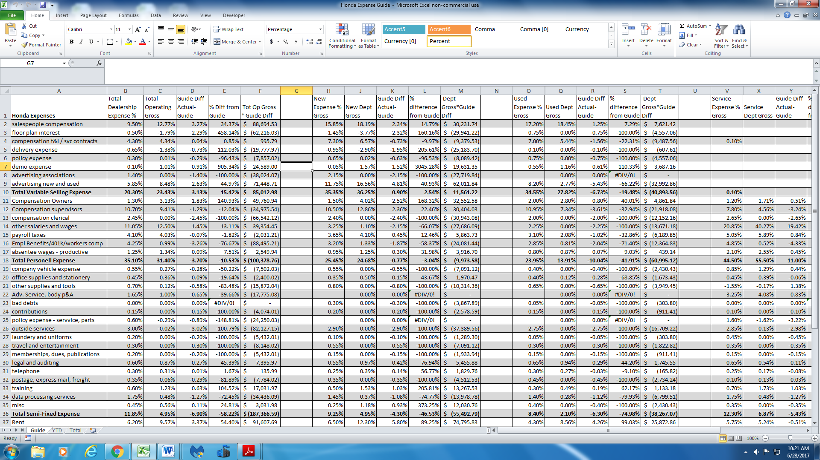
Guide Tab: This sheet is already formatted to print. No inputs are made on this page.
Guide Categories and Values
Category as a % of Total Operating Gross: This is your store’s value
The difference between your store and the Guide
% difference between your store and Guide. Ex. We are 3.27% above guide, but that number is 34% higher than guide. Provides a relative value for correlation
Calculates what it costs or saves your store based on over/under guide. Ex. Being 3.27% above guide costs us and extra $88,000 vs being at guide.
DO NOT MAKE ANY INPUTS ON THIS PAGE. ALL VALUES ON THIS PAGE ARE CALCULATIONS OR REFERENCES FROM OTHER TABS

Slide 3
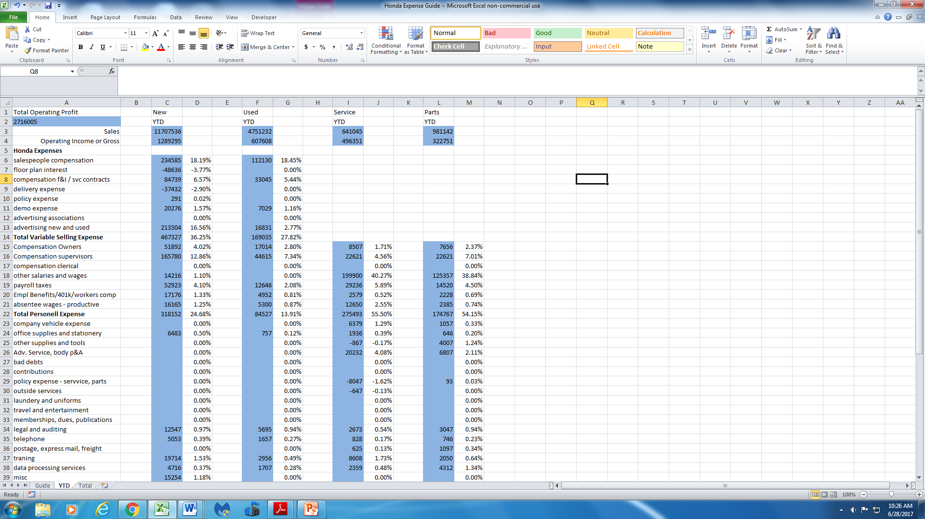
YTD Tab: Place your store’s numbers in the blue shaded areas only. This tab is for each department. Also to remember to do this on the Total tab which is the store’s totals. It’s a little clunky but I’d already done everything and didn’t want to redo formulas, etc so I left it.
Total Operating Profit is on page 2 & 3, line 13. If you use gross the numbers will be skewed.

