Slide 1

Every Day is a Giveaway

Slide 2
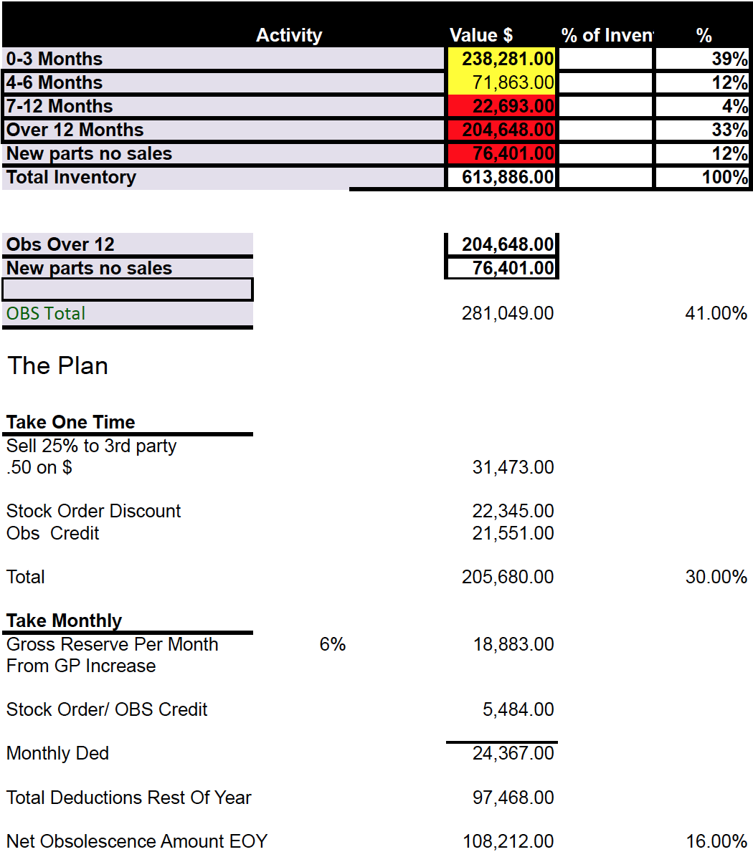
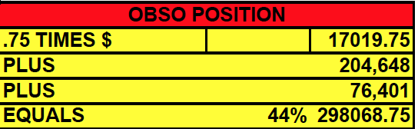
WHAT A MESSSSSSSS?

Slide 3
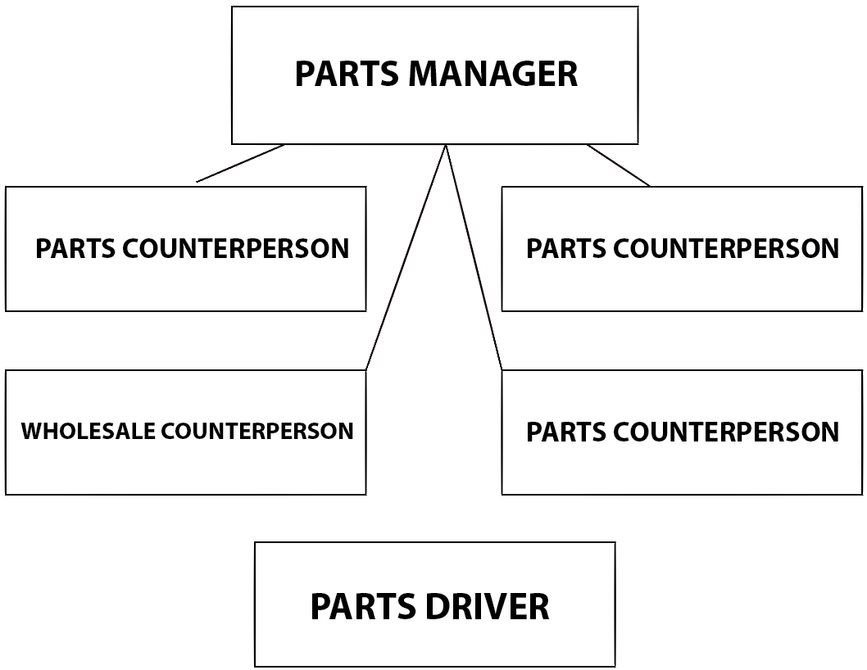

Slide 4
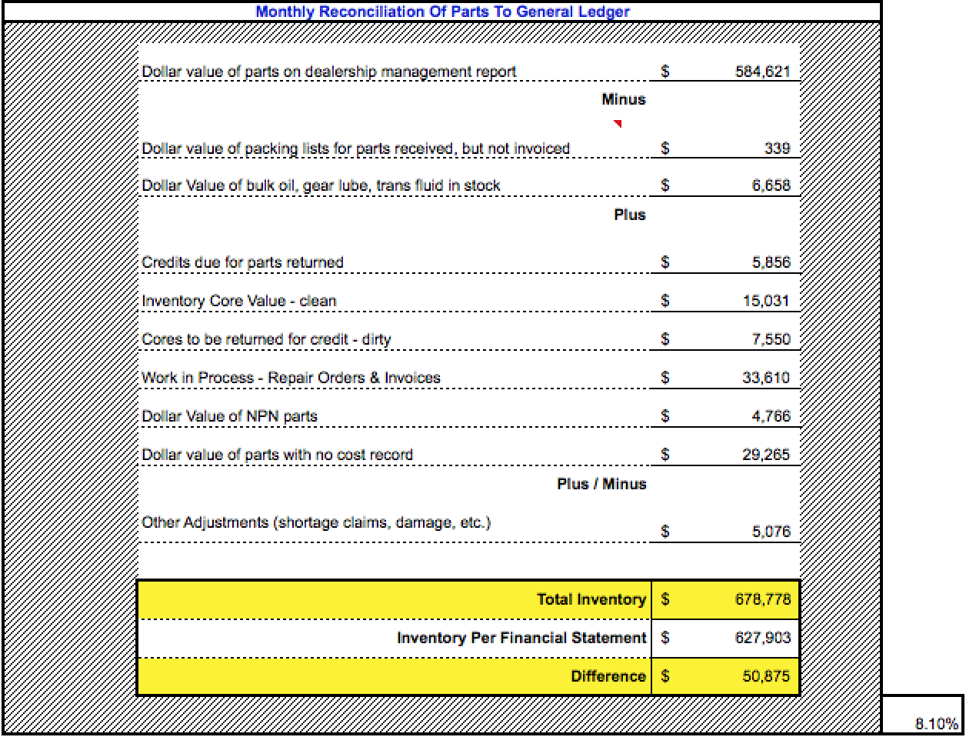

Slide 5
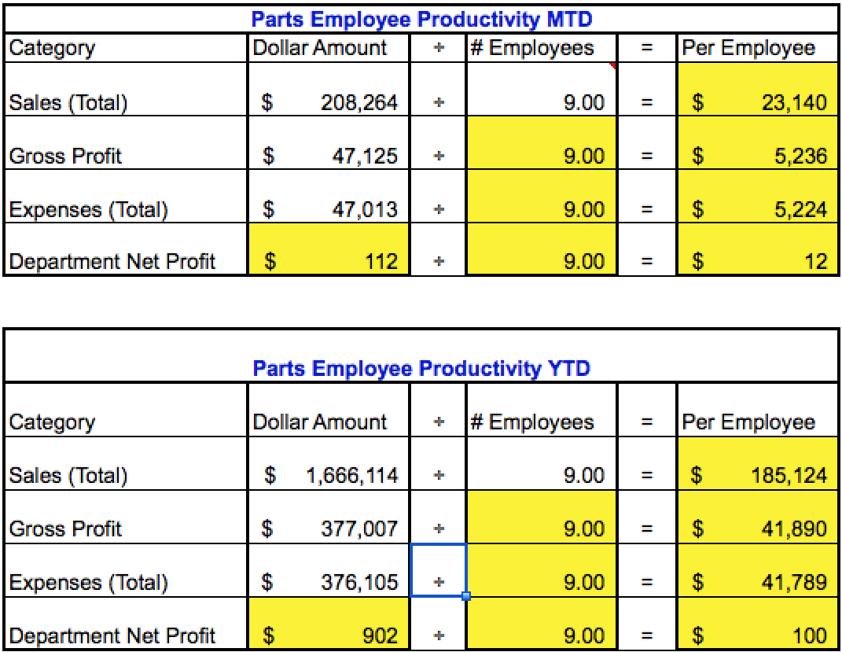
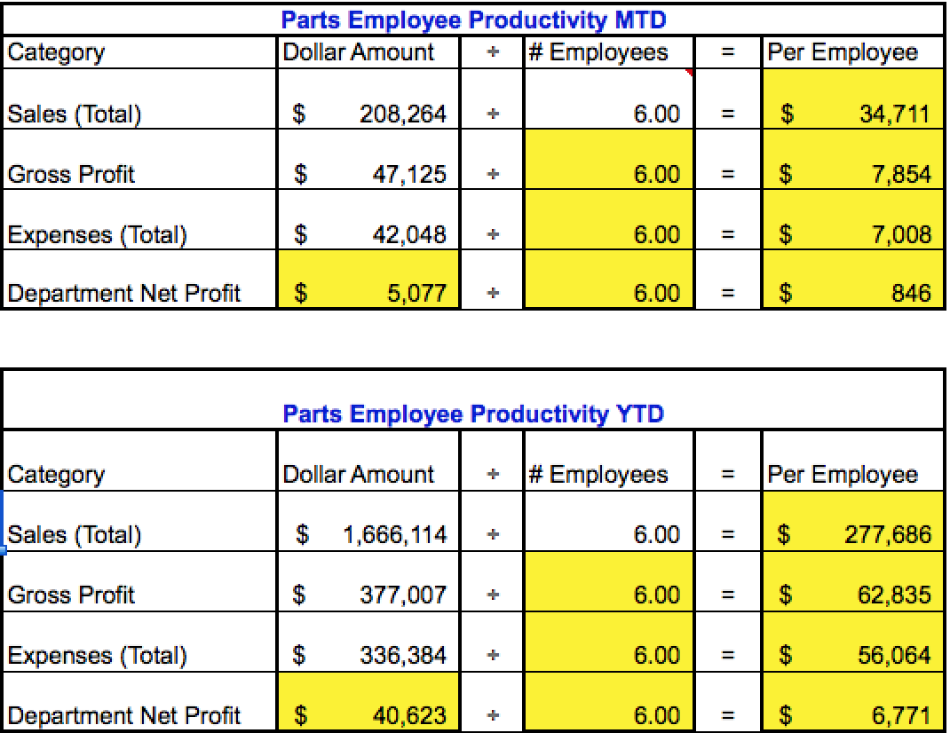
NADA guide: Parts employees should
generate $40k/Month. Currently our 9
Employees are generating $23k/month.
Dilemma:
Our countermen are not generating enough
revenue because WE ARE OVERSTAFFED!
Solution:
We cut 3 parts employees.
Effect:
Salespeople generate: $41,653(MTD) $333,223(YTD)
Expenses decrease: $4,965(MTD) $39,721(YTD).
Net profit increases: $4,965(MTD) $39,721(YTD).
Gross Profit – Department net =
Total Expenses: $377,007 - $902 = $376,105
Total Expense – Personnel Expense =
Fixed Expense: 376,105 – 119,065 = $257,040
Fixed Expense + Employee Expense for 6 employees =
Total Expense w/ 5 employees: $257,040 + $(1,653 * 6 = 9918 * 8) = $336,384

Slide 6

$61000.00 sold at cost ??????
REASONS:
High % of Obsolescent parts
Discounting
Poor Inventory control
Incorrect Mix of parts
Failure to report lost sales
Poor SOP process
Excessive Returns
Benefits:
Free frozen capital
Increase customer base
Negatives:
No return on investment
Missed opportunity

Slide 7
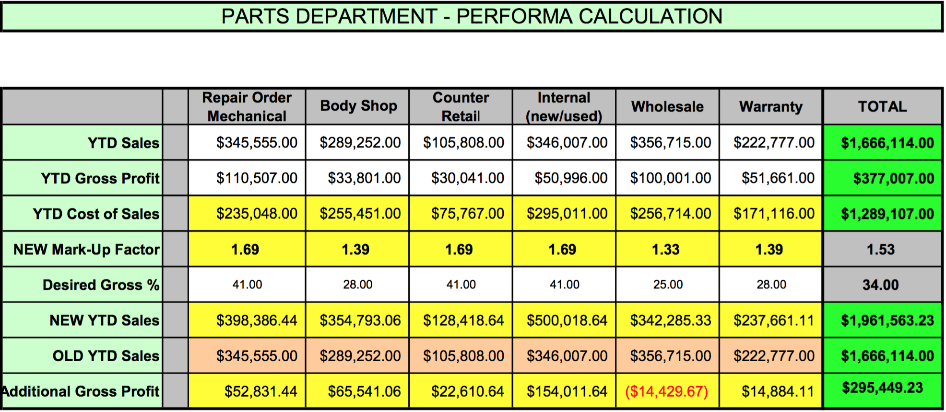
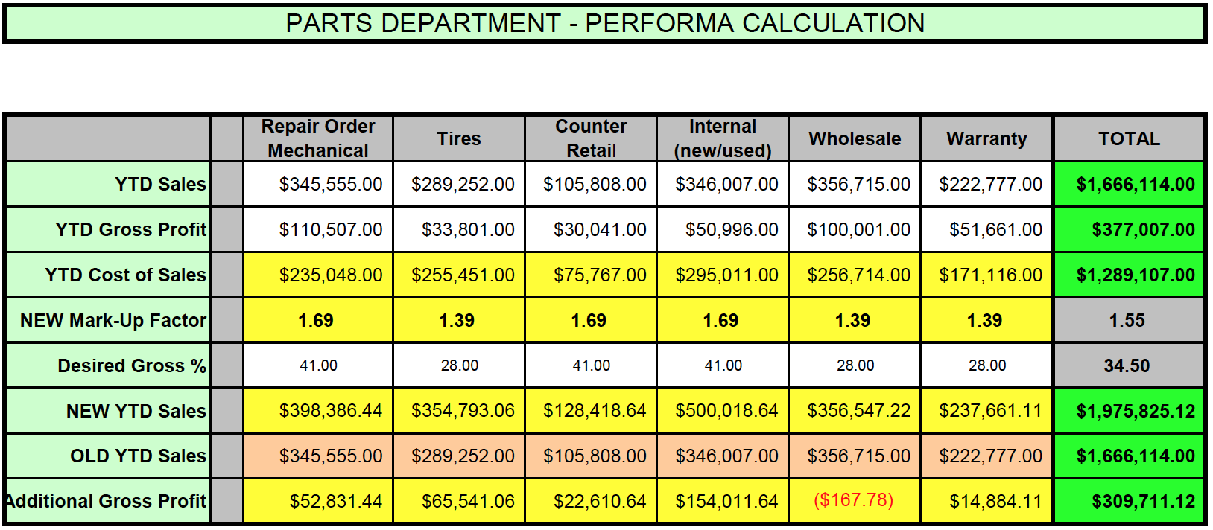
Gross Profile increases our gross profit
In all areas except Wholesale where we
exceeded profile.
DESIRED GROSSSSSSSSSSSSSS
100 – DGP = X
100/X = Markup Factor
We bump our Wholesale
desired Gross up so we don’t take
as huge of a loss.

Slide 8
Every Day is a Giveaway

