Slide 1
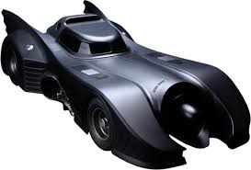
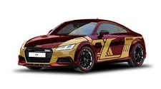

Marvel Motors
Adam Stein
John Stanko
John Guido
Alper Simsek Anthony Benfatti

Slide 2
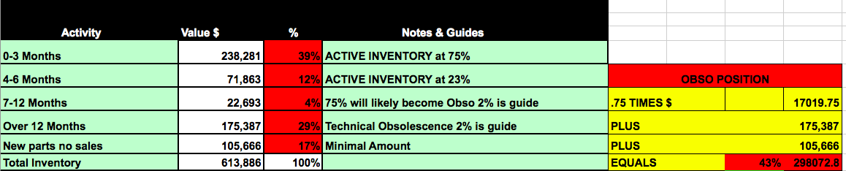
Obsolescence
43% OF TOTAL RECONCILED INVENTORY IS OBSOLETE, WHICH IS EQUAL TO $298,072.80
How We Got It
How To Get Rid Of It
Poor stocking criteria
(BSL/BRP)
(Phase in/Phase out)
Un-used Obsolescence Credits from factory
Wholesale Returns and Un-installed SOPs
Wrong parts ordered by technicians
Not tracking lost sales. Likely operating off speculation
Change Stocking criteria phase In 3/12
Use factory return credit accumulated
Order parts heavily on stock orders to gain more return allowance
Put together E-commerce program to help get rid of obsolete parts
Put “j” in front of bin location in DMS to not lose sale over price.
Pint, circle, sign for all SOP parts
Trade Obsolescence files with other dealers
Send flyers to wholesale accounts

Slide 3

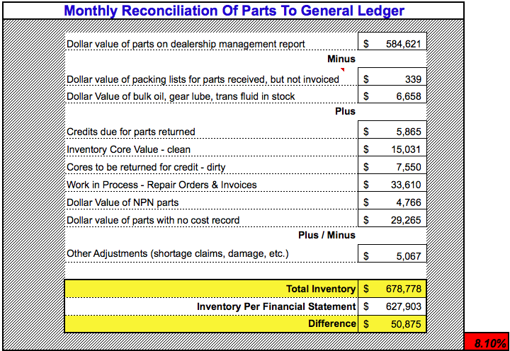
Monthly Reconciliation

Slide 4




Employee Chart
Parts Manager
Assistant Parts Manager
Front Counter
Back Counter
Back Counter
Wholesale
Parts Counter Staff
Parts Drivers/Runners

Slide 5

Employee Strategy
Retain All 9 Employees
Parts Manager Will Track Lost Sales
Reduce High Days Supply by 50% to 46 Days
Reduce Low Days Supply by 50% to 33 Days
Asst. Parts Manager will:
Train Staff Phone Skills
Train Staff on DMS Use
Improve Department By:
Increasing Prices
Internal Rate increase by 26.3%

Slide 6
Pros & Cons of Selling At Cost
Pros
Cons
Relieves obsolescence
Free up frozen capital
Could be a multi-point location selling off to other stores at cost and letting those stores make the money
Loss of profit opportunity

Slide 7

61k Sold At Cost - Why?
Service Director and Parts Manager don't have the eye on the ball
Trying to sell down aged or non-refundable inventory
No plan for dealing with obsolescence
Not doing bin count: Theft
Poor mix from failing to track lost sales
Too many emergency orders
Employees making deals with friends
Bad matrix in DMS for profit by category
Phase in and phase out are off guide
CSI – Improving Customer Satisfaction

Slide 8
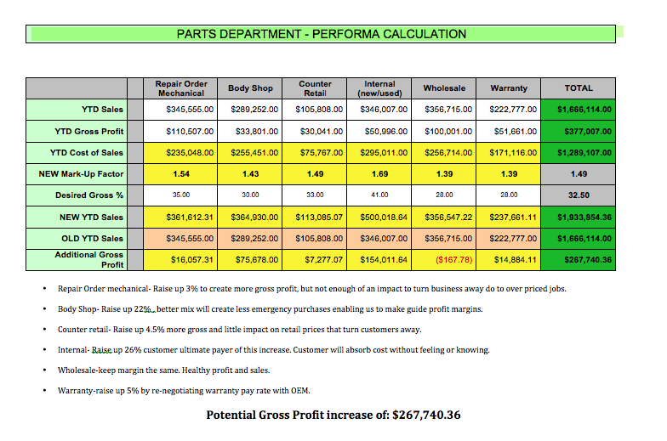
Gross Profile

Slide 9


