Slide 1
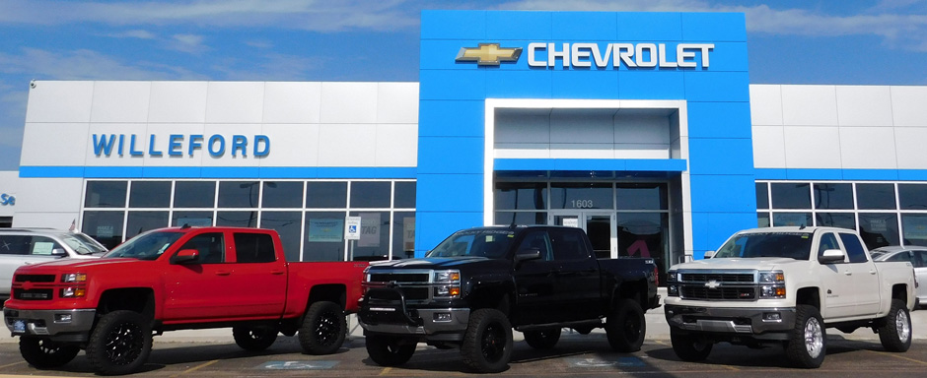
BAD NEWS BEARS
BAD NEWS BEARS

Slide 2
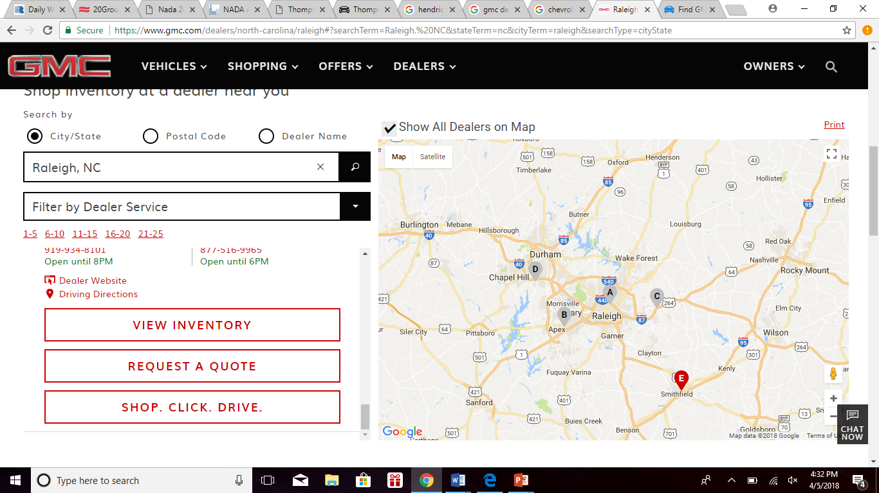
Who’s in our Market?
Who’s In Our Market
5 GMC Dealers

Slide 3
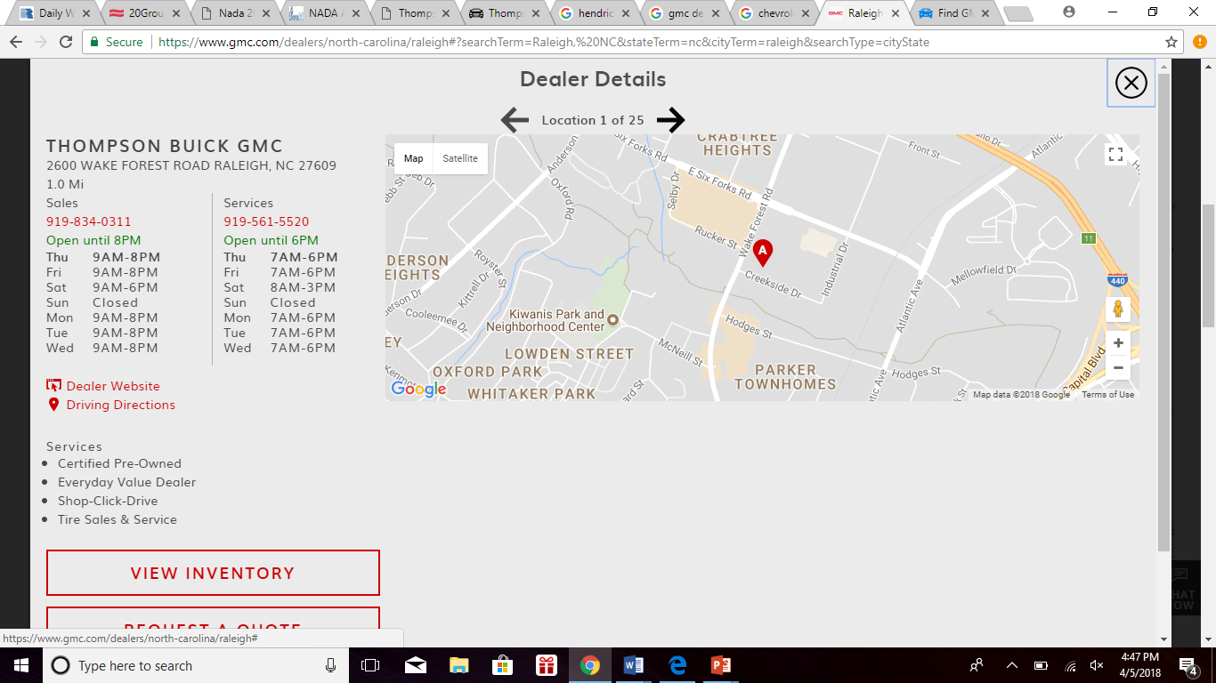
Evaluate the Competition: Thompson Buick GMC
Our New Hours:
Service: 7am-6pm
Sales: 9am-8pm

Slide 4
NEW CAR INVENTORY:
Strengths -Gross as a % of sales above guide (6%) -PVR $2,504 | Weaknesses -Aged Vehicle Inventory (over 100 vehicles +180 days) -Low PRU on F&I ($573)
Opportunities -Introduce Menu Selling F&I -Address new car aged inventory with Spiff/Bonus plan ($5000 if they can sell ½ in November, ½ in December) -Put 20% into loaner vehicles | Threats Model year turn over No rebates No leasing Uncertainty of Incentives

Slide 5
PRE-OWNED VEHICLES
Strengths -Above GP Guide (14%) -Strong front end gross (Average PVR $3,944) | Weaknesses -Aged Inventory (140 vehicles over 60 days) -Poor F&I Penetration -Floor plan on used car inventory (almost $4 million) -Frozen capital
Opportunities -Faster Turn Using 60 day turn policy with continued evaluation -List on O.V.E & Smart Action -Reduce Pricing market +100 days -Spiff sales team -Fresh start Jan 1st -Bring in Professional F&I vendor | Threats -Aging inventory threat to cash flow

Slide 6
FIXED OPERATIONS
Strengths -78% fixed absorption | Weaknesses -GPI for Service 62.6% (Should be 73) -GPI for Parts 29.6% (Should be 38)
Opportunities -Service at guide would be $453,895 -Parts +$629,302 in gross profit = Total improvement over $1million!!! -Review all KPIs and operations for service -Raise door rate ($125) -Review and curtail discounting -Raise internal labor rate to $125/hour -Maximize REM return on rolling 15 month basis -Reduce sublet to help increase in house gross profit (only service manager) | Threats -In jeopardy of losing warranty rate of $90 -Wrong parts in inventory

Slide 7
GENERAL OVERVIEW
Strengths 78% Absorption fixed operations (Guide is 60%) 136% Total Absorption (Guide is 100%) | Weaknesses -Trending losses (September and October)
Opportunities -Hours of Operation -Review and correct compensation -$4.2 million gap between operating profit and net income --Service at guide would be $453,895 -Parts +$629,302 in gross profit = Total improvement over $1million!!! | Threats -Cash poor -High current (over a million due to trade creditors)and accrued liabilities (over 860$ due in salary and wages) -Major threat for write offs, incentives, rebates, and F&I reserve -Pre-paid expenses that haven’t been expensed yet

Slide 8
Re-brand!!!
RE-BRAND:
WINNING TEAM

