Slide 2
Irrigation Unit 9 – Crop Production and Marketing Lesson 9.1 Tools of Plant Production
Principles of Agricultural Science – Plant
Notes:
This is an overview of common machinery, tools, structures, and equipment used to establish, harvest, and haul crops.

Slide 3
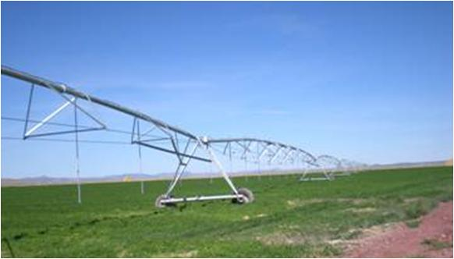
Irrigation
Three main types of irrigation:
Flood
Furrow (a type of flood irrigation)
Overhead
Drip
Notes:
You will be investigating each of these methods and listing the advantages and disadvantages for each in Activity 10.1.3 Irrigation Brief.

Slide 4
Examining the Methods of Irrigation
The selection of the irrigation method will depend upon the type of crop.
Flood – field crops, some greenhouse container crops
Overhead – most common, found in all types of production systems
Drip – used extensively in nursery and landscape
Notes:
This slides provides you with some limitations for the use of each method. You will research more limitations during your search for information in Activity 10.1.3 Irrigation Brief.

Slide 5
Goals of Irrigation
The goals of a irrigation are to:
Provide the appropriate amount of water.
Prevent overwatering.
Prevent water waste by targeting root zone.
Limit loss of water to evaporation.
Prevent excess water runoff causing erosion and pollution.
Notes:
No matter the method of irrigation that is used, conservation of water is the key. Today sophisticated computer controlled irrigation systems are used to apply only the necessary amount of water to certain areas of the field or greenhouse based on the plant needs. As water resources become more limited in the future, technology will be needed to prevent waste.

Slide 6
References
Parker, R. (2010). Plant and soil science: Fundamentals and applications. Clifton Park, NY: Delmar.

