Slide 2
Greenhouses Unit 9 – Crop Production and Marketing Lesson 9.1 Tools of Plant Production
Principles of Agricultural Science – Plant
Notes:
This is an overview of environmentally-controlled structures commonly used to produce crops.

Slide 3
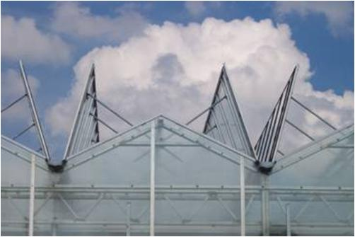
Greenhouse Structures
Greenhouses create an artificial environment for growing plants.
A greenhouse will provide optimal
Light
Temperature
Notes:
Greenhouses are used to grow plants in a controlled environment that will allow crops to be grown outside of their seasonal cycle or hardiness zone.

Slide 4

Greenhouses
Greenhouses work by
Storing heat and slowing the loss of heat to the atmosphere.
Trapping light radiation causing warmer temperatures.
Notes:
The skin of a greenhouse or the “glazing” works to trap light radiation and gasses.

Slide 5
Greenhouse Construction
Materials used for greenhouse skins:
Acrylic sheets
Good insulation, high light transmission, expensive
Fiberglass sheets
Discolors after 7 - 10 years, poor insulation
Glass
High light transmission, long life, expensive
Polycarbonate sheets
High light transmission, durable, good insulation
Polyethylene (rolls of flexible plastic)
Short life, not durable, inexpensive
Notes:
These are the common products used for glazing on a greenhouse. Note how each has advantages and disadvantages. It is up to the individual producer to determine the material that works best for their operation and budget.

Slide 6
Greenhouse Equipment
Benches
Circulation fans
Cooling and ventilation fans
Heaters
Propane or natural gas
Irrigation systems
Lighting
Shade cloth
Notes:
Some greenhouses are called cold frames. These greenhouses do not have heaters and rely on the stored heat in the ground below the greenhouse to maintain warmth overnight when no light radiation is available. Heating devices and fuel to operate heaters are very expensive.

Slide 7
References
Parker, R. (2010). Plant and soil science: Fundamentals and applications. Clifton Park, NY: Delmar.

