Slide 2
Microscopic Pests
Unit 8 – Surviving a Harsh Environment
Lesson 8.2 Diving into Diseases
Principles of Agricultural Science – Plant
Notes:
This presentation introduces students to disease-causing agents, symptoms of infection, types of prevention, and treatment.

Slide 3
Disease-Causing Agents
Plant diseases are caused by:
Bacteria
Fungi
Viruses
Notes:
These three disease-causing organisms will be discussed in the next few slides.

Slide 4
Bacteria
Single-celled organisms
Cell membranes
Reproduce through division
Often spread between plants by insect vectors
Can multiply very quickly
Notes:
Bacteria are single-celled organisms found nearly everywhere on earth. There are hundreds of species of bacteria and several major types that cause damage in living plants. Bacteria belong to a different kingdom than plants.

Slide 5
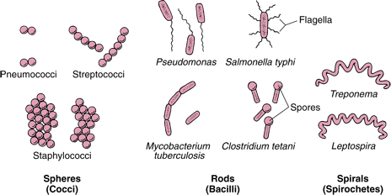
Bacteria
Image: Merck Manual.
Notes:
Bacteria are single-celled organisms found nearly everywhere on earth. There are hundreds of species of bacteria and several major types that cause damage in living plants.

Slide 6
Fungi
Reproduces via spores
Examples are mushrooms, yeast, and mold
Spread from plant to plant through the transfer of spores
Notes:
Fungi are part of a different kingdom than plants. Fungi will typically grow on decaying tissue, but some species will attack live plants.

Slide 7
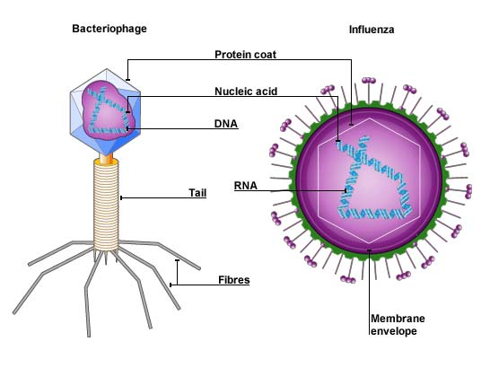
Viruses
Extremely small
Submicroscopic and Sub cellular
A particle containing RNA or DNA
Require a host cell
Carried by insects, nematodes, and air
Image: BBC
Notes:
Viruses are extremely small organisms that can reproduce quickly and spread throughout. Viruses are not always recognized in the classification system, but when they are, they are categorized into their own kingdom. Viruses are NOT free-living; this means that viruses cannot reproduce or carry on metabolic processes without a host cell.

Slide 8
Symptoms of Infection
Bacteria
Cause gall, spots, and scabs in plants
Fungi
Cause rust, smut, mildew, and rot in plants
Viruses
Cause plant stunting, flower break, and yellowing
Notes:
These are common physical symptoms to look for to detect disease problems. Typically, if a plant is showing signs of abnormal growth they are suffering from a disease or growth requirement deficiency.

Slide 9
Disease Control
Prevention
To take measures to keep diseases from occurring or invading
Treatment
To perform a practice or add a substance to eliminate a disease agent or reverse the effects of a disease
Notes:
The types of control is prevention and treatment. Both are needed in plant production operations to limit the damage caused by diseases.

Slide 10
Methods of Prevention
Clean growing conditions
Quarantine new plant material
Regular preventative chemical applications
Keep plants healthy and stress free
Manage insects and animals
Crop rotation
Notes:
It is important to have a good insect control plan to minimize the spread of diseases. Quarantine means to keep new plant material isolated from other plants for sufficient time to ensure the new plant material has no signs of disease that could spread to the rest of the plant stock.

Slide 11
Types of Treatments
Chemicals
Environmental conditions
Notes:
Some diseases are brought on by and continue to infect plant material only if environmental conditions are adequate for disease agent growth. Knowledge of the specific pest will help you to create a management plan.

Slide 12
References
BBC. (2014). Bitesize: structure of viruses. http://www.bbc.co.uk/bitesize/higher/biology/cell_biology/viruses/revision/1/
Levison, Matthew E. (2008). Overview of bacteria. Merck manual. http://www.merckmanuals.com/home/infections/bacterial_infections/overview_of_bacteria.html
Parker, R. (2010). Plant and soil science: Fundamentals and applications. Clifton Park, NY: Delmar.
Schooley, J. (1997). Introduction to botany. Albany, NY: Delmar Publishers.

