Slide 2
Plant Pests Unit 8 – Surviving a Harsh Environment Lesson 8.1 Pesky Bugs and Plants
Principles of Agricultural Science – Plant
Notes:
This presentation is an overview of the pests that damage plants. A brief list of ways pests damage plants is provided as well as a list of methods for control.

Slide 3
Plant Damage
How can pests cause negative effects on plant growth, production, and overall health?
Take away resources
Eat plant tissue
Eat seeds and fruit
Bore holes
Remove fluids
Retard growth
Degrade plant tissue quality
Disrupt metabolic processes
Others?

Slide 4
Observe, Diagnose, and Prevent
Plant damage is easy to mitigate with knowledge of:
Pest types
How pests cause damage
How to eradicate or deter pests
Pest life cycles

Slide 5
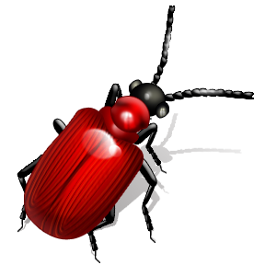
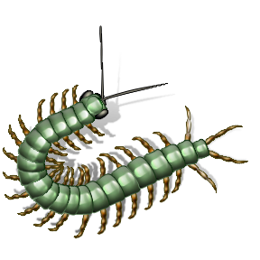

Types of Pests
Insects
Mollusks
Nematodes
Vertebrates
Weeds
Disease Agents

Slide 6
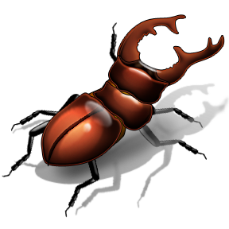
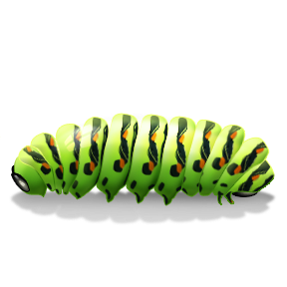
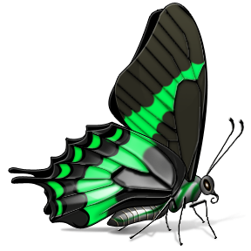
Insects
Different kinds of insects have different eating habits:
Chewing
Sucking
Boring

Slide 7
Mollusks and Nematodes
Mollusks include snails and slugs
Nematodes – soil-borne wormlike organisms

Slide 8
Vertebrates
Vertebrates include birds and rodents

Slide 9

Weeds
Hinder target crops by competing for water, space, light, and nutrient resources.
Undesirable plants, sometimes simply growing in the wrong place at the wrong time.

Slide 10
Disease Agents
Bacteria, viruses, and fungi
Although plant disease agents are organisms and considered pests by definition, they hold a special distinction that will be examined more closely in Lesson 8.2 Diving into Diseases.

Slide 11
Methods of Pest Control
Biological
Lady bugs and parasitic wasps
Chemical
Herbicides, pesticides, and repellents
Cultural Practices
Crop rotation, clean equipment, and quarantine
Physical/Mechanical
Cultivators, hoes, and mowing

Slide 12
References
Lee, J. (2003). Introduction to plant and soil science and technology. Danville, IL: Interstate Publishers, Inc.
Parker, R. (2010). Plant and soil science: Fundamentals and applications. Clifton Park, NY: Delmar.
Reiley, H. E., & Shry, C. L. (2007). Introduction to horticulture (7th ed.). Clifton Park, NY: Delmar.

