Slide 2
All about Bugs Unit 8 – Surviving a Harsh Environment Lesson 8.1 Pesky Bugs and Plants
Principles of Agricultural Science – Plant
Notes:
This is a closer look at insects and how knowledge of the life cycles of insects can assist with controlling them.

Slide 3
Insects Plight
Insects cause billions of damage to plant crops each year.
They are the single greatest cause of financial loss for crop production.

Slide 4
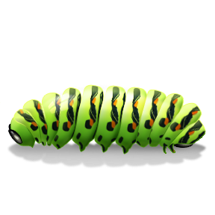
Breaking the Cycle
When controlling plant pests, knowledge of pest life cycles is vital.
Pests become a threat at certain stages of their life span.
Pests are sometimes best controlled at certain stages of their life span.
Eliminating a pest before reproduction is vital to population control.
Notes:
When evaluating plant damage and making decisions to control pests, you must consider the life cycle of the pest.

Slide 5
Insect Metamorphosis
As insects go through stages of development from eggs to an adult, their transformation is called metamorphosis.
Two types of metamorphosis:
Incomplete
Complete
Notes:
Insect life cycles must be understood because of metamorphosis. Insects can be completely different in shape, size, eating habits, and structure due to metamorphosis.

Slide 6
Incomplete Metamorphosis
Also known as gradual metamorphosis:
All stages have the same eating habits
Example: Grasshopper Transformation
Egg → Early Nymph → Late Nymph → Adult
Notes:
Incomplete Metamorphosis is not as critical for producers to follow because eating habits stay the same.

Slide 7
Complete Metamorphosis
Complete metamorphosis has the extreme variation of anatomical features:
Larva and adult stages have different eating habits
Example: Butterfly Transformation
Eggs → Larva → Pupa → Adult
Notes:
Complete metamorphosis is very important to understand because larva will attack a plant differently than an adult. Trying to control an insect in egg or pupa stage is also counter productive. Some biological control alternatives will only work on certain stages of metamorphosis.

Slide 8
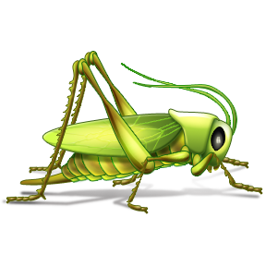
How Insects Eat at Various Stages
Adult insects: vegetation feeders or plant tissue fluid suckers.
Larvae insects: boring into stalks, feeding on young plants or roots.
For example, rootworm larvae feeds on corn roots while rootworm adult feeds on corn silk.
Notes:
Larvae have different mouth parts than adults causing different damages to plants. The mouth parts also dictate to the insect the part of the plant that is preferred.

Slide 9
References
Herren, R. V. (2004). The science of agriculture: A biological approach (2nd ed.). Albany, NY: Delmar.
Reiley, H. E., & Shry, C. L. (2007). Introduction to horticulture (7th ed.). Clifton Park, NY: Delmar.

