Slide 2
The Power of Change
Principles of Agricultural Science – Plant
Unit 7 – Plant Reproduction
Lesson 7.5 Evolutionary Ideas

Slide 3
What is evolution?
Change in the gene pool of a population from generation to generation by such processes as mutation, natural selection, and genetic drift.
Simply put:
  Change over time
Notes:
Encourage class discussion over the question posed in the title. Remind students that they should respect personal beliefs and values in any discussion.
While some students may have beliefs in conflict with the theory of evolution, encourage students to be open-minded and willing to discuss the relationships and differences of living organisms.
You might discuss how historical science and observational science seem at odds at times. No matter how students believe that life on earth began, they can observe plants adapting through selection, mutations, and selective breeding.

Slide 4
Why evolve?
Environmental conditions – become better-suited to live in a specific environment or a variety of environments
Adaptation – process of an inherited trait that increases an organism’s chance of survival in a particular environment

Slide 5
Evolution = Genetic Shifts
Mutation – spontaneous changes in DNA makeup
Migration – plants moving from one population to another
Population size – group size limits reproduction possibilities
Random mating – no sexual selection
Selection – no environmental influences or preferences
Notes:
Genetic equilibrium is very difficult because all of the items above occur frequently in nature and lead to changes in the genetic makeup of a population.

Slide 6

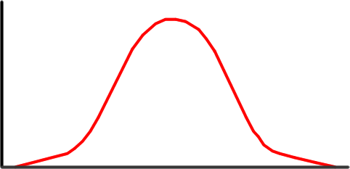


No Evolution = Genetic Equilibrium
Most individuals will exhibit the average trait. Phenotypes in a population tend to remain the same from generation to generation.
Number of Individuals Exhibiting a Trait
Body size
Notes:
Ask students to think back to the lessons on genetics. When using the Punnett Square, they assumed that traits would be passed on in exact proportions. In a perfect environment or when selectively breeding plants, that may be possible. In most natural settings, genetic equilibrium is nearly impossible.

Slide 7
Charles Darwin
Scientist credited with evolutionary theory
Two theories:
  Descent with modification (evolution) – newer forms in fossil record are modified descendents of older species
  Modification by natural selection – how evolution occurs
Notes:
Charles Darwin is the scientist credited with the theory of evolution although others worked on similar theories at approximately the same time. The publication of his book, The Origin of Species, and the thoroughness of his studies lead to his name becoming well-known in discussions pertaining to evolution.
His two main theories were that evolution occurred and it occurred through the process of natural selection.

Slide 8
Natural Selection
Organisms best suited to their environment reproduce more successfully than other organisms
Survival of the Fittest

Slide 9
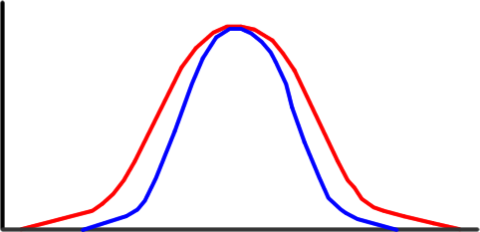
Stabilizing Selection
The average has the greatest chance of survival
Subsequent generations have fewer extreme alleles
Number of Individuals
Equilibrium
Population after selection
Body size
Notes:
When stabilizing selection occurs, the average trait is the fittest increasing the percentage of individuals who exhibit that trait in each generation.

Slide 10
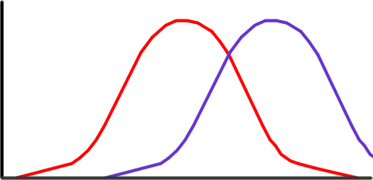
Directional Selection
An extreme trait gives an organism a better chance of survival and reproduction.
More organisms with that trait are in each subsequent generation.
Number
Body size
Equilibrium
Population after selection
Notes:
Directional selection occurs when an extreme form of a trait gives individuals a greater chance of survival and reproduction. With each generation, more individuals exhibit the extreme, such as leaf size, stem length, or flower coloration.
In this example, the size of the bee shifts to the larger bee because of an advantage for better survival.

Slide 11
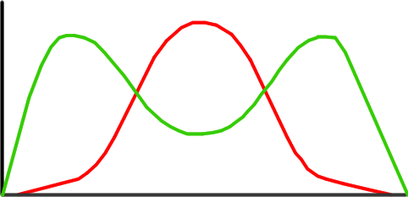
Disruptive Selection
Organisms with either extreme trait have a better chance of survival than the average.
Number
Equilibrium
Body size
Population after selection
Notes:
Both extremes have a higher chance of survival and reproduction than the average when disruptive selection occurs.
This fluctuation occurs in response to environmental conditions such as growth requirements or predation.

Slide 12
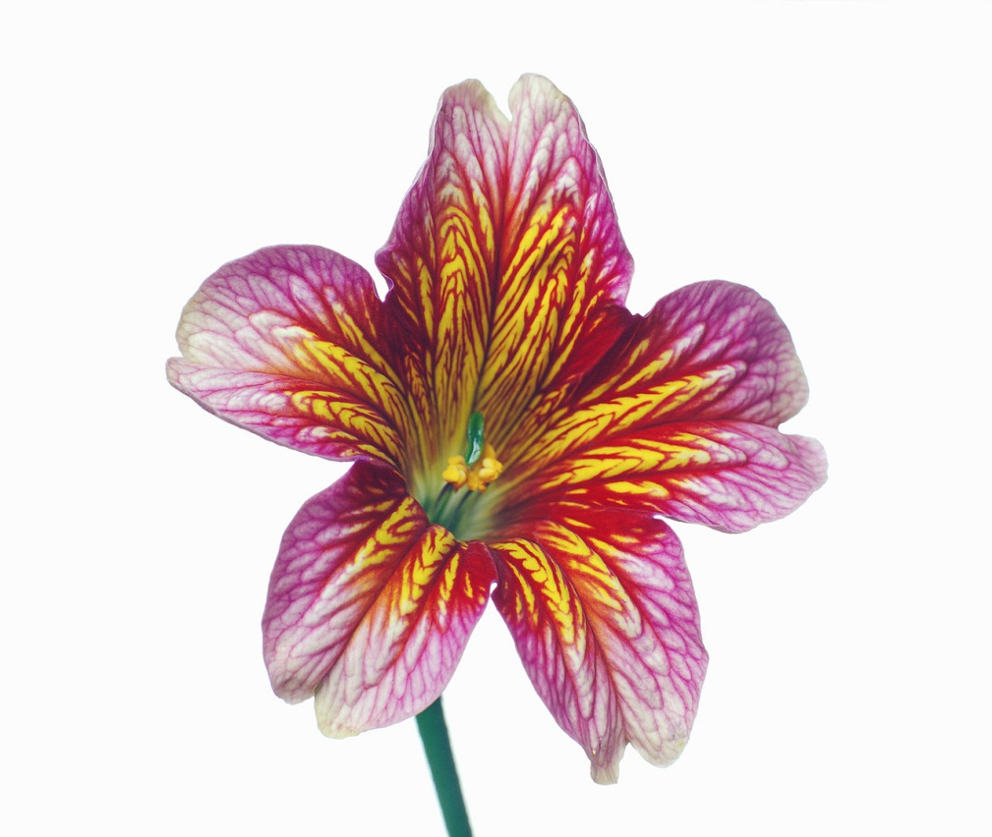
Sexual Selection
Reproductive efficiency based on coloration of flowers or other anatomical features
Desired traits = greater reproductive success

Slide 13
Isolation
Similar species that adapt to different environments become less similar
Geographic
Species separated by a geographic feature evolve to fit the environment
Reproductive
Reproductive seasons of species change until they are no longer compatible
Notes:
When populations become isolated, their population size tends to decrease limiting the genetic diversity. After long periods, this isolation may lead to differentiation of species to the point they can no longer interbreed.
Isolation can occur geographically or reproductively. Geographic isolation occurs when populations are separated into different regions and adaptation to the environment occurs. In reproductive isolation, populations develop distinct breeding seasons that do not overlap. Even though they may be genetically compatible, the populations no longer interbreed because their reproductive cycles are very different.

Slide 14
References
Dictionary.com. (2011). Dictionary.com unabridged (v 1.1). Retrieved from: http://dictionary.reference.com/browse/
Feldkamp, S. (Ed.). (2002). Modern biology. Austin, TX: Holt, Rinehart, and Winston.

