Slide 2
Grafting
Unit 7 – Plant Reproduction
Lesson 7.4 Plant Multiplication
Principles of Agricultural Science – Plant
Notes:
This presentation provides an overview of grafting and illustrates the steps involved for grafting a cactus as the students will do in Activity 7.4.4 A Grafting Experience.

Slide 3
What is grafting?
An ancient technique uniting two plants to grow as one.
The scion is the top, or new shoot, of the plant.
The rootstock is the bottom of the plant and provides roots for the new plant.
Topwork: several scion varieties on one rootstock.
Physical union: the new part will produce whatever variety it was taken from.

Slide 4
Why graft?
Rapidly produce many desirable plants.
Make a disease-prone plant more disease-resistant.
Graft desirable parts of a plant (like ones that produce fruit) onto less expensive rootstock.
Graft several different varieties to one rootstock to save space.

Slide 5
Requirements for Grafting
The plants must be closely related: orange grafted to orange, apple to apple, etc. However, peach rootstock is related closely enough to graft to almonds, pears, and even plums.
Wood should be > 1 year old and disease-free.
Winter is best, when trees are dormant.
Cambium layers of scion and rootstock must be matched, held tightly and waterproofed.

Slide 6
Types of Grafts
There are three types of grafts normally used, in addition to something called budding, which will be discussed later.
  Whip graft
  Side veneer graft
  Cleft graft
Notes:
See if the students can brainstorm the list.

Slide 7
Grafting Cactus
To illustrate a simple way to graft, cactus will be used.
  Cactus can be grafted at any time.
  Cactus do not require waterproofing, but they do require a tight bond of their cambium layers and inner structures (xylem and phloem) to be successful.

Slide 8
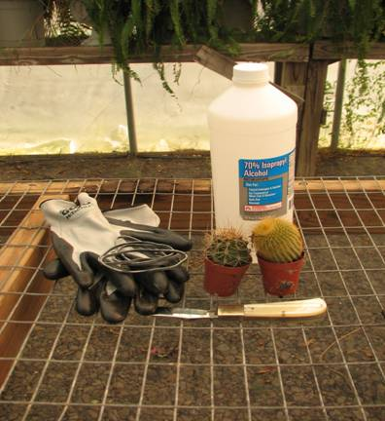
Equipment Needed:
Alcohol or bleach for sterilizing grafting knife
Large rubber bands
Two different varieties of cactus, similar in size
Nitrile or leather palmed gloves
Sharp knife (SAFETY FIRST!)
Safety goggles

Slide 9
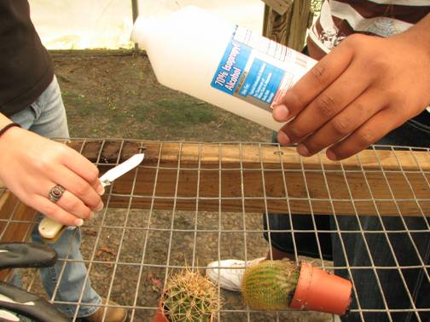
Step One: Sterilize Tools
Sterilize knife to prevent the spread of disease between each graft.
Notes:
Sterilization is needed to kill any bacteria on the knife.

Slide 10
Step Two: Incision
Lay cactus on side and decide how much of the top of the cactus to remove (recommended about one-third of the top)
Make a single cut all the way through the cactus with a very sharp knife

Slide 11
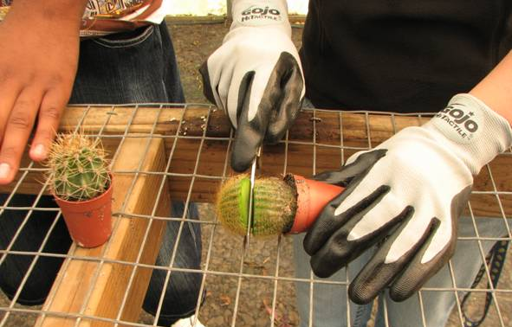
Illustration of Step 2
Notes:
Notice gloves are important to protect your hands.

Slide 12
Step Three: Joining Scion and Rootstock
Trim the scion to match the diameter of the rootstock if necessary
Place the scion on top of the rootstock joining cut edges

Slide 13
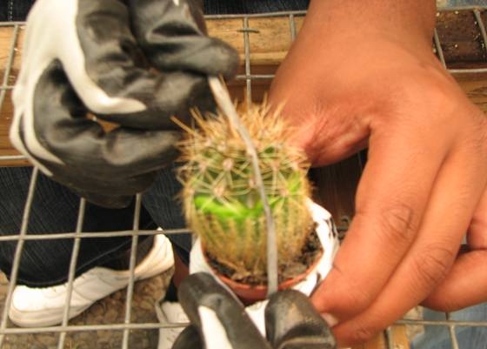
Step Four: Securing the Scion to Rootstock
Use a large rubber band to secure the cactus
Notes:
Make sure the scion is positioned on top of the rootstock properly.

Slide 14
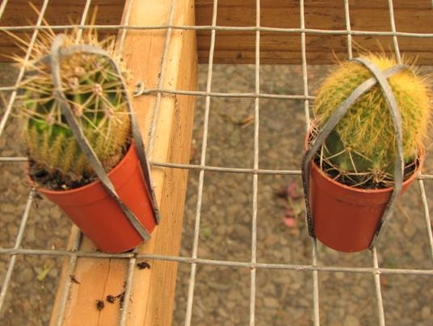
Ta-Da!
The finished product:

Slide 15
Care of Grafted Cacti
DO NOT water for at least a week.
Keep bands on grafted cactus for at least a month to insure the rootstock and scion join together permanently.
Water sparingly after one week and do not get the area that was cut wet.
Notes:
Watch for signs of discoloration around the graft and in the scion tissue.

Slide 16
Specialty Equipment
For grafting and budding trees the right equipment helps-
  The students in this PowerPoint® used a special knife, called a “budding” knife, to graft cactus. On the next slide, notice the odd shaped tip, which is used to lift tree bark up for certain types of grafting or budding methods.

Slide 17
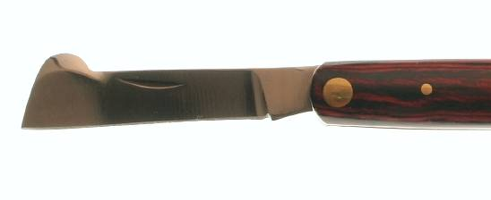
Budding Knife
Odd shaped tip for lifting tree bark
Notes:
A type of budding knife will be used in Activity 7.4.5 Best Buds.

Slide 18
References
Reiley, H. E., & Shry, C. L. (2007). Introduction to horticulture (7th ed.). Clifton Park, NY: Delmar.

