Slide 2
The Seed
Unit 7 – Plant Reproduction
Lesson 7.3 Kernels of Life
Principles of Agricultural Science – Plant
Notes:
Overview of seed structure and introduction to the germination process.

Slide 3
Seed Formation
After an egg is fertilized in the ovule:
The egg develops into an embryo
The ovule develops into the seed testa or seed coat
Notes:
Pollination and fertilization was discussed further in Lesson 7.1 Plant Genetics and Lesson 7.2 Pollination and Dispersion.

Slide 4
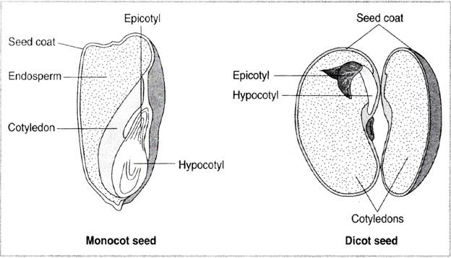
Seed Parts
Basic parts of the monocotyledon and dicotyledon seeds:
(Parker, 2004)
Notes:
This illustration and further reading about seed anatomy is found on pages 59-60 in the textbook, Plant and Soil Science: Fundamentals and Applications (Parker, 2010).

Slide 5
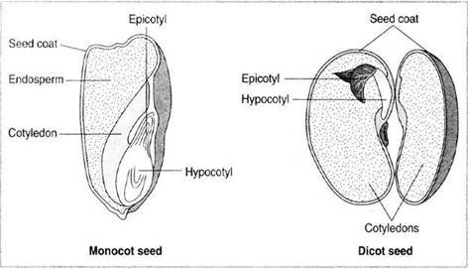
Cotyledon
The first leaf to be developed by the embryo in seed plants. Also called seed leaf.
Notes:
Cotyledons defined. Notes should be made regarding monocotyledon having one leaf compared to dicotyledon having two. This is important identification and classification criteria.

Slide 6
Endosperm
Serves as food for the growing plant during seed germination, often being entirely consumed in the process.
Notes:
Endosperm is associated with monocotyledon seeds or kernels. In dicotyledon seedlings, the starch food reserves are held in the cotyledons.

Slide 7
Epicotyl
The part of the axis of an embryo above the region of attachment of the cotyledons.
Notes:
Essentially, the epicotyl is a region of the embryo. The epicotyl will form all of the parts above the first node of the seedling.

Slide 8
Hypocotyl
The short stem of an embryo seed plant, the portion of the axis of the embryo seedling between the attachment of the cotyledons and the radicle.
Notes:
The hypocotyl will form the roots and some lower stems associated with the seedling.

Slide 9
Seed Coat
The hard outer layer of a seed; the protective covering. Also called a testa.
Notes:
The seed coat is to provide protection. Some seed coats are very hard and require external forces to allow water to enter.

Slide 10
Seed Germination
Seeds are living but in a dormant state.
Seeds require specific environmental conditions for germination.
When a seed breaks dormancy and begins to germinate, the process includes:
  Seed absorbs water to soften and split the testa.
  Cell division (mitosis) causes the embryo growth.
  Starch from endosperm or cotyledons is converted to sugar and used as plant food.
Notes:
This slide is an overview of the germination process. You will be collecting evidence that seeds respire in an upcoming activity.

Slide 11
Seed Enzymes
Starch is present in both the endosperm of the monocotyledon seed and the cotyledons of the dicotyledon seedling.
Diastase is an enzyme that digests the starch and transforms it into glucose.
Notes:
As students will discover in Activity 7.3.2 Seed Structure and Enzymes, enzymes convert starch into glucose to fuel seedling growth until true leaves are developed and the seedling can produce food on its own via photosynthesis.

Slide 12
References
Herren, R. V., & Donahue, R. L. (2000). Delmar’s agriscience dictionary with searchable CD-ROM. Albany, NY: Delmar.
Lab-Aids Incorporated. (2002). Seed structure and enzyme action kit [Brochure]. Ronkonkoma, NY: Author.
Parker, R. (2004). Introduction to plant science (Rev. ed.). Clifton Park, NY: Delmar.
Parker, R. (2010). Plant and soil science: Fundamentals and applications. Clifton Park, NY: Delmar.

