Slide 2
Germination Requirements Unit 7 Plant Reproduction Lesson 7.3 Kernels of Life
Principles of Agricultural Science – Plant
Notes:
This presentation provides information about germination rate and identifies the environmental factors required for germination.

Slide 3
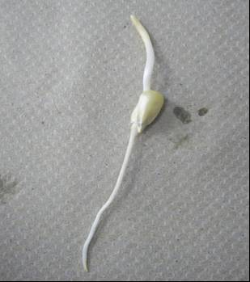
Germination Defined
Sprouting of a seed, and beginning of plant growth.
Notes:
Germination defined.

Slide 4
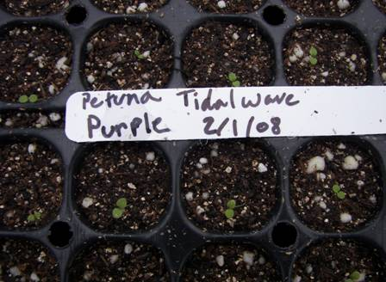
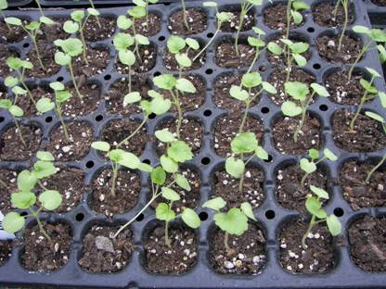
Germination Rate
The number of seeds that are likely to germinate under proper conditions.
Allows calculation of the number seeds required to establish a target population.
Notes:
Germination rate defined.

Slide 5
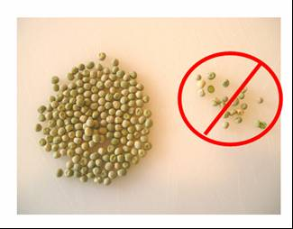
Germination Rate (Continued)
Usually expressed as a percentage
Example:
85% germination rate = 85 out of 100 seeds will germinate under proper conditions
Notes:
Emphasis should be given to “proper conditions.”
This is the transition slide into environmental factors required for seed germination.

Slide 6
Influences of Germination Rate
Physiological factors – developmental stages and degradation of seed:
Age of seed
Maturity or health of parent plant
Environmental factors – critical factors for germination:
Water
Temperature
Oxygen
Light
Notes:
Even if a healthy plant forms the seed, drastic changes in the environmental factors may still seal the fate of the seedling. All requirements of the seed must be met throughout the germination process.

Slide 7
Age of the Seed
Many seeds have a “shelf life”
Examples:
a bean seed with a 3-year life expectancy
a pigweed seed with over a 40-year life expectancy
Notes:
This is a natural response to climatic conditions in the wild. In times of drought when young seedlings would not survive, the seed can stay dormant until enough moisture is present and the temperature conditions are sufficient to support the new seedling.
In terms of seed viability, a seed may not be able to wait too long for the right conditions before the seed dies.

Slide 8
Maturity and Health of Parent Plant
A young immature plant forced into early seed production may produce weak seeds.
Other health issues, such as stress from drought may also influence seed viability.
Notes:
Seeds could be small, and thus do not have adequate food reserves to allow the embryo to emerge from the soil.

Slide 9
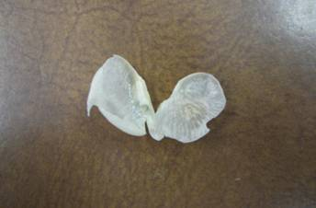
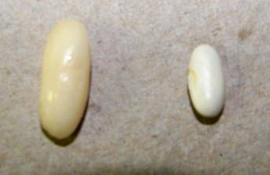
Water
The seed swells when it absorbs water and will aid the embryo in pushing through the hard seed coat.
Seeds need water to soften the seed coat that protected the embryo during dormancy.
Notes:
The top picture is a seed coat removed after softening.
The lower picture shows a seed after it swelled from the uptake of water.

Slide 10
Water (Continued)
Water is necessary for cell growth. Cells enlarge and multiply very rapidly during germination.
Water is also essential for translocation of nutrients throughout the embryonic tissues.
Notes:
We learned about translocation in Lesson 6.2 All Wet.

Slide 11
Temperature
Plants have specific temperature ranges for optimal germination.
The range of temperature will depend upon whether the plant is a cool-season or warm-season species.
Notes:
Cool-season plant: Plants that survive best in the cool-season, such as cabbage, peas, lettuce, or spinach.
Warm-season plant: Designating a plant which thrives best when the temperature is regularly quite high (e.g., okra, cotton, grain sorghum, and corn).

Slide 12
Oxygen
Everything living needs oxygen – active or dormant.
A common problem in germination is too much water that saturates the soil depriving oxygen to the embryo.
Notes:
You must take precautions to prevent seeds from drying out once they start germination – but too much water will deplete the soil of oxygen.

Slide 13
Light
A few species require their seeds to be exposed to light for a short duration of time prior to germinating.
Example – lettuce and pigweed

Slide 14
References
Herren, R. V., & Donahue, R. L. (2000). Delmar’s agriscience dictionary with searchable CD-ROM. Albany, NY: Delmar.
Parker, R. (2010). Plant and soil science: Fundamentals and applications. Clifton Park, NY: Delmar.
Schooley, J. (1997). Introduction to botany. Albany, NY: Delmar Publishers.

