Slide 2
The Role of Fruit Unit 7 – Plant Reproduction Lesson 7.2 Pollination and Dispersion
Principles of Agricultural Science – Plant
Notes:
The following presentation examines various types of fruits, the function they serve, and their value to humans.

Slide 3
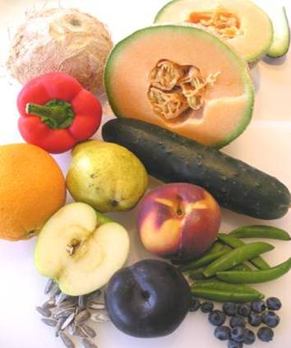
Fruit
The wall of the fruit, or ripened ovary, is called the pericarp.
Two types of fruit:
Dry
Fleshy
Notes:
The two categories of fruit types, dry and fleshy, will be discussed in the next several slides.

Slide 4
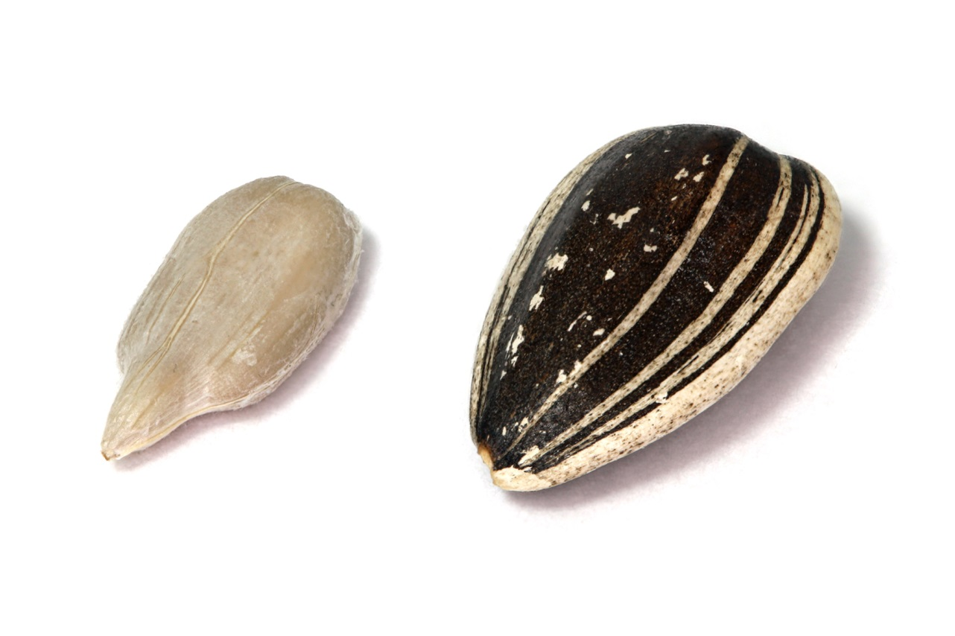
Common Dry Fruits
1) Achene – one-seeded, hard thin shell, such as a sunflower seed
Notes:
Achene
Any small, dry fruit having but one seed whose pericarp does not burst when the fruit is ripe.
Refer to Plant and Soil Science: Fundamentals and Applications (Parker, 2010) pp. 57-59 for a complete listing of fruit types.

Slide 5
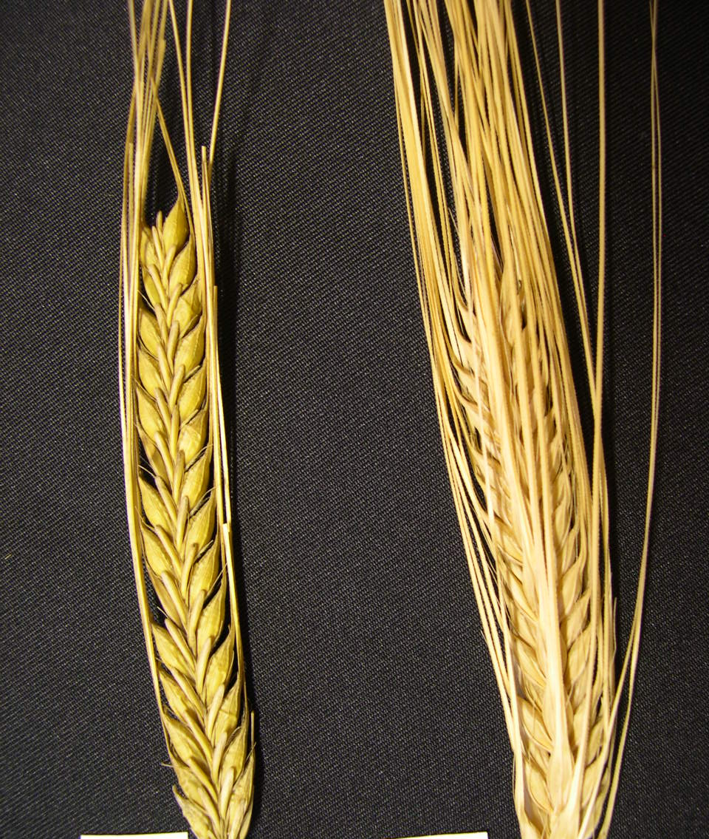
Common Dry Fruits (Continued)
2) Grain – one-seeded, very thin seed covering, such as grasses and cereal grains
Notes:
Grain
The seed of the cereal crops.

Slide 6
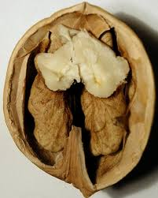
Common Dry Fruits (Continued)
3) Nut – hard-shelled one seeded fruit, such as a walnut
Notes:
Nut
An indehiscent, one-celled and one-seeded, hard and bony fruit, as the acorn of Quercus.

Slide 7
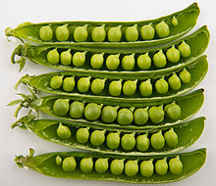
Common Dry Fruits (Continued)
4) Pod – legumes that have multiple seeds, such as peas and beans
Notes:
Pictured are peas and beans humans commonly use for food. The fruit, pods in this case, are green because they are not mature. Once they mature they will dry out and split open.
Pod
Technically, a dry, many-seeded fruit that splits open, such as a pea pod or bean pod; a legume.

Slide 8
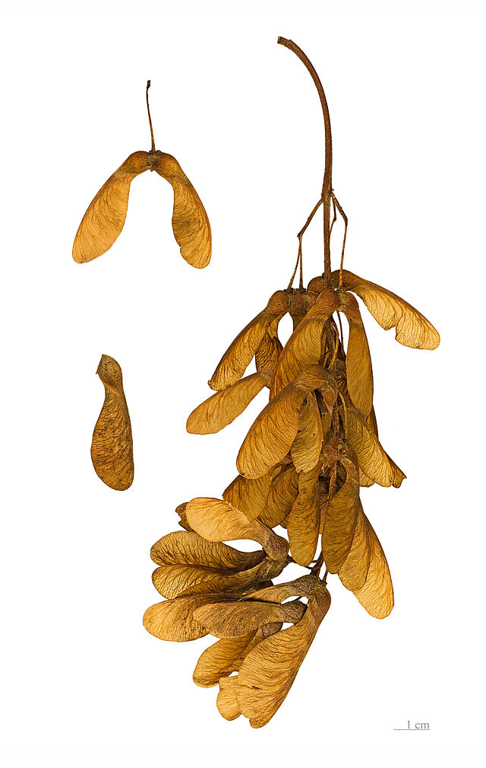
Common Dry Fruits (Continued)
5) Samara – two-seeded winged fruit, such as from a maple tree
Notes:
The last of the dry fruits. As you can see from the visual characteristics, fruits come in various forms unlike common misconceptions that a fruit is always a fleshy, edible tissue. The “wings” of a maple seed allow the seed to be carried by the wind to have a better chance to germinate and survive.
Samara
A single-seeded, winged fruit, whose wing helps in seed dissemination, like that of the maple, ash, and elm.

Slide 9
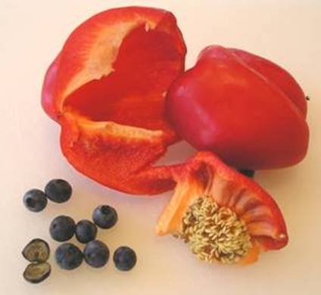
Common Fleshy Fruits
1) Berry – one or more flesh covered carpels, such as a blueberry or pepper
Notes:
Berry
Any small pulpy fruit, as the raspberry, strawberry, etc..; usually edible.

Slide 10
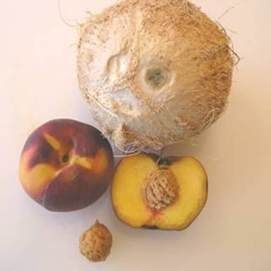
Common Fleshy Fruits (Continued)
2) Drupe or stone fruit – one-seeded, outer flesh covering, with hard endocarp layer, such as a peach or coconut
Notes:
Pictured on this slide is the peach and the coconut. The coconut is actually the seed. The flesh has been striped from the endocarp and only the fibers of the flesh remain on the endocarp, which is called a husk. Coconuts are buoyant in order to float across the oceans to establish on a beach in some tropical area.
Drupe
A single-seeded, fleshy fruit that does not split open, e.g., cherry, peach, plum, or olive. Also called a stone fruit.

Slide 11
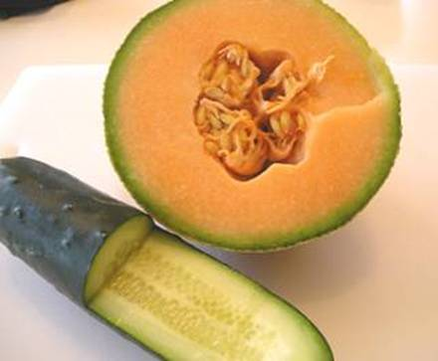
Common Fleshy Fruits (Continued)
3) Pepo – tough outer covering with fleshy inside, such as melons and cucumbers
Notes:
Pepo fruits will have several carpels unless they have been bred to be seedless – like some watermelon varieties available today.

Slide 12
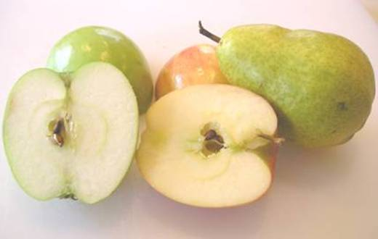
Common Fleshy Fruits (Continued)
4) Pome – multiple seeds contained in the center of flesh surrounded by a thin outer skin, such as an apple or pear
Notes:
Pome
A fleshy fruit having several seeds instead of a stone, such as an apple, pear, and quince.

Slide 13
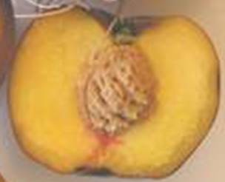
What functions do fruit serve?
Protection for the seed
Provides nutrients to young seedling
Seed dispersal
Marketable products for human consumption
Plant identification and classification
Notes:
Reasons why fruit are essential to plants AND to humans.
Several opportunities exist for students to benefit from the production of fruit and nut production as either a future career or Supervised Agricultural Experience project.

Slide 14
Seed Dispersal
Plants use several dispersal mechanisms:
Animals | Feed on fruit
Force | Seed pods burst or shatter
Insects | Carry seeds to burrows
Water | Rain and water bodies transport the seed, such as the coconut
Wind | Seeds have adapted special anatomical features to catch the wind, such as the dandelion
Notes:
Activity 7.2.4 Dependency of Animals will explore seed dispersal in connection to animals. It is important to note the five methods of seed dispersal for future reference.

Slide 15
References
Parker, R. (2010). Plant and soil science: Fundamentals and applications. Clifton Park, NY: Delmar.
Schooley, J. (1997). Introduction to botany. Albany, NY: Delmar Publishers.
United States Department of Agriculture. (2007). Fruit and tree nuts situation and outlook yearbook 2007. Retrieved from http://www.ers.usda.gov/publications/FTS/2007/Yearbook/FTS2007.pdf

