Slide 2
Pollination and Fertilization Unit 7 – Plant Reproduction Lesson 7.2 Pollination and Dispersion
Principles of Agricultural Science – Plant
Notes:
The Pollination and Fertilization PowerPoint® presentation will address concepts and key terminology related to pollination and fertilization. The presentation will start with an overview of the broader concepts related to pollination methods and the various agents plants use to facilitate pollination. Steps involved in the fertilization process will follow.

Slide 3
If We Have Pollen…
pollination can occur.
Pollination is the transfer of pollen from the anther to the stigma of a flower.
Notes:
Pollination defined.

Slide 4
Types of Pollination
Some plants use different methods to achieve pollination:
Self-pollination: Transfer of pollen from the anther to the stigmas of the same flower or to flowers on the same plant.
Cross Pollination: Transfer of pollen between two plants that are not of identical genetic material.
Notes:
Cross pollination ensures more genetic variation among plant offspring. Some plant species have systems to prevent self-pollination. This could include varied time intervals for pollen and stigma to ripen on the same flower, or the reproductive parts are on different parts of the plant in the case of corn (monoecious plants). Other plants, such as dioecious species, have male and female flowers located on different plants.
Monoecious and dioecious are two terms that will need to be reviewed with students.

Slide 5
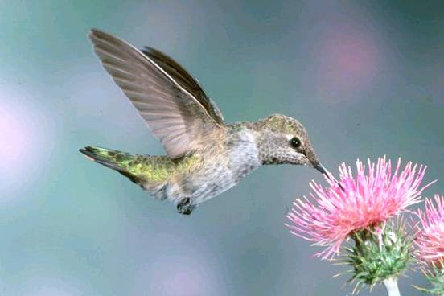
Mechanisms Used for Pollen Transfer
Vertebrates
Insects
Water
Wind
Notes:
Vertebrates can feed on flowers or brush up against them when passing by. Pollen is transferred to fur, feathers, lips, or beaks and then to another flower if the vertebrate comes in contact with it.
Insects are the most common way pollen is transferred among flowers. Insects feed on nectar produced by the flower and when visiting multiple flowers to feed, the insect transfers pollen from their bodies.
Water can move pollen from anther to stigma or plant to plant in cases of rain or irrigation.
Many plants depend on wind to transfer their pollen, especially if they do not have the mechanisms to attract animals or insects to their flowers.

Slide 6
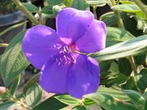
Attracting Pollinators
The flower uses important features to attract animals and especially insects to help the pollination process:
Bright petal colors
Fragrance
Nectar
Notes:
This point reinforces the earlier lesson on flower function.
These mechanisms the flower uses to attract pollinators are the same reasons for their commercial value for floriculture and nursery marketing.

Slide 7
Fertilization
Fertilization is the union of pollen with the ovule to produce seeds.
Once pollen grains are transferred to the stigma:
Pollen grains move through the pollen tube to the ovule.
A pollen gamete unites with the egg cell gamete in the ovule.
Ovary swells and forms the fruit.
Notes:
It may be helpful for students to reference their notes from the earlier lesson on flowers to reference the parts involved with the fertilization process. Fertilization stops at the formation of fruit, which will be covered in the next lesson.

Slide 8
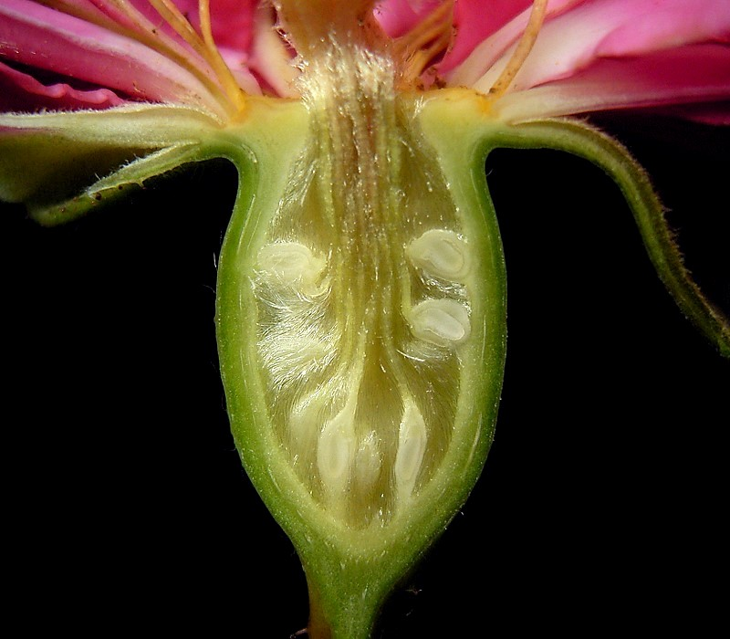
The Next Step
Following fertilization, division of the zygote will continue the cell replication process.
Notes:
The zygote essentially brings us back to the beginning of the cell development process.

Slide 9
References
Herren, R. V., & Donahue, R. L. (2000). Delmar’s agriscience dictionary with searchable CD-ROM. Albany, NY: Delmar.
Parker, R. (2004). Introduction to plant science (Rev. ed.). Clifton Park, NY: Delmar.
Schooley, J. (1997). Introduction to botany. Albany, NY: Delmar Publishers.
Toogood, A. R. (Ed.). (1999). American Horticultural Society plant propagation: The fully illustrated plant-by-plant manual of practical techniques. New York, NY: Dorling Kindersley.

