Slide 2
Fun-de-Mendels of Genetics Unit 7 – Plant Reproduction Lesson 7.1 Plant Genetics
Principles of Agricultural Science – Plant
Notes:
The following presentation will address terminology related to genetics and tools to predict heredity in offspring from sexual reproduction.

Slide 3
Gregor Mendel: The Man, the Monk, the Master of Genetics
Austrian monk in the mid-1800s
Through experiments with pea plants, discovered the principles of heredity
Provided the basis for laws of inheritance:
The law of dominance
The law of segregation
The of independent assortment
The law of unit characters
Notes:
Mendel’s work with breeding peas was the first record of genetic discovery. It should be noted that Mendel was not a scientist, but his writings related to the research he conducted have become the foundation for the study of genetics.
Mendel proposed theories for the basis of four laws. These laws can be elaborated upon from information presented in Introduction to Botany (Schooley, 1997) page 51.

Slide 4
What are genes?
The simplest units of inheritance
Influence specific genetic traits
Carried in the chromosomes of gametes
Passed from parent to offspring during sexual reproduction
Notes:
Definition of terminology. These statements tie into the previous PowerPoint® presentation Birth of Pollen and Egg Cells. You may want students to refer to their Presentation Notes from that discussion. New terms are presented including heredity and inheritance.

Slide 5
Genotype
The genetic make-up of living things.
Individual organisms of the same genotype breed alike.
Notes:
It will be important in Activity 7.1.3 Mendel’s Peas Simulation for students to be able to distinguish between genotype and phenotype.

Slide 6
Phenotype
The observed characteristics of an individual organism.
Influenced by both environment factors and genotype.
Individuals of the same phenotype may look similar but may not breed alike.
Notes:
Visual appearance, such as plant height, colors, shapes, and appendices.

Slide 7
How Heredity is Affected by Genes
The genetic transfer of traits from parent to offspring is called heredity or inheritance.
Each characteristic or trait has two genes – one derived from each of the parents.
If both genes for a characteristic are the same, the plant is homozygous for that characteristic.
If the two genes differ, the plant is heterozygous.
Notes:
The introduction of terms homozygous and heterozygous. These terms will be illustrated in following examples.

Slide 8
Which Trait Wins in Heterozygous Pairings?
The law of dominance offered by Mendel states that one gene of the pair may exert influence over the other.
D
d
Notes:
If there are two different traits trying to be expressed, what are the mechanisms for the decision? Chance may be a logical assumption by students, but Mendel provides evidence of genetic dominance among gene pairs. Therefore, prediction of traits can be better than left to chance.

Slide 9
Dominance
One gene overrides the other gene and is visible in the organism’s phenotype.
This is also referred to as a dominant trait.
Notes:
Definition of dominance.

Slide 10
Recessive
The other gene partner of heterozygous traits will not be visible in the phenotype.
The recessive gene remains in the genotype.
When crossed with another plant containing the same recessive trait, some offspring may exhibit the recessive characteristic.
Notes:
The explanation for recessive genes – the other gene in the pair of a heterozygous plant.

Slide 11
Predicting Offspring
Each gene is signified by a letter (ex: D)
Each gene is paired with another – one from each parent plant (ex: DD, Dd or dd)
If the letter is capitalized it is a dominant gene (ex: D)
If the letter is not capitalized it is a recessive gene (ex: d)
Notes:
As mentioned in a previous slide, knowledge of dominant and recessive traits can help predict offspring. Here are some rules for students to remember as the Punnett Square is introduced. The Punnett Square will be the tool used to help students predict offspring from breeding pairs of genes.

Slide 12

Flower Color
If purple is the dominant trait, it could be represented by “P.”
The recessive trait, white, represented by “p.”
Plant Phenotype | Corresponding Genotype
Homozygous dominant for purple traits | PP
Heterozygous for purple trait | Pp
Recessive for white traits | pp
Plant Phenotype | Corresponding Genotype
Homozygous dominant for purple traits
Heterozygous for purple trait
Recessive for white traits
Notes:
This slide provides the student a specific example for the rules for using a Punnett Square.
Have students predict the corresponding genotypes. The correct genotypes will appear when you advance the slide.

Slide 13
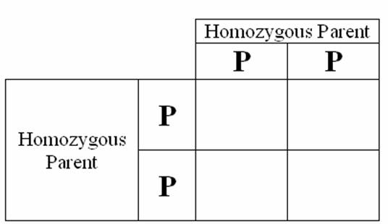
Punnett Square
Use a Punnett Square to determine the offspring for two homozygous parents:
Notes:
Have students try a practice Punnett Square.
This will build foundation knowledge related to dominance.
Modeling of how to use the square may be needed.

Slide 14
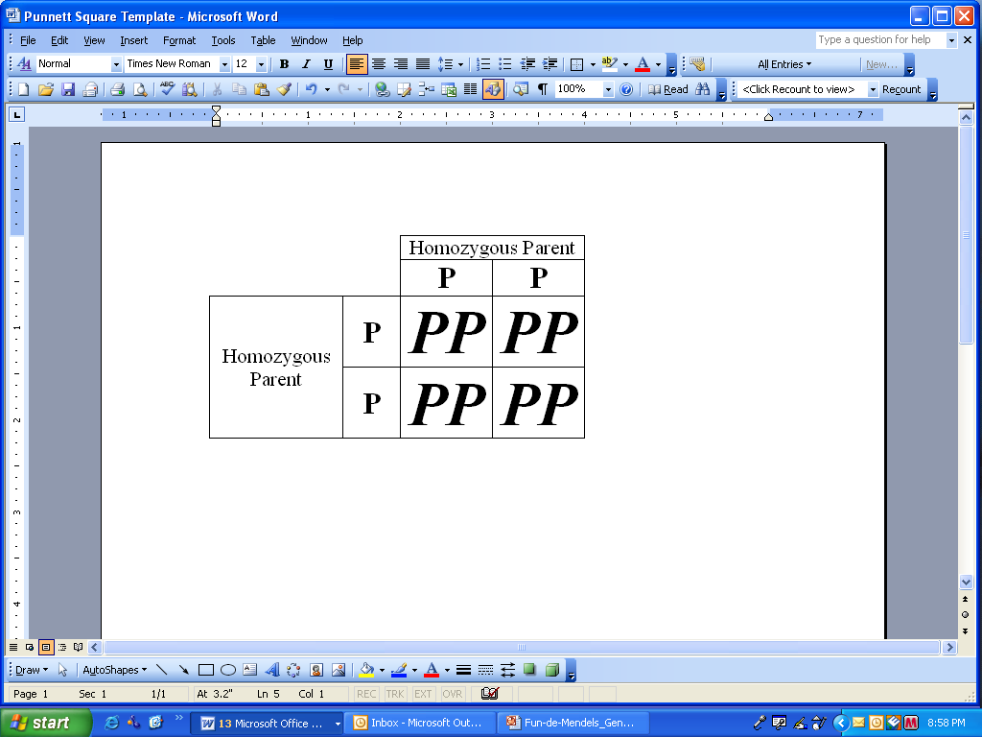
Results of Homozygous Pairing
What is the percent chance of offspring with purple flowers?
Notes:
Of course the predicted percentage of purple flowers is 100%. If the parent plants produced 100 new offspring all would have the genetic traits of purple flowers.

Slide 15
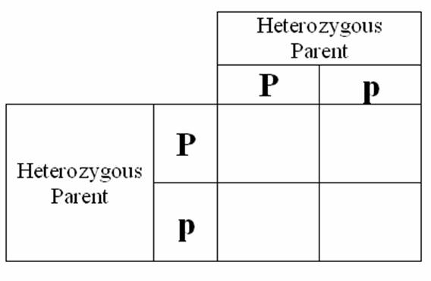
Let’s see how recessive genes reappear…
Use a Punnett Square to determine the offspring for two heterozygous parents:
Notes:
This simple example will illustrate how recessive genes are still part of the genetic make up even though the parent plants do not show phenotypic characteristics. In this example, the small “p” may represent a light blue flower color.

Slide 16
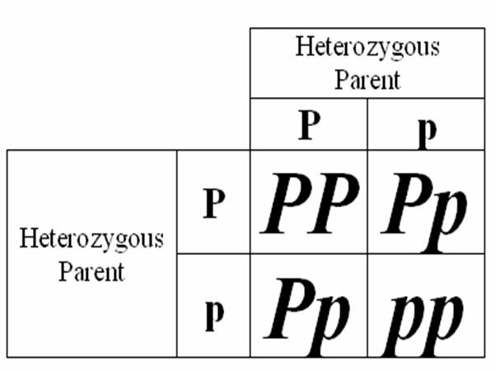
The Results…
What is the percent chance of offspring with purple flowers?
Notes:
Once the Punnett Square is completed, students should be able to determine that the recessive gene emerges in 75% of the crosses, however when paired with a dominant gene it will only be expressed in the phenotype 25% of the time. Therefore, the students can predict that 75% of the offspring will have purple flowers and only a 25% chance will exist for light blue.

Slide 17
References
Herren, R. V., & Donahue, R. L. (2000). Delmar’s agriscience dictionary with searchable CD-ROM. Albany, NY: Delmar.
Parker, R. (2010). Plant and soil science: Fundamentals and applications. Clifton Park, NY: Delmar.
Schooley, J. (1997). Introduction to botany. Albany, NY: Delmar Publishers.

