Slide 2
Degrees of Growth
Unit 6 – The Growing Environment
Lesson 6.4 Chilly Lilies
Principles of Agricultural Science – Plant
Notes:
This presentation is an overview of how temperature effects plant health and growth. It is important to take careful notes to be used later.

Slide 3
Environmental Temperature Variations
The climate, specifically temperature, for a geographic location is influenced by:
Latitude
Elevation
Microclimate zones, such as coastal areas
Notes:
All three of these factors are used to determine a plant hardiness zone and are discussed in the following slide.

Slide 4
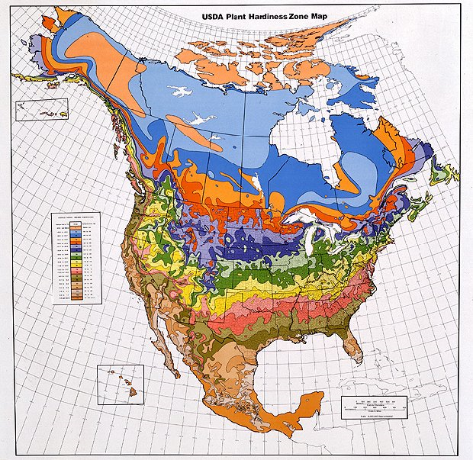
Hardiness Zones
A hardiness zone map
Provides temperature characteristics of geographic regions
Used to determine the species and varieties of plants best suited for an area
USDA, 2003
Notes:
For a clearer image of a hardiness zone map for the U.S. see page 249 of Plant and Soil Science: Fundamentals and Applications (Parker, 2010) or the USDA website at URL: http://www.usna.usda.gov/Hardzone/ushzmap.html?.

Slide 5
Temperature Classifications
Two general categories based on temperature requirements:
Cool-season plants
  survive mild frost
  tolerate cool spring and fall temperatures
Warm-season plants
  typically killed by frost
  require warm temperatures
Notes:
It is important to know the temperature requirements for plants that you are growing. If a plant is not suited for the growing environment, it will not grow well and possibly die before maturity.

Slide 6
Temperature Sensitive
Specific temperatures trigger:
Vegetative growth
Physiological development
  Maturity based on the length of time exposed to temperatures
  Reproductive stages
Dormancy
  Cold-induced
  Heat-induced
Notes:
This presentation will highlight several of the plant requirements for temperature.
These three points are discussed further in the next slides.

Slide 7
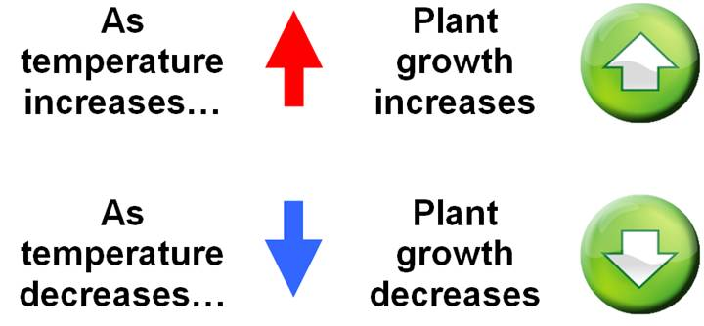
Temperature vs. Growth
Plant growth and temperature have a direct relationship:
Notes:
Temperature is directly related to the rate of metabolism as presented in the next slide.

Slide 8
Why is plant growth influenced by temperature?
Temperature influences three main metabolic functions of plants:
Transpiration
Photosynthesis
Respiration
Notes:
Warmer temperatures increase transpiration and therefore affects water translocation and loss. Photosynthesis rates are increased during periods of higher temperatures if light requirements are met. As plant growth increases, cell division will increase and respiration will increase.

Slide 9
Maturity Requirements
Plants require a specific amount of time exposed to a specific threshold of temperature in order to initiate flowering.
The requirement is met by accumulating Growing Degree Units (GDU).
Notes:
See the formula for GDU on the next slide.

Slide 10
More on Growing Degree Units
Growing Degree Units (GDU) are units of exposure to adequate temperatures required for plant growth.
To calculate GDU use the following formula:
Daily High Temperature + Daily Low Temperature | - | Base Temperature Requirement | = | GDU
2
Notes:
Be sure to have students copy this formula in their notes because they will use this formula for Activity 6.4.1 Comparing Growing Locations and Problem 6.4.2 Forecasting Harvest.

Slide 11
Dormancy Requirements
Temperature is also used to initiate and break dormancy of seeds and vegetative growth for perennial and biennial plants.
Plants sense natural seasonal changes in temperature to initiate growth responses.
Notes:
To break dormancy, you alter the growing environment to imitate natural cycles of seasonal temperatures.

Slide 12
Terms Related to Dormancy Associated with Temperature
Forcing: controlling temperature to promote vegetative growth and flowering outside of natural seasonal patterns in plants
Stratification: the duration of exposure to cold temperatures to promote germination of some seed types
Vernalization: the cold treatment applied to plants to initiate flowering
Notes:
Forcing and vernalization will be discussed further in Project 6.4.3 Forcing Bulbs to Grow.

Slide 13
References
United States National Arboretum. (2003). "Web version" of the USDA plant hardiness zone map. Retrieved December 12, 2008 from http://www.usna.usda.gov/Hardzone/ushzmap.html?
Parker, R. (2010). Plant and soil science: Fundamentals and applications. Clifton Park, NY: Delmar.

