Slide 2
Macronutrients Unit 6 – The Growing Environment Lesson 6.1 Plant Food
Principles of Agricultural Science – Plant
Notes:
This presentation is an overview of the primary and secondary macronutrients.

Slide 3
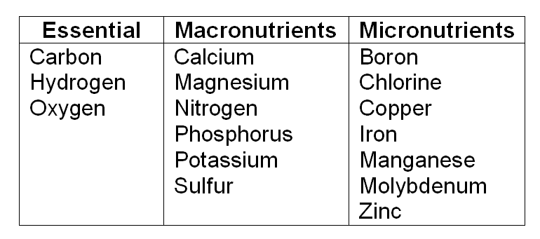
Plant Nutrients
Plants require 16 elements for proper growth and development.
Notes:
Be sure that students have this table in their notes.

Slide 4
The Essentials
Carbon (C)
Hydrogen (H)
Oxygen (O)
Normally present in the atmosphere
These elements combine in various forms:
Carbon Dioxide (CO₂)
Water (H₂O)
Glucose (C₆H₁₂O₆)
Notes:
Carbon, hydrogen, and oxygen are present in the environment. In some cases, greenhouses are supplemented with CO₂ generators to increase carbon dioxide levels 2-4 times. This increase in CO₂ concentration has been proven to accelerate plant growth since plants use CO₂ for photosynthesis.

Slide 5
Plant Nutrients
Macronutrients – required in large amounts
Two sub-categories:
Primary – required in highest levels
Secondary – required in lower levels
Micronutrients – required in trace amounts
Notes:
Fertilizers are balanced for Macronutrients. In special situations a fertilizer may have a micronutrient added.
Micronutrients will be discussed in a later presentation in Lesson 6.1.

Slide 6
Primary Macronutrients
The three primary nutrients:
Nitrogen (N)
Phosphorus (P)
Potassium (K)
These make up the first values of a fertilizer analysis, expressed as N-P-K
Notes:
N-P-K are the first three numbers for any fertilizer formulation. If an element of N-P-K is not present in a fertilizer, the fertilizer bag will use a zero for this element, such as 16-0-8. Secondary macronutrients and micronutrients are not represented by zero numbers if they are not present in a fertilizer.
You will learn more about fertilizer analysis later in the lesson.

Slide 7
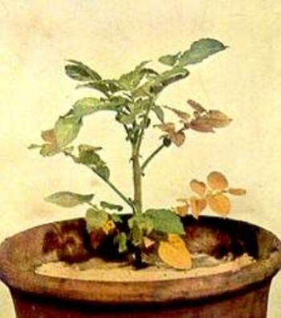
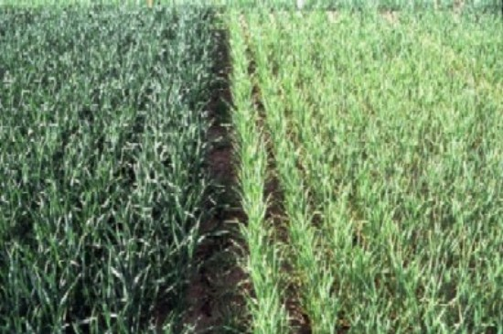
Nitrogen (N)
Present in chlorophyll
Increases vegetative growth
Deficiency symptoms:
Stunted growth
Pale yellow color
Yellow color “fires” from the bottom of the plant to the top
Notes:
Nitrogen gives green plants their bright green color. It is one of the most used of all nutrients. Nitrogen influences the development of proteins and is essential for cell division, photosynthesis, vitamins, use of carbohydrates, and the energy reactions in plants.

Slide 8
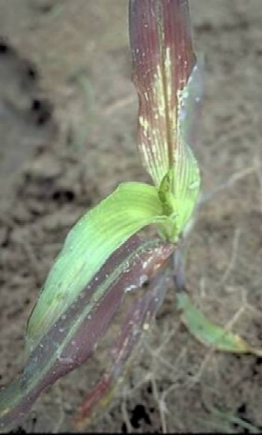
Phosphorus (P)
Responsible for early plant growth
Reproduction
Deficiency symptoms:
Reddish coloring on the underside of leaves
Low quantity flowers and fruits
Weak and spindly growth
Notes:
Phosphorus influences root health and growth of seedlings. If ample phosphorus is available to young plants, they will develop strong root systems that are important for their survival. Later in the life of the plant, phosphorus will again play a major role in reproductive health.

Slide 9
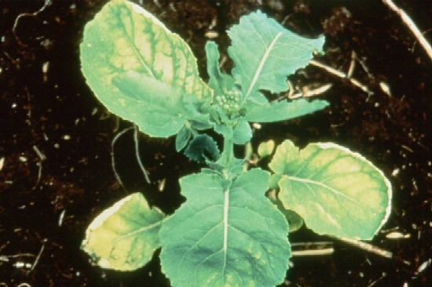
Potassium (K)
Involved with photosynthesis, primarily sugar transformation
Deficiency symptoms:
Slow growth
Brown leaf tips and leaf margins
Poor fruit and seed quality
Notes:
Potassium increases photosynthesis, water-use efficiency, and disease resistance.

Slide 10
Secondary Macronutrients
Three secondary macronutrients:
Calcium (Ca)
Magnesium (Mg)
Sulfur (S)
Required in smaller amounts than primary nutrients, but still needed in ample quantities
Notes:
Secondary macronutrients typically effect how a plant utilizes other elements and molecules. For example, calcium has a relationship with nitrogen metabolism and magnesium affects phosphorus and iron utilization.

Slide 11
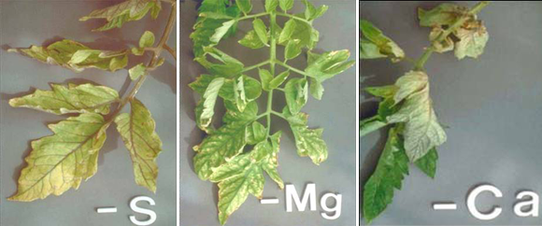
Secondary Nutrients Uses
Magnesium (Mg) | Sulfur (S) | Calcium (Ca)
Produces chlorophyll Regulates other plant nutrient metabolism | Amino acids Enzyme production Chlorophyll formation | Essential for cell division and formation Used for cell walls and membranes
Notes:
For example, plants rely on sulfur to develop enzymes and vitamins within the plant.

Slide 12
References
McCarroll, K. (2011). Identifying nutrient deficiency in plants. Farmspeak. http://www.farmspeak.com/nutrient-deficiency.html
Montana State University. (n.d). Nutrient deficiencies. Retrieved from http://landresources.montana.edu/soilfertility/nutrientdeficiencies.html
Parker, R. (2010). Plant and soil science: Fundamentals and applications. Clifton Park, NY: Delmar.
Plaster, E. J. (2003). Soil science and management (4th ed.). Clifton Park, NY: Delmar.

