Slide 2
A Plant’s Grocery Store
Unit 6 – The Growing Environment
Lesson 6.1 Plant Food
Principles of Agricultural Science – Plant
Notes:
This presentation is an overview of fertilizer sources and how to calculate quantities of fertilizer needed, fertilizer application rates, and costs associated when using a particular type of fertilizer.
Activity 6.1.3 Fertilizer Figures will allow you to practice these calculations. You will determine:
- Pounds of nutrient per pound of fertilizer
- Fertilizer application rates
- Liquid fertilizer application rates in ppm
- Fertilizer costs

Slide 3
Sources of Plant Nutrients
Organic substances
Legumes
Chemical fertilizers
Notes:
Organic means that the primary nutrients are from plants or animals.
The Amish have had success with increasing the organic matter in their soils by using green manure. The practice of using green manure is too expensive for most large farming operations, but leaving crop residue, such as stalks from corn production in the field and later incorporating it into the soil prior to replanting, can increase organic matter in the soils.

Slide 4
Organic Substances
Examples: manure, sludge, and compost
Manure contains nutrients in varying amounts.
Sludge is processed human waste.
Composting raises organic matter content and destroys pathogens.
Notes:
Sludge can have human pathogens and heavy metals present. It must be used according to state and federal guidelines.
Sludge is most often applied to fruit, seed, and grain crops. If the pH of the soil is above 6.5, it will bind the heavy metals from the sludge and render them inactive.

Slide 5
Legumes
Examples: peanuts, soybeans, and vetch
Legumes “fix” nitrogen.
Improve nitrogen content of the soil.
Most other crops deplete nitrogen.
Often rotated with nitrogen-depleting crops.
Notes:
Legumes contribute to soil nutrition through bacterial fixation in root nodules that remove nitrogen from the air and convert it into available soil nitrogen.
Legumes can be used as a green manure source that is a cover crop grown specifically for being turned under soil rather than harvested.

Slide 6
Chemical Fertilizers
Manufactured fertilizers
Inorganic compounds concentrate desired nutrients
Benefits | Disadvantages
Easy to apply Concentrated Readily available Formulated to plant needs | Expensive Petroleum based

Slide 7
Forms of Chemical Fertilizers
Commercial chemical fertilizer comes in different forms:
Dry (granular or pelleted)
Liquid
Water soluble powder

Slide 8
What the Numbers Mean
The set of three numbers of a fertilizer analysis is the N-P-K percentage.
Example: A bag of 10-20-10 means the bag contains:
10% elemental nitrogen
20% phosphate (P₂O₅)
10% potash (K₂O)
Notes:
Explain to students that the next slides will demonstrate how to determine the amount of each primary fertilizer ingredient is in a single bag and how to use that information to determine quantities of nutrients that are being applied to soil.

Slide 9
Let’s do some math…
How much nitrogen is in a 100 lb. bag of 15-16-17 fertilizer?
Correct: 15 lbs.
15% x 100 = .15 x 100 = 15 lbs.

Slide 10
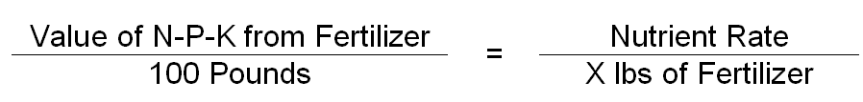
Calculating Fertilizer Application Rates
How many pounds of fertilizer do you need to apply in order to get enough nutrients for a plant?
Notes:
Explain to students where the numbers for each component of the formula are derived.
Value of N-P-K from the fertilizer bag or information sheet - Students will use the fertilizer percentage for the nutrient being determined to apply to the plants.
Explain that the 100 pounds is the conversion factor for the percentage.
Nutrient Rate is the volume or weight that is needed to be applied.
Students will calculate fertilizer rates in Part 2 of Activity 6.1.3 Fertilizer Figures.

Slide 11
Let’s try a rate calculation…
You want to add fertilizer to a family member’s yard.
They have 1000 square feet of lawn
Recommended amount of nitrogen application is 1 lb /1000 sq. ft.
The fertilizer you have is 16-16-16
How much nitrogen fertilizer should you apply?

Slide 12
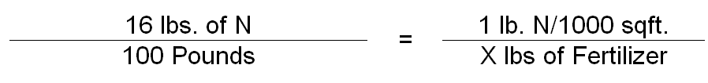
Problem Solved
Set up the formula:
16x = 100
x = 6.25 lbs. of fertilizer
for every 1000 sq. ft.

Slide 13
Calculations Depends on Form
Dry fertilizers are expressed in weight measurements
Liquid or water soluble fertilizers are expressed in parts per million (ppm)
Notes:
The PPM formula is given during Activity 6.1.3 Fertilizer Figures.

Slide 14
Fertilizer Cost
Cost can be confusing…
Why does a 100 lb bag of 20-20-20 cost twice as much as a 100 lb bag of 10-10-10?
Nutrient content is based on percentage, 20-20-20 has twice as much nutrient value as 10-10-10.
Notes:
Formulas are presented in Activity 6.1.3 Fertilizer Figures.

Slide 15
References
Parker, R. (2010). Plant and soil science: Fundamentals and applications. Clifton Park, NY: Delmar.
Plaster, Edward J. (1992). Soil science and management (2nd Ed.). Albany, NY: Delmar.

