Slide 2
Flower Parts and Function Unit 4 – Anatomy and Physiology Lesson 4.5 Flower Power
Principles of Agricultural Science – Plant
Notes:
The following PowerPoint® presentation will introduce students to the various parts of the flower and the function each part serves in the reproductive process. In addition, students are introduced to types of flowers, such as perfect, pistillate, and staminate.

Slide 3
Value of Flowers
Human value:
Aesthetics (Beauty)
Career and SAE opportunities
Value to the plant:
Pollination
Fertilization
Seed development
Notes:
Humans use flowers in various ways to promote beauty in their living environments. Many people may believe the purpose of flowers is the aesthetic value they bring to humans. This is not exactly true if we consider the value flowers have for plant reproduction.
For the plant, the purpose of flowers is to reproduce by developing viable seeds. To accomplish sexual reproduction, the plant will go through three major propagation processes.
Pollination – The transfer of pollen to the female reproductive parts.
Fertilization – The uniting of pollen and ovule cells.
At this point seed development can happen.

Slide 4
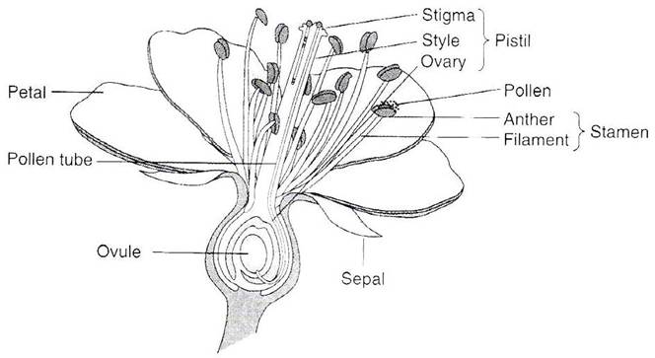
Parts of the Flower
Let’s take a minute to review the following parts of the flower:
Parker, 2004
Notes:
Students should draw a flower and label the parts in their notes. Pages 48-54 in Plant and Soil Science: Fundamentals and Applications has a more detailed overview of flower parts and function.

Slide 5
Female Flower Parts
Ovule: “egg cell” of the plant. Becomes the seed when fertilized
Pollen tube transfers pollen from stigma to ovule
Pistil
Stigma collects pollen
Style supports stigma
Ovary contains one or more ovules
Notes:
The above parts and their functions provide a review of the terminology associated with female flower parts.
The specific terms listed in the Key Terms of the lesson are in bold print on this slide.
NOTE: Please refer to the Key Terms for definitions with additional details.

Slide 6
Male Flower Parts
Stamen:
Filament supports anther
Anther develops and contains pollen.
Pollen – male sex cell
Notes:
The above parts and their functions provide a review of the terminology associated with male flower parts.
The specific terms listed in the Key Terms of the lesson are in bold print on this slide.
NOTE: Please refer to the Key Terms for definitions with additional details.

Slide 7
Supporting Parts
Petal: Protects pistil and stamens, and attracts insects for pollination.
Sepal: Outermost leaves protecting the flower during the bud stage.
Notes:
The above parts and their functions provide a review of the terminology associated with flower parts.
The specific terms listed in the Key Terms of the lesson are in bold print on this slide.
NOTE: Please refer to the Key Terms for definitions with additional details.

Slide 8
Types of Flowers
Complete: Contains all major flower parts including petals, sepals, and both reproductive organs.
Perfect: Includes both female and male reproductive parts.
Incomplete: Missing one or more of the sepals, petals, stamens, or pistils.
Imperfect:
Pistillate
Staminate
Notes:
Four types of flowers exist based on anatomical arrangement of reproductive structures; complete, perfect, incomplete, and imperfect. The value of knowing this information is for identification and classification purposes.

Slide 9
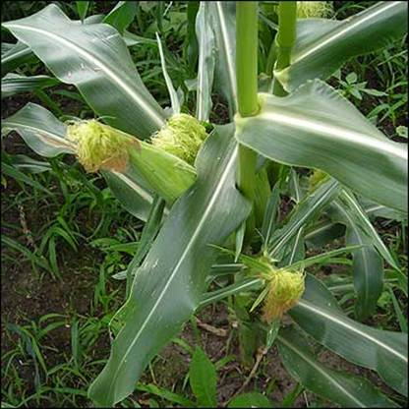
Pistillate Flowers
The flower is lacking stamens.
The ear on a corn plant is an example of a pistillate flower.
Notes:
An ear of corn is fine example of a pistillate flower. The “silk” coming out of the top of the ear are extensions of the stigma that transfers the pollen grain to individual kernels or seeds.

Slide 10
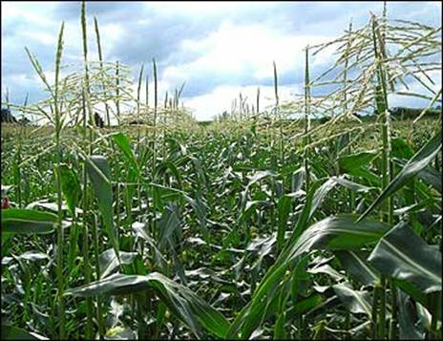
Staminate Flowers
The flower is lacking a pistil.
The tassel on a corn plant is an example of a staminate flower.
Notes:
The tassel of the corn plant relies on wind and gravity to transfer the pollen of the plant to the pistillate flowers below.

Slide 11
References
Parker, R. (2004). Introduction to plant science (Rev. ed.). Clifton Park, NY: Delmar.
Parker, R. (2010). Plant and soil science: Fundamentals and applications. Clifton Park, NY: Delmar.
United States Department of Agriculture. (2006). Floriculture and nursery crops yearbook. Retrieved from http://usda.mannlib.cornell.edu/usda/ers/FLO-yearbook//2000s/2006/FLO-yearbook-06-23-2006.pdf
Notes:
The following references may be used by the teacher or the students for doing additional research or acquiring information.

