Slide 2
Internal Parts and Function of Leaves
Unit 4 – Anatomy and Physiology
Lesson 4.4 Leave It to Leaves
Principles of Agricultural Science – Plant
Notes:
Leaves contain several internal structures that are important for understanding the vital functions leaves serve. Internal parts and their related functions are explained in this presentation which introduces information students may need for Activity 4.4.2 Sugar Factory.

Slide 3
What Leaves Do…
Major functions that leaves provide:
Transpiration
Photosynthesis
Food storage
Notes:
Transpiration and photosynthesis will be introduced in the following slides and studied further in future lessons.

Slide 4
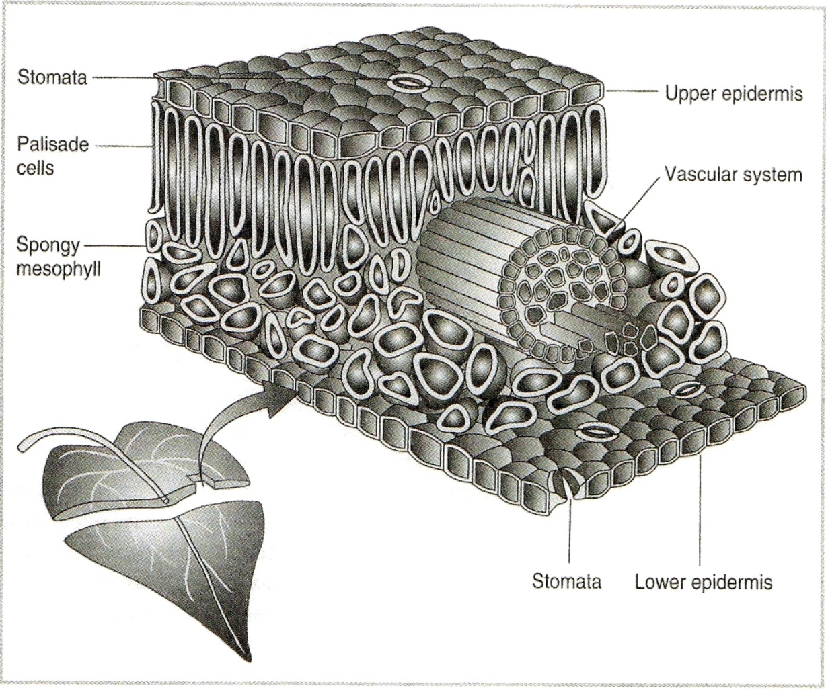
How the Leaf Does It…
Parker, 2004
Notes:
Note the vascular system running through the center of the leaf. The vascular system was explored in Lesson 4.3 Stems, Stalks, and Trunks.

Slide 5
Internal Parts
Epidermis
  Skin or barrier to prevent injury to leaf cells
Palisade cells
  Cells primarily responsible for photosynthesis
Spongy mesophyll
  Adds structure to leaf
Stomata
  Pores allowing the plant to breath
  Stomata are used to cool the plant through the process of transpiration
Notes:
This slide provides an explanation of the function for the internal parts that were introduced in the previous slide.

Slide 6
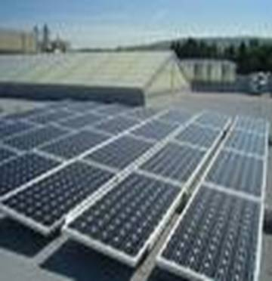
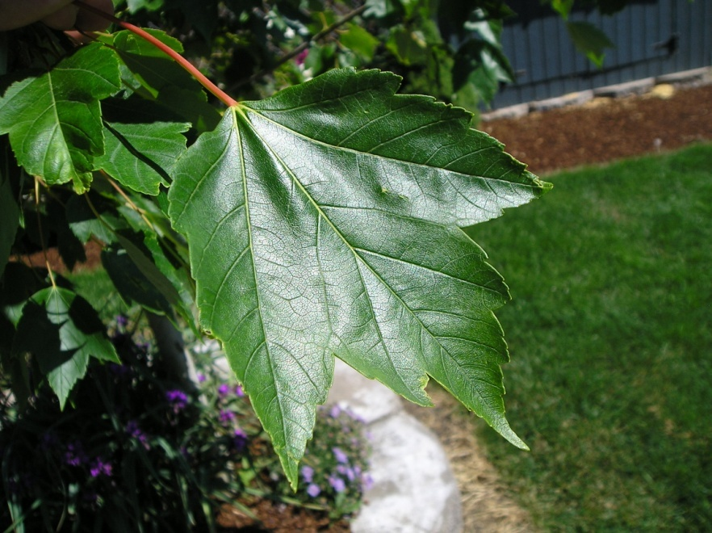
Solar Panels
Leaves collect sun energy using chlorophyll found in plant cell organelles (chloroplasts)
Notes:
The analogy of solar panels illustrate the collection of solar radiation by the plant leaves.

Slide 7
Food Production
Plants use the energy from the sun to convert water and carbon dioxide into sugar (glucose), water, and oxygen.
Do you know what the process of making food in this manner is called?
Photosynthesis
Notes:
Sugar produced by photosynthesis is called glucose. However, glucose is converted into starch, cellulose, sucrose, and fats or oils.

Slide 8
Food Storage
Glucose produced during photosynthesis is stored in plant parts as an energy source to be available when needed.
In the leaf, glucose is converted to cellulose and stored in leaf cells.

Slide 9
Reference
Parker, R. (2004). Introduction to plant science (Rev. ed.). Clifton Park, NY: Delmar.
Parker, R. (2010). Plant and soil science: Fundamentals and applications. Clifton Park, NY: Delmar.

