Slide 2
Stem Facts Unit 4 – Anatomy and Physiology Lesson 4.3 Stems, Stalks, and Trunks
Principles of Agricultural Science – Plant
Notes:
The following presentation introduces students to external and internal structures of the stem. In addition to the anatomical features, an overview of the various types of stems is provided. This presentation introduces information necessary for Activity 4.3.1 Examining Stems.

Slide 3
Function of Stems
Provide physical support
Aid in translocation of nutrients
Store food reserves
Site of photosynthesis
Notes:
The function of stems was introduced in Introduction to Agriculture, Food, and Natural Resources and again in ASP Lesson 4.2 The Radicle Root. This slide should be used as a review of prior knowledge.

Slide 4
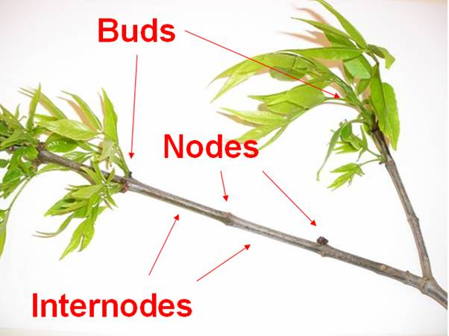
External Parts
Notes:
The three major external parts of a stem are the buds, internodes, and nodes. In this picture the buds have sprouted with new growth of leaves.

Slide 5
Internal Parts
Annual rings (woody plants)
Phloem (cambium – woody plants)
Pith or Secondary Xylem (woody plants)
Xylem
Phloem and xylem comprise the vascular system
Notes:
Internal parts are essential for translocation of raw materials, sugars, and water throughout the plant.
Phloem and xylem make up the vascular system, which will be important for students to know as they try to distinguish monocotyledon from dicotyledon plants.

Slide 6
Function of Xylem and Phloem
Xylem
Translocate water and dissolved nutrients upward from the roots throughout the plant.
Phloem
Carry synthesized food (sugars) downward from leaves and other photosynthetic regions throughout the plant growing regions.
Notes:
Translocation and photosynthesis are two terms to review during this slide.
Translocation
The transfer of the products of metabolism, etc., from one part of a plant to another.
Photosynthesis
Process by which green plants, using chlorophyll and the energy of sunlight, produce carbohydrates from water and carbon dioxide, release oxygen.

Slide 7
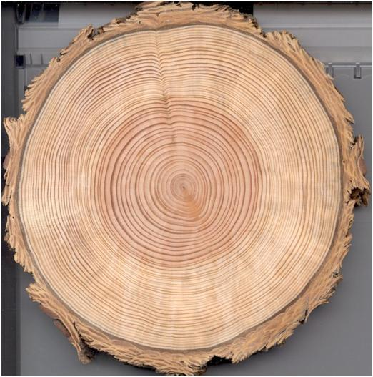
Internal Parts Labeled
Annual Ring
Bark
Pith
Phloem/Cambium
Xylem
Notes:
Check student understanding of internal structures of a tree.
Ask students to see if they can identify the internal parts of a tree shown. The next slide shows the parts labeled.

Slide 8
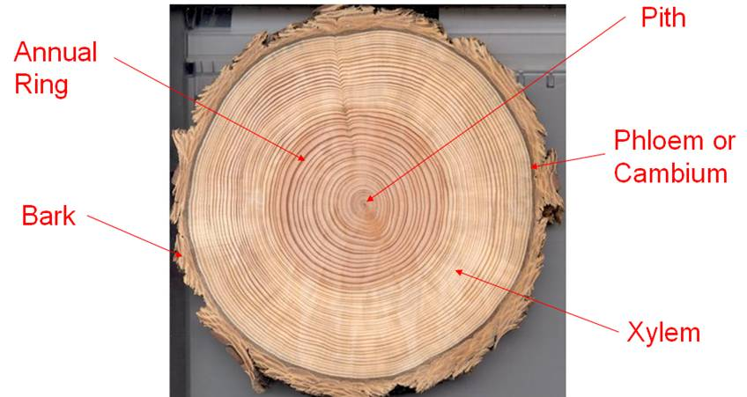
Internal Parts Labeled
Notes:
Students will use knowledge related to secondary xylem tissue, known as tree rings, to determine the age of a tree.
Dendrochronology is the study of tree rings used to determine the age of trees. Tree rings are actually the record of growing seasons for a tree.

Slide 9
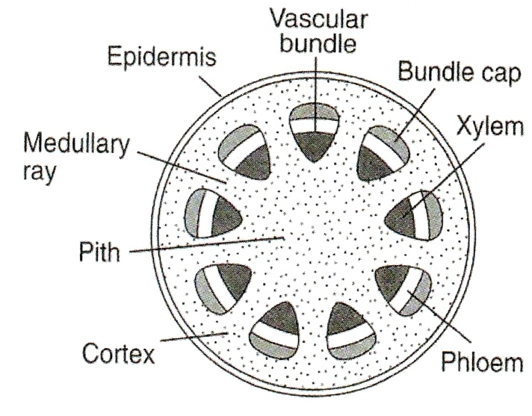
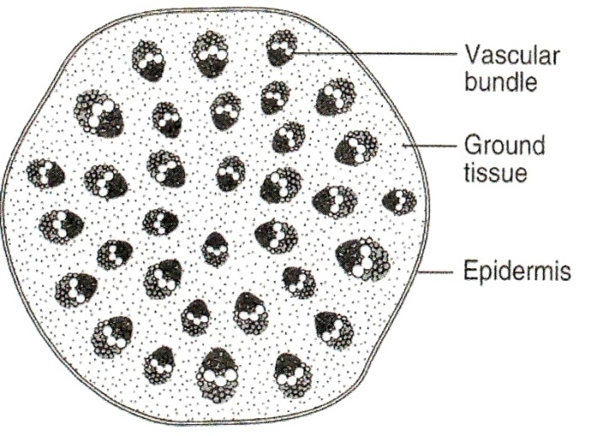
Monocotyledon versus Dicotyledon
The arrangement of the vascular system provides evidence to distinguish between monocotyledon and dicotyledon plants
Parker, 2004
Monocotyledon
Dicotyledon
Notes:
The major difference to point out is that monocotyledons have vascular bundles that are scattered throughout the plant stem. Dicotyledon plants have vascular bundles that tend to be around the outer region of the stem wall. Thus, the dicotyledon has an open center to the stem called the pith. In woody dicotyledons, the phloem and xylem are separate and are found at different depths horizontally through the stem.
Image Reference
Parker, R. (2004). Introduction to plant science (Rev. ed.) pg 36. Clifton Park, NY: Delmar.

Slide 10
Strength of Stems
Herbaceous
Herbaceous stems rely on water pressure, known as turgor.
Modified
Woody
Rigid, or woody, stems derive their strength from extra thick cell walls.
The specific material which comprises the rigid cell walls is called hemicellulose and lignin.
Notes:
Three major categories of stems are illustrated in the next three slides.

Slide 11
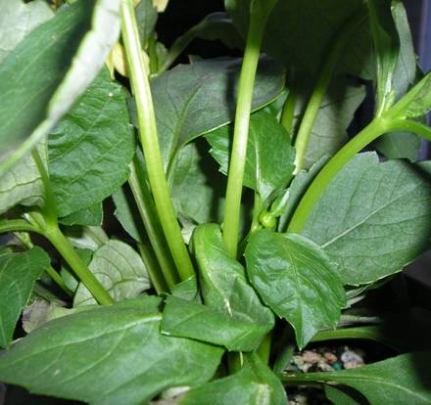
Herbaceous Stems
Physical support is a result of turgor or internal water pressure.
Notes:
Herbaceous stems rely on internal water pressure to keep the plant upright. The water is also essential for translocation to occur.

Slide 12
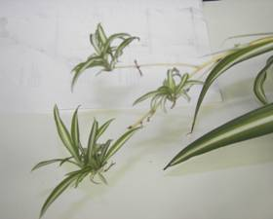
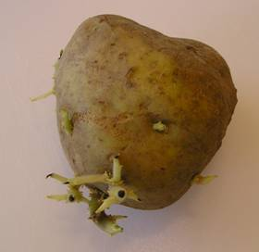
Modified Stems
Types of modified stems:
Bulbs
Corms
Rhizomes
Runners
Tubers
Runner
Tuber
Notes:
Modified stems are a natural process many plants use to propagate asexually. More regarding asexual propagation will be presented in a later unit.

Slide 13
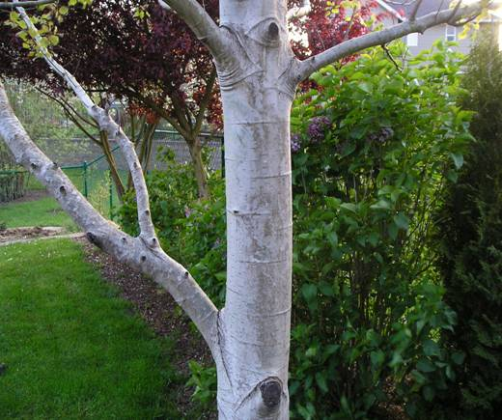
Woody Stems
Physical support is a result of rigid cell walls.
Notes:
Many perennial species of plants are hardwood or semi-hardwood stemmed.
The fibers that make up the cell walls and provide strength for the stem are the same fibers humans count on for many uses, such as lumber and paper.

Slide 14
References
Parker, R. (2004). Introduction to plant science (Rev. ed.). Clifton Park, NY: Delmar.
Parker, R. (2010). Plant and soil science: Fundamentals and applications. Clifton Park, NY: Delmar.
Schooley, J. (1997). Introduction to botany. Albany, NY: Delmar Publishers.

