Slide 2
Root Absorption Unit 4 – Anatomy and Physiology Lesson 4.2 The Radicle Root
Principles of Agricultural Science – Plant
Notes:
The following presentation prepares students for Activity 4.2.4 Just Passing Through and discusses concepts related to root hairs, osmosis, diffusion, and turgidity.

Slide 3
Check for Understanding…
How do plant roots “absorb” water?
Root Physiology Misconception:
Many speculate that roots act like sponges, absorbing water by pulling it into the root.
In reality the root doesn’t “absorb” water.
Water uptake is a physiological process involving osmosis.
Notes:
This is a quick review to check for student misconceptions.
Write a short paragraph that answers the question. NOTE: If students are not sure of the correct answer, direct them to explain their best guesses.
Definition for osmosis is provided in upcoming slides.
Ask students how they believe materials gain access to cells (this is the topic for the upcoming slides).

Slide 4
Cell Access
Passive transport: requires no energy output from the cell to transfer substances in and out of the cell.
Active transport: requires an output of energy from the cell to move substances.
Notes:
There is resistance for materials moving through the cell membrane. Some materials that pass through easily do so with passive transport. Passive transport requires no energy output from the cell and materials move across the cell membrane quickly. Diffusion and osmosis are both examples of passive transport.
When materials are too large or too slow passing through the cell membrane, active transport occurs. Cells expend energy during active transport. Endocytosis is a method of active transport.

Slide 5
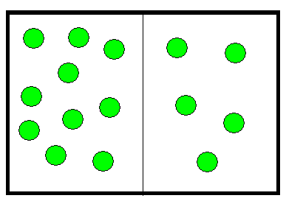
Diffusion
The movement of particles from areas of higher concentration to areas of lower concentration.
Which way will the substance move?
Notes:
Diffusion is the process that allows small molecules to move across cell membranes from areas of higher concentration to areas of lower concentration until equilibrium is reached. This process helps cells and bodies maintain homeostasis.

Slide 6
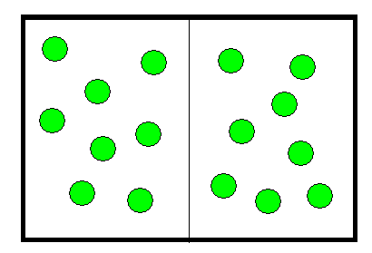
Diffusion
Diffusion occurs until there is equilibrium.
Notes:
Diffusion will occur until there is a balance of the substance on each side of the membrane, such as dissolved plant nutrients.
Important: Think of osmosis for water and diffusion for nutrients.

Slide 7
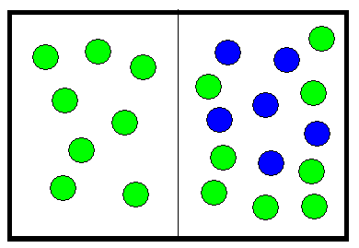
Osmosis
Diffusion of water through a semi-permeable membrane separating two solutions.
Maintains the level of water necessary in the cell.
Which way will the water move?
Notes:
Osmosis is a special type of diffusion, which allows water molecules to move across cell membranes.
In Activity 4.2.4 Just Passing Through, students will explore the concepts of osmosis and diffusion.

Slide 8
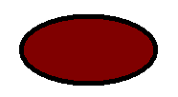

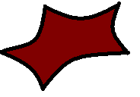
What happens in osmosis?
As water reaches equilibrium, a cell may be dehydrated or over-hydrated:
Hypertonic:
Lower H₂O conc. out of cell, H₂O moves out = cell shrinks
Isotonic:
H₂O conc. in cell = H₂O conc. out of cell.
Hypotonic:
Higher H₂O conc. out of cell, H₂O moves in = cell expands.
Notes:
Osmosis is essential for maintaining balance, but it can also cause problems. When water concentrations are equal in the cell and outside of the cell, the solution is isotonic. This is the normal and healthy state for most cells.
If the concentration of water is higher outside of the cell, water moves into the cell causing it to expand and the solution is considered hypotonic. Plants have an organelle, the vacuole to pump excess water out and maintain correct pressure. In animal cells, the cytosol must expend energy to pump excess water out. If water movement into a cell exceeds the ability of the cell to remove water, the cell may burst.
If the concentration of water is lower outside of the cell, water moves out causing the cell to shrink. This solution is considered hypertonic. Dehydration occurs in both plants and animals. In plants this is called wilting. Without sufficient water the cell may die.

Slide 9
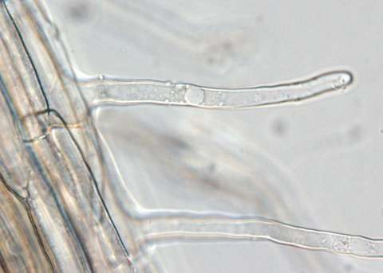
So Where Does Osmosis Happen?
Water and dissolved nutrient uptake happen through the root hairs.
Root hairs are specialized epidermal cells on the surface of roots.
(University of Wisconsin-Madison, 2008)
Notes:
The picture illustrates a magnified grass seedling root hair. It is important to point out that a root hair is a single specialized cell. Notice the nucleus is clearly visible in the uppermost root hair cell. Root hairs only survive about 24 hours and are replaced with newly generated root hair cells.

Slide 10
Fluid Transfer
As the plant consumes water, water and dissolved nutrients are drawn up the plant stem.
This causes an unbalance between the cell content and soil.
Water and dissolved nutrients pass through the cell membranes of root hairs to balance the deficiency.
Notes:
Transpiration will be studied in a later lesson and will relate the “pull” of water and nutrients through the plant. Transpiration pull is also related to turgidity discussed on the next slides.
More on translocation (movement of fluid through the plant system) will be discussed in Lesson 4.3 Stems, Stalks, and Trunks.

Slide 11

The Concept of Turgor
Internal water pressure of a plant
Balloon analogy:
If fully inflated a balloon can stand up vertically and be very rigid.
If the balloon does not have enough pressure, it will flop over and not stand up.
Notes:
Optional: Pass balloons out to students and have them simulate turgidity as described on the slide…you could also have them blow the balloons until they pop.

Slide 12
Bounty of Water
Soil can’t distribute “too much water” to plants unless it is saturated.
The plant won’t absorb any more water if turgid.
If the soil is saturated with water, the root hairs die from the lack of oxygen, and thus end the uptake of water and nutrients.
Notes:
Like a balloon with too much air, too much water could cause plant cells to burst under the pressure. However, not many plant cells would do this because of rigid cell walls.

Slide 13
Not Enough Water
The plant reaches its wilting point:
Plants without enough water will deflate
If no water is present in the soil, some water loss will happen from the roots.
This causes the plant to wilt very fast and shut down physiological processes.
Notes:
Wilting point is a measurement indicator of loss of turgidity in plant systems. This is the equilibrium point between adequate soil water and deficient soil water.

Slide 14
References
Herren, R. V., & Donahue, R. L. (2000). Delmar’s agriscience dictionary with searchable CD-ROM. Albany, NY: Delmar.
Schooley, J. (1997). Introduction to botany. Albany, NY: Delmar Publishers.
University of Wisconsin-Madison Department of Botany. (2008). Retrieved from http://botit.botany.wisc.edu/Resources/Botany/Root/Grass%20Root%20Tip/Root%20tip.jpg.html

