Slide 2
Water Works
Unit 3 – Soilless Systems
Lesson 3.2 Hydroponics
Principles of Agricultural Science – Plant
Notes:
This presentation examines what hydroponics is, the advantages of hydroponics over the traditional method for the production of plants, and the components that are used in hydroponic systems.

Slide 3
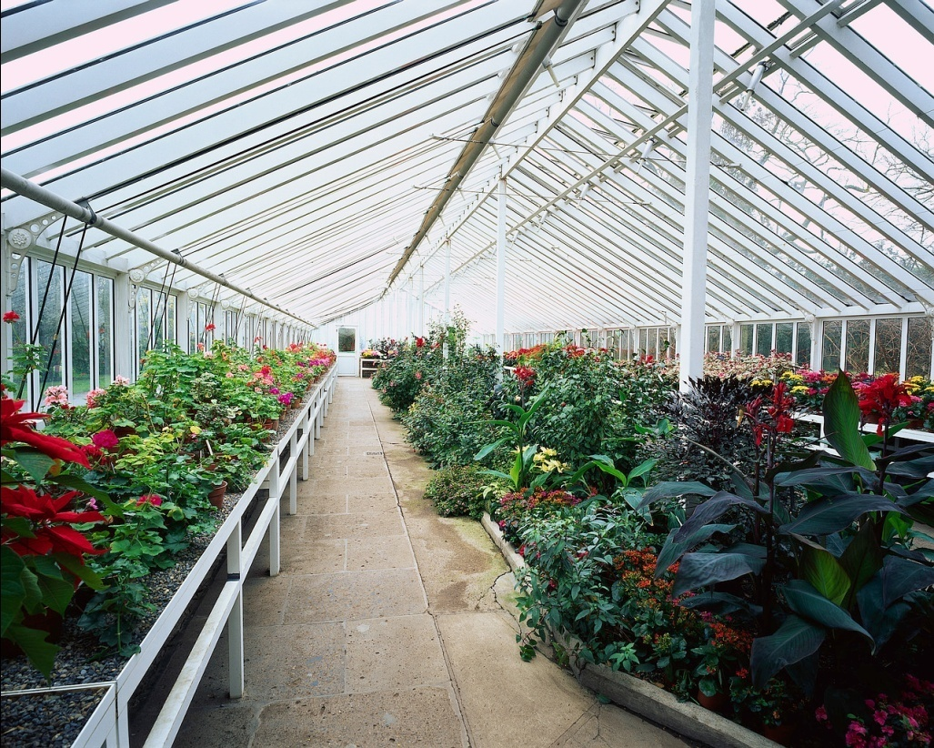
What is hydroponics?
Hydroponics is the growing of plants with no soil
Plants are grown in a media with no nutrient value
Notes:
Hydroponics is a soilless system of growing plants where a controlled environment is used to monitor all aspects of plant requirements for growth. The media that plants are grown in will have no nutritional value, it simply provides support to anchor the plant.

Slide 4
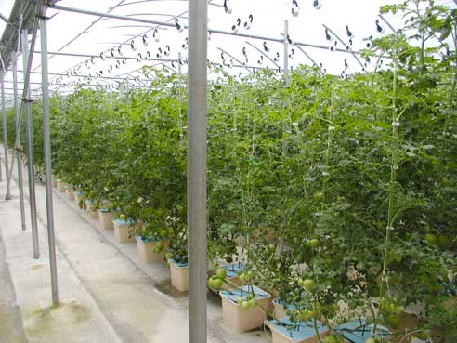
Uses of Hydroponics
Most species of plants will grow in this culture, but the most common are:
  Tomatoes
  Cucumbers
  Peppers
  Roses
(USDA, 2009)
Notes:
Hydroponics can be used for almost any kind of plant species. Some plant species don’t do well in very wet conditions and they are the exception.
Image was obtained from http://www.wv.nrcs.usda.gov/news/images/06success/ama_mtclare_weaver/overvieww.jpg

Slide 5
Advantages
Less space
Less growing time
Reduced labor
Conserved water
Nutrient recycling
Better control of pest, weed, and disease problems
No soil-borne pests
Higher yields
Notes:
The advantages of hydroponics all point toward the better use of space and time while limiting the number of soil borne diseases. Higher yields of crops will be experienced from a hydroponic system with the use of less water. A hydroponic system will use between 5% and 10% of the total amount of water used in a traditional production setting.

Slide 6
Disadvantages
High set-up cost
Additional skill and knowledge needed
Diseases spread faster
Plants react quickly to positive AND negative changes
Notes:
Costs and monitoring of growth requirements are the major disadvantages. Diseases can spread faster and more skill is needed to identify and monitor the needs of the plants in a hydroponic system.

Slide 7
Components of a Hydroponic System
Hydroponic systems must provide the following:
Plant support
Water
Oxygen
Mineral nutrients
Light
Temperature
Spacing

Slide 8
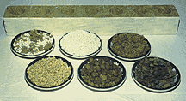
Support Substances
Plants still need support when there is no soil.
Soil substitutes include:
Rock wool
Sand
Perlite
Vermiculite
Notes:
The support media replaces the soil and can be anything the roots can grab on to. The media should not be able to break down and will absorb and retain water for plant use.

Slide 9
Water and Oxygen
Water
Provided directly to the roots
Plants do not have to spend energy looking for water
Quality – pH and salt content – must be monitored
Oxygen
Required in the media to avoid killing roots
Notes:
Water is a requirement for all plants and with a hydroponic system the roots may be completely submerged in water for the entire life of the plant. To avoid rotting of the roots, oxygen must added to the water. This is monitored by measuring the dissolved oxygen level of the water exposed to the plants roots. More about water and oxygen later in the lesson.

Slide 10
Nutrients
Mineral Nutrients
Macro- and micronutrients are added in premixed forms and diluted in the water
Notes:
Nutrients are also mixed in the water to provide the minerals needed for vegetative, root, reproductive, and fruit growth.

Slide 11
Light and Temperature
Light
8-10 hours of light needed per day
Temperature
Regulate air temp
Regulate media temp
Notes:
Plants need light for photosynthesis. The temperature of the water and media will encourage or discourage vegetative growth. The optimum temperature will vary based upon the type of plants being grown. The average daytime temperature is 75 degrees Fahrenheit and the average night time temperature is 65 degrees Fahrenheit. Greenhouses are used to meet the optimal requirements for plants year round.

Slide 12
Give me room!
Spacing
Hydroponic systems allow for growing more plants per square foot.
Vertical space is utilized in a greenhouse to increase the efficient use of space.
Notes:
Because of the readily available water and nutrients, plant spacing can be much closer in a hydroponic system and in addition can be grown vertically as well. Plants are not competing with each other for most resources since optimal levels are being provided. The major limiting factor is the light availability if plants are too crowded.

Slide 13
References
Burton, D. L., & Cooper, E. L. (2007). Agriscience fundamentals and applications (4th ed.). Clifton Park, NY: Delmar.
The Growing Edge. (2008). The growing edge of hydroponic basics. Retrieved from http://www.growingedge.com/basics/start.html

