Slide 2
The Problem with pH Unit 2 – Mineral Soils Lesson 2.2 Soil Chemistry
Principles of Agricultural Science – Plant
Notes:
This presentation is an overview of general pH principles and how pH is important for soil chemistry. This basic overview will help students with Activity 2.2.1 What is the pH Problem?

Slide 3
What is pH?
pH is the measure of acidity or alkalinity in a soil, based on the balance of hydrogen ions (H+) and hydroxyl ions (OH-).
Acid: substance with a pH value less than 7.0; caused by a higher concentration of hydrogen ions (H+).
Alkaline: substance with a pH value greater than 7.0; caused by a higher concentration of hydroxyl ions (OH-).
Notes:
Definitions are essential for pH concepts.

Slide 4
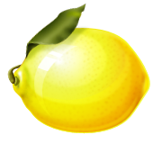
pH: The Sweet and Sour of Soil
Acidic substances are sour, such as lemons and vinegar.
Alkaline, or basic, substances are rather bitter, such as sea water and baking soda. But compared to acids, alkaline substances are referred to as sweet.
Notes:
Sweet and sour are traditional terms used to describe acid or alkaline soils. At one time producers would taste the soil to detect these characteristics.
Now very simple and inexpensive testing devices are used to measure the exact pH to determine soil management decisions.

Slide 5
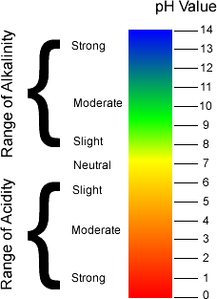
pH Scale
Measured on a scale of 0 - 14.
7.0 is neutral.
Each pH point multiplies the pH factor by 10.
For example:
A pH of 5.0 is 10 times more acidic than pH 6.0 and 100 times more acidic than pH 7.0.
Notes:
Distilled water would be an example of a pH neutral substance.
Let’s try another pH calculation:
How many times more alkali is 9.0 from 6.0? (1000 times)

Slide 6
Who cares about pH?
Soil pH is important to horticulturalists and crop producers because of its influence of nutrient availability in the soil.
At the ideal soil pH level, plants can uptake soil nutrients required for growth and health.
Certain soil nutrients become unavailable at different pH levels.
Notes:
pH is an important consideration for any plant production industry because pH will determine the efficiency of plants to utilize fertilizers added for optimal growth. If pH is not optimal for the plant, many nutrients added in the form of fertilizer are washed away rather than used for plant growth and health.

Slide 7
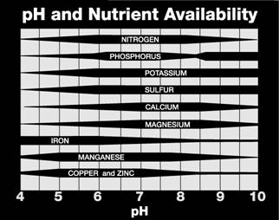
Available Nutrients
Different plant nutrients are affected by pH levels
(The wider the bar the more available the nutrient is to the plant)
Redding, K., & Masterman, D. (2007).
Notes:
In the figure above, the thicker the bar indicates the best range for availability of nutrients for plant uptake. The chart shows a range of approximately 6.0 to 8.0 as optimal for nutrient availability. Notice how nitrogen becomes less available for plants starting at pH 5.5 and pH 8.5. Soils with a pH level below 4.0 and greater than 10.0 will not support many species of plants.
The pH and Nutrient Availability diagram in the above slide can also be found on page 145 of Plant and Soil Science: Fundamentals and Applications (Parker, 2010) for future reference.
You will explore more about specific plant nutrients and the relationship with pH in Lesson 6.1 Plant Food later in the course.
Chart source: Johnson, R. L., Stahmer-DeMoss, G., & Sorensen, R. (2007). Earth Science with Vernier. Beaverton, OR: Vernier Software & Technology.

Slide 8
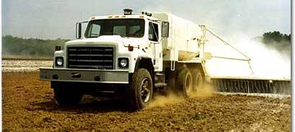
Changing pH
Low pH levels in soil can be changed by adding a buffer, such as lime to the soil. Lime raises soil pH to a more acceptable level.
Soil pH can also be lowered by adding sulfur compounds to the soil.
Notes:
You will explore buffering and correction of soil pH in Activity 2.2.2 Correction of a pH Problem.

Slide 9
References
Feldkamp, S. (Ed.). (2002). Modern biology. Austin, TX: Holt, Rinehart, and Winston.
Owings, A., et.al. (2006). The Louisiana manual for the environmental horticulture industry. Louisiana Association of Nurserymen. Baton Rouge.
Plaster, E. J. (2003). Soil science and management (4th ed.). Clifton Park, NY: Delmar.
Redding, K., & Masterman, D. (2007). Biology with Vernier. Beaverton, OR: Vernier Software & Technology.

