Slide 2
Water Behavior
Unit 2 – Mineral Soils
Lesson 2.1 Understanding Soil Properties
Principles of Agricultural Science – Plant
Notes:
The ability and rate that water filters through the soil are examined in the following presentation.
Two main concepts, permeability and water holding capacity are introduced.
Both permeability and water holding capacity are influenced by soil porosity.

Slide 3
Relationships of Soil & Water
Two principles define soil and water relationships:
Permeability rate – how quickly water moves through soil
Water holding capacity – how much water is retained by soil particles
Notes:
Both permeability and water holding capacity determine the quality of a soil in the way water is filtered or retained in the soil.

Slide 4
Permeability
Depends upon:
Texture
Structure
Organic Matter
Porosity
Notes:
A definition of permeability.
Three factors influence the rate of water moving through the soil: soil texture, soil structure, and soil porosity.
Porosity will be discussed on the next slide.

Slide 5
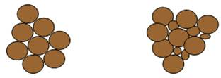
Porosity
Pores in the soil are created by:
Roots and other organic matter (i.e., decaying substances)
Animals, such as worms and rodents
Soil particle size and “fit”
Notes:
A definition for porosity: Refers to the extent of voids or openings in the soil that exist between soil particles and soil peds or clods.

Slide 6
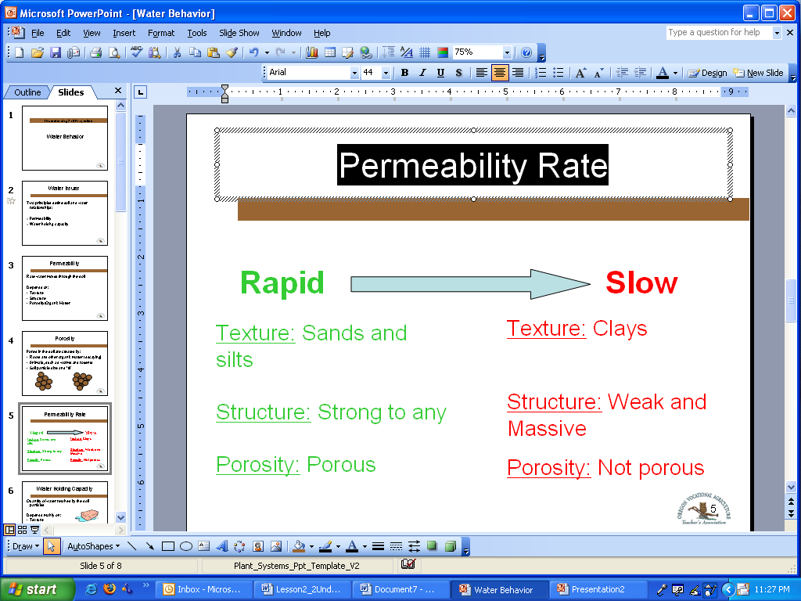
Permeability Rate
Notes:
The illustration above provides a guide for the effects of soil characteristics on permeability rates.
Knowledge related to the differences in soil textures and structure will be necessary to predict permeability rates for a soil.
The relationship of porosity to permeability is also illustrated. That is, the more porous a soil the faster the rate of permeability.

Slide 7
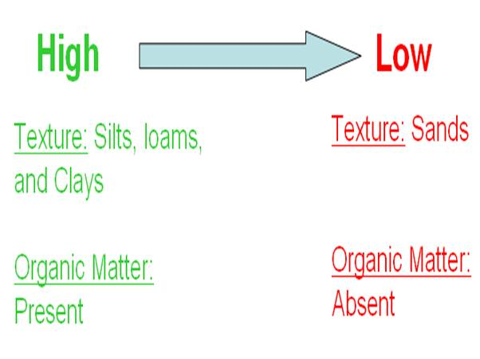
Water Holding Capacity
Notes:
Water holding capacity depends mainly on texture, and is improved by organic matter will also provide clues for determining the quality of a soil.
The analogy of a sponge representing water holding capacity will be used in further detail as part of Activity 2.1.4 The Sponge Effect.

Slide 8
Types of Soil Water
Plants can’t use all soil water.
Available water is free to plants for use.
Unavailable water is held too tightly by clay particles and surface tension.
Saturated soils have excess water that will run off increasing erosion concerns.
Notes:
Water is important for plant growth and maintenance. Plants obtain water through their roots that are anchored in the soil. Plants will die without enough water.
However, not enough water is only half of the problem for plant growth, sometimes too much water causes growth problems. Too much water is also responsible for other negative soil aspects, such as erosion.

Slide 9
References
Huddleston, J. H., & Kling, G. F. (1996). Manual for judging Oregon soils. Corvallis, OR: Oregon State University.
Parker, R. (2010). Plant and soil science: Fundamentals and applications. Clifton Park, NY: Delmar.

