Slide 2
The Size of the Matter Unit 2 – Mineral Soils Lesson 2.1 Understanding Soil Properties
Principles of Agricultural Science – Plant
Notes:
Sand, silt, and clay make up the three main particle sizes of soil.
The following presentation introduces these particles and provides a method to determine their presence in a soil sample.
The textural triangle is also introduced to help students classify soil based on the percentage of sand, silt, and clay present in a sample.

Slide 3
The Components
Soils have four main components that make up the whole
Notes:
The four components are defined in more detail in the next several slides.

Slide 4
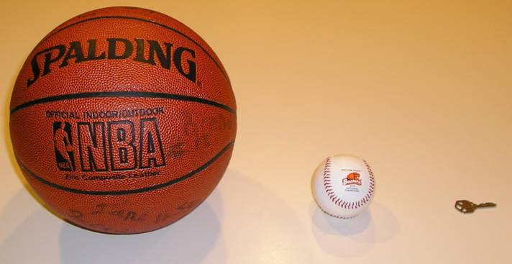
Soil Mineral Particles
Sand
Silt
Clay
Notes:
This is a comparison of the relative size among the three particles using objects you are familiar with – a basketball representing a grain of sand, a baseball representing a particle of silt, and a key representing clay.

Slide 5
Sand
.05 – 2 mm
Round shape
Feels gritty
Attributes to Soil
Adds porosity
Reduces water holding capacity
Notes:
Think about beach or river sand or textures you have felt in a sand box when you were young.
The feeling is described as being “gritty”.

Slide 6
Silt
.002 - .05 mm
Round shape – but very small to detect
Feel smooth but does not stick together very well
Attributes to Soil
Moderately good for porosity
Helps water holding capacity
Notes:
Silt has the texture of flour, but it is not sticky when wet – just smooth.

Slide 7
Clay
Less than .002 mm
Flat or platy
Sticky when wet – ribbon test
Bad for porosity
Ties up water so plants can’t use it
Notes:
Clay is very slick and sticky when wet. You can conduct a ribbon test to determine how much clay content is present in a sample of soil.
The ribbon test requires you to moisten a soil sample and work the moistened soil between your thumb and forefinger pushing a thin ribbon upwards. The longer the ribbon formed, the more clay present. If no ribbon forms or only a small ribbon forms and breaks off, the sample has more sand and silt present than clay.
REFERENCE:
See Plaster, E. J. (2003). Soil science & management (4th ed.) pp 51-54. Clifton Park, NY: Delmar.

Slide 8
Testing for Particles
A simple field test allows you to determine if the three particles are present.
If you detect clay, you can perform a ribbon test to determine the approximate amount of clay in the soil sample.
Notes:
The two tests will be conducted by students in Activity 2.1.1 Testing the Feel for Soil. The specific steps are detailed in the activity’s procedure section.

Slide 9
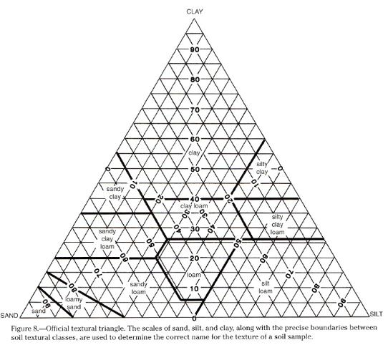
The Textural Triangle
The triangle helps you determine classifications for soil textures
Huddleston & Kling, 1996
Notes:
The soil textural triangle is a tool to help classify soils based on their percentages of sand, silt, and clay.
A version of this triangle is found in Parker, R. (2010). Plant and soil science: Fundamentals and applications. Clifton Park, NY: Delmar, pp 113.
Some instruction will need to be provided in order for students to use the triangle.
Activity 2.1.1 Testing the Feel for Soil will provide an opportunity to utilize it further.

Slide 10
Loams
A soil that is a mixture of sand, silt, and clay is called “Loam.”
Loam soils are optimal soils for growing plants.
Notes:
Loams will be important to discuss because typically soils are not pure.
Loams provide a balance of good porosity and water holding capacity. These are two essential properties of soils this lesson will examine in more detail.

Slide 11
References
Huddleston, J. H., & Kling, G. F. (1996). Manual for judging Oregon soils. Corvallis, OR: Oregon State University.
Parker, R. (2010). Plant and soil science: Fundamentals and applications. Clifton Park, NY: Delmar.
Plaster, E. J. (2003). Soil science & management (4th ed.). Clifton Park, NY: Delmar.

