Slide 2
Structure and Depth Perception
Unit 2 – Mineral Soils
Lesson 2.1 Understanding Soil Properties
Principles of Agricultural Science – Plant
Notes:
Soil structure provides clues for how well the entire soil profile will function as a system.
The following slides will introduce soil structure types and grades. It will also discuss how soil structure influences properties, such as rooting depth and drainage characteristics.

Slide 3
Soil Structure
When soil particles cling together in an arrangement known as a ped, it is called structure.
Organic matter is important in soil structure formation.
Two considerations must be made for soil structure:
Structure type – the shape of the ped
Structure grade – the strength of the ped
Notes:
Soil structure is the arrangement of primary soil particles into compound particles or aggregates that are separate from adjoining aggregates.
It is important to note that organic matter has a positive relationship with soil structure grade. In areas of high organic matter production, soils can be found with very well defined structure.

Slide 4
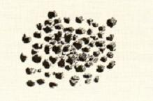
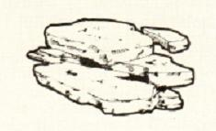
Structure Type
Granular
Roughly spherical, like grape nuts.
Plant roots, microorganisms, and sticky products of organic matter decomposition bind soil grains into granular aggregates.
Platy
Flat peds that lie horizontally in the soil.
(Huddleston & Kling, 1996)
Notes:
Soil structure type is the physical shape the soil aggregate or ped displays. The best way to determine soil type is to break up the clods in your hand with gentle pressure allowing the clod to break apart into these natural forming shapes.
On the slide are two of the six types you could encounter in soil.
REFERENCE:
Picture is from Huddleston, J. H., & Kling, G. F. (1996). Manual for judging Oregon soils. Page 27. Corvallis, OR: Oregon State University.

Slide 5
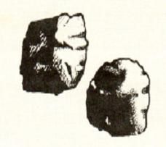
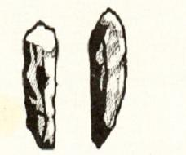
More Defined Structure Types
Blocky
Roughly cube-shaped, with more or less flat surfaces.
Blocky structures are typical of B horizons.
Prismatic
Larger, vertically elongated blocks, often with five sides.
(Huddleston & Kling, 1996)
Notes:
Blocky and prismatic are two common types of structures found in good quality soils.
REFERENCE:
Picture is from Huddleston, J. H., & Kling, G. F. (1996). Manual for judging Oregon soils. Page 27. Corvallis, OR: Oregon State University.

Slide 6
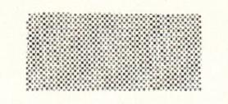
Structureless Types
Massive
Compact, coherent soil not separated into peds.
Small pores, slow permeability, and poor aeration.
Single grain
Every grain acts independently.
No binding agent holding grains together.
Permeability is rapid.
The above structure types are the two extremes in terms of effects on permeability.
(Huddleston & Kling, 1996)
Notes:
Neither massive or single grain are good soils for growing plants. Water will not permeate through a massive soil and water filters through a single grain soil too fast.
REFERENCE:
Picture is from Huddleston, J. H., & Kling, G. F. (1996). Manual for judging Oregon soils. Page 27. Corvallis, OR: Oregon State University.

Slide 7
Structure Grade
Four grades define soils:
Strong – good aeration by ample pore space
Moderate
Weak
Structureless – poor conditions for crop use
Notes:
Soil structure grade is a determination of soil quality as well.
More defined soil peds display better characteristics in terms of water movement and holding capacity.

Slide 8
Effective Depth
Effective depth is the zone, which plant roots can easily grow.
Barriers for root growth are caused by:
Massive soils
Dense soil structure
Poor internal drainage
Abrupt texture changes between horizons
Gravelly and large sands
Notes:
Effective depth is essentially how far plant roots will grow into a soil.
An alfalfa plant, for example, can have roots growing down to depths of over 20 feet. However, if soil conditions are not ideal, such as a massive layer, root growth will be prohibited.
This slide outlines the common issues effecting the rooting depth of plants. The relationship is somewhat dependent upon water and in turn soil water is effected by soil properties.

Slide 9
Signs of Promise for Roots
Good conditions for effective depth include:
Moderate and strong structure grades
Brown or red soils, which indicate good aeration
Notes:
Soil color provides clues for quality as well. Color is affected by both water movement, porosity, and organic matter.
Soil horizons with different colors indicate differences in soil properties, such as structure or permeability.

Slide 10
References
Huddleston, J. H., & Kling, G. F. (1996). Manual for judging Oregon soils. Corvallis, OR: Oregon State University.
Parker, R. (2010). Plant and soil science: Fundamentals and applications. Clifton Park, NY: Delmar.
Plaster, E. J. (2003). Soil science & management (4th ed.). Clifton Park, NY: Delmar.

