Slide 1
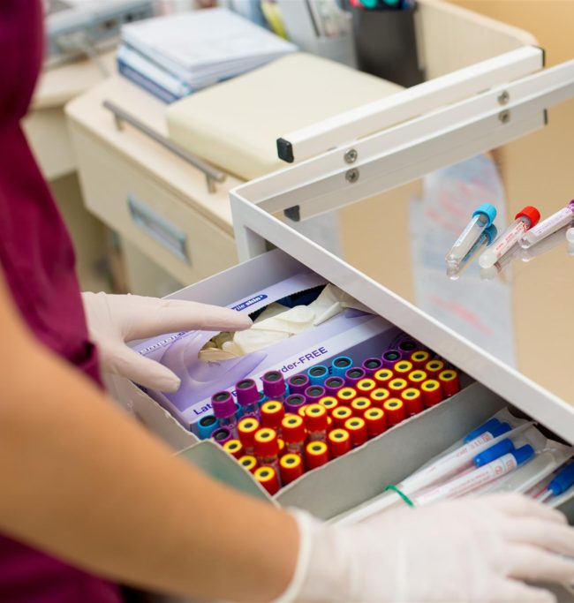

Phlebotomy Technician Program
Chapter 1

Slide 2
Chapter 1: Phlebotomy: Past and Present and the Healthcare Setting
Demonstrate basic knowledge of terminology for healthcare settings including the national healthcare organizations that contributed to the evolution of phlebotomy and the role of the phlebotomist today.
Describe the basic concepts of verbal and nonverbal communication as they relate to the professional image and proper telephone protocol in the healthcare.
Compare types of healthcare institutions and the methods used by providers for coverage.
List the personnel levels in the clinical analysis areas of the laboratory and the types of laboratory procedures performed in each of the areas.
Objectives

Slide 3
Overview
READ: Phlebotomy Essentials Enhanced Seventh Edition Pages 2-34
Why is it necessary to draw blood? Clinical decisions are based on medical standards of practice, diagnostic testing, a patient’s history, and observation of signs and symptoms. Before a physician can make a clinical decision, laboratory test results from the patient are needed. Laboratory test results influences most medical decisions and play such an important role in the clinical management of patients. Many health care workers are taking greater roles in the specimen collection process.

Slide 4
Overview
Among those who perform phlebotomy task are clinical or medical laboratory personnel (including certified phlebotomists), nurses, nurse aides, respiratory therapists, medical assistants, home health personnel, and others. Lab results are critical to patient care. Some of the most important aspects of lab tests are:
- Diagnostic and screening – to figure out what is wrong with a patient
- Therapeutic assessment – to develop the correct treatment or choose right drugs
- Monitoring health – to make sure the therapy or treatment is working

Slide 5
Overview
The term phlebotomy is derived from the Greek words, phlebo, which relates to veins, and tomy, which relates to cutting. The practice of drawing blood from a vein or through a cut in the skin is called phlebotomy, and the person who draws the blood is called a phlebotomist.
Phlebotomists have played an important role is blood collection. In addition to blood collection skills, successful specimen collection requires the phlebotomist to demonstrate competence, professionalism, good communication and public relations skills, working knowledge of the healthcare delivery system, and familiarity with clinical laboratory services.

Slide 6
Phlebotomy: A Historical Perspective
Stone Age
  Crude tools used to cut vessels & drain blood from body
Egypt (1400 BC)
  Tomb painting shows leech applied to patient for bloodletting
Hippocrates (460-377 BC)
  Health depended on balance of four humors in body
  (blood, phlegm, black bile, yellow bile)
  Bloodletting was used to remove excess humor
  Venesection: cutting vein to bleed patient

Slide 7
Phlebotomy: A Historical Perspective
Middle Ages of Europe (5th to 15th century)
  Barber-surgeons performed bloodletting & leeching
  Barber pole (red & white): represented blood of patient
  Bleeding bowl: used to collect blood from patient
17th & 18th Centuries
  Phlebotomy became a major therapy
  Lancets were used during venesection
  Cupping & leeching were used

Slide 8
Cupping
Process
  Application of heated suction device, the cup
  Multiple incisions of capillaries with lancet or fleam
    Single- or double-edged blade
    Multiple fleams attached & folded for ease of carrying
  Blades wiped clean with a rag
Fleams were also used for general phlebotomy to directly access and open arteries and veins to remove large amounts of blood.

Slide 9
Leeching
Process
  Place drop of milk or blood on the patient’s skin to entice the leech to patient’s location needing bloodletting
  Introduce Hirudo medicinalis to the site that injects:
    Local vasodilator
    Local anesthetic
    Hirudin, an anticoagulant
  Allow the leech to engorge and fall off
Present day
  Used in microsurgical replantation

Slide 10
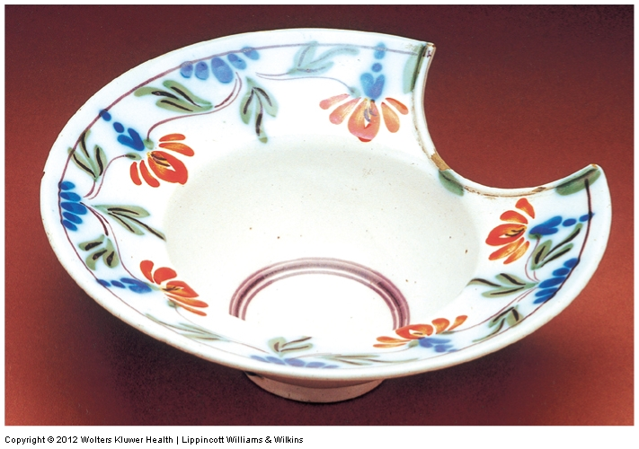
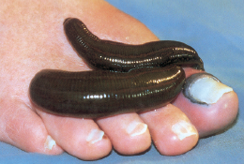
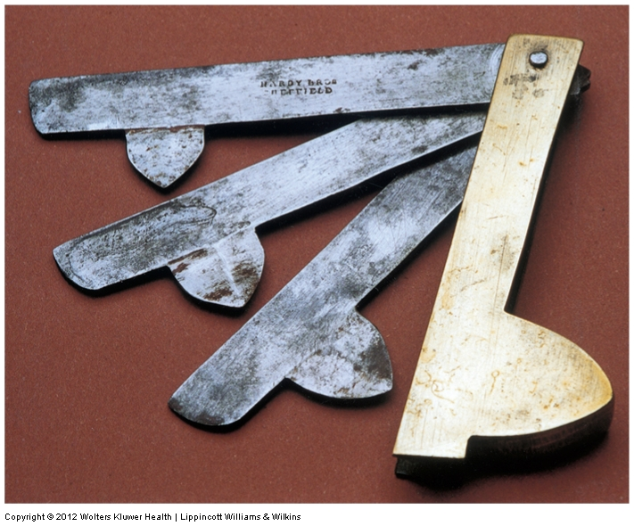
Phlebotomy: A Historical Perspective
Bleeding bowl, fleams, & leeches
Courtesy of Robert Kravetz, MD, Chairman, Archives Committee, American College of Gastroenterology.
Courtesy of Robert Kravetz, MD, Chairman, Archives Committee, American College of Gastroenterology.
Courtesy of Robert Kravetz, MD, Chairman, Archives Committee, American College of Gastroenterology.

Slide 11
Goals and Methods of Phlebotomy Today
Goals
  Obtain blood for diagnostic purposes & monitor treatment
  Remove blood for transfusions at a donor center
  Remove blood for therapeutic purposes (polycythemia)
Methods
  Venipuncture: blood collection via a needle inserted in a vein
  Capillary puncture: blood collection via a lancet puncture of the skin

Slide 12
The Changing Role of the Phlebotomist
Role
  Phlebotomist: anyone trained in blood collection
  Many healthcare team members are trained in phlebotomy
Skills/Knowledge/Competencies Needed
  Good manual dexterity
  Special communication skills
  Good organizational skills
  Thorough knowledge of lab specimen requirements
  Thorough knowledge of departmental policies

Slide 13
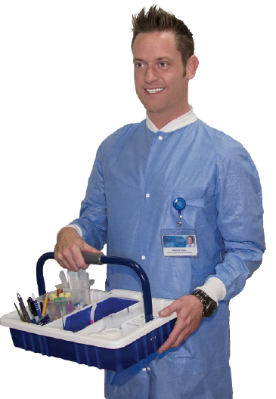
Role and Skills of the Phlebotomist
A confident and
professional phlebotomist
Phlebotomists will find that when dealing with patients who are ill or irritable, a confident and professional appearance will be most helpful to them in doing their job.

Slide 14
Official Recognition
Certification
  Certificate: document (recognition) granted by agency
  Requires completion of defined academic and training requirements
  Requires attainment of satisfactory score on comprehensive examination
  Certification is voluntary or may be required by facility/employer
Licensure
  License: official document or permit granted by state agency
  Required by law
  Requires specific education, experience, & passing an examination
Continuing Education (CE)
  Required by most certifying and licensing agencies

Slide 15
Patient Interaction
Customer Relations
  Phlebotomist may be the only contact/interaction patient has with lab
  Patient may judge hospital based on encounter with phlebotomist
  Goal: put patient at ease & establish positive relationship
Recognizing Diversity
  Beliefs & values
  Needs based on environment
  Customs & traditions
  Attitudes toward seeking help from healthcare providers

Slide 16
Qualities of Professionalism
Professional appearance
Self-confidence
Integrity
Compassion
Self-motivation
Dependability
Ethical behavior
The primary objective in any healthcare professional’s code of ethics must always be to safeguard the patient’s welfare.
Phlebotomists must always be professional in the workplace

Slide 17
Patients’ Rights
Federal law guarantees
  Right to privacy of medical records
  Right for patients to obtain copy of medical records
Most states have additional patient protection laws
Most healthcare facilities have their own official statements on patient rights

Slide 18
Patients’ Rights
American Hospital Association’s (AHA’s) The Patient Care Partnership
  High-quality hospital care
  A clean & safe environment
  Involvement in patient care
  Help with leaving the hospital and with billing claims
  Maintaining patients’ personal rights, including privacy
  Maintaining patients’ dignity
  Sensitivity to differences in culture, race, religion, gender, and age

Slide 19
Confidentiality
Patient information must be kept private & confidential
Ethical standards & laws enforce confidentiality
Health Insurance Portability and Accountability Act (HIPAA)
  Safeguards confidentiality of protected health info (PHI)
  Established national standards for electronic exchange of PHI
  States that patients must be informed of rights
  Disclosure of PHI requires written authorization

Slide 20
Communication Skills
Communication
  The means by which information is exchanged or transmitted
Interpersonal Communication Components
  Verbal
  Active listening
  Nonverbal (body language)
    Kinesics: study of nonverbal communication
    Proxemics: individual’s concept and use of space
    Appearance
    Touch

Slide 21
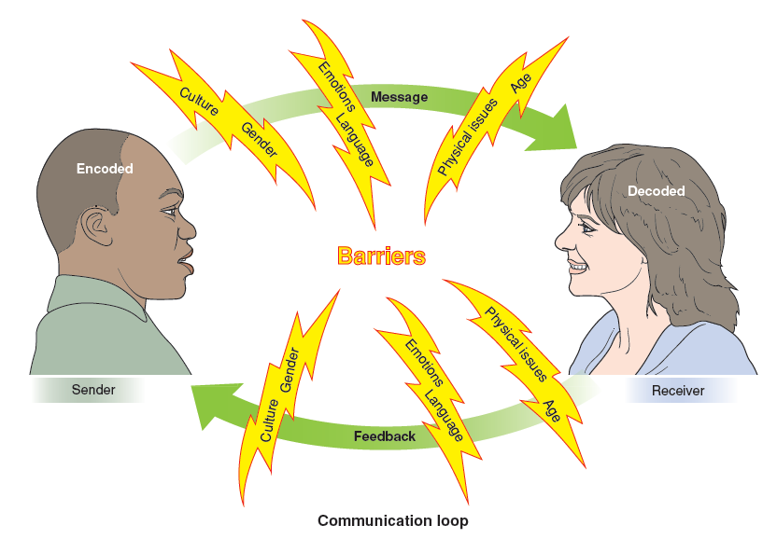
Communication Skills
The verbal communication feedback loop
Test your knowledge of communication components in Labeling Exercise 1-1 in the WORKBOOK

Slide 22
Communication Skills
Elements of Effective Healthcare Communication
  Empathy
  Control
  Trust
  Respect & confirmation
Listening is the foundation of good interpersonal communication. The phlebotomist will find that listening carefully to what is being said and watching for nonverbal cues is the way to quickly build mutual trust with patients.

Slide 23
Telephone Communication
Constant ringing may interrupt workflow and cause stress to HCWs in the laboratory.
Proper telephone etiquette is very important in the laboratory.
  Impacts quality of patient care
  Vital to efficient and effective service

Slide 24
Proper Telephone Etiquette
Answer promptly.
State your name and department.
Be helpful.
Prioritize calls.
Transfer and put callers on hold properly.
Be prepared to record important information.
Know the laboratory’s policies.
Defuse hostile situations.
Try to assist everyone.

Slide 25
Written Communication
Handwritten communication must be legible and written in ink
Both handwritten and typed communication
  Must be clear, concise, and accurate
  Must contain proper spelling, grammar, and punctuation
  Must be recorded in a timely manner when documenting events or problems

Slide 26
Healthcare Delivery
Three levels of healthcare in the United States
  Primary: patient’s main source for routine care
  Secondary: specialist or facility with specific expertise
  Tertiary: highly specialized to perform advanced procedures
Two general categories of facilities
  Ambulatory (outpatient)
  Non-ambulatory (inpatient)

Slide 27
Healthcare Delivery
Ambulatory Care
  Medical care delivered on outpatient basis
  Patients requiring care after discharge from hospital
  Two types
    Freestanding medical care settings & hospital-owned clinics
    Outpatient departments & urgent care facilities
  Observation, diagnosis, treatment, rehabilitation
Homebound Services
  Patients’ homes
  Long-term care facilities

Slide 28
Healthcare Delivery
Public Health Service (PHS)
  Part of Department of Health and Human Services (HHS)
  Mission: to protect & advance nation’s physical & mental health
  Sponsors & administers programs on:
    Development of health resources
    Prevention & control of diseases
    Dealing with drug abuse
  Constantly monitors, screens, protects, & educates public
  Provides services for little or no charge to entire population

Slide 29
Healthcare Financing
Affordable Care Act (ACA)
  Guarantees access to healthcare by preventing denial of coverage or additional charges for pre-existing conditions
Third-Party Payers
  Indirect pay to provider by insurance company, federal government, managed care program, or self-insured company
  Alternative to direct payment, also known as self-pay or out-of-pocket pay, where patient pays provider
Diagnosis & Billing Codes
  Current procedural terminology (CPT) codes (see Table 1-4)
Reimbursement (entitlement programs)
  Medicare & Medicaid

Slide 30
Healthcare Financing
Accountable Care Organizations (ACOs)
  Network of hospitals, physicians, other providers
  Voluntarily coordinate care for Medicare patients
  Intended to improve quality of care while reducing costs by reducing duplication

Slide 31
Managed Care
Definition
  A payment system that attempts to manage cost, quality, & access to healthcare by:
    Limiting the providers that patient can use
    Using PCPs as gatekeepers to control referrals
    Using case managers to monitor and coordinate patients
    Utilize review of all healthcare services
Characteristics
  Set fee schedule
  Preauthorization for certain medical procedures
  Designated case manager required

Slide 32
Managed Care
Case Manager
  Is primary care provider & “gatekeeper”
  Is experienced healthcare professional
  Coordinates all of patient’s healthcare
  Knows patient’s condition & needs
  Knows available resources for support & treatment
  Advises patient on healthcare needs
  Provides early detection & treatment for disease
  Refers patients to appropriate specialists

Slide 33
Managed Care
Network Service Systems
  Health maintenance organizations (HMOs)
    Group practices
    Reimbursed on a prepaid, negotiated, & discounted basis
  Preferred provider organizations (PPOs)
    Independent groups of physicians or hospitals
    Exchange discounted services for steady supply of patients
  Integrated Delivery Networks (IDNs/IDSs)
    Number of different types of associated medical facilities
    Offers cost-effective holistic and coordinated care

Slide 34
Clinical Laboratory Services

Slide 35
Clinical Laboratory Services
Clinical laboratories generally have two major divisions/areas:
  Clinical analysis area
  Anatomical & surgical pathology area
All laboratory testing is associated with one of these two areas
Similar tasks are grouped into departments, the goal being to perform each task
  Accurately
  Efficiently
  Cost-effectively
Match laboratory departments with laboratory tests in Matching 1-4 in the WORKBOOK

Slide 36
Clinical Laboratory Services
Clinical analysis areas:
  Chemistry: detect &measure chemical substances in body fluids
  Hematology: discover, identify, & monitor diseases in blood and blood-forming tissues
  Coagulation: discover, identify, & monitor defects in blood clotting mechanism
  Serology/immunology: identify antibodies and antigens
  Urinalysis: test urine specimens
  Microbiology: analyze blood and other body tissues for microorganisms
  Blood bank/immunohematology: prepare blood for transfusion
  Cytogenetics: examine sample for genetic diseases
  Flow cytometry: analyze and sort cells

Slide 37
Clinical Laboratory Services
Anatomical & Surgical Pathology
  Histology: evaluate tissue samples (biopsy or frozen section) for pathology
  Cytology: identify, county, & study cells to diagnose malignant and premalignant conditions
Satellite Laboratories
  Established in some tertiary care facilities
  Located close to populations served (e.g., NICU or ED)
  For procedures & tests needed immediately
Reference Laboratories
  Large, independent labs
  Receive specimens from many facilities in city, state, or region
  Provide routine & specialized analysis of blood, urine, tissue
  Offer fast turnaround times & reduced cost due to high volume

Slide 38
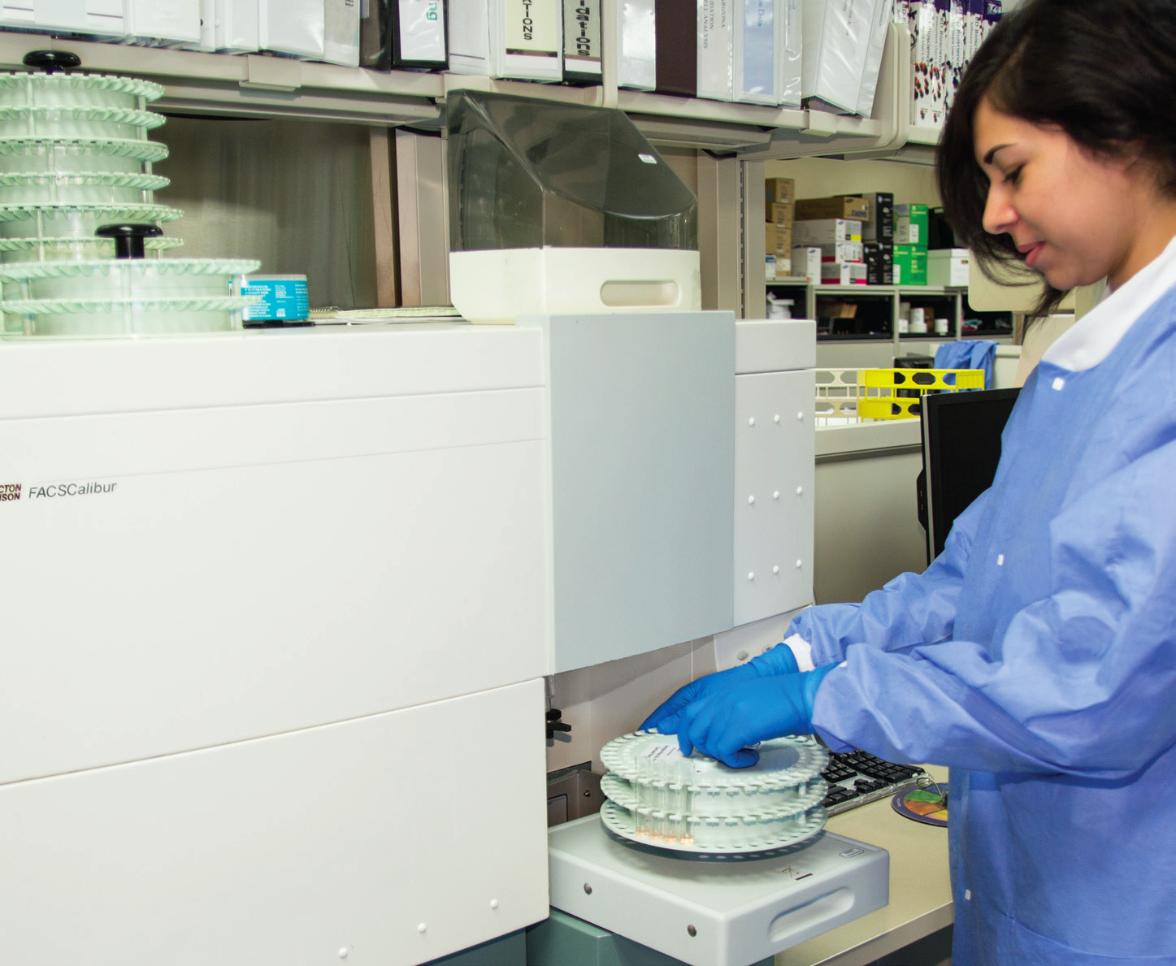
Clinical Laboratory Services
Medical Laboratory Scientist loads BC FACSCaliburTM modular flow cytometry analyzer with tissue samples for HLA testing

Slide 39
Clinical Laboratory Personnel
Laboratory Director/Pathologist
  Manages lab (along with lab administrator)
  May be a pathologist or clinical lab scientist with a doctorate
Laboratory Administrator/Laboratory Manager
  Usually a technologist with advanced degree & experience
  Oversees all operations involving physician & patient services
  May supervise ancillary services (radiology & respiratory therapy)
Technical Supervisor
  Administers a lab section or subsection
  Reports to lab administrator
  Has additional education in one or more clinical lab areas

Slide 40
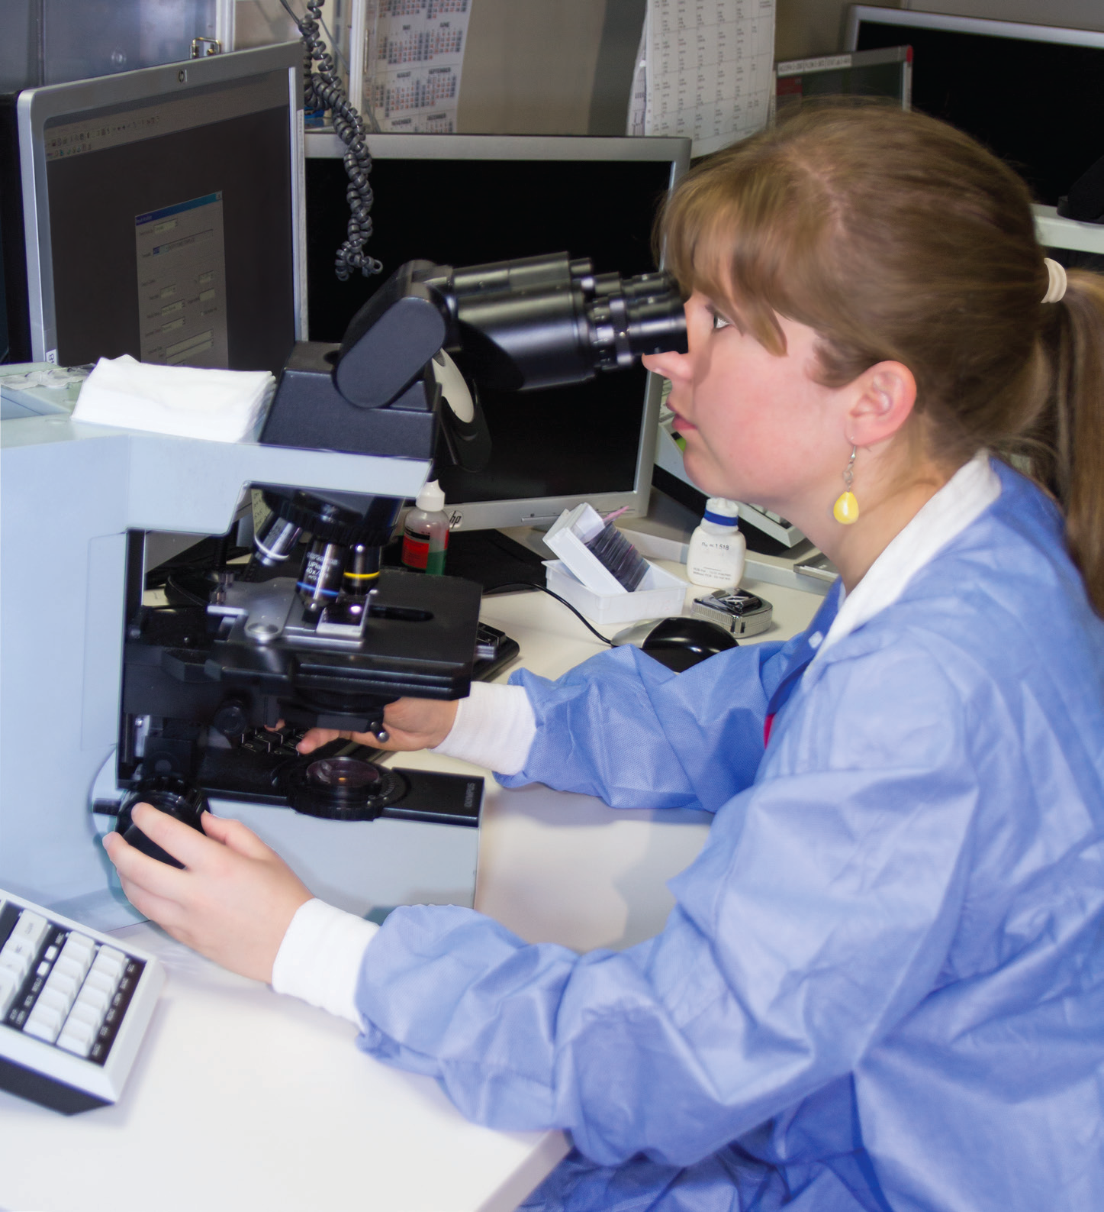
Clinical Laboratory Personnel
Medical Technologist/Medical Laboratory Scientist
  Typically has bachelor’s degree plus study in MT program
  Performs all levels of testing in any area of lab & reports results
  Performs quality control & evaluates new procedures
  Maintains instruments
A medical technologist checks a differential in the ED STAT lab.

Slide 41
Clinical Laboratory Personnel
Medical Laboratory Technician
  Typically has associate’s degree
  Performs routine testing
  Operates & maintains all equipment
Clinical Laboratory Assistant
  Has phlebotomy experience
  Has skills in specimen processing & basic lab testing
  Is a generalist; assists MLS or MLT in any area

Slide 42
Clinical Laboratory Personnel
Phlebotomist
  Collects blood for lab tests for diagnosis & care of patients
  Often serves in role of lab assistant or specimen processor
  Formal programs usually require high school diploma or equivalent to enroll
Other Laboratory Personnel
  Laboratory information systems managers
  Quality and compliance coordinator
  Point-of-care supervisor
  Education coordinator
  Supervisor of support services

Slide 43
NAACLS Entry Level Competencies Met in This Chapter
1.00 Demonstrate knowledge of the healthcare delivery system and medical terminology.
4.2 Describe the types of patient specimens that are analyzed in the clinical laboratory.
4.3 Define the phlebotomist’s role in collecting and/or transporting these specimens to the laboratory.
9.00 Communicate (verbally and nonverbally) effectively and appropriately in the workplace

Slide 44
NAACLS Entry Level Competencies Met in This Chapter
9.1 Maintain confidentiality of privileged information on individuals according to federal regulations
(e.g., HIPAA).
9.2 Demonstrate respect for diversity in the workplace.
9.3 Interact appropriately and professionally.
9.5 Comply with the American Hospital Association’s Patient’s Bill of Rights and the Patient’s Bill of Rights from the workplace.
9.6 Model professional appearance and appropriate behavior.

Slide 45
Questions?
Send all questions, concerns and/or comments to:
info@llhschoolofphlebotomy.com

