Slide 1
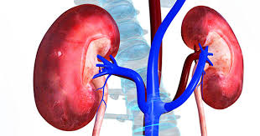
Renal Failure

Slide 2
Objectives
Explain the nursing management of patients with chronic kidney disease.
Explain the nursing management of patients with complex acute and chronic medical surgical conditions.
Compare the disorders of complex acute and chronic conditions of the medical surgical patient in terms of physiologic alterations, clinical manifestations, management, and nursing care.

Slide 3
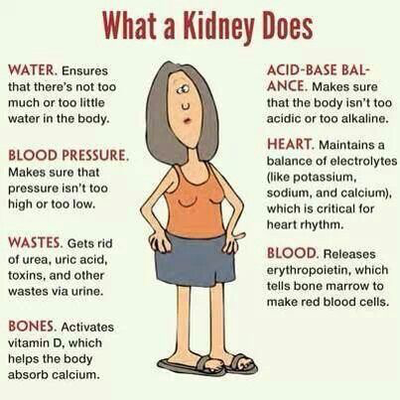

Slide 4
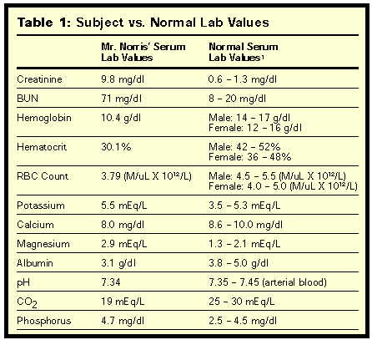

Slide 5

Acute Kidney Injury (AKI)
Sudden cessation of renal function that occurs when _______________ to the kidneys is significantly compromised
AKI occurs in up to 15% to 18% of hospitalized patients and in up to 66% of ICU patients
Mortality rate between 50% and 60% patients treated with renal replacement therapy (RRT)
Greater than 80% survivors of severe AKI are independent of dialysis by discharge
Hallmark sign = AZOTEMIA

Slide 6
AKI cont.
Definition
Abrupt onset
Increased serum _________________
Decreased urine output
Oliguria
Nonoliguria
Anuria

Slide 7
AKI cont.
Phases
Onset
Oliguria
Diuresis
Recovery
Classes
Stage 1 (________ stage)
Stage 2 (__________ stage)
Stage 3 (__________ stage)
Types
Prerenal
Intrarenal
Postrenal

Slide 8
AKI cont.
Pathophysiology
Prerenal
Impaired blood flow leads to hypoperfusion
Leads to decreased GFR
Intrarenal
Actual damage to the glomeruli or kidney tubules
Leads to decreased GFR, progressive azotemia, and fluid/electrolyte imbalances
Postrenal
Obstruction distal to the kidney
Pressure within the kidney tubules rise

Slide 9
AKI—Nursing Interventions
Elevate the _______
Monitor vital signs
Establish an ____ access
Complete a full assessment of body systems

Slide 10
Chronic Kidney Disease (CKD)
Slow, progressive, _________________ kidney disease
Unable to ______________ waste and maintain fluid/electrolyte balance
Asymptomatic except during periods of stress
Manifestations become apparent with progression
What causes CKD?
Leads to end-stage renal disease (ESRD)
Considerations for the older adult
Aging process
Dehydration

Slide 11
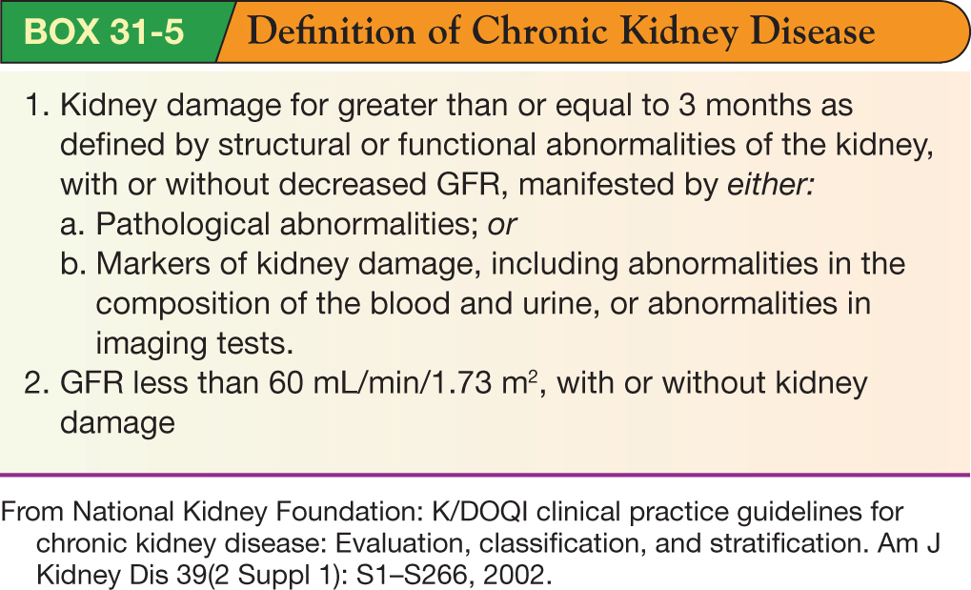
CKD cont.

Slide 12
CKD cont.
Five Stages
Stage 1
GFR = greater than _______
Stage 2
GFR = ________
Stage 3
GFR = ________
Stage 4
GFR = ________
Stage 5
GFR = less than ________

Slide 13
CKD cont.
Risk Factors
Acute kidney injury
Diabetes mellitus
Chronic glomerulonephritis
Nephrotoxic medications
Hypertension
Autoimmune disorders
Polycystic kidney disease
Pyelonephritis
Renal artery stenosis
Recurrent severe infections

Slide 14
CKD cont.
Expected Findings
Generalized
Neurologic
Cardiovascular
Respiratory
Hematologic
Gastrointestinal
Musculoskeletal
Renal
Integumentary
Reproductive

Slide 15
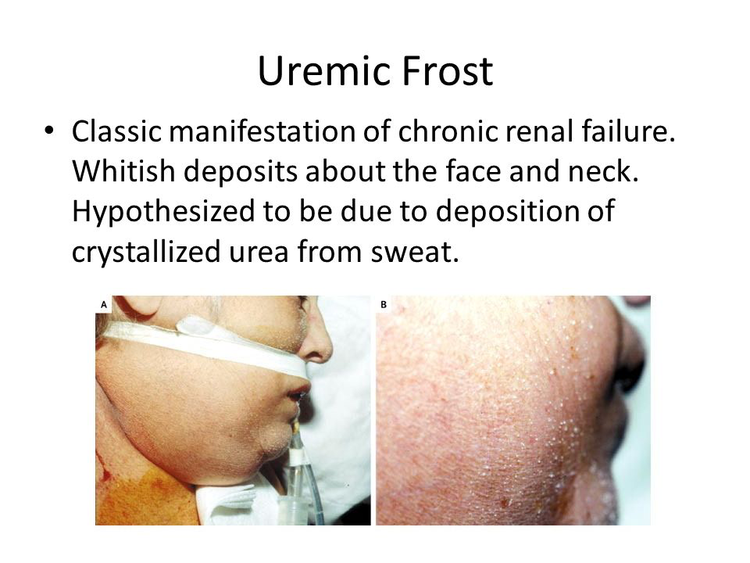

Slide 16
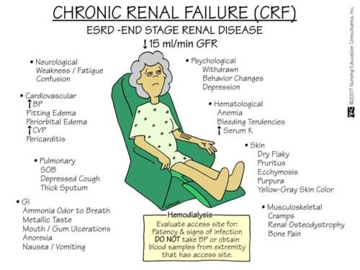

Slide 17
CKD cont.
Diagnostic Studies
X-ray
Ultrasound
CT or MRI
Renal biopsy
Urinalysis (UA)
Urine sodium
Urine osmolality
Sedimentation
24-hour urine

Slide 18
CKD cont.
Laboratory Tests
Urinalysis
Serum creatinine
BUN
Serum electrolytes
CBC
ABGs

Slide 19
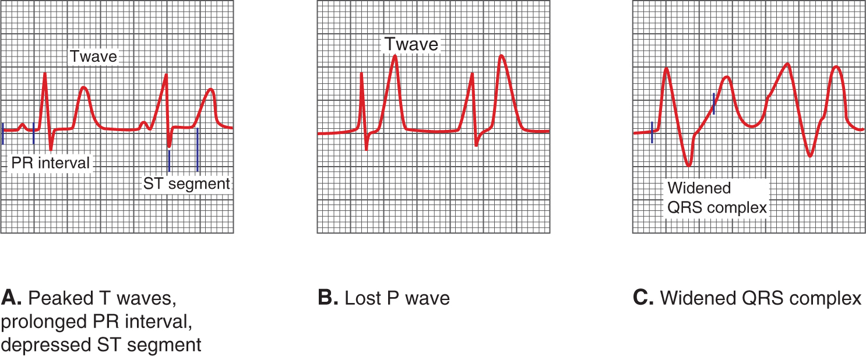
CKD cont.
Complications
Anemia
ECG changes

Slide 20
Management of Renal Failure
Managing neuromuscular alterations
Managing hematological alterations
Managing pulmonary alterations
Managing gastrointestinal alterations
Management of alterations in drug elimination
Management of skeletal alterations
Managing integumentary alterations
Managing alterations in dietary intake
Managing alterations in psychosocial functioning

Slide 21
Management of Renal Failure cont.
Nursing Interventions
Monitor
Assess and monitor _________________________ or peritoneal dialysis insertion site
Control ______________ intake
Diet
Avoid ____________________ medications
Referral

Slide 22
Question
A nurse is assessing a patient who has prerenal AKI. Which of the following findings should the nurse expect? Select all that apply.
A. reduced BUN
B. elevated cardiac enzymes
C. reduced urine output
D. elevated serum creatinine
E. elevated serum calcium
Notes:
Answer: C, D

Slide 23
Dialysis
Can be life-sustaining
Does not replace _____________________ functions of kidneys
Two Types
Hemodialysis
Peritoneal dialysis
Functions
Get rid of excess __________________________
Acid-base balance
Eliminate waste
Restore _____________________
Contraindications to hemodialysis
Continuous renal replacement therapies (CRRTs)

Slide 24
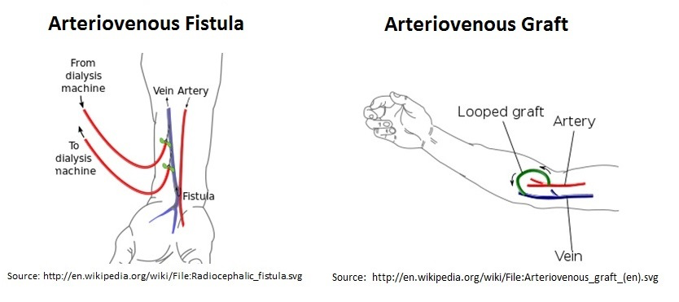
Dialysis cont.
Vascular access
Arteriovenous (AV) fistula
Arteriovenous graft

Slide 25
Dialysis cont.
Pre-Procedure Nursing Interventions
Informed consent
Assess patency of access device
Avoid measuring ____________________, administering injections, performing venipunctures or inserting IVs into an arm with an access site
Assess VS, lab values, and weight
Discuss medications to hold
Patient education

Slide 26
Dialysis cont.
Intra-Procedure Nursing Interventions
Monitor for complications
Monitor VS and coagulation studies
Monitor for bleeding
Patient education
Post-Procedure Nursing Interventions
Monitor VS
Monitor lab values
Compare patient’s weight
Assess for complications

Slide 27
Disequilibrium Syndrome
Results from rapid decrease in _____________ and circulating fluid
Can result in cerebral edema and increased ___________
Early recognition is essential
Range of manifestations
_______________________ is a risk factor

Slide 28
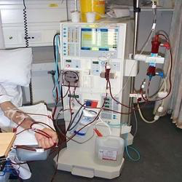

Slide 29
Question
Is the following statement true or false?
The term dry weight or ideal weight is used to express the weight at which fluid volume is in a normal range for a patient who is free of the symptoms of fluid imbalance.
Notes:
Answer: True

Slide 30
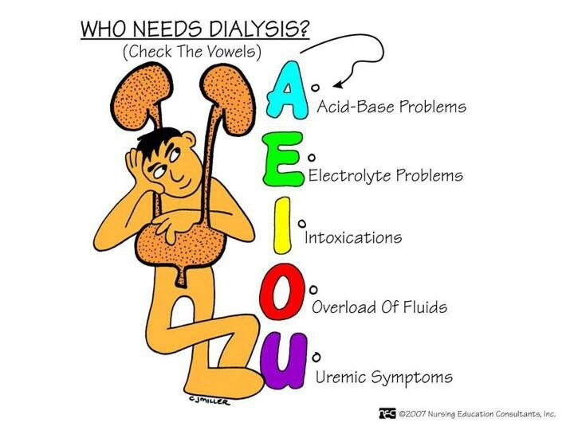

Slide 31
Intermittent Hemodialysis vs. Continuous Renal Replacement Therapies
Intermittent Hemodialysis
Removes by-products of protein metabolism
Removes excess _______________
Maintains or restores the body’s buffer system
Electrolyte balance
Continuous Renal Replacement Therapies
Does the same as intermittent hemodialysis
Only done for ___________ hours in ICU/CCU

Slide 32
Anticoagulation During Dialysis
Two Ways
Systemic Anticoagulation
Regional Anticoagulation

Slide 33
Peritoneal Dialysis
May also be referred to as continuous ______________ peritoneal dialysis (CAPD)
Instillation of ___________________________ into peritoneal cavity
Dialysate is drained
Peritoneum serves as filtration membrane
Treatment of choice for _________________
Treats patients who:
Can’t tolerate anticoagulation
Have difficulty with vascular access
Have chronic infections
Have chronic diseases

Slide 34
Peritoneal Dialysis cont.
Advantages
Less complicated equipment
Readily available supplies
Less training
Fewer restrictions
Minimal _____________________
Self-management at home
Disadvantages
More time to be effective
Can cause peritonitis
Strict ________________ technique

Slide 35
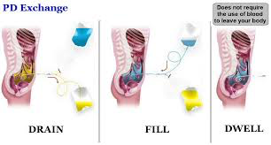
https://www.youtube.com/watch?v=SgBMoCArNak

Slide 36
Complications of Dialysis
Hemodialysis
Clotting or _____________ at the access site
Disequilibrium syndrome
Hypotension
Anemia
Infectious diseases
Air _____________
Peritoneal Dialysis
Peritonitis
Infection at the access site
Protein loss
Hyperglycemia
Hyperlipidemia
Poor dialysate __________________ or _______________

Slide 37
Question
The nurse is caring for a patient who does his own peritoneal dialysis at home. During the health history, the patient states that the peritoneal fluid looks different and that his belly has been a bit tender. Which of the following diagnoses should the nurse anticipate?
A) Peritonitis
B) Disequilibrium syndrome
C) Urinary tract infection
D) Constipation
Notes:
Answer: A

Slide 38
Question
The nurse is caring for a patient on CRRT. Regional anticoagulation is used to maintain filter patency. Which of the following statements demonstrates an understanding of regional anticoagulation?
A) An anticoagulant is given intravenously and its effects are monitored with serial laboratory values.
B) An anticoagulant is given as intermittent boluses.
C) An anticoagulant is administered prefilter and its antidote is administered postfilter.
D) No anticoagulation is used because of the risk of heparin-induced thrombocytopenia.
Notes:
Answer: C

Slide 39
Question
A 60-year-old woman with diabetes is scheduled for a cardiac catheterization after having a positive stress test. Her baseline creatinine level is 2.0. To help prevent contrast-induced nephropathy, which of the following interventions may be ordered?
A) Aggressive hydration with 0.9% normal saline solution and IV furosemide post procedure
b) Aggressive hydration pre- and post procedure and avoidance of nephrotoxic drugs for 24 hours prior to the procedure
c) furosemide pre- and post procedure and starting a calcium channel blocker
d) Aggressive hydration post procedure and IV mannitol
Notes:
Answer: B

Slide 40
Question
A 60-year-old African American man with stage 2 chronic kidney disease (CKD) secondary to hypertensive nephrosclerosis is admitted for a hypertensive emergency. During his hospitalization, his ace-inhibitor medication is increased to help better control his blood pressure. In educating the patient about his chronic illness, which of the following is the most accurate regarding his blood pressure control?
a) Strict blood pressure control helps slow the progression of kidney disease.
b) Target blood pressure control for patients with CKD according to the Kidney/Dialysis Outcomes Quality Initiative guidelines is 140/80.
c) Ace inhibitors are first-line therapy for proteinuric CKD because they lower blood pressure more effectively than other antihypertensive agents.
D) Restricting protein intake has been shown to help lower blood pressure in CKD.
Notes:
Answer: A

Slide 41
Glomerulonephritis
Inflammation of the _____________________
Immunologic kidney disorders
Occurs one of two ways
Starts in the _____________
Results from _____________________________________
Results in glomerular injury
Can lead to end-stage kidney disease (ESKD)
Can be acute or chronic

Slide 42
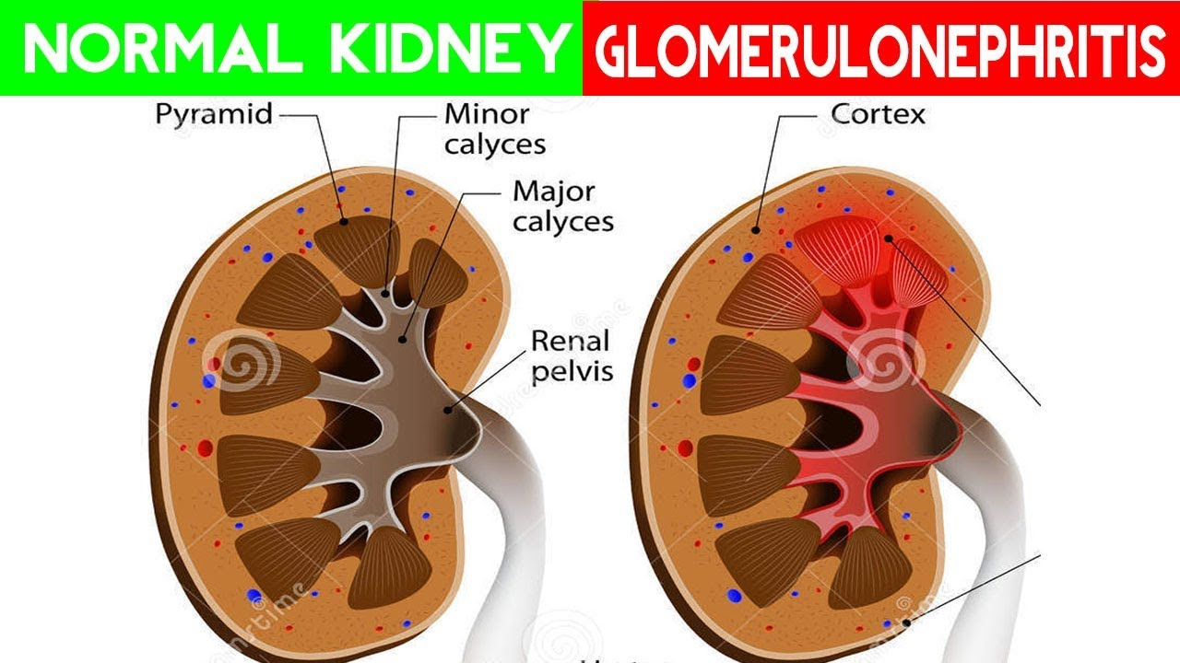

Slide 43
Glomerulonephritis cont.
Risk Factors
Recent infection
Recent travel
Presence of systemic diseases
Recent surgery or illness

Slide 44
Glomerulonephritis cont.
Expected Findings
Anorexia
Nausea/vomiting
Dysuria
Oliguria
Fatigue
Hypertension
Difficulty ________________
Crackles
S3 heart sound
Weight ______________-
Reddish-brown or ______________________ urine
Gerontologic Considerations

Slide 45
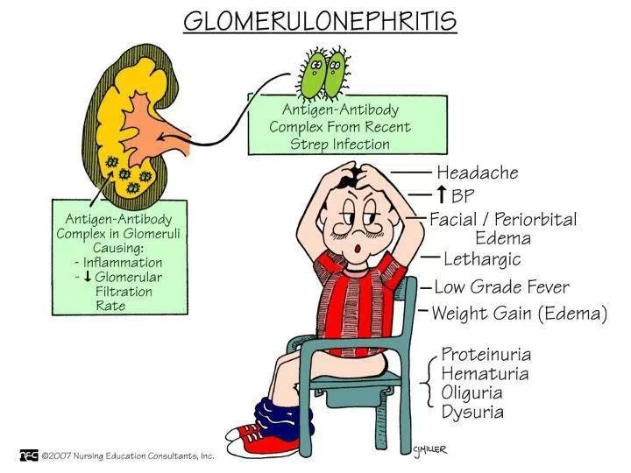

Slide 46
Glomerulonephritis cont.
Laboratory Tests
UA
24-hour urine
GFR
Cultures
BUN and _________________
Antistreptolysin-O titer
Electrolytes
Diagnostic Studies
Kidney biopsy

Slide 47
Glomerulonephritis cont.
Potential Complications
Acute Nephrotic Syndrome
Hypertensive encephalopathy
Heart failure
Pulmonary edema

Slide 48
Glomerulonephritis cont.
Nursing Interventions
Conserve patient _____________
Antibiotics
Monitor blood pressure
Monitor fluid and electrolytes
Reduce stress
Monitor _________________ status
I&O
Dialysis

Slide 49
Question
A nurse is caring for several clients. Which of the following clients are at risk for developing pyelonephritis? Select all that apply.
A. A client who is at 32 weeks gestation
B. A client who has kidney calculi
C. A client who has a urine pH of 4.2
D. A client who has a neurogenic bladder
E. A client who has diabetes mellitus
Notes:
Answer: A, B, D, E

