Slide 1
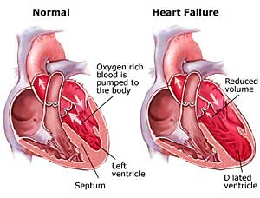
Heart Failure, Pulmonary Hypertension, CAD, Angina, & MI

Slide 2
Objectives
Apply the nursing process as a framework for care of patients with heart failure.
Explain manifestations, medical and nursing management and their treatment to patients experiencing pulmonary hypertension.
Explain manifestations, medical and nursing management and their treatment to patients experiencing CAD or angina.

Slide 3
Pulmonary Hypertension
Elevated ________________ arterial pressure and secondary _______________ventricular failure.
Can not be measured indirectly
Recognition becomes hard until late progression
What are the risk factors?
https://www.youtube.com/watch?v=LzlG_pxiKzY

Slide 4
Pulmonary Hypertension cont.
Pathophysiology
As vessels become destroyed or obstructed the heart is not able to handle the flow and volume.
Pressure and resistance increases.
Affects the hearts workload and right ventricular function. Right ventricle becomes hypertrophy (enlarged) which leads to heart failure.

Slide 5
Pulmonary Hypertension—Manifestations
Dyspnea
Chest Pain
Weakness
Fatigue
Syncope
Occasional ___________
Right sided heart failure
Anorexia
_____________ pain

Slide 6
Pulmonary Hypertension—Diagnostics
Chest x-ray
Electrocardiogram (ECG/EKG)
Echocardiogram
Able to see ejection fraction
Two kinds
Traditional
Transesophageal Echocardiogram (TEE)

Slide 7
Pulmonary Hypertension—Diagnostics cont.
Right Sided Heart Catheterization
Invasive
Uses __________ or __________site
Conscious sedation
Lidocaine at insertion site
Sheath and guide wire inserted
Shows pulmonary artery ____________ pressure & overall heart functioning
Patient recovery
Discharge education

Slide 8
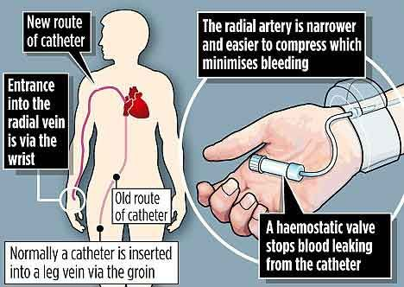

Slide 9
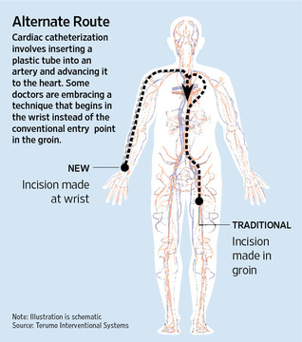

Slide 10
Pulmonary Hypertension—Management
What is the ultimate goal?
Standardized treatment
O2 with ____________
Diuretics
Anticoagulants
Digoxin
Calcium Channel Blockers
Vasodilators

Slide 11
Pulmonary Hypertension—Nursing Management
Know the medications that are given
Know the procedures and post care
Know who is at risk
Knowledge about oxygen and home oxygen

Slide 12
Heart Failure
A myocardial disease in which there is a problem with either the __________ of the heart or the __________ of the heart
Two Forms
Systolic Failure
Diastolic Failure
The heart is unable to pump sufficient blood to meet the needs of the tissues for oxygen and other nutrients
Characterized by two things
Progressive, lifelong disorder
How is it managed?

Slide 13
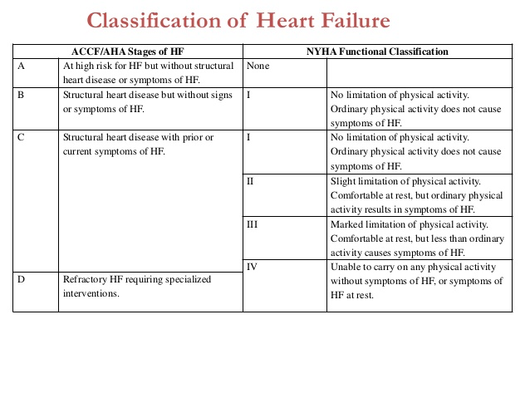

Slide 14
Acute vs. Chronic Heart Failure
Used to describe the ________ and __________ of symptoms
Acute
Chronic
If the cause of acute symptoms are not reversed → then heart failure becomes __________

Slide 15
Acute vs. Chronic Heart Failure cont.
Acute Heart Failure
Occurs _____________
Symptoms progressive
Reverse the cause if possible
Chronic Heart Failure
Occurs ______________
Symptoms represent patient’s baseline
Symptoms don’t disappear
Stable periods interrupted by acute episodes

Slide 16
NCLEX Question
A 56-year-old male presented to the emergency department with chest pain and shortness of breath that occurred suddenly. He was admitted to the unit for management of a myocardial infarction and heart failure. Measurement of his heart size and ejection fraction (EF) at the catheterization showed an EF of 30% and a normal size heart. Which of the following statements best describes acute heart failure?
A. Symptoms develop gradually over months.
B. Symptoms develop quickly over hours to days.
C. Symptoms occur with exertion.
D. Symptoms are minimal even with exertion.

Slide 17
Right-Sided vs. Left-Sided Heart Failure
Right-sided heart failure
Inability of the right ventricle to ________ or __________ sufficient blood into the peripheral tissues
Left-sided heart failure
Left ventricle cannot effectively ____________ blood out of the ventricle
**Remember in chronic HF patients may have both.

Slide 18
Clinical Manifestations Right-Sided vs. Left-Sided Heart Failure
Right-Sided
Viscera and __________ congestion
Jugular venous distention (JVD)
Dependent ________
Hepatomegaly
Ascites
Weight ________
Left-Sided
Pulmonary congestion, ____________
Ventricular gallop
Dyspnea on __________
Orthopnea
Dry, _______________ cough initially
Oliguria

Slide 19
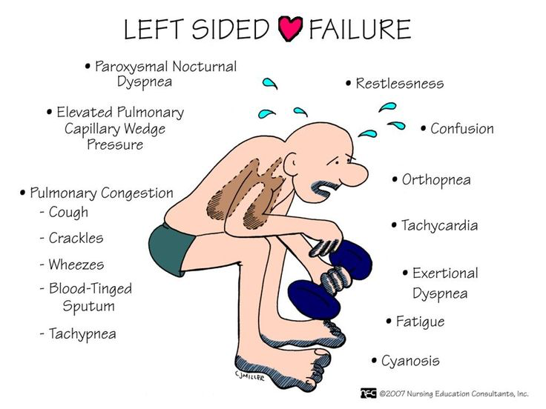

Slide 20
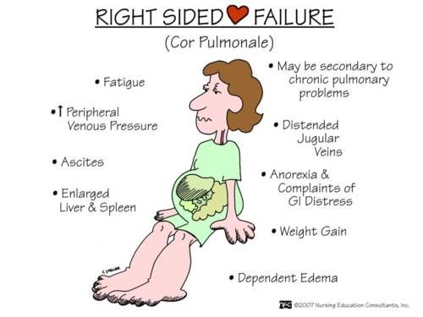

Slide 21
Question
Is the following statement true or false?
The underlying result of heart failure is insufficient cardiac output.

Slide 22
Cardiac Output
Underlying result of heart failure is insufficient ___________________
Oxygen demand
Mechanical factors
Stroke volume and heart rate

Slide 23
Heart Failure—Diagnostic Testing
Echocardiogram-provides pictures of the heart valves and chambers
EF: How well your heart is pumping
What % is considered heart failure?
Chest x-ray
EKG
Electrolytes, BUN, Creatinine, CBC, UA
Assess factors that may be contributing to hear failure and/or the impact of the heart failure
BNP

Slide 24
Heart Failure—Medical Management
Focuses on:
Improvement of cardiac function by reducing preload and afterload
Reduction of symptoms and improvement of functional status
Stabilization of patient condition and lowering of the risk of hospitalization
Delay of the progression of HF and extension of life expectancy
Promotion of a lifestyle conducive to cardiac health

Slide 25
Heart Failure—Nursing Assessment
Focus
Effectiveness of therapy
Patient’s ______________
S&S of increased HF
Emotional or psychosocial response
Health history
Focus on S & S
Physical Exam
Mental status
Lung sounds
Heart sounds
Fluid status
Daily weight
I&O
Assess response to medications

Slide 26
Heart Failure—Planning
Goals
Promote activity and reduce fatigue
Relieve fluid overload symptoms
Decrease anxiety or increase the patient’s ability to manage anxiety
Encourage the patient to verbalize his or her ability to make decisions and influence outcomes
Educate the patient and family about management of the therapeutic regimen

Slide 27
Heart Failure—Nursing Interventions for Activity Intolerance
Bed rest for acute exacerbations
Encourage regular _______________
Exercise training
Pacing of activities
Wait _______ hours after eating for physical activity
Avoid activities in extreme hot, cold, or humid weather
Modify activities to __________ energy
Positioning

Slide 28
Heart Failure—Nursing Interventions for Fluid Volume Excess
Assessment for ____________ of fluid overload
Daily _________
I&O
Diuretic therapy
Fluid ________
Maintenance of _________ restriction

Slide 29
Heart Failure—Nursing Interventions for Anxiety & Powerlessness
Minimize stress
Promote physical comfort
Provide psychological support
Reassurance and taking part in decision making
Education on techniques to control anxiety and promote relaxation
Family support
Screen for depression

Slide 30
Heart Failure—Collaborative Problems and Potential Complications
Hypotension
Poor perfusion
Cardiogenic shock
Dysrhythmias
Thromboembolism
Pericardial effusion
Cardiac tamponade
Pulmonary edema

Slide 31
Heart Failure—Patient Education
Medications
Dietary recommendations
Monitoring for signs of excess fluid, hypotension, and symptoms of disease exacerbation
Exercise and activity program
Stress management
Prevention of infection
Know how and when to contact health care provider
Include family in education

Slide 32
Heart Failure—Medications
Angiotensin-converting enzyme (ACE) inhibitors (-pril)
Lisinopril, Enalapril, Captopril
Angiotensin II receptor blockers (ARBs) (-sartan)
Losartan
Beta-blockers (-lol)
Carvedilol, Metoprolol
Diuretics
Furosemide, Bumetanide, Hydrochlorothiazide, Spironolactone
Digitalis
Digoxin
Inotropes
Dopamine, Dobutamine, Milrinone

Slide 33
Heart Failure—Management of Acute Decompensation
Airway and breathing
Intubation
Diuresis
Circulation
Optimize hemodynamics
Increase contractility
Vasodilation
Heart rate

Slide 34
Treating Heart Failure--“UNLOAD FAST”
Upright position
Nitrates
Lasix
Oxygen
ACE inhibitors
Digoxin
Fluids
Afterload
Sodium restriction
Test

Slide 35
Heart Failure—Gerontologic Considerations
May present with atypical signs and symptoms
Decreased renal function
Administration of diuretics to older men

Slide 36
NCLEX Question
Which of the following statements describes the relationship between heart failure and cardiomyopathy?
A. Heart failure is synonymous with cardiomyopathy
B. Heart failure is caused by a cardiomyopathy
C. Cardiomyopathy is caused by heart failure
D. Heart failure and cardiomyopathy are unrelated

Slide 37
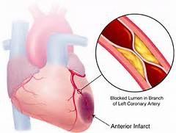
CAD-Atherosclerosis: Pathophysiology
Triglycerides, hypertension, and cigarette smoking cause damage to the endothelium.
Fatty substances, cholesterol, cellular waste products, calcium, and fibrin pass are deposited forming lipid plaque (atheroma)
Blood flow is reduced, decreasing oxygen supply to tissues
Symptoms occur with 75% or more occlusion

Slide 38
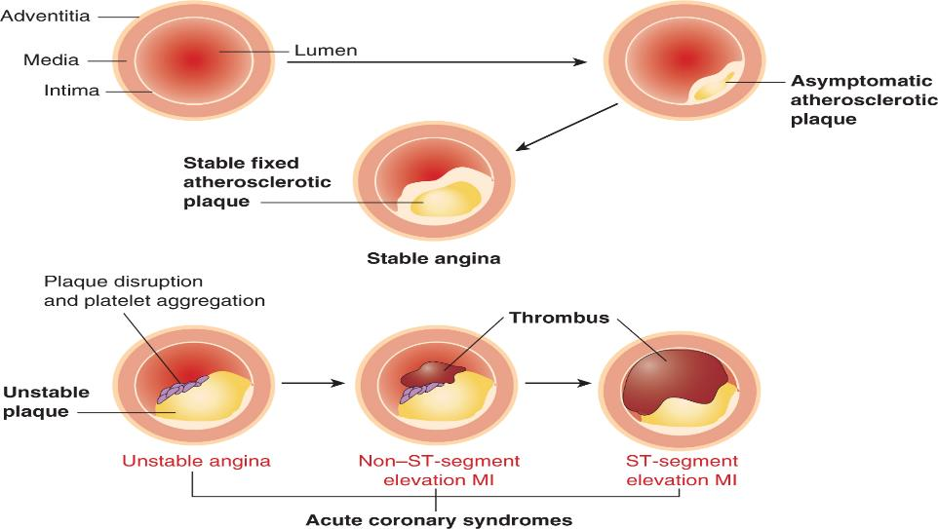
Atherosclerotic Plaque

Slide 39
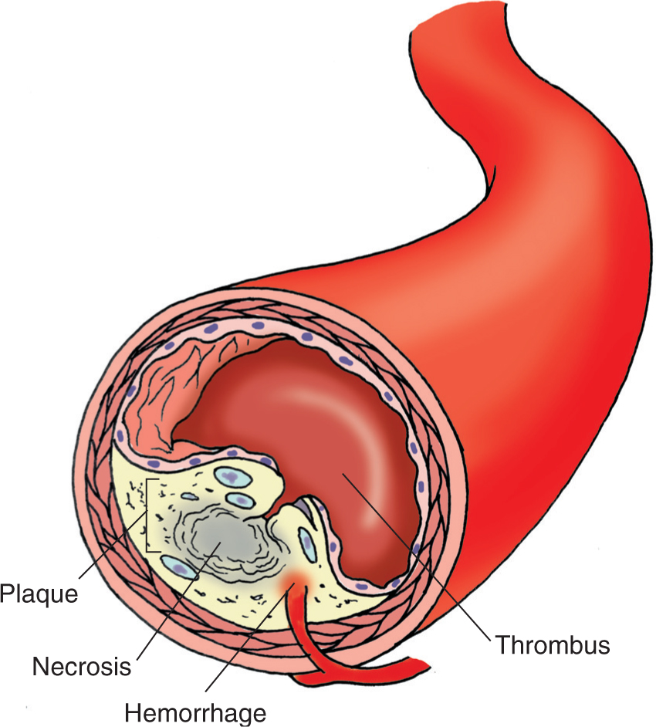
Thrombosis

Slide 40
CAD—Risk Factors—Unmodifiable
Age
Heredity
Race
Gender

Slide 41
CAD—Risk Factors—Modifiable
Cigarette smoking
High ______________
Hypertension
Physical inactivity
Obesity and overweight
Stress
Excessive alcohol intake

Slide 42
CAD—Treatment
Starts with _____________
Controlling cholesterol
Dietary measures
Physical activity
Medications
________________ cessation
Management of
Hypertension
Diabetes

Slide 43
CAD—Potential Complications
Heart ____________
Dysrhythmias
Chest pain
Heart attack
Sudden death
_____________ diseases

Slide 44
Angina Pectoris (Chest Pain)
Chest pain or discomfort that results from _________
Causes
Atherosclerotic narrowing that reduces oxygen supply
Spasm of coronary artery
Arterial inflammation
Marked increase in oxygen demand

Slide 45
Classification of Angina
Stable angina
Unstable angina
Variant (Prinzmetal’s) angina

Slide 46
Angina—Assessment
History
Description of symptoms
Associated symptoms
Review of risk factors
Physical findings

Slide 47
Angina—Diagnostic Tests
12-lead ECG
Cardiac markers
Coagulation studies
Lipid profile
Exercise stress testing
Coronary angiography

Slide 48
Question
A nurse is teaching a patient who has angina about a new prescription for metoprolol. Which of the following statements by the patient indicates understanding of the teaching?
A. I should place the tablet under my tongue.
B. I should have my clotting time checked weekly.
C. I will report any ringing in my ears.
D. I will call my doctor if my pulse rate is less than 60.

Slide 49
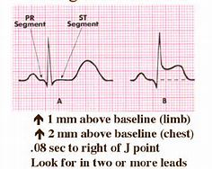
Acute Coronary Syndrome
Unstable angina
Myocardial Infarction

Slide 50
Myocardial Infarction
Prolonged ischemia
Plaque rupture triggers thrombus formation
Occlusion of blood flow results in MI
Irreversible damage occurs after 20 to 40 minutes
Tissue can be salvaged if flow is restored
Can occur without cause

Slide 51
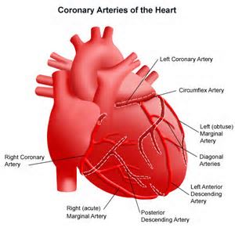
Location of the Infarction
Anterior left ventricle
Lateral and posterior left ventricle
Inferior left ventricle
Right ventricle

Slide 52
Question
A nurse is admitting a patient who has a suspected MI and a history of angina. Which of the following findings will help the nurse distinguish angina from an MI?
A. Angina can be relieved with rest and nitroglycerin
B. The pain of an MI resolves in less than 15 minutes
C. The type of activity that causes an MI can be identified
D. Angina can occur for longer than 30 minutes

Slide 53
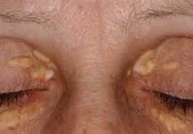
MI—Physical Examination
VS
Integumentary
Xanthomas
Carotid/femoral bruits
Heart sounds
Lung sounds
Pulses
Overall appearance

Slide 54
MI—Laboratory Tests
Referred to as = CK ________________
Creatine kinase
Troponin – Troponin ____ & Troponin ____
Myoglobin
Creatine phosphokinase (CPK)
Chest x-ray
Echocardiogram
EKG
Angiography
Chest MRI

Slide 55
MI—Nursing Management
Initial evaluation should be quick
Patient history
12-lead EKG
Frequent vital signs
Obtain IV access
Continuous cardiac monitoring
Who meets you at the door?
M
O
N
A

Slide 56
MI—Management
Pharmacological therapy
Nitroglycerin
Morphine
β-blockers
Calcium channel blockers
Aspirin/Antiplatelet
ACE inhibitors
Fibrinolytic therapy
Percutaneous coronary intervention

Slide 57
MI—Intensive/Intermediate Care Management
Maximize cardiac output
Minimize cardiac workload
Frequent vital signs
Continuous cardiac monitoring with ST segment
Monitor pulse oximetry
Serial EKGs and serial serum cardiac markers
What should activity be?
What should their pain be?
Should they eat?

Slide 58
Cardiac Rehabilitation
What is Cardiac Rehab?
Goals
Limit the adverse physiological and psychological effects of heart disease
Modify risk factors
Reduce sudden death or re-infarction
Control cardiac symptoms
Stabilize/reverse atherosclerotic process
Enhance the patient’s psychosocial and vocational status

Slide 59
Question
A nurse is caring for a patient who asks why her provider prescribed a daily aspirin. Which of the following is an appropriate response by the nurse?
A. Aspirin reduces the formation of blood clots that could cause a heart attack.
B. Aspirin relieves the pain due to myocardial ischemia.
C. Aspirin dissolves clots that are forming in your coronary arteries.
D. Aspirin relieves headaches that are causes by other medications.

