Slide 1
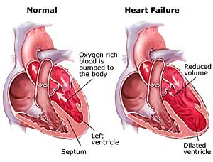
Heart Failure, Pulmonary Hypertension, CAD, Angina, & MI

Slide 2
Pulmonary Hypertension
Elevated pulmonary arterial pressure and secondary right heart ventricular failure.
Can not be measured indirectly AKA Blood pressure
Recognition becomes hard until late progression
Risk factors
Congenital heart disease, stimulates, portal hypertension, HIV, COPD, PE, mitral valve disease, vascular disease
https://www.youtube.com/watch?v=LzlG_pxiKzY
Notes:
Pulmonary Hypertension—elevated pulmonary arterial pressure with secondary right heart ventricular failure
Cannot be measured indirectly (blood pressure) → diagnosis is confirmed with a cardiac catheterization
Recognition becomes hard until late progression
Risk Factors
Congenital heart disease
Stimulants
Portal hypertension
HIV
COPD
PE
Mitral valve disease
Vascular disease

Slide 3
Pulmonary Hypertension cont.
Pathophysiology
As vessels become destroyed or obstructed the heart is not able to handle the flow and volume.
Pressure and resistance increases.
Affects the hearts workload and right ventricular function. Right ventricle becomes hypertrophy (enlarged) which leads to heart failure.
Notes:
Pulmonary Hypertension cont.
As vessels become destroyed or obstructed → the heart is not able to handle the flow and volume of blood → pressure and resistance then increases → affects the hearts workload and right ventricular function—right ventricle becomes enlarged which leads to heart failure

Slide 4
Pulmonary Hypertension—Manifestations
Dyspnea
Chest Pain
Weakness
Fatigue
Syncope
Occasional hemoptysis
Right sided heart failure
Anorexia
Abdominal pain
Notes:
Pulmonary Hypertension—Manifestations
Dyspnea—main symptom → usually occurs at first with exertion and eventually at rest
Chest pain—substernal
Weakness
Fatigue
Syncope
Occasional hemoptysis—blood-tinged sputum
Right-sided heart failure—peripheral edema, ascites, distended neck veins, liver engorgement, crackles, heart murmur
Anorexia
Abdominal pain—RUQ

Slide 5
Pulmonary Hypertension—Diagnostics
Chest x-ray
Electrocardiogram (ECG/EKG)
Echocardiogram
Able to see ejection fraction
Two kinds
Traditional
Transesophageal Echocardiogram (TEE)
Notes:
Pulmonary Hypertension—Diagnostics
Chest x-ray → will show an enlarged heart
Initial testing—non-invasive
Electrocardiogram (ECG/EKG) → shows heart functioning through measurements of the hearts electrical pathway
Second form of testing—non-invasive → may be done prior to or with chest x-ray
Echocardiogram → ultrasound view of the heart to see the size and function of the heart
Able to see ejection fraction—an important measurement in determining how well your heart is pumping out blood and in diagnosing and tracking heart failure
Two kinds of echo
Traditional—outside of the body → non-invasive
Transesophageal Echocardiogram (TEE) → invasive—patient is given conscious sedation—an echo transducer (produces sound waves) is attached to a thin tube that passes through the mouth, down the throat and into the esophagus →because the esophagus is so close to the upper chambers of the heart, very clear images of the heart structures and valves can be obtained—post-procedure nursing interventions = focuses on swallowing (waiting for gag reflex to return)

Slide 6
Pulmonary Hypertension—Diagnostics cont.
Right Sided Heart Catheterization
Invasive
Uses femoral or radial site
Conscious sedation
Lidocaine at insertion site
Sheath and guide wire inserted
Shows pulmonary artery systolic pressure & overall heart functioning
Patient recovery
Discharge education
Notes:
Pulmonary Hypertension—Diagnostics cont.
Right-Sided Heart Catheterization → internal visualization and measurements of the heart and its functioning → shows pulmonary artery systolic pressure and overall heart functioning
Invasive procedure → can be done either inpatient or outpatient
Uses either the femoral or radial site—lidocaine is applied to insertion site (numbing) → sheath and guidewire is inserted
Conscious sedation is used
Patient recovery
Femoral site → bedrest, HOB flat or less than 30 degrees, site assessment (hematoma or frank bleeding), dressing assessment (pressure to plug hole), first ambulation → discharge may be the same day or next day
Radial site → less bedrest, different site to assess, TR Band—While TR band is on, check wrist every 15 minutes for bleeding, hematoma, cap refill, color, warmth, and pulse oximetry signal • Start to deflate in 2 hours following diagnostic procedure, per protocol 3 ml every 15 minutes. • Once off, check site every 15 minutes for the first hour, then every 30 minutes for the next hour, then every hour for the next two hours • Bedrest is NOT necessary
Discharge education → avoid strenuous exercise, restrict llifting to less than 10 lbs, immediately report: bleeding from insertion site, CP, SOB
Nursing Interventions
Check peripheral pulses in the affected extremity
Keep hip and leg extended (femoral cath)
Remain in bed up to 6 hours (femoral cath)

Slide 7
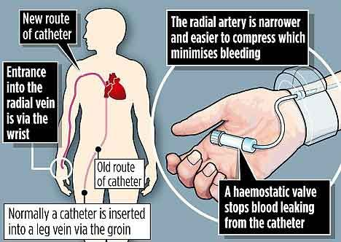

Slide 8
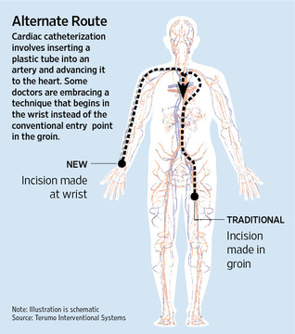

Slide 9
Pulmonary Hypertension—Management
Goal = treat the underlying cause
Standardized treatment
O2 with exercise
Diuretics
Anticoagulants
Digoxin
Calcium Channel Blockers
Vasodilators
Notes:
Pulmonary Hypertension—Management
Goal = treat the underlying cause
Standardized treatment
Oxygen with exercise—if patient requires → assess oxygen saturation
Diuretics → monitor blood pressure and potassium level
Anticoagulants—patient is at an increased risk for blood clots → assess PT/INR, PTT/aPTT, platelet count
Digoxin—helps control heart rate and improve ejection fraction → monitor digoxin levels and heart rate—hold for bradycardia or dig toxicity
Calcium Channel Blockers—help widen the blood vessels by affecting the muscle cells in the arterial walls—blocks calcium from entering
Vasodilators—various options → up to the MD

Slide 10
Pulmonary Hypertension—Nursing Management
Know the medications that are given
Know the procedures and post care
Know who is at risk
Knowledge about oxygen and home oxygen
Notes:
Pulmonary Hypertension—Nursing Management
Know the medications that are given → proper medication administration (5 rights—right person, right drug, right dose, right route, right time), side effects
Be familiar with the procedures and know post-procedure nursing care interventions
Know who is at risk for the development of pulmonary hypertension → early S&S as well
Patient education—home oxygen if patient requires supplemental at home

Slide 11
Heart Failure
A myocardial disease in which there is a problem with either the contraction of the heart or the filling of the heart
Two Forms
Systolic Failure
Diastolic Failure
The heart is unable to pump sufficient blood to meet the needs of the tissues for oxygen and other nutrients
Characterized by:
Fluid overload
Inadequate tissue perfusion
Progressive, lifelong disorder
Managed with:
Medications
Lifestyle changes
Notes:
Heart Failure—a myocardial disease in which there is a problem with either the contraction of the heart or the filling of the heart
Systolic failure—problem with the contraction of the heart
Diastolic failure—problem with the filling of the heart
Heart is unable to pump sufficient blood to meet the needs of the tissues for oxygen and other nutrients
Characterized by: fluid overload or inadequate tissue perfusion
Progressive, lifelong disorder managed with lifestyle changes and medications

Slide 12
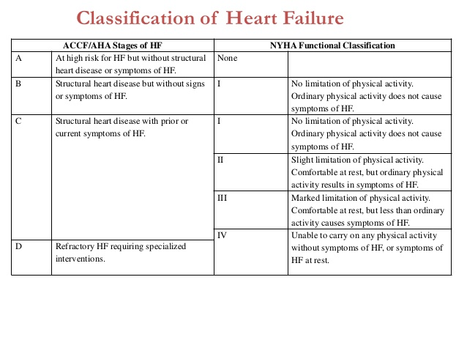
Notes:
NYHA- New York Heart Association
ACCF/AHA
American Council for Capital Formation
American Heart Association

Slide 13
Acute vs. Chronic Heart Failure
Used to describe the onset and intensity of symptoms
Acute
Chronic
If the cause of acute symptoms are not reversed → then heart failure becomes chronic
Notes:
Acute vs. Chronic Heart Failure
Describes the onset and intensity of symptoms
Acute → sudden onset over days or hours
Chronic → develops over months to years
If the cause of acute symptoms is not reversed → then heart failure becomes chronic

Slide 14
Acute vs. Chronic Heart Failure cont.
Acute Heart Failure
Occurs suddenly
Symptoms progressive
Reverse the cause if possible
Chronic Heart Failure
Occurs over time
Symptoms represent patient’s baseline
Symptoms don’t disappear
Stable periods interrupted by acute episodes
Notes:
Acute vs. Chronic Heart Failure cont.
Acute Heart Failure
Occurs suddenly
Symptoms progress to the point of needing emergency intervention to save the patient’s life
If cause is not reversible → heart failure then becomes chronic
Chronic Heart Failure
Occurs over time
Symptoms represent baseline condition
Symptoms don’t diseappear symptoms are controlled or absent
Characterized by stable periods interrupted by episodes of acute decompensation

Slide 15
NCLEX Question
A 56-year-old male presented to the emergency department with chest pain and shortness of breath that occurred suddenly. He was admitted to the unit for management of a myocardial infarction and heart failure. Measurement of his heart size and ejection fraction (EF) at the catheterization showed an EF of 30% and a normal size heart. Which of the following statements best describes acute heart failure?
A. Symptoms develop gradually over months.
B. Symptoms develop quickly over hours to days.
C. Symptoms occur with exertion.
D. Symptoms are minimal even with exertion.
Notes:
Answer: B
Acute heart failure develops over a short period of time. Symptoms that develop over months to years define chronic heart failure. The association of symptoms with exertion may be chronic or acute.

Slide 16
Right-Sided vs. Left-Sided Heart Failure
Right-sided heart failure
Inability of the right ventricle to fill or eject sufficient blood into the peripheral tissues → blood backs up and results in congestion in venous system
Left-sided heart failure (most common)
Left ventricle cannot effectively pump blood out of the ventricle → blood backs up and results in congestion in pulmonary system
**Remember in chronic HF patients may have both.
Notes:
Right-Sided vs. Left-Sided Heart Failure
Right-Sided heart failure → inability of the right ventricle to fill or eject sufficient blood into the peripheral tissues → blood backs up and results in congestion within the venous system
Left-Sided Heart Failure—most common → left ventricle cannot effectively pump blood out of the ventricle → blood backs up and results in congestion within the pulmonary system
**REMEMBER THAT IN CHRONIC HF PATIENTS → THEY MAY HAVE BOTH FORMS

Slide 17
Clinical Manifestations Right-Sided vs. Left-Sided Heart Failure
Right-Sided
Viscera and peripheral congestion
Jugular venous distention (JVD)
Dependent edema
Hepatomegaly
Ascites
Weight gain
Left-Sided
Pulmonary congestion, crackles
Ventricular gallop
Dyspnea on exertion (DOE)
Orthopnea
Dry, nonproductive cough initially
Oliguria
Notes:
Clinical Manifestations—Heart Failure
Right-Sided
Jugular vein distention
Dependent edema—legs, ankles
Abdominal distention
Ascites
Fatigue, weakness
Nausea, anorexia
Liver enlargement/spleen enlargement (hepatosplenomegaly)
Weight gain
Left-Sided
Dyspnea or orthopnea (SOB while lying down)
Fatigue
Displaced apical pulse (hypertrophy)
Ventricular gallop → presence of S3 heart sound
Pulmonary congestion—crackles
Frothy sputum → can be blood-tinged
Oliguria—decrease in urine output
Altered mental status
Cough—dry, hacking

Slide 18
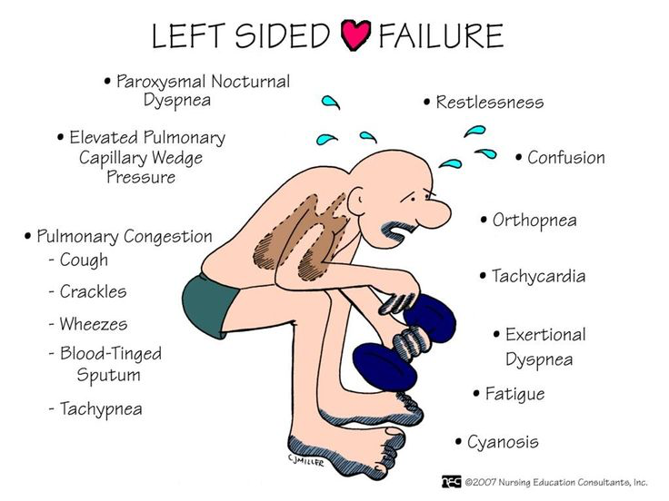

Slide 19
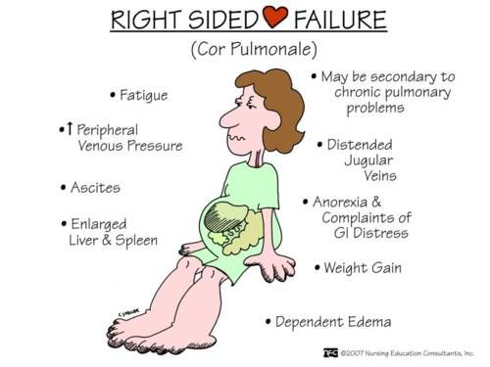

Slide 20
Question
Is the following statement true or false?
The underlying result of heart failure is insufficient cardiac output.
Notes:
True
Rationale: The underlying result of all types of heart failure is insufficient cardiac output.
That is, the volume of blood pumped by the heart in 1 minute is inadequate.
Some patients may have a normal cardiac output at rest, but they do not have the reserve function to increase cardiac output to meet the increased demands of exercise, hypoxemia, or anemia.

Slide 21
Cardiac Output
Underlying result of heart failure is insufficient cardiac output
Oxygen demand
Cardiac output increases to meet increased O₂ demand
Mechanical factors
Stroke volume and heart rate
Notes:
Cardiac Output—refers to the total amount of blood ejected by one of the ventricles in liters per minute → normal adult cardiac output is 4-6 L/min
Computed by multiplying the stoke volume by the heart rate
Stroke volume—amount of blood ejected from one of the ventricles per heartbeat → average is 60-130 mL
Cardiac output increases to meet oxygen demands of the body
Disease processed like cardiomyopathy can affect cardiac output – goal in treating these disease processes would be to improve cardiac output

Slide 22
Heart Failure—Diagnostic Testing
Echocardiogram-provides pictures of the heart valves and chambers
EF: How well your heart is pumping
What % is considered heart failure?
Chest x-ray
EKG
Electrolytes, BUN, Creatinine, CBC, UA
Assess factors that may be contributing to hear failure and/or the impact of the heart failure
BNP – Key diagnostic indicator
Notes:
Heart Failure—Diagnostic Testing
Echocardiogram—ultrasound that provides pictures of the heart valves and chambers
Determines ejection fraction—percentage of blood volume in the ventricles at the end diastole that is ejected during systole → measures contractility and how well the heart is pumping → EF of 40% or less is considered heart failure
Chest x-ray—can reveal cardiomegaly and pleural effusions
EKG
Electrolytes
BUN
Creatinine
CBC
UA
BNP(B-type natriuretic peptides)—key diagnostic indicator → confirms diagnosis—the larger the number, the worse the HF is—less than 100 = no heart failure

Slide 23
Heart Failure—Medical Management
Focuses on:
Improvement of cardiac function by reducing preload and afterload
Reduction of symptoms and improvement of functional status
Stabilization of patient condition and lowering of the risk of hospitalization
Delay of the progression of HF and extension of life expectancy
Promotion of a lifestyle conducive to cardiac health
Notes:
Heart Failure—Medical Management
Focuses on:
Improvement of cardiac function by reducing preload (degree of stretch of the cardiac muscle fibers at the end of diastole—period of ventricular relaxation resulting in ventricular filling) and afterload (the amount of resistance to ejection of blood from the ventricle)
Reduction of symptoms and improvement of functional status—SOB, oxygen, positioning
Stabilization of patient condition and lowering the risk of hospitalization
Delay of the progression of heart failure and extending life expectancy
Promotion of a lifestyle conducive to cardiac health—restricted sodium, restricted fluid intake

Slide 24
Heart Failure—Nursing Assessment
Focus
Effectiveness of therapy
Patient’s self-management
S&S of increased HF
Emotional or psychosocial response
Health history
Focus on S & S
Physical Exam
Mental status
Lung sounds
Heart sounds
Fluid status
Daily weight
I&O
Assess response to medications
Notes:
Heart Failure—Nursing Assessment
Focuses on:
Effectiveness of therapy
Patients self-management—compliance
S/S of increased or worsening HF
Emotional or psychosocial response
Health History
Focuses on S/S—SOB, fatigue, edema, sleep disturbances (orthopnea)
Physical Exam
Mental status
Lung sounds—crackles, wheezes
Heart sounds—S3
Fluid status/signs of fluid overload
Daily weight
I&O
Assess response to medications

Slide 25
Heart Failure—Planning
Goals
Promote activity and reduce fatigue
Relieve fluid overload symptoms
Decrease anxiety or increase the patient’s ability to manage anxiety
Encourage the patient to verbalize his or her ability to make decisions and influence outcomes
Educate the patient and family about management of the therapeutic regimen
Notes:
Heart Failure—Planning
Goals focus on:
Promotion of activity and reduction of fatigue—activity and rest periods, gradually increase activity level as patient can tolerate
Relieve fluid overload symptoms—diuretics, O2 if SOB and decreased O2 sat present
Decrease anxiety or increase the patients ability to manage anxiety—Ativan, Xanax → this may help with breathing as well
Encourage the patient to verbalize his or her ability to make decisions and influence outcomes → as long as the patient is A&O and able
Educate the patient and family about the management of the therapeutic regimen—dietary restrictions (Na, H20), medications, daily weight, follow up appointment

Slide 26
Heart Failure—Nursing Interventions for Activity Intolerance
Bed rest for acute exacerbations
Encourage regular physical activity
Exercise training
Pacing of activities
Wait 2 hours after eating for physical activity
Avoid activities in extreme hot, cold, or humid weather
Modify activities to conserve energy
Positioning
Notes:
Heart Failure—Nursing Interventions for Activity Intolerance
Bedrest for acute exacerbations → help decrease SOB if present, elevate extremities of peripheral edema is noted
Encourage regular physical activity → 30-45 minutes daily
Exercise training → increase activity gradually as patient can tolerate
Pacing of activities → include frequent rest periods, especially if patient is short of breath
Wait 2 hours after eating for physical activity → able to exert self more
Avoid activities in extreme hot, cold or humid weather → difficult to breath, especially if patient has SOB at baseline
Modify activities to conserve energy
Positioning → elevate HOB to facilitate easier breathing, elevate extremities if peripheral edema is noted

Slide 27
Heart Failure—Nursing Interventions for Fluid Volume Excess
Assessment for symptoms of fluid overload
Daily weight
I&O
Diuretic therapy
Fluid intake
Maintenance of sodium restriction
Notes:
Heart Failure—Nursing Interventions for Fluid Volume Excess
Assessment for symptoms of fluid overload → crackles, peripheral edema, SOB, weight gain
Daily weight → will help determine effectiveness of medications in an acute exacerbation or detect weight gains/losses
I&O → help determine effectiveness of medications
Diuretic therapy → Lasix—timing of medications (not too closely to bed) daily is given at 0900, BID given at 0800 and 1800
Monitor fluid intake → fluid restrictions
Maintenance of Na restriction → usually 2g or less per day

Slide 28
Heart Failure—Nursing Interventions for Anxiety & Powerlessness
Minimize stress
Promote physical comfort
Provide psychological support
Reassurance and taking part in decision making
Education on techniques to control anxiety and promote relaxation
Family support
Screen for depression
Notes:
Heart Failure—Nursing Interventions for Anxiety & Powerlessness
Minimize stress → stress stimulates the sympathetic nervous system which causes vasoconstriction—increases BP
Promote physical comfort → positioning, medications, supplemental O2 if required
Provide psychological support → therapeutic communication, active listening
Provide reassurance and take part in decision making → educate patient if they are undereducated
Education on techniques to control anxiety and promote relaxation → medications, guided imagery, music
Provide family support → education
Screen for depression

Slide 29
Heart Failure—Collaborative Problems and Potential Complications
Hypotension
Poor perfusion
Cardiogenic shock
Dysrhythmias
Thromboembolism
Pericardial effusion
Cardiac tamponade
Pulmonary edema
Notes:
Heart Failure—Potential Complications
Hypotension → related to diuretic use
Poor perfusion → related to edema, SOB
Cardiogenic shock—failure in the hearts ability to pump → S/S include: tachycardia, hypotension, inadequate urinary output, altered LOC, crackles, tachypnea, cool/clammy skin, decreased peripheral pulses, chest pain
Dysrhythmias
Thromboembolism “blood clots”
Pericardial effusion ("fluid around the heart") → an abnormal accumulation of fluid in the pericardial cavity. Because of the limited amount of space in the pericardial cavity, fluid accumulation leads to an increased intrapericardial pressure which can negatively affect heart function
Cardiac tamponade—pressure on the heart that occurs when blood or fluid builds up in the space between the heart muscle and the outer covering sac of the heart → S/S include: hypotension, jugular vein distention, muffled heart sounds
Pulmonary edema → we will see severe SOB, tachycardia, and crackles → can be life-threatening complication of heart failure
Treatment
Administration of oxygen → helps to ease the workload of breathing
Administration of furosemide → helps to eliminate accumulated fluid within the lungs
Insertion of a foley catheter → ensures accurate output
Administration of IV morphine sulfate → reduces venous return, decreases anxiety (SOB), and reduces the workload of breathing
Place the patient in a high-fowler’s position → eases the workload of breathing = makes it easier to breathe
Patient may need to go to a coronary care unit if not responsive to treatment

Slide 30
Heart Failure—Patient Education
Medications
Dietary recommendations
Monitoring for signs of excess fluid, hypotension, and symptoms of disease exacerbation
Exercise and activity program
Stress management
Prevention of infection
Know how and when to contact health care provider
Include family in education
Notes:
Heart Failure—Patient Education
Medications → when to take, how to take, what to look for
Dietary recommendations → low-sodium diet, fluid restriction
Monitoring for signs of excess fluid, hypotension → taking BP prior to taking medications, symptoms of disease exacerbation → daily weight
Exercise and activity program → 30-45 minutes per day → at least 3 times per week
Stress management → relaxation techniques, anxiety medications
Prevention of infection
Know how and when to contact health care provider → more than 2 lb weight gain overnight, SOB, etc.
Include family in on education session

Slide 31
Heart Failure—Medications
Angiotensin-converting enzyme (ACE) inhibitors (-pril)
Lisinopril, Enalapril, Captopril
Angiotensin II receptor blockers (ARBs) (-sartan)
Losartan
Beta-blockers (-lol)
Carvedilol, Metoprolol
Diuretics
Furosemide, Bumetanide, Hydrochlorothiazide, Spironolactone
Digitalis
Digoxin
Inotropes
Dopamine, Dobutamine, Milrinone
Notes:
Heart Failure—Medications
Angiotensin-converting enzyme (ACE) inhibitors—lisinopril, enalapril, captopril → promote vasodilation, diuresis and decrease after load (helps heart pump more easily)
Monitor for: hypotension, hyperkalemia, altered renal function, dry cough (#1 complaint)
Angiotensin II receptor blockers—losartan → given as an alternative to ACE inhibitors as these work very similarly to ACE inhibitors
Beta-blockers—carvedilol, metoprolol → slows the heart rate and allows more time for the heart to fill with blood; allows the left ventricle to fill more completely and increases the volume of blood the heart pumps with each heart beat (EF)
Given in addition to ACE inhibitors
Takes several weeks before effectiveness is seen
Should be used with caution in patients who have asthma → can cause bronchoconstriction
Diuretics—furosemide, bumetanide, hydrochlorothiazide, spironolactone → decreases fluid volume
Monitor serum electrolytes (K) → loop, thiazide can decrease K; potassium-sparing can increase K
Digitalis—digoxin (cardiac glycoside) → improves contractility of the heart, improves the hearts ability to pump which increases cardiac output
Monitor for toxicity—anorexia, nausea, visual disturbances, confusion, bradycardia
Monitor for hypokalemia → can increase chances of toxicity
Inotropes—dopamine, dobutamine, milrinone → used to hospitalized patients admitted for acute decompensated HF—these are IV medications → increase the strength and force of the heart beat which causes more blood to circulate through the body → improves/increases cardiac output
Monitor heart rhythm (dysrhythmias can occur), blood pressure (hypotension can occur → should see a rise in systolic), and urine output closely → should increase
Therapeutic effects = increase in systolic BP and an increase in urine output

Slide 32
Heart Failure—Management of Acute Decompensation
Airway and breathing
Intubation
Diuresis
Circulation
Optimize hemodynamics
Increase contractility
Vasodilation
Heart rate
Notes:
Heart Failure—Management of Acute Decompensation
Airway and breathing
Intubation → patent airway and helps control breathing
Diuresis → helps get fluid off in hopes that patient will be able to breathe easier and on their own
Circulation
Optimize hemodynamics → stability in BP, HR
Increase contractility of the heart → dopamine
Vasodilation → nitrates
Heart rate → normal range, normal rhythm

Slide 33
Treating Heart Failure--“UNLOAD FAST”
Upright position
Nitrates
Lasix
Oxygen
ACE inhibitors
Digoxin
Fluids
Afterload
Sodium restriction
Test
Notes:
Treating HF—UNLOAD FAST
Upright position
Nitrates
Lasix
Oxygen
ACE inhibitors → lisinopril, enalapril
Digoxin
Fluids → decrease
Afterload → decrease
Sodium restriction
Test → digoxin level, ABGs, potassium level

Slide 34
Heart Failure—Gerontologic Considerations
May present with atypical signs and symptoms
Decreased renal function
Administration of diuretics to older men
Notes:
Heart Failure—Gerontologic Considerations
May present with atypical signs/symptoms → fatigue, weakness, drowsiness
Decreased renal function → can make older adult patient resistant to diuretics and more sensitive to changes in volume
Administration of diuretics to older men → monitor for bladder distention—caused by urethral obstruction from an enlarged prostate

Slide 35
NCLEX Question
Which of the following statements describes the relationship between heart failure and cardiomyopathy?
A. Heart failure is synonymous with cardiomyopathy
B. Heart failure is caused by a cardiomyopathy
C. Cardiomyopathy is caused by heart failure
D. Heart failure and cardiomyopathy are unrelated
Notes:
Answer: B
Heart failure is not the same as cardiomyopathy. All heart failure results from a cardiomyopathy, but because heart failure is a set of symptoms rather than a disease, asymptomatic cardiomyopathy is by definition, NOT heart failure.

Slide 36
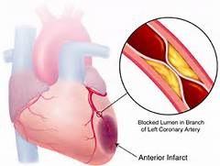
CAD-Atherosclerosis: Pathophysiology
Triglycerides, hypertension, and cigarette smoking cause damage to the endothelium.
Fatty substances, cholesterol, cellular waste products, calcium, and fibrin pass are deposited forming lipid plaque (atheroma)
Blood flow is reduced, decreasing oxygen supply to tissues
Symptoms occur with 75% or more occlusion
Notes:
Coronary Artery Disease (CAD)—Atherosclerosis: Pathophysiology
Atherosclerosis is a major cause of cardiovascular disease → white blood cells, smooth muscle cells and platelets aggregate at the site forming a fibrous plaque → blood flow is reduced which decreases oxygen supplies to tissues
Symptoms occur with 75% or more occlusion

Slide 37
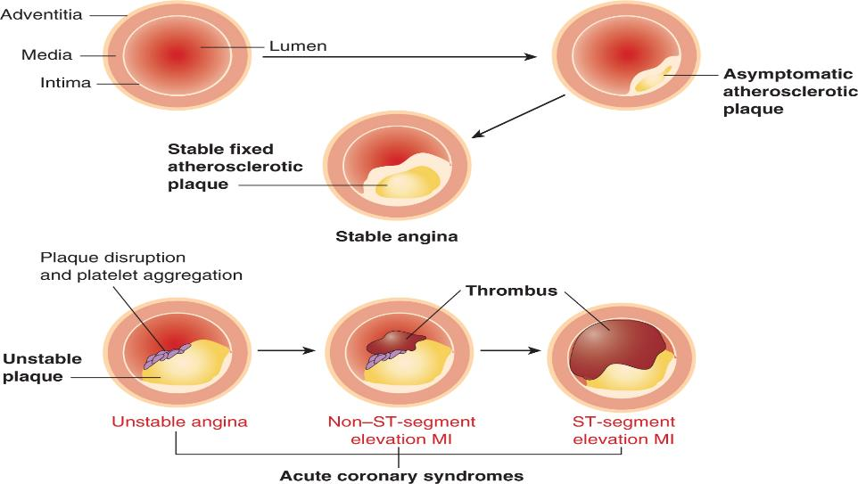
Atherosclerotic Plaque

Slide 38
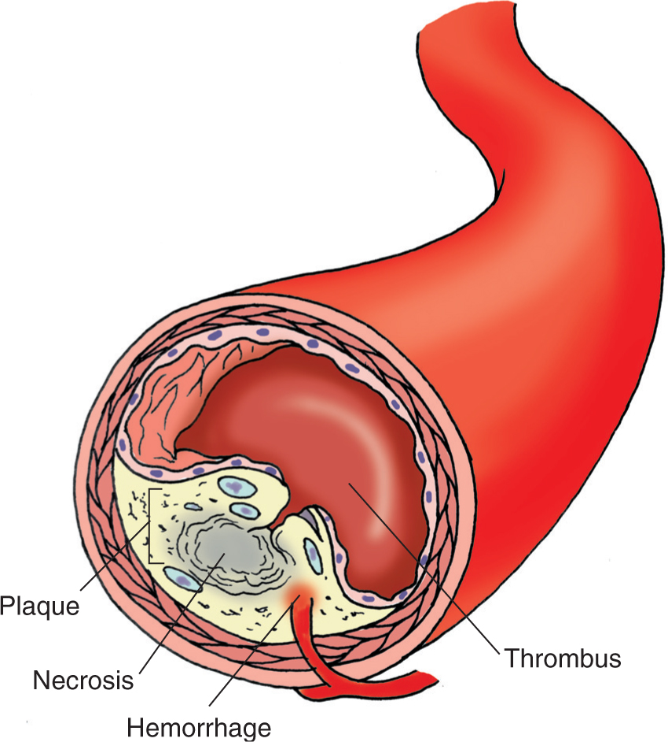
Thrombosis
Notes:
When plaque is in the way, and blood is unable to flow through properly, a thrombus forms → which blocks off blood supply completely → can lead to an MI

Slide 39
CAD—Risk Factors—Unmodifiable
Age
Heredity
Race
Gender
Notes:
CAD—Risk Factors—Unmodifiable
Age → greater than 65 years old
Heredity
Race → African American, Mexican American, Native American, Native Hawaiian, Asian Americans
Gender → More common in men; chances increase in women after menopause—death rate is higher in women

Slide 40
CAD—Risk Factors—Modifiable
Cigarette smoking
High blood cholesterol
Hypertension
Physical inactivity
Obesity and overweight
Stress
Excessive alcohol intake
Notes:
CAD—Risk Factors—Modifiable
Cigarette smoking → cessation
High blood cholesterol → decrease with medication, diet
Hypertension → decrease with medication
Physical inactivity → activity 30-45 minutes per day
Obesity/overweight → diet and exercise
Stress → decrease
Excessive alcohol intake → reduce consumption to less than 3 oz/day
Patient Teaching
Smoking cessation/avoiding secondhand smoke
Regular physical activity
Reduce alcohol consumption
Weight monitoring
Diet → limit fast food as these are high sodium/high fat

Slide 41
CAD—Treatment
Starts with prevention
Controlling cholesterol
Dietary measures
Physical activity
Medications
Smoking cessation
Management of
Hypertension
Diabetes
Notes:
CAD—Treatment
Starts with prevention
Controlling cholesterol → LDL goal = less than 100; Total cholesterol goal = less than 200; Triglyceride goal = less than 150; HDL goal = less than 40 (males) and greater than 50 (females)
Dietary measures → therapeutic lifestyle changes
Physical activity → increase
Medications
Lipid lowering agents—Atorvastatin, Simvastatin
Smoking cessation
Management of → hypertension and diabetes are both known to accelerate the development of heart disease and heart failure
Hypertension
Diabetes

Slide 42
CAD—Potential Complications
Heart failure
Dysrhythmias
Chest pain
Heart attack
Sudden death
Arterial diseases
Notes:
CAD—Potential Complications
Heart failure → over time, CAD can lead to heart failure due to the increased workload on the heart
Dysrhythmias → atrial fibrillation
Chest pain → caused by the reduction of blood flow within the coronary arteries
Heart attack → blood clots can form around the atherosclerosis plaques which blocks blood flow to the heart
Sudden death → if coronary artery blood flow is severely blocked and not restored, it can cause sudden death
Arterial diseases → can lead to ischemic strokes

Slide 43
Angina Pectoris (Chest Pain)
Chest pain or discomfort that results from CAD
Causes
Atherosclerotic narrowing that reduces oxygen supply
Spasm of coronary artery
Arterial inflammation
Marked increase in oxygen demand
Notes:
Angina Pectoris (Chest Pain)
Chest pain or discomfort that results from CAD → presents as pressure, fullness, squeezing, heaviness or pain in the chest
Causes:
Atherosclerotic narrowing that reduces oxygen supply → non-occlusive thrombus develops
Spasm of coronary artery → sudden tightening of the arteries
Arterial inflammation
Marked increase in oxygen demand → S/S include: fever, tachycardia, thyrotoxicosis (excess levels of thyroid hormones—decreased TSH)
Exertion and anxiety can trigger the pain

Slide 44
Classification of Angina
Stable angina
Unstable angina
Chest pain at rest, pre-infarction
Variant (Prinzmetal’s) angina
Variant angina is the result of coronary artery spasm.
Most people who experience variant angina have severe coronary atherosclerosis of at least one major coronary artery, and the spasm occurs very near the area of blockage.
Notes:
Classification of Angina
Stable angina → chest pain after physical exertion or emotional stress—usually relieved with rest or nitroglycerin (SL) → given under the tongue, sip of water after
Unstable angina → chest pain at rest usually between midnight and 8 am—usually occurs pre-infarction (MI)
Variant (Prinzmetal’s) angina → chest pain as a result of coronary artery spasm (sudden tightening of the arteries) → patients usually have severe atherosclerosis of at least one major coronary artery

Slide 45
Angina—Assessment
History
Description of symptoms
Associated symptoms
Review of risk factors
Physical findings
Notes:
Angina—Assessment
History → past medical history (CAD), family history
Description of the symptoms → onset of pain, cause, relief of pain, quality of pain, location of pain, duration of pain
Associated symptoms → SOB, dizziness, syncope, nausea, diaphoresis, vomiting, anxiety/feeling of impending doom
Review of risk factors → age, sex
Physical findings → pale, cool/clammy skin, tachycardia, tachypnea with SOB, diaphoresis, decreased LOC

Slide 46
Angina—Diagnostic Tests
12-lead ECG
Cardiac markers
Coagulation studies
Lipid profile
Exercise stress testing
Coronary angiography
Notes:
Angina—Diagnostic Tests
12-lead EKG → looking for ST elevation, T-wave inversion (indicates ischemia)
Cardiac markers → creatine kinase (CK), troponins, myoglobin
Coagulation studies → PT/INR, PTT, D-dimer
Lipid profile → total cholesterol, LDL “bad” cholesterol, HDL “good” cholesterol, triglycerides
Stress testing → tolerance of activity is tested using either a treadmill, bicycle or medications to evaluate response to increased heart rate via continuous EKG monitoring
Coronary angiography (cardiac cath) → gives definitive diagnosis of CAD—looks at how blood is flowing through the arteries using contrast dye and x-ray

Slide 47
Question
A nurse is teaching a patient who has angina about a new prescription for metoprolol. Which of the following statements by the patient indicates understanding of the teaching?
A. I should place the tablet under my tongue.
B. I should have my clotting time checked weekly.
C. I will report any ringing in my ears.
D. I will call my doctor if my pulse rate is less than 60.
Notes:
Answer: D
Metoprolol lowers HR → beta blockers should be held if the HR is below 60

Slide 48
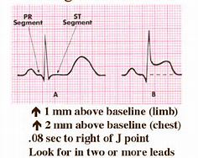
Acute Coronary Syndrome
Unstable angina
Myocardial Infarction
Notes:
Acute Coronary Syndrome
Unstable angina → unexpected chest pain or discomfort at rest
Myocardial infarction → two kinds = ST-segment elevation MI (STEMI) and Non-St-segment elevation MI (NSTEMI)

Slide 49
Myocardial Infarction
Prolonged ischemia
Plaque rupture triggers thrombus formation
Occlusion of blood flow results in MI
Irreversible damage occurs after 20 to 40 minutes
Tissue can be salvaged if flow is restored
Can occur without cause
Notes:
Myocardial Infarction
Prolonged ischemia → causes chest pain
Plaque rupture triggers thrombus formation → at the site of an atherosclerotic lesion → occlusion of blood flow then results in an MI
Irreversible damage occurs after 20-40 minutes → early recognition and treatment is essential to prevent death
Tissue can usually be salvaged if flow is restored → within 6 hours
MI can occur without cause → usually occurs in the morning after having been at rest all night

Slide 50
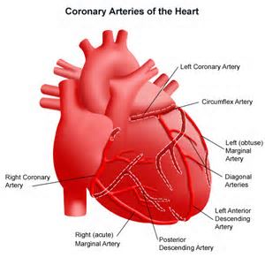
Location of the Infarction
Anterior left ventricle
Lateral and posterior left ventricle
Inferior left ventricle
Right ventricle
Notes:
MI—Location of the Infarction
Anterior left ventricle → occlusion of left anterior descending (LAD)—LAD is the widow maker
Lateral and posterior left ventricle → occlusion of left circumflex artery
Inferior left ventricle → occlusion of the right coronary artery
Right ventricle → occlusion of the right coronary artery

Slide 51
Question
A nurse is admitting a patient who has a suspected MI and a history of angina. Which of the following findings will help the nurse distinguish angina from an MI?
A. Angina can be relieved with rest and nitroglycerin
B. The pain of an MI resolves in less than 15 minutes
C. The type of activity that causes an MI can be identified
D. Angina can occur for longer than 30 minutes
Notes:
Answer: A
Angina can be relieved by rest and nitro.

Slide 52
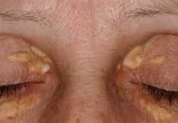
MI—Physical Examination
VS
Integumentary
Xanthomas
Carotid/femoral bruits
Heart sounds
Lung sounds
Pulses
Overall appearance
Notes:
MI—Physical Examination
Vital signs → tachycardia with hypertension, bradycardia with hypotension, tachypnea, low-grade fever
Integumentary → pale, cool/clammy skin
Xanthomas—irregular, yellow nodule or patch on the skin (shown in picture) → high lipid/cholesterol levels—shows the build up of fat
Carotid/femoral bruits → blowing or swishing sound heart with the bell of a stethoscope
Heart sounds → diminished, S4 indicates decreased left ventricular compliance (decreased functioning of the left ventricle)
Lung sounds → crackles, rhonchi, labored breathing
Pulses → irregular/faint pulses, JVD
Overall appearance → restless, agitated, in distress
Manifestations
Dyspnea
Headache
CP with jaw/back pain
Nausea
Vomiting
Tachycardia
Dysrhythmias
Diaphoresis
Anxiety

Slide 53
MI—Laboratory Tests
Referred to as = CK isoenzymes
Creatine kinase
Troponin – Troponin I and Troponin T
Myoglobin
Creatine phosphokinase (CPK)
Chest x-ray
Echocardiogram
EKG
Angiography
Chest MRI
Notes:
MI—Laboratory Tests
Referred to as = CK isoenzymes → will begin to see a rise in these within 2-3 hours in a patient with an MI
Creatine kinase-MB (CK-MB) → specific to myocardial (heart) cell damage → rises at 2-12 hours, peaks at 24 hours, returns to normal at 48-72 hours after the onset of symptoms
Troponin → protein that regulates the myocardial contraction process (heart contraction) → preferred cardiac marker in the diagnosis of MI → Troponin I—rises at 3-12 hours, peaks at 24 hours and remains elevated for 5-10 days; Troponin T—rises at 3-12 hours, peaks at 12 hours-2 days and remains elevated for 5-14 days
Myoglobin → protein that helps transport oxygen—found in cardiac and skeletal muscles → rises at 1-4 hours, peaks at 6-7 hours, returns to normal at 24 hours after the onset of symptoms → not specific for the diagnosis of MI
Creatine phosphokinase (CPK) → increased in the presence of muscle injury
Chest x-ray → will show other underlying conditions—pulmonary edema, cardiomegaly
Echocardiogram → ultrasound of the heart → will show valve disorders, cardiomyopathy
EKG → records electrical activity of the heart → T-wave inversion = ischemia, ST-elevation = cardiac injury, abnormal Q-wave = necrosis
Angiography (cardiac cath) → used to evaluate the presence and degree of coronary artery blockage
Chest MRI → will show other underlying conditions

Slide 54
MI—Nursing Management
Initial evaluation should be quick
Patient history
12-lead EKG
Frequent vital signs
Obtain IV access
Continuous cardiac monitoring
Who meets you at the door? MONA
Notes:
MI—Nursing Management
Initial evaluation should be quick → within 10 minutes of arrival
Patient history should be obtained—history of CAD
12-lead EKG should be obtained → ST-elevation present in two or more leads = MI
Frequent vital signs → every 5 minutes until stable, then every 1 hour after that
Obtain IV access → large-bore is ideal (18-20 gauge)
Continuous cardiac monitoring → for duration of hospitalization
Nursing care focuses on—who meets you at the door? → MONA → morphine (if pain isn’t relieved by nitro), oxygen (2-4L), nitro (SL q5min x3 doses, IV drip, or transdermal patch), aspirin

Slide 55
MI—Management
Pharmacological therapy
Nitroglycerin
Morphine
β-blockers
Calcium channel blockers
Aspirin/Antiplatelet
ACE inhibitors
Fibrinolytic therapy
Percutaneous coronary intervention
Notes:
MI—Nursing Management cont.
Pharmacological therapy
Nitroglycerin—SL q5min x3 doses, transdermal patch, or IV drop → helps relieve chest pain → may cause a HA
SL nitro can be given with a small sip of water → helps to dissolve
Morphine → given if pain is not relieved by SL nitro x3
Beta-blockers—metoprolol → used to decrease myocardial oxygen consumption by reducing myocardial contractility—reduces work load of the heart and decreases myocardial oxygen demands
Calcium channel blockers—amlodipine → used in unstable angina and NSTEMI
Aspirin/Antiplatelet → prevent platelets from forming together which can cause arterial clotting
ACE inhibitors—lisinopril → delays progression of cardiac dysfunction and improves mortality rate → given if EF is less than 40%
Fibrinolytic therapy—alteplase → helps establish reperfusion → given within 30 minutes in STEMI situation—provides the most benefit when given within 3 hours of onset of symptoms → must be given within 3 hours of onset of symptoms
Nursing Interventions
Reconstitute with sterile water (powder)
Administer 15 mg bolus → increases therapeutic effects of medication
Assess for bleeding → back pain, headache, changes in LOC, decreased Hgb/Hct
Percutaneous coronary intervention (cardiac cath)—done through wrist or groin → used to reestablish blood flow → artery is opened by a balloon and a stent is placed → used for patients who present within 12 hours

Slide 56
MI—Intensive/Intermediate Care Management
Maximize cardiac output
Minimize cardiac workload
Frequent vital signs
Continuous cardiac monitoring with ST segment
Monitor pulse oximetry
Serial EKGs and serial serum cardiac markers
What should activity be?
What should their pain be?
Should they eat?
Notes:
MI—Intensive/Intermediate Care Management
Goals = maximize cardiac output, minimize cardiac workload
Frequent vital signs → every 15 minutes until stable, then every 1 hour
Continuous cardiac monitoring → look for ST-segment changes (elevation)
Monitor pulse oximetry → ensures appropriate oxygenation
Serial EKGs and serum cardiac markers → usually every 6 hours
Activity level → bedrest to commode for first 12 hours
Should have no complaints of pain
Diet → NPO until pain free (may need to go back to cath lab) → clear liquids → cardiac diet

Slide 57
Cardiac Rehabilitation
What is Cardiac Rehab?
Goals
Limit the adverse physiological and psychological effects of heart disease
Modify risk factors
Reduce sudden death or re-infarction
Control cardiac symptoms
Stabilize/reverse atherosclerotic process
Enhance the patient’s psychosocial and vocational status
Notes:
Cardiac Rehabilitation
What is it? → combines exercise, education and counseling
Goals:
Limit the adverse physiological and psychological effects of heart disease
Modify risk factors → smoking, obesity, etc.
Reduce sudden death or occurrence of re-infarction
Control cardiac symptoms → medication compliance
Stabilize/reverse atherosclerotic process → medication compliance
Enhance the patients psychosocial and vocational status

Slide 58
Question
A nurse is caring for a patient who asks why her provider prescribed a daily aspirin. Which of the following is an appropriate response by the nurse?
A. Aspirin reduces the formation of blood clots that could cause a heart attack.
B. Aspirin relieves the pain due to myocardial ischemia.
C. Aspirin dissolves clots that are forming in your coronary arteries.
D. Aspirin relieves headaches that are causes by other medications.
Notes:
Answer: A
ASA decreases platelet aggregation that can cause an MI

