Slide 1
Work Related injuries and the importance of prevention.
By: Tenika McMillan

Slide 2
Work related injuries
Define work related injuries (WRI)
Common types of WRI
Risk factors
Prevention
Significance to nursing
Notes:
For this assignment, we will define what a work related injury is; discuss the most common types, risk factors, prevention, and the significance WRI has on the nursing profession.

Slide 3
Work Related Injury Definition
A work-related injury or illness is any injury or illness arising out of and during the course of employment. (vanderbilt.edu, 2011)
Notes:
According to Vanderbilt HR website a work-related injury is what is defined above.

Slide 4
Work Related Injury: helping hands
Healthy People 2010-2020 agenda
ANA’s handle with care campaign
Nurse and Health Care Worker Protection Act of 2009
Notes:
Work related injuries may result in lost of work and work restrictions. Varies organizations have brought attention to this matter such as Healthy people 2010. They have identified reducing work-related injuries resulting in treatment, lost work time, and restricted work activity as an objective in the prevention agenda. This goal is also included in the healthy people 2020. The American nurses association's, handle with care campaign, “seeks to build a health care industry-wide effort to prevent back and other musculoskeletal injuries. This is being done through developing partnerships and coalitions, education and training, increasing use of assistive equipment and patient-handling devices, reshaping nursing education to incorporate safe patient handling, and pursuing federal and state ergonomics policy by highlighting technology-oriented safe-patient handling benefits for patients and nurses.” (Castro, 2004) The nurse and health care worker protection act of 2009, was issued by the Secretary of Labor for occupational safety and health standard to reduce injuries to patients, direct-care registered nurses, and all other health care workers by establishing a safe patient handling and injury prevention standard, and for other purposes. (govtrack.us)

Slide 5
Work place hazards and related injuries
Manual lifting of patients (resulting in musculoskeletal injuries)
Needle Sticks
Physical assault
Exposure to infectious disease
Toxic chemicals (nursingworld.org)
Notes:
A June 30, 2006 report issued by the U.S. Department of Labor’s Bureau of Labor Statistics revealed that from 1995-2004, musculoskeletal injuries were the most common type of non-fatal injury or illness for nursing, psychiatric and home health aides, who represent nearly two-thirds of all health care support occupations. (eeoc.gov) According to nursingworld.org, “Workplace hazards include manual lifting of patients, needles, physical assault, and exposure to infectious diseases and toxic
chemicals. Fatigue from overwork and stressful conditions strains RNs’ health.” For this assignment, we will only address musculoskeletal injuries.

Slide 6
Work Related injuries : Musculoskeletal
12% of nurses leave the profession annually
> 50% of nurses complain of chronic back pain
pain as part of their job
(Corle & Gropelli, 2010)
Notes:
In the article, Nurses’ and Therapists’ Experiences With Occupational Musculoskeletal Injuries, Corle & Gropelli, state that an estimated 12% of nurses leave the profession annually because of back injuries, more than 50% of nurses complain of chronic back pain, and many just accept the musculoskeletal pain as a part of their job.

Slide 7
Risk Factors: Musculoskeletal
Lifting patients
Employee falls due to unsafe work environment
Repetitive movements
Stress
Notes:
Risk factors for work-related injuries include some of the following: lifting, transferring, and repositioning patients, and, are typically performed
Manually without using proper body mechanics; employee falls due to unsafe work environments; repetitive movements, may be due to the use of computers, bending, writing, etc; and phyiscal stress.

Slide 8
Musculoskeletal: cont.
Proper body mechanics is a “myth”
Notes:
According to the ANA’s handle with care fact sheet, “Proper body mechanics is a “myth.” Traditionally taught to student nurses to counteract the physical stress of patient handling, such as lifting, so-called “proper” body mechanics do not translate well to nursing practice. Early findings of body mechanics studies were based on static loads (i.e., boxes with handles) and primarily focused on men. Further, body mechanic methods primarily concentrate on the lower back for lifting and do not account for other vulnerable body parts involved in other types of patient handling tasks, such as lateral transfers from gurney to bed along a horizontal plane.” (pg. 2)

Slide 9
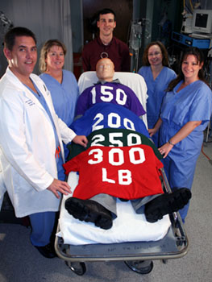
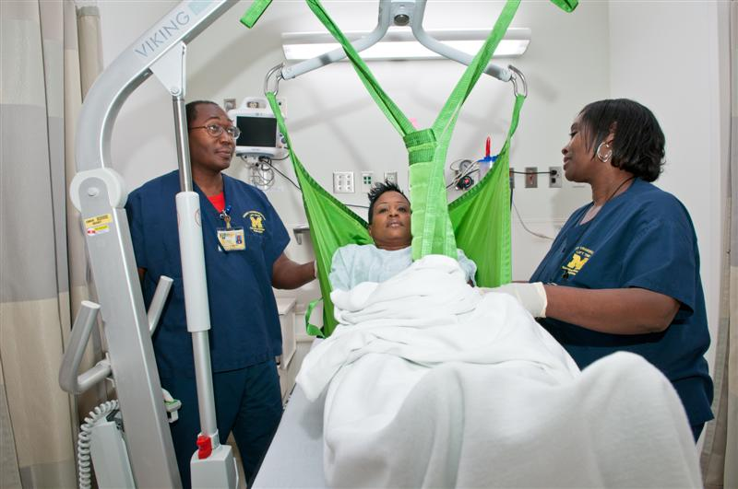
Prevention
Team Lifts
hcljournal.blogspot.com
Lift equipment
uminsideview.org
Notes:
The patient lift team initiative employs three or more physically fit adults, who assist with lifting immobile patients who need assistance. The program significantly reduced nurse injuries, increased nursing staff productivity, and was popular with patients and nurses. (innovations.ahrq.gov)

Slide 10
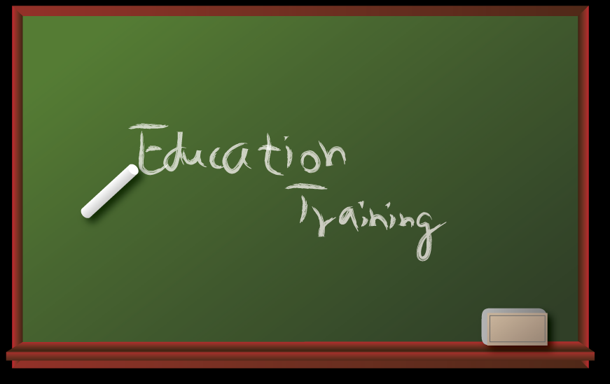
Prevention
jobs-spot.net
Notes:
Innovations.ahrq.gov also suggest that staff training and education will keep staff up to date with the latest in lift training.

Slide 11
Musculoskeletal: Significance to Nursing
Notes:
According to the ANA’s handle with care fact sheet, 52 percent complain of chronic back pain; 38 percent suffered occupational-related back pain severe enough to require leave from work; and 6 percent of RNs reported even changing jobs for neck, shoulder and back problems, respectively. (page. 2)

Slide 12
Musculoskeletal: Outcomes
Loss of physical mobility
Loss of career
Loss of income
Notes:
Musculoskeletal injuries has lots of outcomes, but loss of physical mobility, a loss of a career, and lost of income.

Slide 13
More Information
http://youtu.be/CI37HyoAW_A
Notes:
In the you tube clip above, Beth McCauley discuss the significance of work-related injuries in the nursing profession and offers some suggestions on how to decrease the over all number.

Slide 14
References
2011 ANA HEALTH & SAFETY SURVEY HAZARDS OF THE RN WORK ENVIRONMENT. American Nurses Association Backgrounder. Retrieved from
http://nursingworld.org/FunctionalMenuCategories/MediaResources/MediaBackgrounder
Castro, A. (2004). Handle With Care The American Nurses Association’s Campaign to Address Work-Related Musculoskeletal Disorders. Online journal of Issues in Nursing. Retrieved from
http://www.nursingworld.org/MainMenuCategories/ANAMarketplace/ANAPeriodicals/OJIN
Corle, K., Gropelli, T. (2010) Nurses and Therapists Experiences With Occupational Musculoskeletal Injuries.
Business and Leadership. AAOHN Journal. Vol. 58 {4}
Hoyer lift. Google Images. Retrieved from
http://uminsideview.org
H.R. 2381: Nurse and Health Care Worker Protection Act of 2009. Legislation. Retrieved from
http://www.govtrack.us/congress/bill.xpd?bill=h111-2381

Slide 15
References
Occupational Safety and Health. 2020 topics and objectives. Healthy People 2020. Retrieved from
http://www.healthypeople.gov/2020/topicsobjectives2020/overview.aspx?topicid=30
Patient Lift Team Program Reduces Injuries and Boosts Productivity Among Nurses. Agency for Healthcare Research
and Quality. Retrieved from
http://innovations.ahrq.gov/content.aspx?id=1813
Policy. Human Resources. Vanderbilt University. Retrieved from
http://hr.vanderbilt.edu/policies/HR-011.php
Questions and Answers about Health Care Workers and the Americans with Disabilities Act. The U.S. Equal Employment Opportunity Commission. Retrieved from
http://www.eeoc.gov/facts/health_care_workers.html
Saves Our Nurse. You tube. Retrieved From
http://www.youtube.com/watch?v=CI37HyoAW_A
Team Lift. Google Images. Retrieved from
http://hcljournal.blogspot

