Slide 1
Windshield survey:
The Champaign County Coroner’s Office
N404 Nursing in Community Health
Jessica DeJaynes & Brianna Kennett
March 5, 2012
Notes:
This presentation will discuss the results of a windshield survey conducted in Champaign County Illinois. Community assessment is an important component of community health nursing. A windshield survey is an informal subjective process that nurses may use to conduct community assessments (Harkness & DeMarco, 2012). The focus of our community assessment will be the Champaign County Coroner’s Office located in Urbana, Illinois.

Slide 2
Introduction of Aggregate & Community
Aggregate:
  Employees of the Champaign County Coroner’s Office
Community:
  The population of Champaign County
Notes:
According to Harkness and DeMarco (2012) central principles of public health include focusing on an aggregate and promoting prevention for a community. An aggregate is a group of individuals with common characteristics. The aggregate for this windshield survey will be the employees of the Champaign County Coroner’s Office. (Harkness & DeMarco, 2012)
Several definitions can be applied to describe a community however, “the most basic definition is that a community is a specific population or group of people living in the same geographic area under similar regulations and having common values, interests, and needs” (Taylor, Lillis, LeMone, & Lynn, 2011, p. 63). Individuals within a community interact and utilize shared resources (Taylor et al., 2011). The Champaign County Coroner’s Office serves Champaign County thus the community for this windshield survey is the population of Champaign County.

Slide 3
Windshield Survey Results
Notes:
A windshield survey, “is a subjective process by which nurses understand the community by viewing what appears before their eyes while looking at the physical community” (Harkness & DeMarco, 2012, p. 180). Observations in the assessment should include: economic development, physical environment, safety, transportation, health services, educational services, and recreation. A windshield survey is an informal method for nurses to conduct a community assessment. (Harkness & DeMarco, 2012)

Slide 4
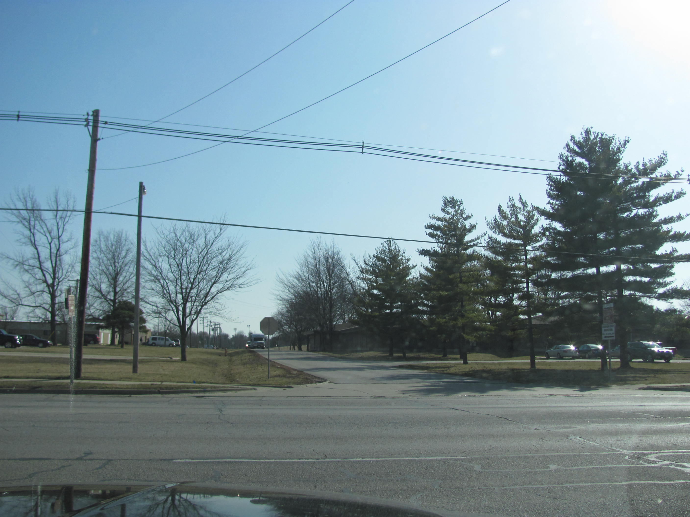
Notes:
We began our windshield survey at the Champaign County Coroner’s Office. The office is located at 202 South Art Bartell Road in Urbana, Illinois (Northrup, 2006). As is evidenced by this picture, the office is located off of the main street and cannot be readily viewed. Even with a provided address, the building was somewhat difficult to locate indicating that community awareness of the office’s location cannot be assumed.

Slide 5
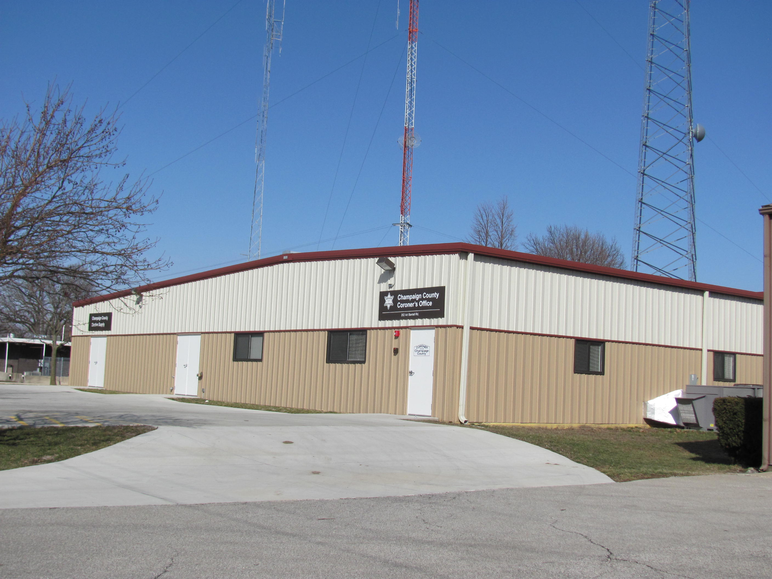
Notes:
Provided is a view from the outside of the building. Although the building is clearly marked, no additional signage is provided on the street making identification somewhat difficult. A recommendation for the office would be to construct a large sign visible from the main road.

Slide 6
Windshield Survey Components
People
Place
Social Systems
Notes:
To conduct a survey of the area immediately surrounding the Coroner’s Office, we drove approximately within a one mile radius of the building. The building is somewhat isolated to an industrial region of the county thus several components of the windshield survey were limited; primarily the “people” component of the survey. During the assessment, no individuals were viewed with the exception of one middle-aged Caucasian female entering an adjacent business. There were also no animals or pets viewed within the community however the Champaign County Humane Society is located down the road from the Coroner’s Office. In addition to the industrialized nature of the area, it was snowing on the day of the assessment thus the adverse weather conditions may have further restricted individuals and animals from being visibly out in the community.
There was no indication of community transportation within the immediate surrounding area consequently individuals lacking personal transportation may not be able to access the area and nearby services such as the Coroner’s Office. As no individuals were viewed, any evidence of socioeconomic status, drug abuse, violence, disease, and/or mental health could not be assessed.
The County Coroner’s Office is located at 202 South Art Bartell Road in Urbana, Illinois (Northrup, 2006). The office is centrally located in Champaign County, east of the city of Champaign (Mapquest, 2012).
Although Champaign County has many resources such as health services, transportation, recreation, religious institutions, educational services, and retail centers; the location of the Coroner’s Office is vastly different in composition. The area is predominately industrial with several governmental buildings in the surrounding area. The Coroner’s Office resides in the same building as the County Clerk Services which houses election equipment such as ballots (Ditman, 2012). Additional businesses within the immediate area include: Champaign County Nursing Home, Champaign County Humane Society, Champaign County Juvenile Detention Center, and the Solo Cup Factory. Recreational areas near the area include: Weaver Park, Ambucs Park, and Prairie Park.
The residential neighborhoods in the immediate area were limited. The majority of the houses appeared to be older single family dwellings that are in need of repair. The houses were a combination of single and multistory homes with varying degree of upkeep. The appearance of the homes reflected neighborhoods with low socioeconomic income status. No individuals were viewed in or outside of the homes therefore vacant housing was difficult to assess; however there were no clearly apparent signs of housing vacancy.
Within Champaign County, there are ample social services, health services, schools, parks, places of worship, public transportation, public protection, and transportation; however the location of the Coroner’s Office does not reflect this availability. Social services and clinics near the Coroner’s Office include the Juvenile Detention Center and the Champaign County Nursing Home. There were no schools within the focused search. Three district parks were located within close proximity to the facility including: Weaver Park, Ambucs Park, and Prairie Park however no individuals were observed during the assessment. The Quaker Meetinghouse is on the main road across from the County Coroner which provides a resource for worship; no additional places of worship were noted in the immediate area. There were also no retail stores and/or grocery stores within the immediate area. Public transportation and public protection were not evident. There were no buses or law enforcement officials observed during the assessment, however the Juvenile Detention Center is located within close proximity of the Coroner’s Office building.

Slide 7
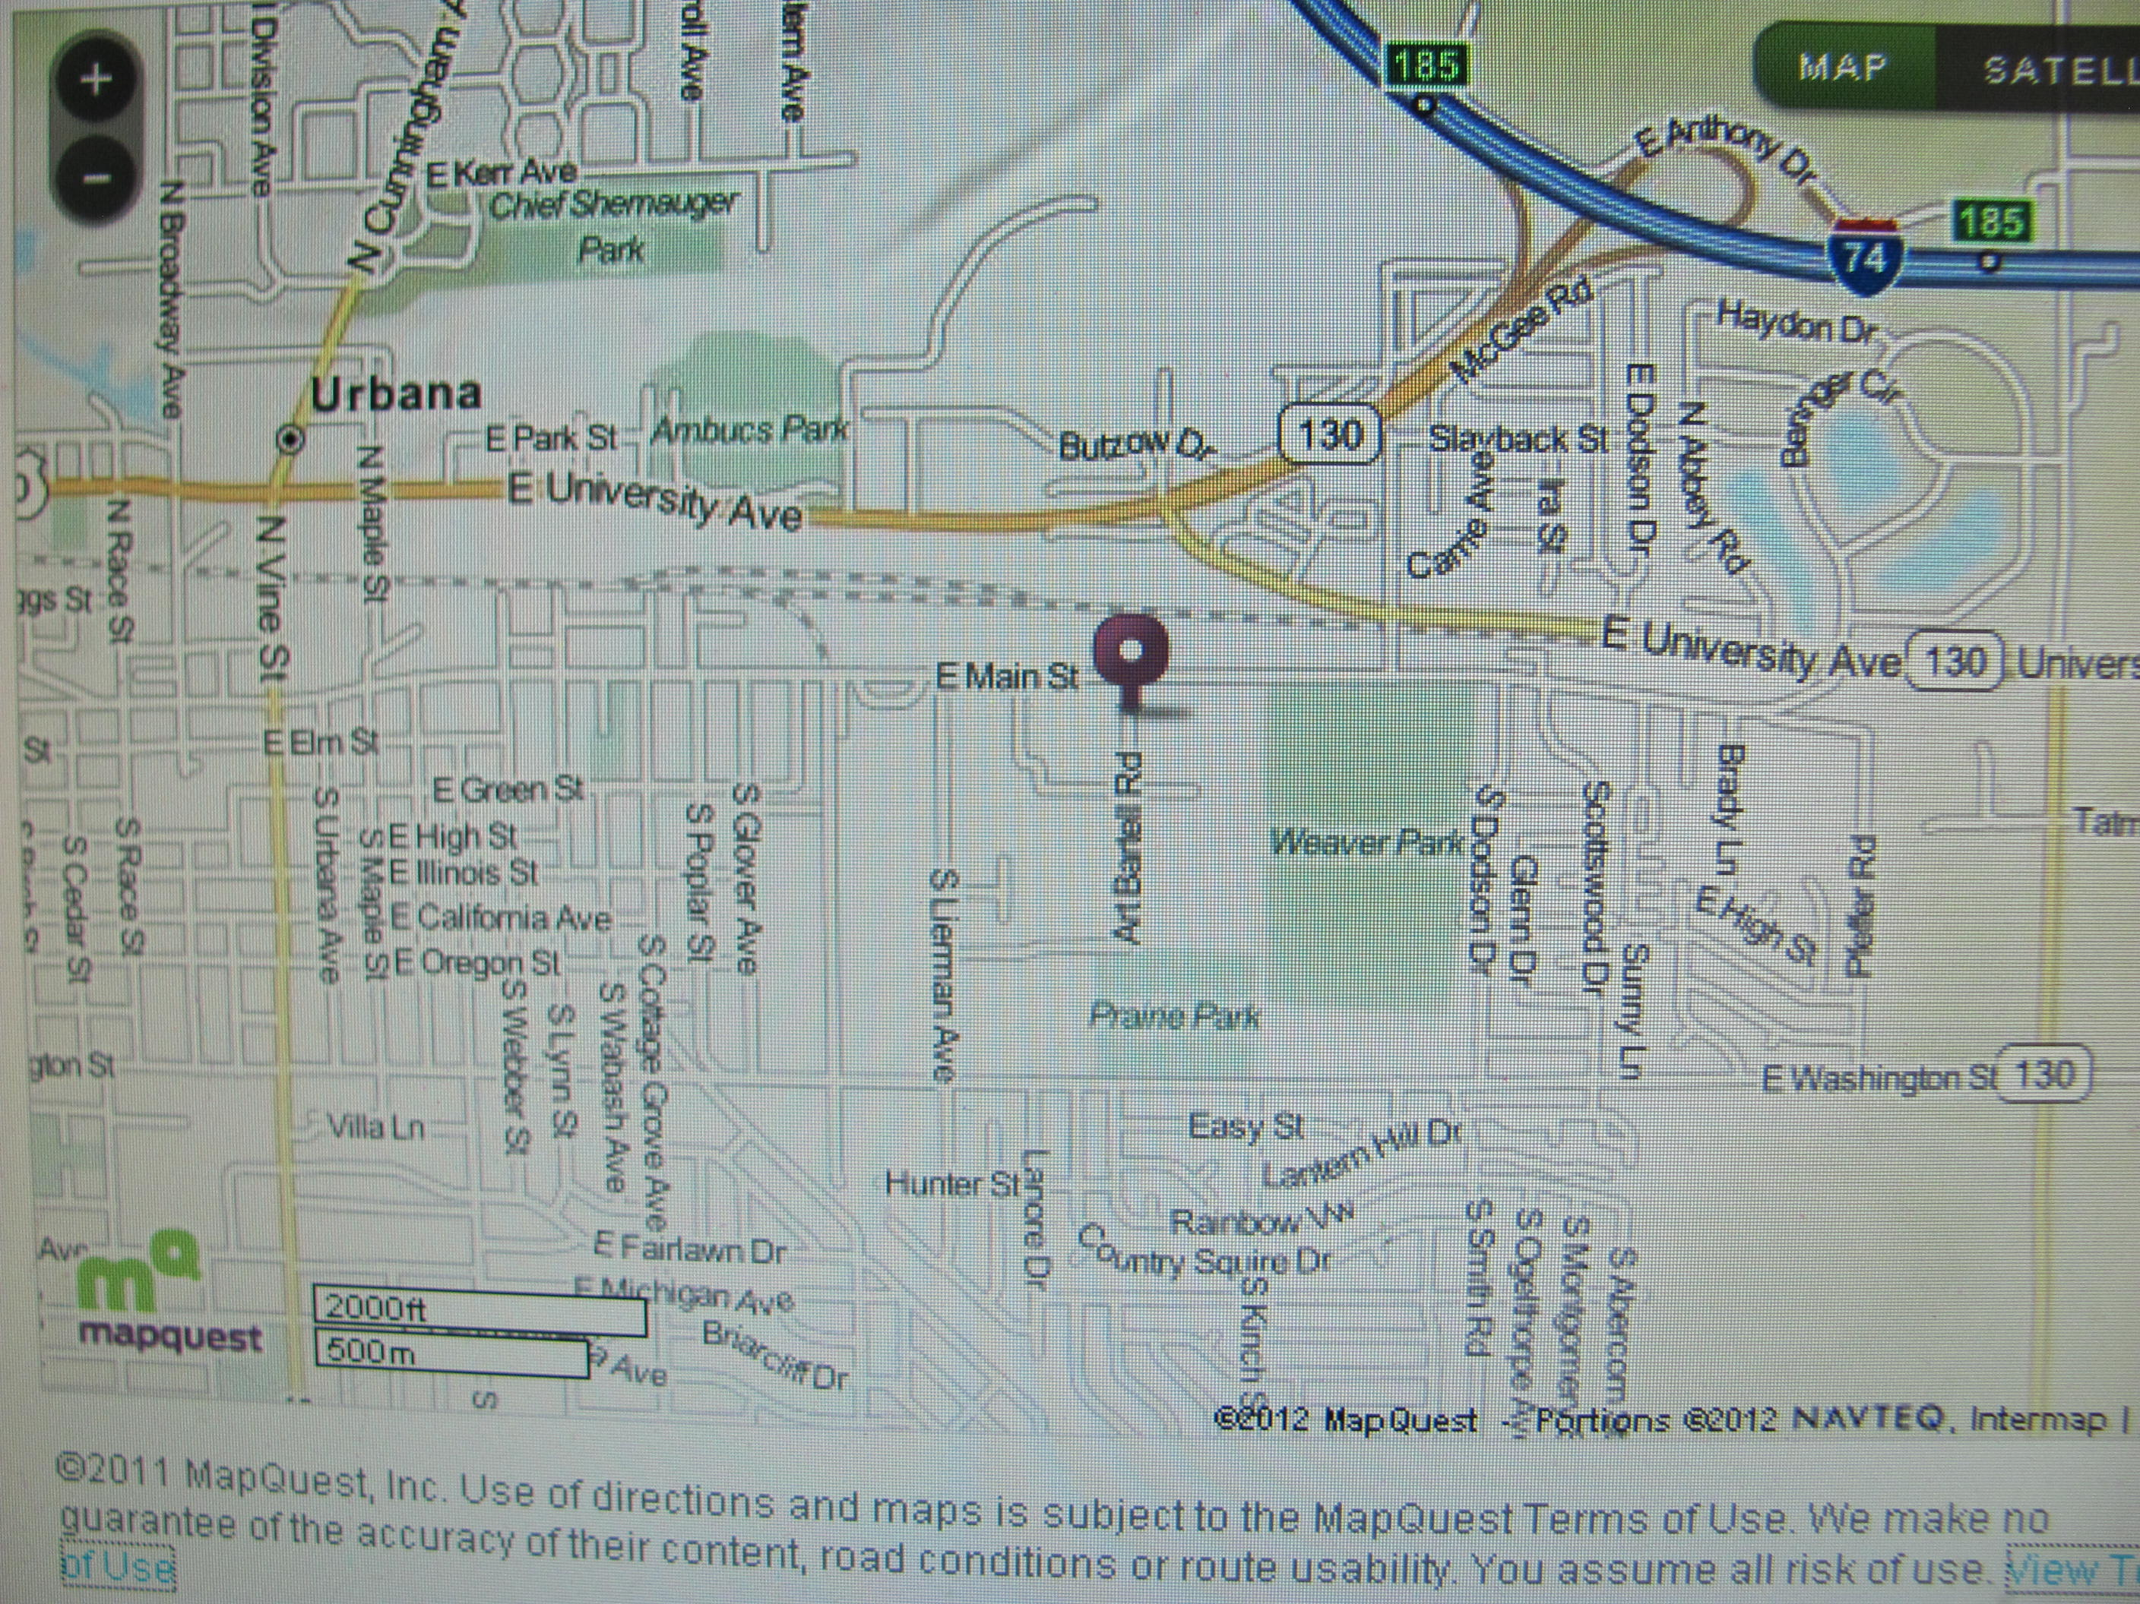
Notes:
Provided is a map obtained through Mapquest (2012). As evidenced by the map, the location of the Coroner’s Office is somewhat isolated as compared to the surrounding area; with few neighborhoods and roads in the immediate location.

Slide 8
Potential Problem Areas
Isolated Location
Social Threats
Environmental Threats
Notes:
Through assessment of the community several potential problem areas were identified. First, the isolated location of the building makes community awareness of the Coroner’s services somewhat restricted. In addition, lack of community transportation further isolates the Coroner’s Office from the community.
The isolated location also contributes to social safety threats due to lack of law enforcement presence in the area. The Juvenile Detention Center also contributes to increased risk of social safety due to increased criminal presence in the area and the possibility of inmate escape.
Several potential environmental threats are present in the area. A major threat is the presence of active rail road tracks in the immediate area. The rail road creates several possible threats including: individuals being hit, injury via derailment, and environmental hazards such as chemical spills. An additional threat of drowning is presented by the location of three bodies of water North East from the Coroner’s Office.
The various businesses also pose several environmental threats to the community. Potential fires and/or chemical spills may pose a threat to the surrounding area. The Champaign County Humane Society poses a risk of animal associated diseases such as rabies. The Juvenile Detention Center, Nursing Home, and Coroner’s Office all pose a threat to the potential spread of communicable diseases. Several potential community health risks were identified and should be considered for prevention to maintain optimal health of the community.

Slide 9
Assessment of the Champaign Coroner’s Office
Notes:
After viewing the surrounding community, we focused our assessment on the Champaign Coroner’s Office.

Slide 10
Champaign Coroner’s Office
Employees
Retention
Required Education
Area Served
Funding
Notes:
The Champaign County Coroner’s Office employs: one coroner, one chief deputy coroner, two full time deputy coroners, three part time deputy coroners, one senior medical secretary, and one part time secretary ("Champaign County Coroner," 2012). The gender composition of the employees are three females and six males. All of the employees are Caucasian.
The coroner’s position holds the same powers as the sheriff and shall assume responsibility provided vacancy in the sheriff’s position (Northrup, 2006). The responsibilities of the coroner are to: investigate deaths not attended by a licensed physician, determine the cause and manner of each death, prepare and conduct inquests, determine the need for autopsy, issue death certificates, grant cremation permits, family communication, funeral home collaboration, and maintain death records for the County (Northrup, 2006). Responsibilities of deputy coroners include: medical death investigations, preliminary investigations, pronouncing death, presenting cases to the coroner for review, and determining the cause and manor of death (T. Brookshire, personal communication, March 1 , 2012).
The employment retention of the office is high with the newest employee having worked for two years. There are no educational requirements for the position however medical and/or law enforcement backgrounds are preferred for employment. The coroner is an elected position and does not require specified educational requirements however a college degree with an emphasis on scientific or medical background is strongly encouraged. The educational requirements for the additional employees of the office is at the discretion of the coroner however law enforcement and/or medical backgrounds are recommended. (T. Brookshire, personal communication, March 1 , 2012)
The Champaign County Coroner’s Office serves primarily Champaign County however additional surrounding areas may be served at the discretion of the regional forensic pathologist. The ultimate decision of service however rests with the coroner. The Coroner’s Office estimates serving approximately 200,000 with varying rates of autopsies performed monthly. Funding for the office is provided through the county budget. (T. Brookshire, personal communication, March 1 , 2012)

Slide 11
Community Recognition
Musculoskeletal Transplant Foundation (MTF) Recognition
Notes:
In May of 2011, the Musculoskeletal Transplant Foundation (MTF) awarded the Champaign County Coroner’s Office with a plaque for recognition of their support for bereaving families and tissue donation. The office began working with MTF in July of 2010, since then there have been nine successful cases resulting in over 400 transplants of tissue and/or bone. Their contribution has had positive impacts on the community. (Rhodes, 2011)

Slide 12
Community Statistics
Population
Gender
Ethnicity
Education
Income
Employment
Notes:
The Champaign County Coroner specifically serves Champaign County, Illinois. The population of Champaign County in 2010 was 201,081. In 2010, the gender composition of Champaign County was 50.1% female and 49.9% male. The ethnic composition of the community is: 73.4% Caucasian, 12.4% African American, 5.3% Hispanic, 0.3% American Indian, 8.9% Asian, 0.1% Pacific Islander, and 2.7% two or more races. (U.S. Census Bureau, 2012)
The educational statistics for individuals aged 25 and older from 2006-2010 in the community are as follows: 92.3% are high school graduates and 41.2% have a Bachelor’s degree or higher. The median household income from 2006-2010 was recorded as $45, 262 and the persons below poverty as 20.5%. (U.S. Census Bureau, 2012)
Recent unemployment rates for Champaign County are 9.5% according to the US Federal Reserve. In January of 2010, the unemployment rate reached a historical high of 10.8%. ("Trading Economics," 2012)
The community statistics have similarities and dissimilarities with the aggregate population. The vast majority of the population in Champaign County is Caucasian with at least a high school education, this is also seen among the employees of the Coroner’s Office. A dissimilarity exists with gender composition; over half of the county is female while only 30% of the employees are female. (T. Brookshire, personal communication, March 1 , 2012)

Slide 13
Relevance of the Data Gap
Population
Gender
Ethnicity
Education
Income
Employment
Notes:
Due to the limitation of the “people” component of the windshield survey, data correlation is somewhat difficult. The lack of individuals observed does not reflect the county’s population of over 200,000 people (U.S. Census Bureau, 2012). The community statistics have similarities and dissimilarities with the aggregate population. A dissimilarity exists with gender composition; over half of the county is female while only 30% of the Coroner’s Office employees are female. The vast majority of the population in Champaign County is Caucasian with at least a high school education, this similarity is also seen among the employees of the Coroner’s Office. (T. Brookshire, personal communication, March 1 , 2012)
According to county statistics, individuals below the poverty line compromised 20.5% of the population. Observation of the surrounding neighborhoods supports this statistic as the overall reflection of the community was that of low socioeconomic status. (U.S. Census Bureau, 2012)

Slide 14
Community Statistics
Suicide Rate per 100,000 population: 2005-2009
 | 2005 | 2006 | 2007 | 2008 | 2009
Champaign County | 6.6 | 2.7 | 2.1 | 5.2 | 10.2
Illinois | 8.4 | 7.8 | 8.49 | No Data | No Data
(Champaign-Urbana Public Health District [C-UPHD], 2011)
Notes:
Through investigating the Coroner’s Office statistics, an alarming trend was noted; a significant increase in suicide for Champaign County with an increase of 8.1% in two years. Through this alarming statistic we decided to focus our assessment on suicide and preventative strategies for the community. (Champaign-Urbana Public Health District [C-UPHD], 2011)

Slide 15
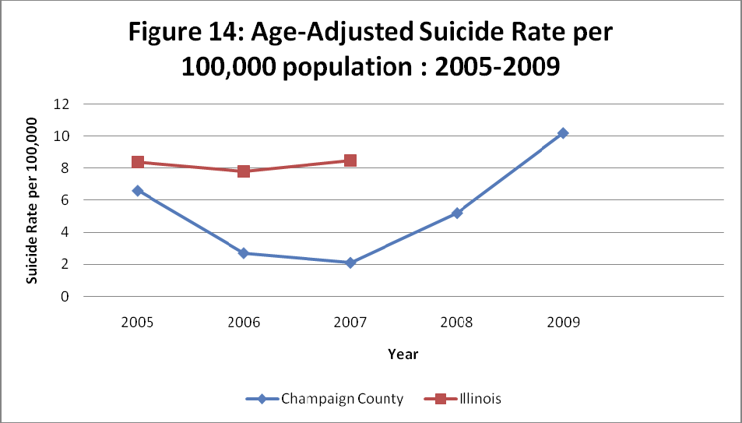
Community Statistics
Suicide Rate per 100,000 population: 2005-2009
(Champaign-Urbana Public Health District [C-UPHD], 2011)
Notes:
Provided is a visual representation of the quickly mounting problem of suicide specifically to Champaign County, Illinois. (Champaign-Urbana Public Health District [C-UPHD], 2011)

Slide 16
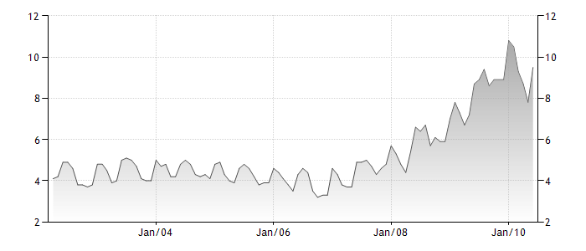
Notes:
An interesting trend was noticed when comparing the data; a positive correlation is evidenced between the rates of suicide and rates of unemployment.

Slide 17
references
202 S. Art Bartell Road, Urbana, IL. (2012). Retrieved from http://www.mapquest.com/maps?address=202+Art+Bartell+Rd&city=Urbana&state =IL&zipcode=61802
Champaign County Coroner. (2006). Retrieved March 1, 2012, from http://www.co.champaign.il.us/Coroner/contacts.htm
Champaign County Coroner. (2012). Retrieved from http://champaigncountycoroner.net/contact.html
Champaign-Urbana Public Health District. (2011). Champaign county community health plan (IPLAN 2010-2015). Washington, DC: U.S. Government Printing Office.
Ditman, T. (2012). County clerk, coroner to hold open house at new facility. Retrieved from http://www.news-gazette.com/news/politics-and-government/2012-02-20/county- clerk-coroner-hold-open-house-new-facility.html

Slide 18
References
Harkness, G. A., & DeMarco, R. F. (2012). Community and public health nursing: Evidence for practice. Philadelphia, PA: Lippincott Williams & Wilkins.
Northrup, D. (2006). Champaign County Coroner. Retrieved from http://www.co.champaign.il.us/coroner.htm
Rhodes, K. (2011, June). Coroner’s office receives recognition. Champaign County’s Insider, 6(3), 2. Retrieved from http://www.co.champaign.il.us/newsletter/20110601insider.pdf
Taylor, C. R., Lillis, C., LeMone, P., & Lynn, P. (2011).Fundamental of nursing: The art and science of nursing care (7th ed.). Philadelphia, PA: Lippincott Williams & Wilkins.
U.S. Census Bureau. (2012). Champaign County Illlinois- State & County QuickFacts [Data file]. Retrieved from http://quickfacts.census.gov/qfd/states/17/17019.html

