Slide 1
Week Seven Health Assessment
Chapter 14 – Head & Neck with Lymphatic Assessment
Chapter 22 – Abdominal Assessment
Lisa Shepherd

Slide 2
Chapter 14 Head & Neck with Lymphatic Assessment

Slide 3
Anatomy Review
Cranium
Sutures – fetal are loose; close later
Carotid arteries – blood supply; jugular veins return
Neck muscles – sternocleidomastoid & trapezius
Salivary glands – parotid, submandibular & sublingual
Vertebral prominence – C7 & T1 most palpable; C7 (the vertebra prominens) protrudes the most
Trachea – midline of neck
Thyroid – butterfly shaped, isthmus in middle, produces T3 & T4 – controls metabolism, usually not palpable in healthy people
Parathyroids – imbedded in thyroid lobes; helps calcium absorption

Slide 4
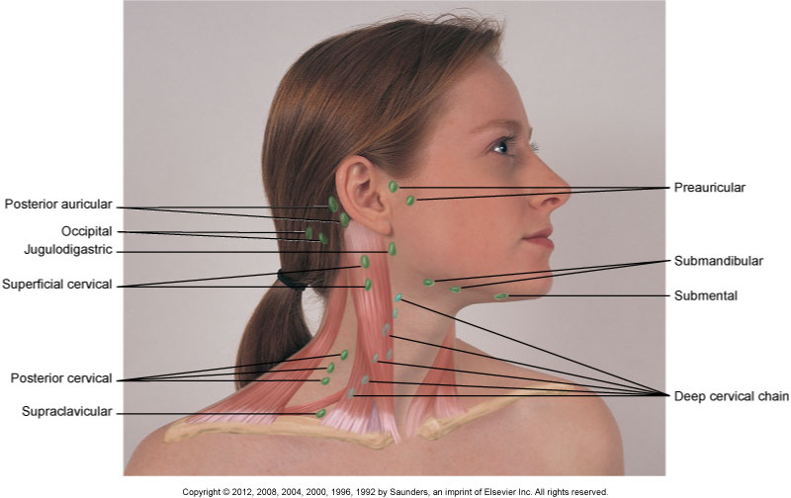
Anatomy Overview
Lymph nodes – preauricular, posterior auricular, occipital, submental, submandibular, jugulodigastric, superficial cervical, deep cervical, posterior cervical, supraclavicular

Slide 5
Lifespan Considerations
Pregnancy
Slight enlargement of thyroid gland common
Newborns/Infants/Children
Newborn head shape through birth canal
Assess anterior/posterior fontannel
“Shotty” lymph nodes
Older adults
Fat decreases, sagging, wrinkling

Slide 6
Acute Assessment
Assess for head injury
Stabilize head/neck until cleared
Neck pain
Most often related to muscle tension/spasm
If associated with fever, may indicate meningitis
May also be MI – sudden onset neck/jaw pain should R/O cardiac causes
Enlarged lymph nodes
If > 1 cm, fixed, irregular, hard or rubbery – R/O cancer
Hyperthyroidism
Signs of hypermetabolism in all systems

Slide 7
Risk Factor Assessment
Hx of accident with LOC or head injury?
Use of seat belt, bicycle/motorcycle helmet
Treated with radiation to the neck/chest/back?
Surgeries involving head/neck?
Family hx of thyroid problems?
Who? Hypo or hyper? How treated? Outcomes?
Regular medications?
Any alcohol use? Herbals?

Slide 8
Focused Health History
Common Head/Neck Sx
Headache
Neck pain
Limited neck movement
Facial pain
Lumps or masses
Hypothyroidism
Hyperthyroidism

Slide 9
Lifespan Considerations
Pregnancy
Changes or swelling in neck? Any headache or sensory/motor/visual changes?
Newborns/Infants
Proper use of carseat EVERY time? Any in utero exposures?
Children/Adolescents
Helmet use? Child bang head? Hold head?
Older adult
New neck lumps/masses? New type of headache? Pain in neck? Any weakness, numb/tingle in arms?

Slide 10
Objective Exam
Equipment
Adequate lighting, penlight or flashlight, gloves, small cup of water
Preparation
Tell patient what you are going to do. If has hairpiece or wig, should remove. Wash hands.

Slide 11
Objective Exam
Inspection
Head – observe for symmetry, deformities
Hair – observe texture, color
Neck – observe for lesions, limitations In movement
Palpation
Scalp – assess masses/lesions
Thyroid – assess for enlargement
Lymph nodes – assess for enlargement/tenderness

Slide 12
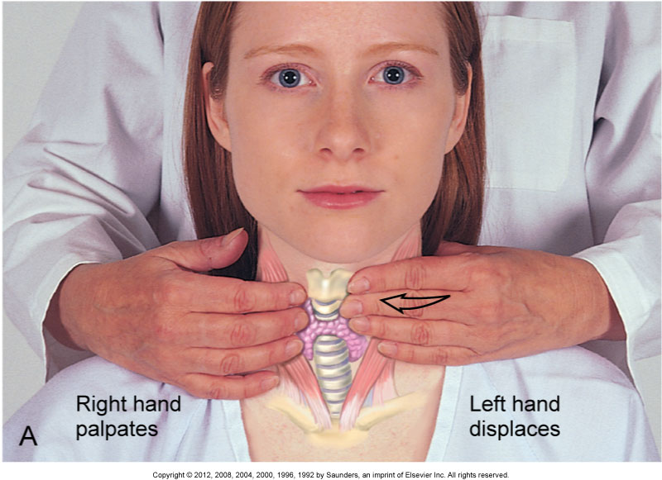
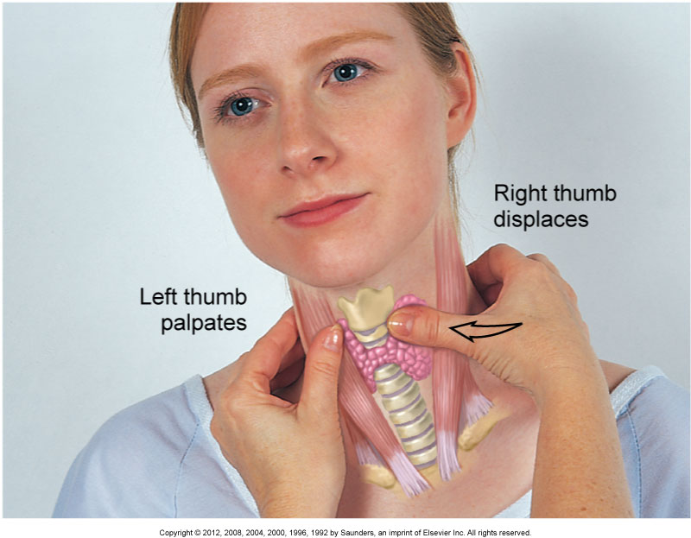
Thyroid Assessment

Slide 13
Lifespan Considerations
Pregnancy
Melasma (AKA chloasma), watch for hyper/hypothyroidism (↑ fetal risk – preterm, miscarriage, neural development)
Infants/Children
Fontannels, caput succedaneum, cephalahematoma
Older Adult
Face more wrinkled, less elastic; thinning of hair, reduced ROM of neck; hypothyroidism may be harder to dx by sx as many sx are also that of aging; more prone to hyperthyroidism

Slide 14
Labs/Diagnostic Testing
X-ray
CT
MRI
Lumbar puncture
Thyroid testing
TSH, T3, T4

Slide 15
Common Nursing Diagnoses/Interventions
Fatigue related to low T3 and high TSH
Assess severity
Evaluate sleep and nutritional status
Gather data to determine if cause is physiological or psychological
Chronic pain related to cervical spine injury
Assess characteristics
Work with pain team to determine appropriate medical treatment
Use nonpharmacologic interventions

Slide 16
Outcomes
Patient verbalizes increased energy and well being.
Pain goals are met.

Slide 17
Chapter 22 Abdominal Assessment

Slide 18
Anatomy Review
Esophagus
Stomach
Small intestines – duodenum, jejunum, ileum
Colon
Kidneys
Bladder
Aorta
Liver
Gallbladder
Pancreas

Slide 19
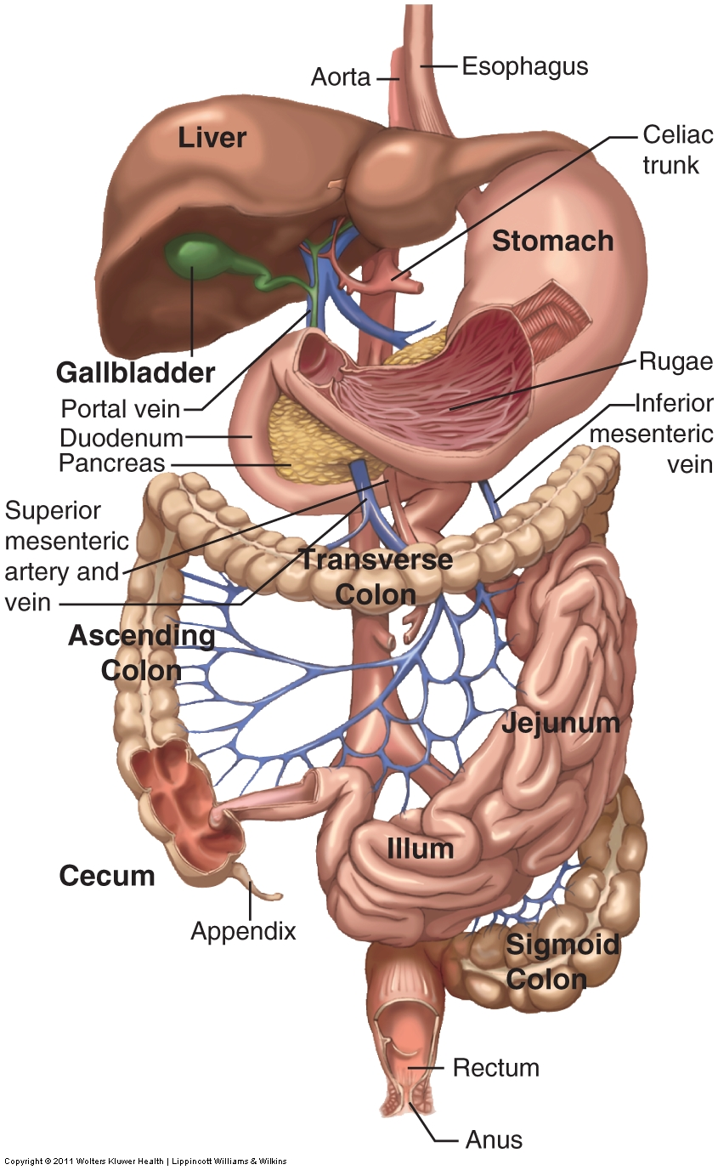

Slide 20
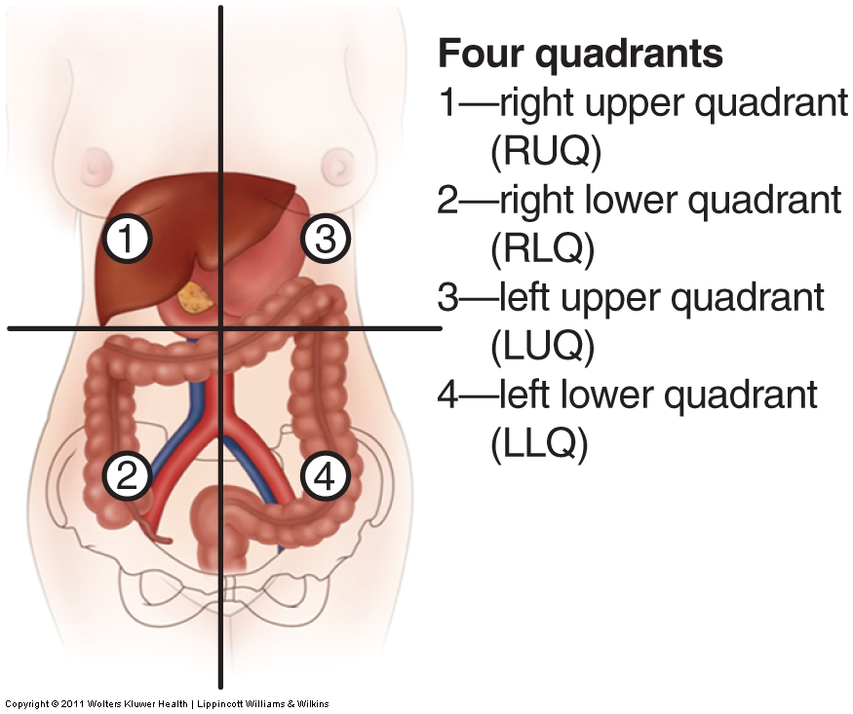
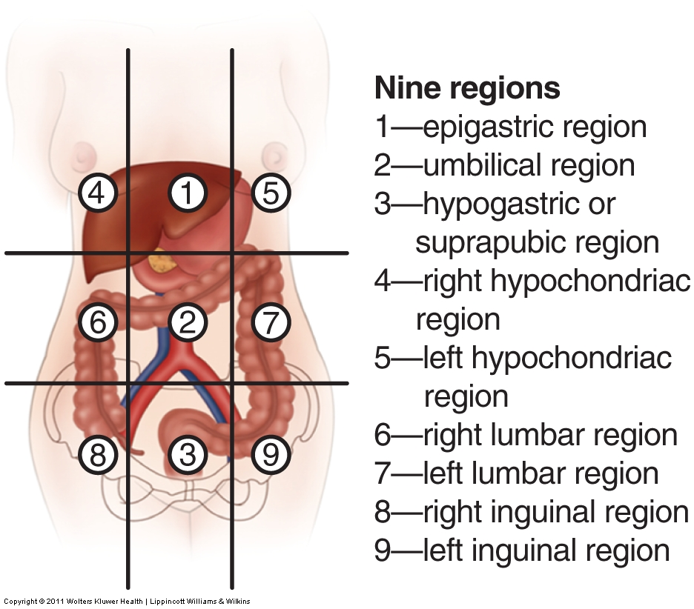
Areas of the abdomen

Slide 21
Functions
Ingestion & Digestion
Mechanical digestion
Chemical digestion
Bolus – chyme
Absorption of Nutrients
Almost exclusively in small intestine
Duodenum – pancreatic juices/bile added to help with absorption
Jejunum/Ileum – many villi absorb nutrients
Elimination
Large intestine absorbs water and a few electrolytes
Remaining waste excreted as feces
Average time from ingestion to excretion = 48 hours

Slide 22
Lifespan Considerations
Pregnancy
Abdominal muscles relax allowing uterine growth; bowel compression may result in ↓bowel sounds (contributes to constipation). Venous pressure in lower abdomen ↑ = hemorrhoids. Linea nigra, striae
Newborns/Infants/Children
NB bladder above symphysis pubis, liver takes up more room, muscles not as developed so abd. protrudes; becomes more noticeable in toddlerhood due to curvature of back; can more easily palpate organs
Older Adults
Stomach acid/saliva production ↓; gastric motility/peristalsis slow; dentition issues = hard to chew; muscle tone less; all make constipation an issue; fat accumulates in lower abd for women, round wait in men; liver smaller & function declines

Slide 23
Acute Assessment
If there is an acute abdominal problem, H & P will be VERY focused
Severe dehydration from N/V, fever, and acute abdominal pain are potentially life-threatening
“Hop on the table” test

Slide 24
Risk Factors
Abdominal problems now?
Unplanned weight changes? Special dietary needs/concerns? Any cultural or religious beliefs that affect diet?
Fever or chills? Any dizziness?
Family Hx – colon cancer in 1⁰ relative; anyone with GERD, PUD, IBS, Irritable bowel disease, anemia, celiac disease
Personal Hx – age, Hx of blood transfusion before 1980? Had HepB vaccine? Hx of endometrial/ovarian/breast cancer? Varicella?
Previous treatment for GI disease? Previous diagnostic testing? Surgeries? Recent trauma? Recent mono infection?

Slide 25
Risk Factors
Malabsorption disease? Sickle cell? Eating disorder? Intestinal polyps?
Chew/swallow issues – thyroid disease, neck mass, vision change, dysphagia, sore throat? Last dental exam?
Breathing – Hx of problems, SOB, or COPD?
Wt. gain – Hx of CV disease, HTN, or CHF?
GU issues – Color of urine? Burning, frequency, urgency? Hx of STI? LMP? Vaginal discharge? Prostate problems? Penile discharge?
Joint pain – Hx of fx, joint pain, weakness
Neuro – ETOH/day? Numbness, back pain, or loss of bowel/bladder control?
Metabolism – Hx of DM or thyroid problems?

Slide 26
Risk Factors
Skin – Changes in hair, skin, nails? Any rashes, itching or lesions?
Lymph/Hematologic – Any food allergies, infection, or sickle cell?
Medications – OTC, Rx
Occupation – profession, where pt. works, PPE used?
Foreign travel – Any place where sanitation less than ideal? Food prepared somewhere that isn’t sanitary? Vaccinated against HepA?
Lifestyle – Use/abuse IV drugs? # of sexual partners, had sex with sex workers?

Slide 27
Patient teaching
Encourage immunizations for those who may be exposed to blood, body fluids, or unsanitary conditions
Risk of colorectal cancer increases with age
Initial screening colonoscopy at age 50
Follow-up based on findings
Alcohol / substance abuse
Discuss effects on organs of substance abuse
Nutritional counseling
Important for patients with food allergies, poor nutrition, & obesity

Slide 28
Common Abdominal Symptoms
Indigestion
Anorexia
Nausea, vomiting, hematemesis
Abdominal pain
Dysphagia, odynophagia
Change in bowel function
Diarrhea
Constipation
Jaundice/icterus
Urinary/renal symptoms
Urinary incontinence
Kidney or flank pain
Ureteral colic

Slide 29
Focused Hx Questions
Indigestion – Have heartburn? Excessive gas? Belching? Abdominal bloating or distention? Unpleasant fullness after meals? Unable to eat full meal?
Anorexia – How is your appetite? Deliberately eat small meals? Ever vomit after eating?
N/V, Hematemesis – Have N/V? Ever vomited blood?
Abd. pain – OLDCART
Dysphagia/odynophagia – Difficulty or pain with swallowing? Feel like food is stuck?
Change in bowels – normal pattern before sx? Change in diet/medications? Have N/V? Happen with certain foods? Pain relieved with BM?

Slide 30
Focused Hx Questions
Jaundice/icterus – Change in color of skin or sclera? Change in color of urine or stool? Traveled to, or had meals in, areas of poor sanitation? Recent exposure to blood or body fluids? Shared needles? Blood transfusion?
Urinary/Renal Sx – Pain on urination or difficulty voiding? Urgency or frequency? Suprapubic pain? Hesitancy or decreased urine stream (males)? Polyuria? Nocturia? Hematuria (painful or not painful)? Leak urine? Not made it to BR? Severe, colicky pain in your flank? Associated with N/V?

Slide 31
Lifespan Considerations
Pregnancy – heartburn, constipation, loss of urine or hemorrhoids?
Newborns/Infants/Children
Baby breast/bottle fed? How is formula tolerated? What foods have been introduced? Tolerated? How many wet diapers/day? BMs?
How often does child eat? Regular meals? Describe previous day’s eating? Eat non-foods? Child have constipation? Water/juice in diet? Constipation tx?
Overweight – when first appeared, diet changes, others in family have problem?, how does child feel?

Slide 32
Lifespan Considerations
Adolescents
Regular meals? Eat breakfast? Snacks? Soft drinks? Exercise? If weight loss, how was it lost? How much? What do parents/friends say about your eating?
Older Adults
Who gets groceries/fixes meals? Eat alone? Dysphagia? How often BM? Liquid consumption? What is taken for constipation? Daily meds?

Slide 33
Cultural Considerations
African Americans
Sickle cell? Lactose intolerant?
Asian Americans
Hx of gastric cancer? Heartburn, anorexia, unplanned weight loss?
Americans of Jewish descent
Personal/family hx of ulcerative colitis or Crohn’s disease? Personal/family hx of lactose intolerance?
Americans of Mediterranean descent
Lactose intolerance? Personal/family hx of chronic anemia or thalassmia?
Native Americans
Drink alcohol? How much/how often? Ever had yellow skin or eyes? Liver, gallbladder disease? Pancreatitis? DM?

Slide 34
Objective Data
Equipment
Stethoscope, pillow, drapes
Preparation
Warm, private environment, adequate lighting
Have patient empty bladder
Use drapes
Explain what you are doing
Wash hands
Talk with the patient to help relax him/her

Slide 35
The Exam
Inspection
Identify shape/contour, scars
Inspect urine
Inspect any emesis
Inspect stool
Auscultation
Bowel sounds – start RLQ (very active area); high pitched, gurgling, irregular sounds; no sounds = listen for 5 minutes
Vascular sounds – bruits – sounds like soft, whooshing, pulsatile sounds best heard with bell

Slide 36
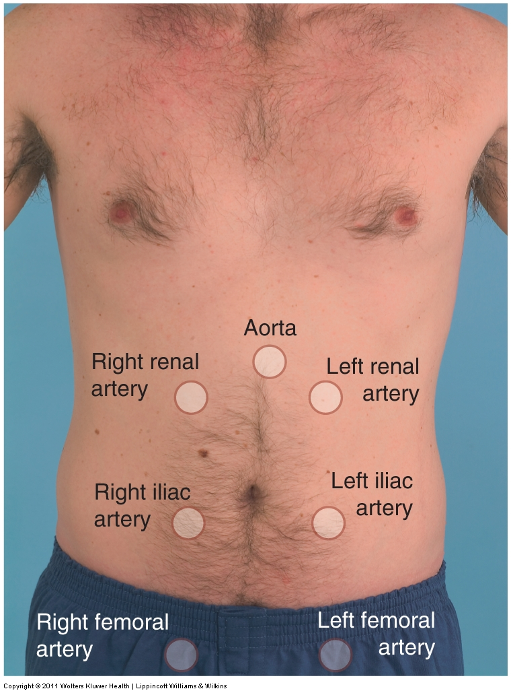
Sites for Bruit Auscultation

Slide 37
The Exam
Percussion
Used to determine organ size/tenderness, detects fluid, air or masses in abdominal cavity
Area of tenderness should be percussed last
Normal findings: dullness in RLQ (liver), tympany in LUQ (over gastric bubble). Mostly should be tympanic sounds due to gas.
Kidneys: Assess for CVA tenderness

Slide 38
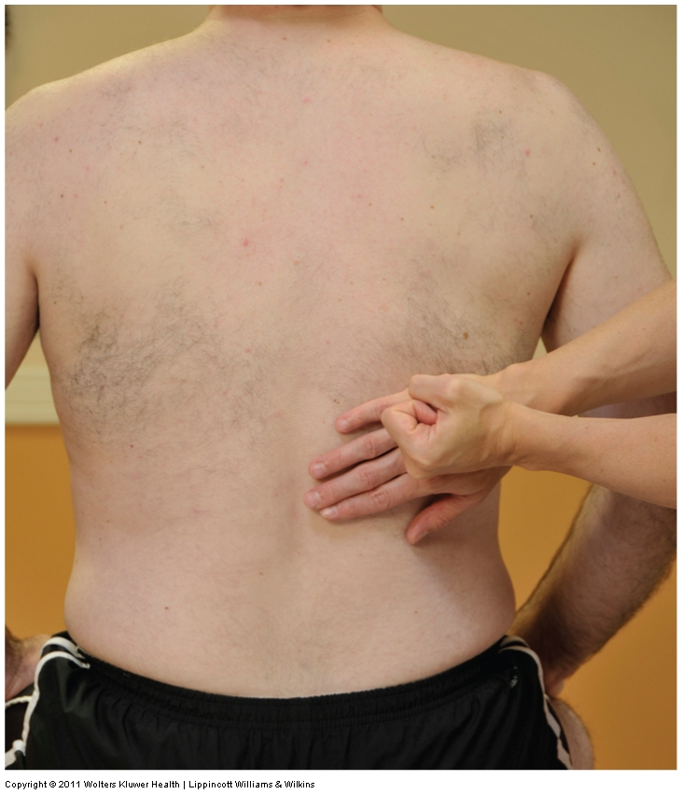
CVA Tenderness

Slide 39
The Exam
Palpation
Light palpation
“Lay of the land”
Deep palpation
Used to assess organs, masses, tenderness; may need to use 2 hands
Liver – see next slide
Spleen – see slide after Liver
Kidneys – see slide after Spleen
Abdominal aorta – see slide after Kidneys
Bladder – deep palpation in suprapubic area – empty bladder should not be palpable
Lymph nodes – inguinal lymph nodes – should be non-tender and slightly palpable

Slide 40
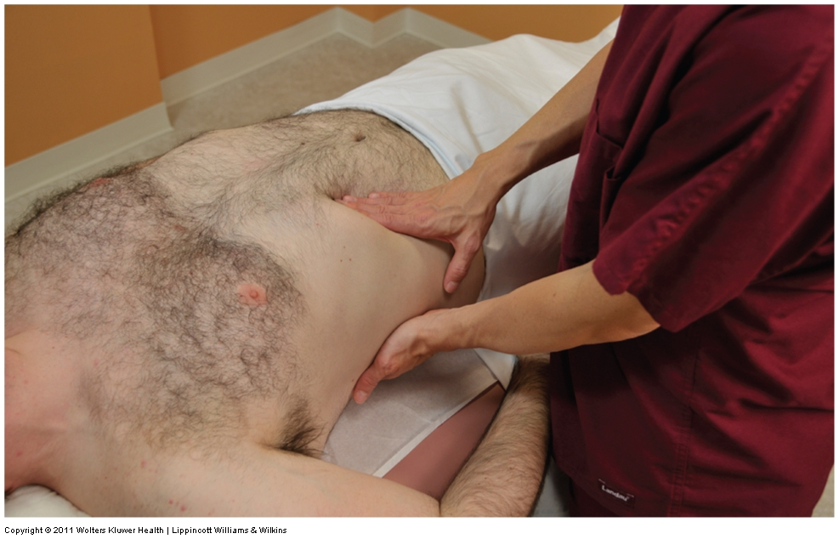
Liver
Place right hand at patient’s right MCL under the costal margin. Left hand on patient’s back at 11th & 12th ribs and press upward to elevate liver toward abdominal wall. Have patient take a deep breath. Press right hand deeply in and up during inspiration

Slide 41
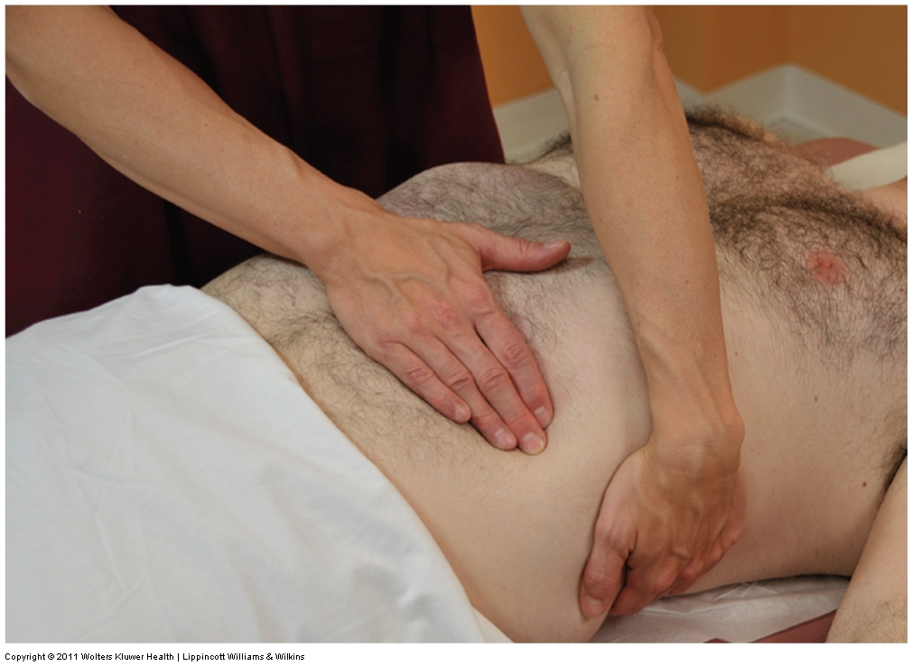
Spleen
Stand on patient’s right side. Place your left hand under patient’s left CVA and pull upward to move spleen anteriorly. Place right hand under the left costal margin & have patient take deep breath; during exhalation try to palpate the spleen.

Slide 42
Kidneys
Left kidney – stand on right side and place left hand in the left CVA. Place right hand at the left anterior costal margin. Have patient take deep breath; press hands together like duck bill and “capture” the kidney. As patient exhales, lift your left hand and palpate the kidney with your right hand.
Right kidney – remain on patient’s right side, place right hand on right CVA, and left hand on the right costal margin. When patient exhales, palpate right kidney.
Common to not be able to palpate the kidneys except in slender patients.

Slide 43
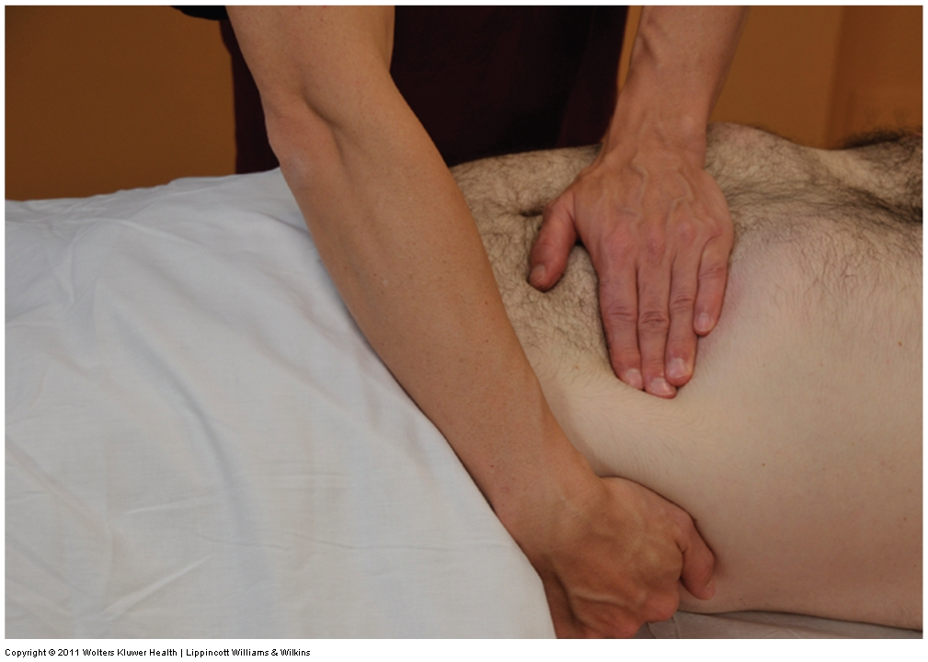
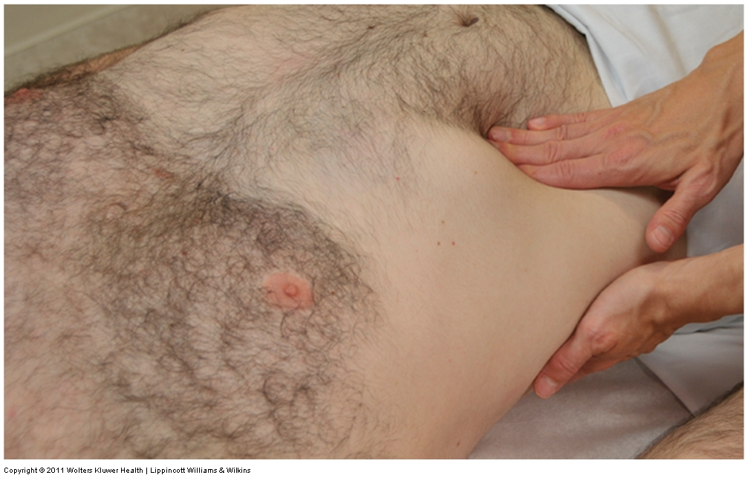
Kidneys

Slide 44
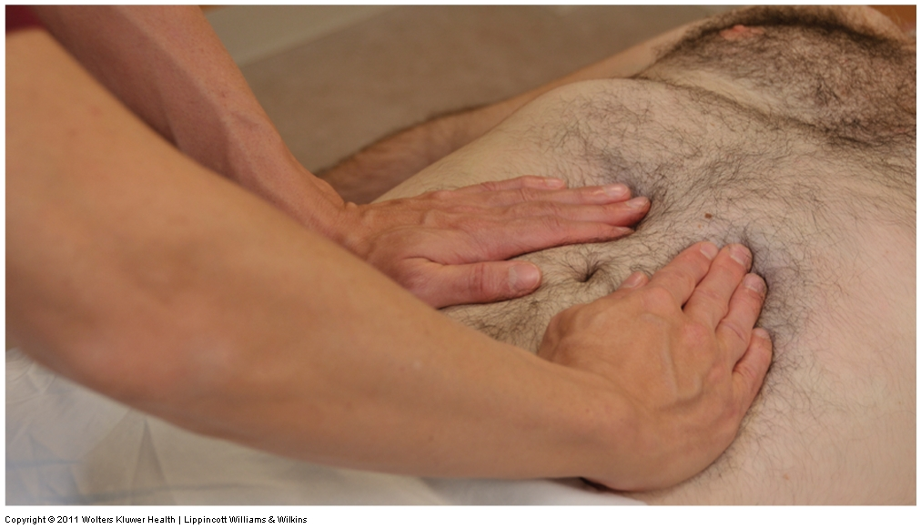
Abdominal Aorta
Place fingers in epigastric region and slightly toward the left of the MCL. Palpate for aortic pulsations on either side of the aorta. Can assess width of aorta by placing one hand on either side.

Slide 45
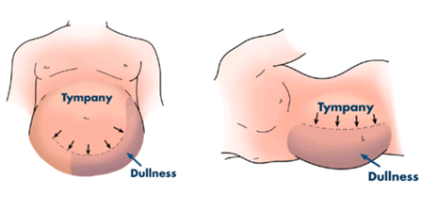

Assessing for Ascites
Detectable after 500 mL of fluid has accumulated
Shifting dullness – percuss dullness w/patient supine, have patient lie on right side, percuss, then left side, percuss
Fluid wave – patient places his/her hand vertically mid-abdomen; place your hands both sides of patient’s abdomen and tap one side while palpating the other

Slide 46
Lifespan Considerations
Pregnancy
Assessment challenging. Linea nigra, striae, heartburn
Infants/Children
Musculature less developed; much larger liver proportionately; bladder above symphysis pubis
Older adults
Poor dentition; decreased saliva and stomach acid production; motility/peristalsis decrease; liver smaller and less functional
Cultural
Obesity – higher in all ethnic minorities
GI cancers – especially Asian Americans

Slide 47
Common Labs/ Diagnostic Testing
CBC – anemia/infection
BMP – good overview; includes glucose, electrolytes, BUN/creatinine
H. pylori testing
EGD (esophagogastroduodenoscopy) determines condition of mucosa of esophagus/stomach/duodenum
Barium Enema – looks for IBD, Ca of colon
Colonoscopy – standard for those > 50 years; conscious sedation; entire colon visualized; requires prep
CT scan – identifies soft tissue problems
MRI – condition of organs, ducts, blood vessels

Slide 48
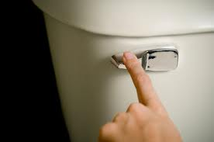
Nursing Diagnoses/Interventions
Diarrhea related to effects of bowel inflammation
Obtain stool specimens to determine infection
Incontinence related to decreased LOC
Review medications that may contribute to incontinence
Perform bladder scan to evaluate if residual is present
Teach principles of bladder training

Slide 49

Outcomes
Diarrhea – Patient will defecate a formed soft stool every day to every third day.
Incontinence – Patient will report relief from or decrease in incidence and severity of incontinent episodes

