Slide 1
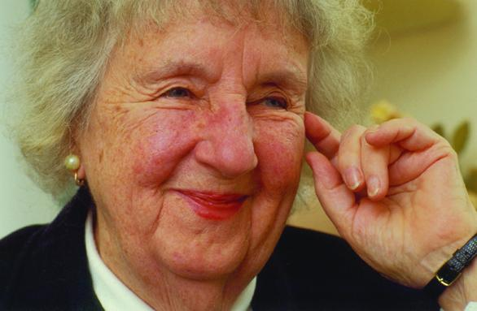
Virginia Henderson

Slide 2
Introduction
Theory: Nature of Nursing
Born 1897
Died 1996
Developed a model that dealt with activities of living

Slide 3
Who is Virginia Henderson
“First lady of nursing”
One of the most influential nurses of the 20th century
Career began in 1921 when she graduated from the Army School of Nursing
Earned her baccalaureate in 1932 and her masters in 1934 from Columbia University Teacher’s College

Slide 4
Who is Virginia Henderson Cont.
Became a research associate for Yale University School of Nursing in 1953
Strong advocate for empirical research in nursing
For 70 years, she read nursing publications, observed different approaches to nursing care, and consulted with countless professionals and nurses.
Represented the nursing profession world wide

Slide 5
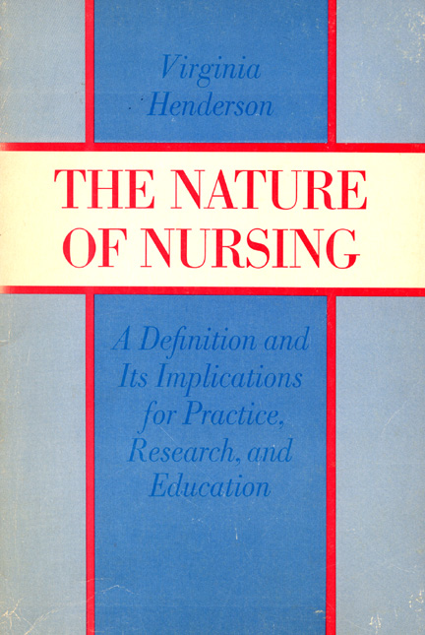
Conceptual Model Basics
Nursing stands separate from medicine and is more than just following physicians’ orders.
Her definition of nursing superseded the definition offered by Florence Nightingale in 1859.

Slide 6
Basic Concept of Theory
Emphasized the importance of increasing independence.
Nurse’s role: Substitutive, Supplemental, Complementary
14 components of Nursing
Her definition of nursing "The unique function of the nurse is to assist the individual, sick or well, in the performance of those activities contributing to health or its recovery (or to peaceful death) that he would perform unaided if he had the necessary strength, will or knowledge. And to do this in such a way as to help him gain independence as rapidly as possible" (Henderson, 1966).

Slide 7

What It Means For The Patient
For this theory the nurse has the main goal of assisting with activities of daily living
The nurse is there to make the patient comfortable and to make daily life go a little smoother for them.

Slide 8
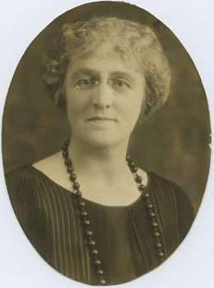
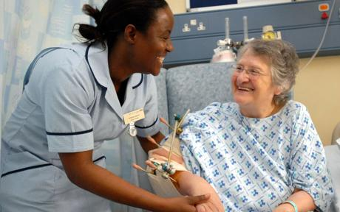
What Virginia Henderson’s Theory Means For Nursing

Slide 9
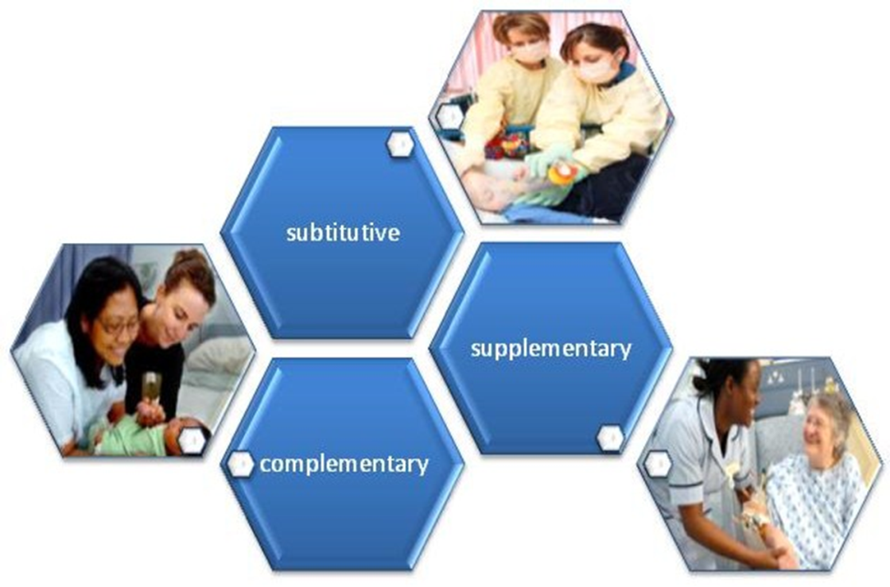
References
Abrams, S. (2007). Nursing the community, a look back at the 1984 dialogue between Virginia A. Henderson and Sherry L. Shamansky. Public Health Nursing, 24(4), 382-386.
Nicely, B., & DeLario, G. T. (2011). Virginia Henderson's principles and practice of nursing applied to organ donation after brain death. Progress In Transplantation, 21(1), 72-77.
Wills, E.M, McEwen, M. (2002). Theoretical basis for nursing. Philadelphia: Lippincott Williams& Wilkins.

