Slide 1
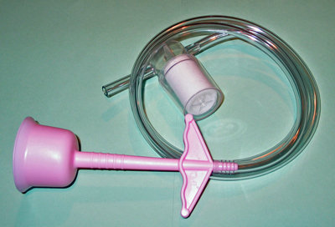
Weiss, R.(2011).Vacuum extractor. Retrieved from http//pregnancy.about.com/od/laborcomplic ations/ig/Labor---Birth- Interventions/Vacuum-Extractor.htmp

Slide 2
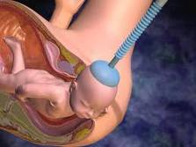
Medi XL. (2010). Vacuum extraction. Retrieved from http://www.medixl.com/2010/10/vacuum-extraction.html.

Slide 3
What is a Vacuum Extraction
A cup like device attached to a suction device that is either connected to the wall or a manual suction pump
The cup is placed on the back of the baby’s head
The suction is then increased and the practitioner pulls as the mother pushes

Slide 4
Vacuum Extraction Cont.
The baby is gently pulled through the birth canal
Once the head is delivered the suction cup is removed and the birthing process continues as normal

Slide 5
Benefits
Can cause less trauma to the mother’s tissues (little internal bruising)
Can be used higher than forceps
An episiotomy is not usually needed

Slide 6
Benefits Cont.
The mother still has an active role during her baby’s birth
Less markings on face and head compared to a forceps delivery
Less anesthesia is required

Slide 7
Levine, D. (2011). Vacuum versus forceps. Retrieved from http://www.healthline.com/yodocontent/pregnancy/assisted-delivery-forceps-vacuum.html

