Slide 1
Truncus Arteriosus
By Leslie Williams, Katie Woods, and Aaka Surti

Slide 2
Definition of Defect
Congenital heart defect- only one major artery leaves the heart and supplies blood to the pulmonary and systemic circulations

Slide 3
Causes of the defect
Single large vessel never finishes dividing into two separate vessels; the valve controlling blood flow from the ventricles to the truncal valve is often defective, allowing blood to flow back to the heart

Slide 4
Pathophysiology
The great vessel contains one valve which comprises 2-5 leaflets and is positioned over both the left and the right ventricle.
So instead of the aorta and pulmonary artery, there is just one great big vessel

Slide 5
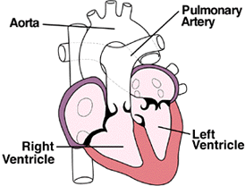
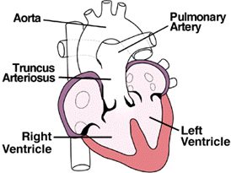
Diagram of Defect
Normal
Truncus Arteriosus

Slide 6
Complications
Blood doesn’t carry enough oxygen
Respiratory problems due to excessive fluid in lungs
Pulmonary HTN due to increased blood flow= increased work load
Heart failure due to increased work load and poor O₂ saturation

Slide 7
Complications later in life
Progressive pulmonary HTN
Regurgitation in the veins
arrhthmias

Slide 8
Assessment Findings
Typically infants demonstrate cyanosis in varying degrees
Nasal flaring
Grunting
Retractions
Restlessness
Noisy breathing
Adventitious breath sounds

Slide 9
Diagnostic Test Findings
Echocardiogram:
reveals single large vessel leading from the heart; a hole in the wall between the left and right ventricle
Can also show an abnormality in the valve between the large vessel and the ventricles
Can reveal blood moving back and forth between the two ventricles and the amount of blood flowing to baby’s lungs
Amount of blood can indicate risk for high blood pressure

Slide 10
Diagnostic Test Findings
X-ray
Shows size of heart
Abnormalities in lungs
Excess fluid in lungs

Slide 11
Medical Management
Child’s age, overall health, and medical history
Extent of the condition
Child’s tolerance for specific medications, procedures, or therapies
Expectations for the course of the condition
Opinion or preference

Slide 12
Medical Management
Medications:
Digoxin
Diuretics
ACE inhibitors
Adequate nutrition:
High-calorie formula or breast milk
Supplemental tube feedings

Slide 13
Medical Management
Surgical Repair
Performed after infant is 2 years old but before the blood vessels in the lungs are overwhelmed by extra blood flow and become diseased.
Pulmonary arteries are detached from common artery (truncus arteriosus) and connected to the right ventricle using a homograft ( section of pulmonary artery with its valves intact from a tissue donor)
Ventricular septal defect is closed with a patch

Slide 14
Nursing Interventions
Assess the surgical wound
Assess vital signs
Assess arterial line/IV sites
Assess placement of/ place NG tube
Assess I&O
Assess chest tube & drainage
Assess pain consistently and frequently
Provide prescribed pharmacological relief
Referal to child life for distraction/entertainment

Slide 15
References
Heart Point. (1997, November). Truncus Arteriosus. Retrieved October 9, 2011, from Heart Point: http://heartpoint.com/congtruncus.html
Ricci, S., Kyle, T. (2009). Maternity and Pediatric Nursing. Philadelphia, PA: Lippincott, Williams & Williams.
Lucile Packard Children's Hospital. (2011). Truncus Arteriosus. Retrieved October 9, 2011, from Lucile Packard Children's Hospital: http://www.lpch.org/DiseaseHealthInfo/HealthLibrary/cardiac/truncus.html
Truncus Arteriosus. (2010). Retrieved October 11, from http://www.mayoclinic.com/health/truncus-arteriosus/DS00746.

