Slide 1
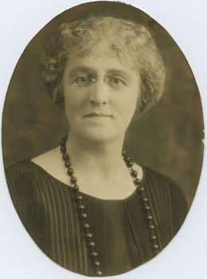

What Virginia Henderson’s Theory Means For Nursing

