Slide 1
Madeline Leininger: Transcultural Nursing
Presented By: Danielle Dill, Lacy Halley, Chelsea Infante, Jerome Jimenez & Jessica Key

Slide 2
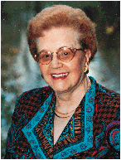
Who is Madeline Leininger?
Born: July 13, 1925
Died: August 10, 2012
Education: University of Washington
She developed the concept of Transcultural Nursing.
She was raised on a farm with four brothers and sisters.

Slide 3
About Madeline Leininger
Madeleine Leininger was inspired by her aunt to pursue her career in nursing.
She identified the importance of “care” early in her career.
Her main focus and motivation to specialize in “care” was a result of feedback and appreciation that came from her patients.
Notes:
***Her inspiration came from her aunt who suffered from congenital heart disease.

Slide 4
How She Developed Her Theory
In 1950’s Leininger experienced cultural shock (recurrent behavioral patterns in children appeared to have culture basis) while working in a children’s guidance home.
She realized a major deficit in nursing comprehension of differential needs and requirements for patient care.
Then she realized the missing link is the lack of knowledge regarding the cultural aspects of care.

Slide 5
Theory of Culture Care Diversity and Universality- basic concepts
Ethno nursing methodology
To assist the career in discovery of data
Patient perception vs. Nurse perception
Perceptions of caring varies with cultural background

Slide 6
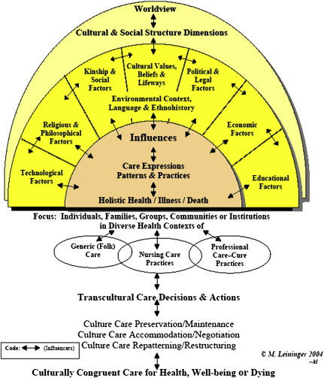
Sunrise Model
Nursing Care
Involves generic (emic) and professional (etic) care systems

Slide 7
Transcultural Nursing and Patient Care
Goal of Leininger’s theory- harmonious care measures.
Addresses the cultural differences that influence the nurse-client relationship.
Wholistic and understanding approach.
Notes:
Goal of Leininger’s theory- IS TO PROVIDE CARE MEASURES THAT ARE IN HARMONY WITH AN INDIVIDUAL’S CULTURAL BELIEFS, PRACTICES AND VALUES.
Addresses the cultural dynamics the influence the nurse-client relationship. WHEN A NURSE THAKES THE TIME TO LEARN ABOUT A PATIENTS CULTURE, BELIEFS AND VALUES, THIS STRENGTHENS THE NURSE-CLIENT RELATIONSHIP.
Wholistic and comprehensive (understanding) approach. THIS APPROACHALLOWS ONE TO LOOKS AT THE “WHOLE OR BIGGER PICTURE”. WHICH HAS LED TO BROADER NURSING PRACTICE APPLICATIONS.

Slide 8
What does this mean for nursing?
Incorporated into care plans = Better care.
Nurses can influence positive changes.
Notes:
Incorporated into care plans. – CULTURALLY COMPETENT NURSING CARE CAN ONLY OCCUR WHEN CLIENT BELIEFS AND AND VALUES ARE THOUGHTFULLY incorporated into NURSING care plans.
Nurses can influence positive changes- NURSES WHO VALUE AND UNDERSTAND CULTURALLY COMPETENT CARE can influence positive changes IN HEALTHCARE PRACTICES.

Slide 9
Quiz question #1
1) A Malaysian client is admitted to the health care facility with complaints of cramping pain in the abdomen and loose stools. Where should the nurse be seated when interviewing the client?
In a chair at the door
On the bed
At the bedside
At a distance of greater than one arm’s length

Slide 10
Answer #1
1) A Malaysian client is admitted to the health care facility with complaints of cramping pain in the abdomen and loose stools. Where should the nurse be seated when interviewing the client?
D. At a distance greater than one arm’s length

Slide 11
Quiz question #2
2) A nursing instructor has assigned a student to care for a patient of Asian descent. The instructor reminds the student that personal space considerations vary among cultures. What personal space preferences are important for the student to consider when caring for this patient?
They touch one another when sitting next to a familiar person
They prefer some distance between themselves and others
They sit at a distance of 18 inches
They have no restrictions when in contact with others

Slide 12
Answer #2
2) A nursing instructor has assigned a student to care for a patient of Asian descent. The instructor reminds the student that personal space considerations vary among cultures. What personal space preferences are important for the student to consider when caring for this patient?
B. They prefer some distance between themselves and others

Slide 13
Quiz question #3
3) A 36 year old woman has arrived in OB to deliver her first baby. The woman is followed by her husband and what she describes as her Ohana, or extended family. In what culture is it acceptable for extended family members to be jointly involved in child bearing?
Hawaiian
African American
Puerto Rican
Asian

Slide 14
Answer #3
3) A 36 year old woman has arrived in OB to deliver her first baby. The woman is followed by her husband and what she describes as her Ohana, or extended family. In what culture is it acceptable for extended family members to be jointly involved in child bearing?
A. Hawaiian

Slide 15
Quiz question #4
4) What culture believes that the secret to good health is to balance hot and cold within the body?
Appalachian
African American
Hispanic
Native American

Slide 16
Answer #4
4) What culture believes that the secret to good health is to balance hot and cold within the body?
C. Hispanic

Slide 17
Quiz question #5
5) What culture believes that blood is the bodies life source and cannot be regenerated?
Asian
Hawaiian
Hispanic
Native American

Slide 18
Answer #5
5) What culture believes that blood is the bodies life source and cannot be regenerated?
A. Asian

Slide 19
References
Bailey, D. (2009). Caring defined: a comparison and analysis. International Journal For Human Caring, 13(1), 16-31.
Oriá, M., Ximenes, L., & Alves, M. (2005). Madeleine Leininger and the theory of the cultural care diversity and universality. Online Brazilian Journal Of Nursing, 4(2).
Suliman, W., Welmann, E., Omer, T., & Thomas, L. (2009). Applying Watson’s nursing theory to assess patient perceptions of being cared for in a multi cultural environment. Journal of Nursing Research (Taiwan Nurses Association), 17(14), doi:10.1097/JNR.0b013e3181c122a3
Taylor, C., Lillis, C., LeMone, P., & Lynn, P. (2011). Fundamentals of nursing: The art and science of nursing care. (7th ed., pp. 43). Philadelphia, PA: Lippincott, Williams & Wilkins
http://www.contemporarynurse.com/archives/vol/15/issue/3/article/631/madeleine-leininger
http://www.reflectionsonnursingleadership.org/Pages/Vol38_3_Note_Leininger_obit.aspx
http://nursing.jbpub.com/sitzman/ch15pdf.pdf

